Slide 1


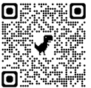
https://tossaspeak.web.app

