Slide 1
Analysis and Implementation of Decipherments of Key Logger
Guided by: Ms. Nalini V Submitted by:
Honnoor Ali 1BM20IS406
G Pramod Sai 1BM18IS070

Slide 2
Abstract
Software keyloggers are very famous tool which are often used to harvest confidential information.
One of the main reasons for this rapid growth of keyloggers is the possibility for unprivileged programs running in user space to eavesdrop and monitor all the keystrokes typed by the users of a system.
A keylogger is a program that record all key stick entered on the keyboard, in another word key loggers are the sort of the spywares that take the information of the clients by following their keyboards.
The primary work of this program is that they will catch the keystrokes squeezed by the client and store them in a log file.

Slide 3
INTRODUCTION
Keyloggers are implanted on a machine to intentionally monitor the user activity by logging keystrokes and eventually delivering them to a third party.
While they are seldom used for legitimate purposes (e.g., surveillance/parental monitoring infrastructures), keyloggers are often maliciously exploited by attackers to steal confidential information.

Slide 4
Literature Survey
Yousuf Al-Hammadi and Uwe Aickelin et al[1] “Detecting bots based on key logging activities”.
Anita at el. (2). “Detecting keyloggers based on traffic analysis with periodic Behavior.”
J. Fu at el. (3). “Detecting Software Keyloggers with Dendritic Cell Algorithm.”
Aslam at el. (4). “ Anti-Hook Shield against the Software Key Loggers”.
Le at el. (5). “Detecting Kernel Level Keyloggers Through Dynamic Taint Analysis”
Stefano at el.(6). “KLIMAX: Profiling Memory Write Patterns to Detect Keystroke-Harvesting Malware.”
Manan Kalpesh Shah at el. (7). “Real Time Working of Keylogger Malware Analysis”.
Martin Vuagnoux at el.(8). “Compromising electromagnetic emanations of wired and wireless keyboards”.
Fu, Jun, Yiwen Liang at el.(9). "Detecting software keyloggers with dendritic cell algorithm."
A. Davis at el.(10), "Hardware keylogger Detection”

Slide 5
Literature Survey
1
Paper Title & Author Names
2
Challenges
3
Implemented Approach
Yousuf Al-Hammadi and Uwe Aickelin et al[1] “Detecting bots based on key logging activities”.
Different works deal with the detection of key loggers.
The simplest approach is to rely on signatures.
Many commercial anti-malware adopt this strategy as detection routine.
Defences Against Keyloggers.
One popular technique that deals with malware in general is taint analysis.
The role of the injector is to inject the input stream into the system, mimicking the behaviour of a simulated user at the keyboard.

Slide 6
Literature Survey
1
Paper Title & Author Names
2
Challenges
3
Implemented Approach
Aslam at el. (4). “ Anti-Hook Shield against the Software Key Loggers”.
Although, hook is the core of keyloggers. So this paper presents anti-hook technique to scan all processes and static executables and DLLs.
Can easily found all suspicious processes or files, whether it is visible or invisible at any level of the application
This technique requires a lot of computation and the false positive rate is very high

Slide 7
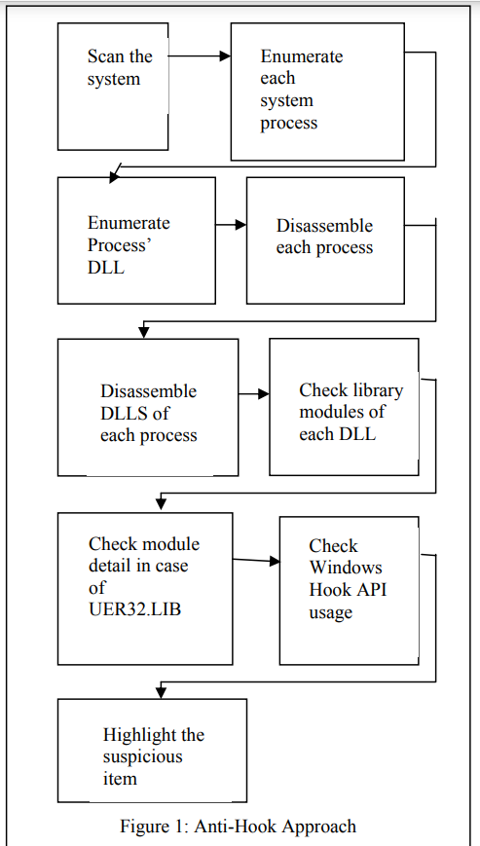

Slide 8
Literature Survey
1
Paper Title & Author Names
2
Challenges
3
Implemented Approach
Le at el. (5). “Detecting Kernel Level Keyloggers Through Dynamic Taint Analysis”
Host-based intrusion detection and dynamic taint analysis to detect kernel level keyloggers.
Integration with VMscope techniques is necessary
Framework can detect kernel level keylogging that intercept keyboard driver, particularly tty buffer and identify their root causes.

Slide 9
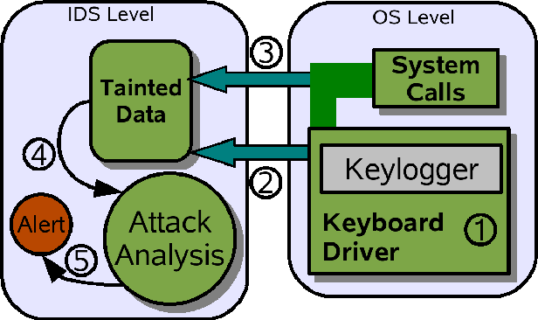
Keyloggers as invisible keystroke recorders have posed a serious threat to user privacy and security. It is difficult to detect keyloggers, especially kernel keyloggers that operate at the operating system’s kernel level, because of their inconspicuous activities and flexible interception methods.

Slide 10
Literature Survey
1
Paper Title & Author Names
2
Challenges
3
Implemented Approach
Manan Kalpesh Shah at el. (7).
“Real Time Working of Keylogger Malware Analysis “.
In the world with increasing technology the safety should also increase. The effect of malware is getting worse, studies say.
Your machine will also search for behaviors that may indicate the existence of new, unidentified malware.
We concentrate on a specific form of malware, keyloggers.

Slide 11
Literature Survey
1
Paper Title & Author Names
2
Challenges
3
Implemented Approach
Fu, Jun, Yiwen Liang at el(9). "Detecting software keyloggers with dendritic cell algorithm."
Dendritic Cell Algorithm implement a hook program to monitor API calls generated by running processes In the host and five signals to define the state of the system.
Data captured include passwords, user ID’s, document contents and other critical information; therefore, an attacker can obtain sensitive data without cracking database or file server.

Slide 12
CONCLUSION
Keyloggers are powerful tools that cannot threat the system itself, but the user’s confidential data such as user name, password, pin and card bank. Although some keylogger are applied as legitimate way, but many keyloggers are used illegally by the creator. Detecting keylogging technology within the organization is no different than controlling other malicious threats, requiring common awareness, regularly monitoring and a layered defence.

Slide 13
REFERENCE
[1] Yousuf Al-Hammadi and Uwe Aickelin. Detecting bots based on key logging activities. In Proceedings of the 2008 Third International Conference on Availability.
[2] M. Aslam, R.N. Idrees, M.M. Baig, and M.A. Arshad. Anti-Hook Shield against the Software Key Loggers.
[3] Martin Vuagnoux and Sylvain Pasini. Compromising electromagnetic emanations of wired and wireless keyboards.
[4] Mihai Christodorescu and Somesh Jha. Testing malware detectors.
[5] Manuel Egele, Theodoor Scholte, Engin Kirda, and Christopher Kruegel. A survey on automated dynamic malware-
analysis techniques and tools.
[6] Andrea Lanzi, Davide Balzarotti, Christopher Kruegel, Mihai Christodorescu, and Engin Kirda. Accessminer: using system-centric models for malware protection. [7] Kaspersky Lab. Key loggers: How they work and how to detect them. [8] Engin Kirda, Christopher Kruegel, Greg Banks, Giovanni Vigna, and Richard A. [9] Anthony Cozzie, Frank Stratton, Hui Xue, and Samuel T. King. Digging for data structures. [10] Security Technology Ltd. testing and reviews of key loggers, monitoring products and spy software.

