Slide 1
Biology
BIFX 550
BMS 501
Computer
Science
BMS 530
Bioinformatics
BIFX 504
BMS 552
BIFX 545
BIFX 552
BIFX 553
BIFX 547
BIFX 572
BIFX 579
CSIT 512
CSIT 530
CS 570
Math &
Statistics
BIFX 546
GBIO 505

Slide 2
Domain-Specific Coursework
Biology
Cross-Domain
Coursework
Advanced Interdisciplinary Coursework
Computer
Science
Bioinformatics
Math &
Statistics

Slide 3
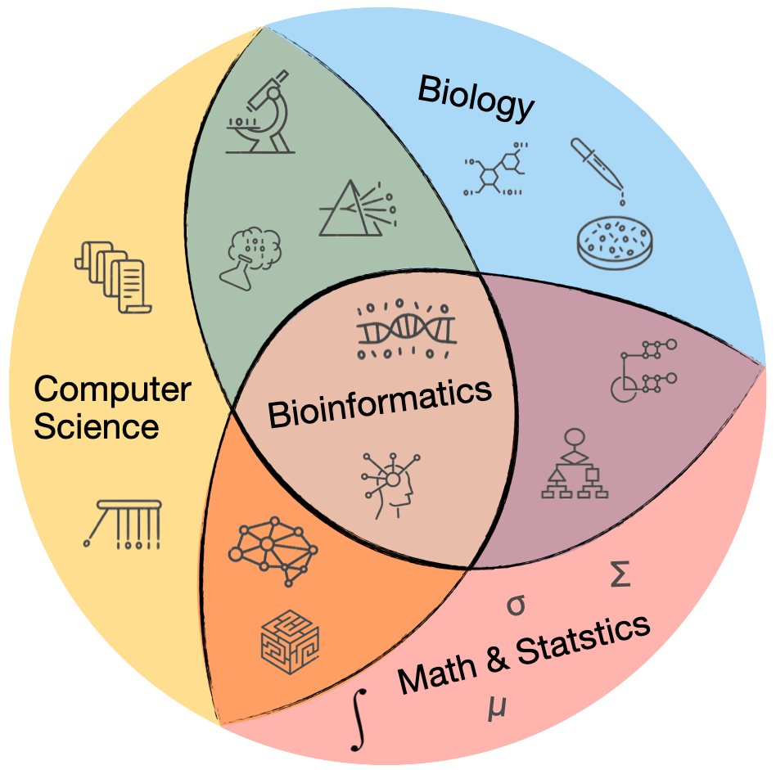
Foundations
Life Sciences (BMS 501)
Computer Sciences (CSIT 512)
BIFX 550
BMS 501
Required
Intro Classes
  Biostats (BIFX 503)
  Molecular Biology (BIFX 504)
  Reproducible Research (BIFX 545)
  Functional Genomics (BIFX 550)
  Programming for BIFX (BIFX 551)
Advanced Classes
  BIFX Data Skills (BIFX 552)
  Applied Data Science (BIFX 553)
  Capstone or Thesis
CSIT 512
BIFX 572
BIFX 546
BIFX 504
BIFX 552
BIFX 553
IT 530
BIFX 545
BIFX 547
BIFX 551
Electives
Machine Learning (BIFX 546)
AI and Web-based BIFX (BIFX 547)
Genomics Practicum (BIFX 572)
Database Systems (IT 530)
BIFX 503

