Slide 1
ViT Transformers for Image Recognition at scale

Slide 2
목차
1. Introduction
Backgrounds
Related works
2. What is ViT?
Concept of ViT
Architecture with Equations
3. Results
Datasets
Graphs

Slide 3
Introduction
Related Works : Naïve application of self attention
: cost too much (quadratic cost)
=> local neighbor
=> scalable approximation(resize / lower resolution)
Our Works :
X all pixel attention
=> “patch” attention”
2*2 (2020)
14*14 / 16*16 increased patch size
Tendency :
Mid – sized dataset : CNN 보다 성능이 조금 부족
하게 나옴
Why? : “ lack some of inductive biases”
BUT in large dataset , ViT out performs.

Slide 4
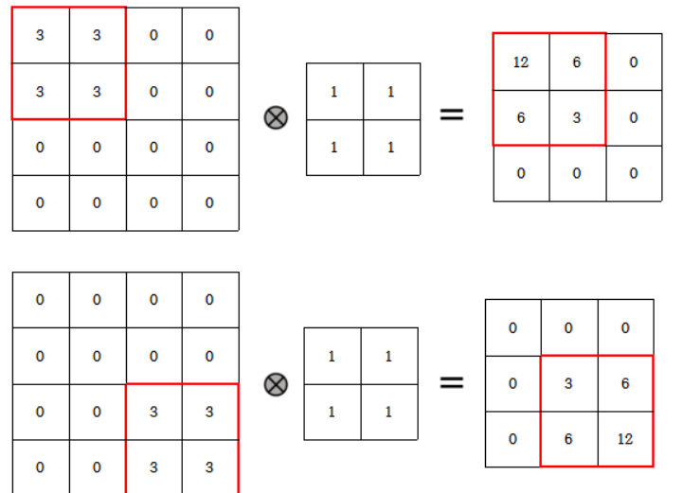
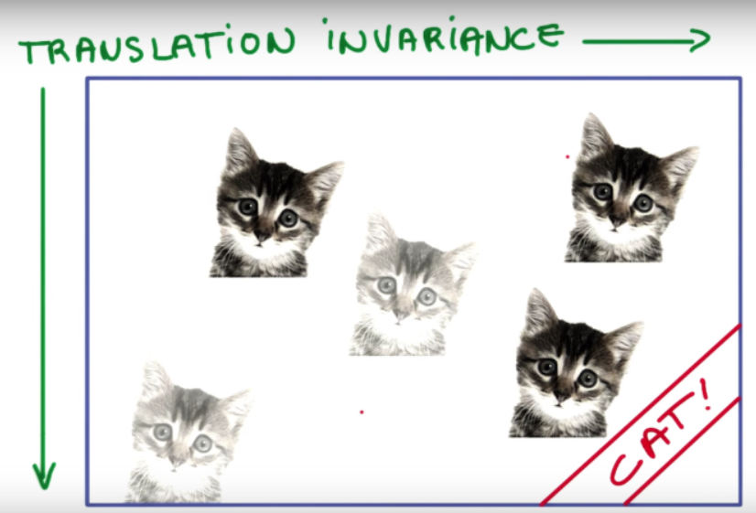
Inductive bias :
모델이 학습하면서 얻는 추론을 위한 가정
ex) CNN – Locality : Kernel의 범위내의 있는 것들은 상관관계가 있을 것이라는 가정(built – in)
- Translation invariance : 특징의 위치가 달라도 값이 같다는 점(input이 달라도 output이 같다.)
Transfer Learning :
특정 분야에서 학습된 신경망의 일부 또는 전부를 유사하거나 전혀 다른 분야에서 사용하는 것.
Fine –Tuning¹ : 미세조정
위의 특정 분야 또는 방대한 데이터를 통해 보편적인 low level feature을 학습시키고, 특정 데이터 학습을 위한,
high level feature을 특정 데이터에 맞게 다시 학습시키는 것.
low level : 윤곽 /선 / 점
high level : 특정한 label 이미지의 특징
Few – Shot :
학습된 모델을 학습하지 않았던 label의 문제를 해결하는 것.
¹⁾To do so, we use small sub-splits from the training set (10% for Pets and Flowers, 2% for CIFAR, 1% ImageNet) as development set and train on the remaining data.

Slide 5
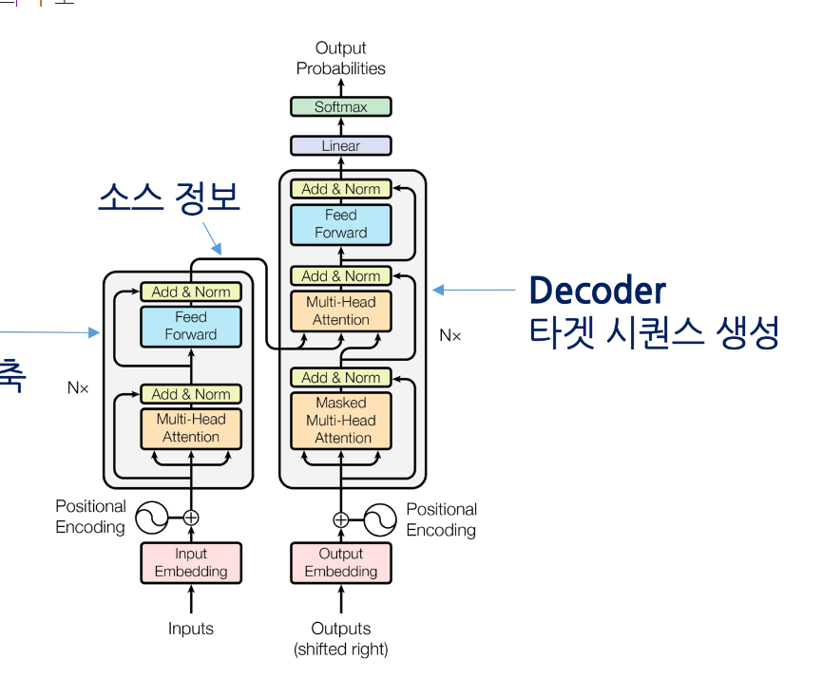
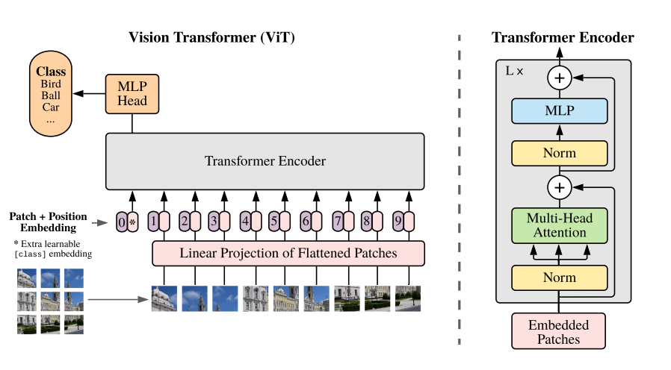
2. What is ViT?

Slide 6
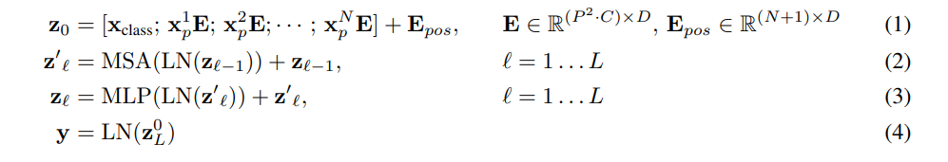
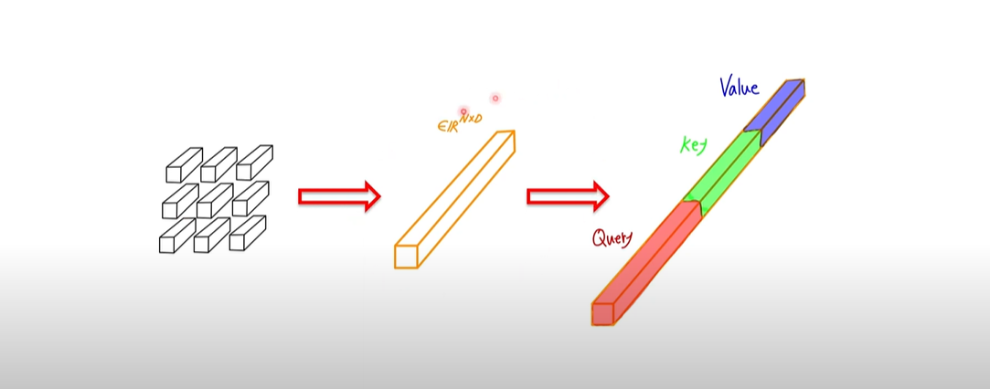

Model structure(1)
Transformer receives as input a 1D sequence
Image : H*W*C : x $ε$ $R^{H∗W∗C}$
2D patches : $x_{p}ε$ $R^{N∗(P^{2}∗c)}$
p : patch number, P : Patch size
↓ Linear Projection
E : “투영 행렬” => $R^{N∗D}$(D차원으로 * patch의 수)
“Trainable Linear Projection”
+ CLS token
+ position embedding

Slide 7
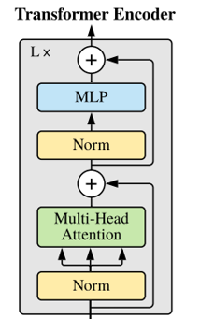
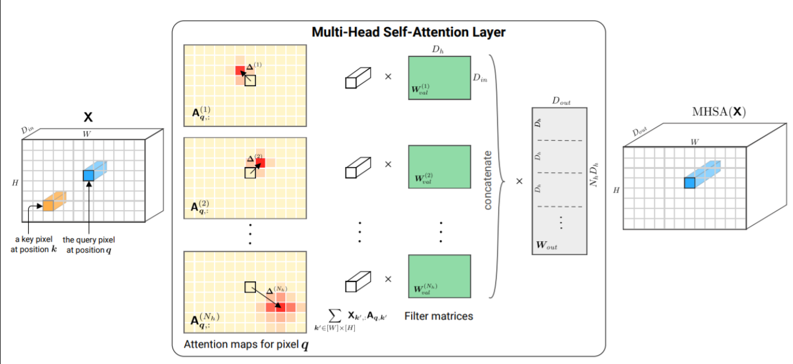
ENCODER / MSA
MSA : Multiheaded self-attention.

Slide 8
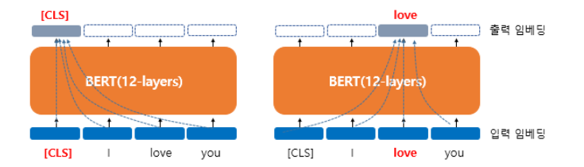
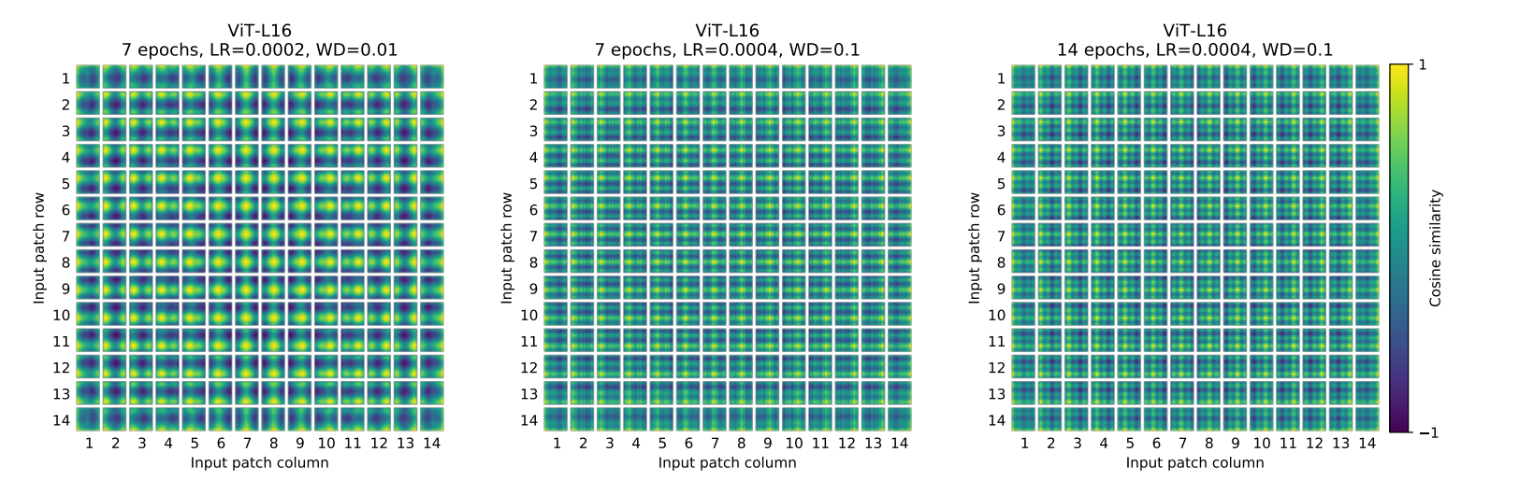
Inductive bias
ViT much less inductive bias
MLP layer 부분만 local &translation equivariance
CNN : locality, neighborhood structure ~ : in layer
All spatial relations between the patches have to be learned from the scratch
$z_{L}^{0}$ L : Layer, 0: position : 마지막 레이어의 첫번째 토큰
CLS token: 정보적으로는 의미가 x
: priority 가 x => sentence의 전체 정보.
Positional embedding : standard learnable positional
embeddings

Slide 9
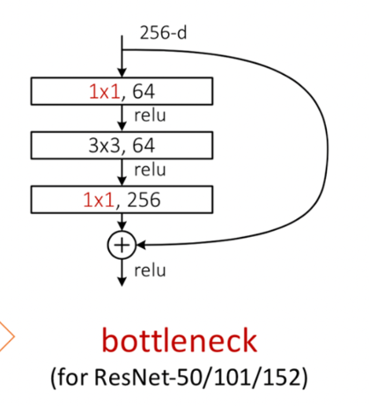
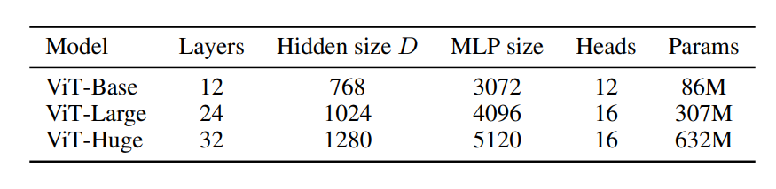
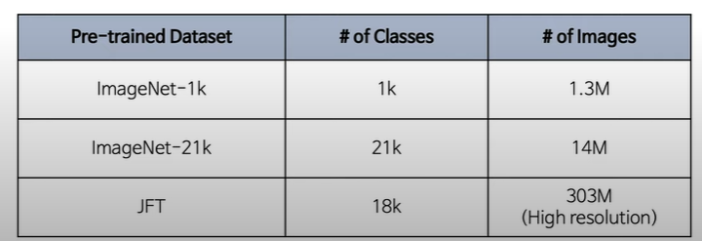
3. Results
Data sets
Image Net , CIFAR , Pets, VTAB
VTAB(low data transfer) :
Three groups : Natural (Pets, CIFAR..) Specialized (Medical, satellite..) , Structured(understanding localization
Models
d
Results : few – shot / fine tuning

Slide 10
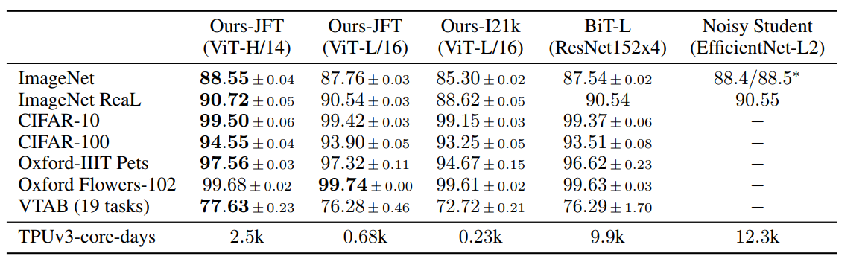
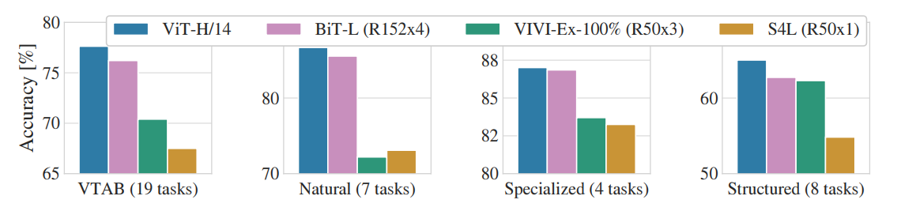
*TPUv3 – core –days : core used * days(training time) / ViT-H/14 : ViT huge model with patch size 14*14
Out performs with lower computation
BiT : Big Transfer model(Resnet)

Slide 11
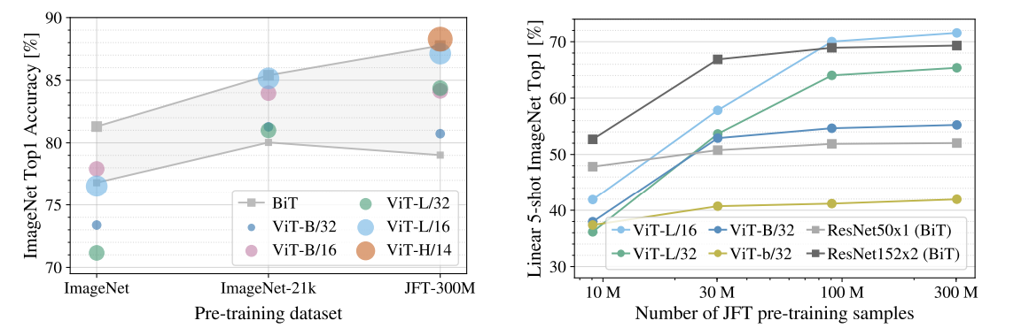
Cruciality of data size
Data size is crucial for creating inductive bias

Slide 12
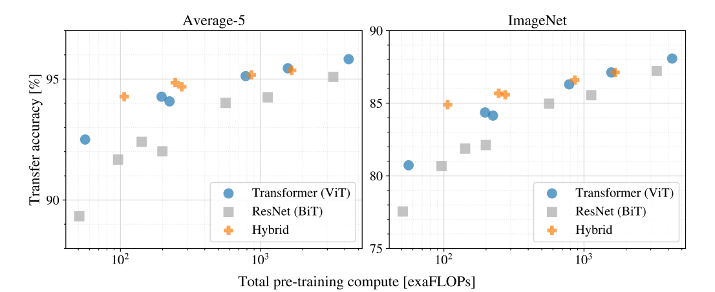
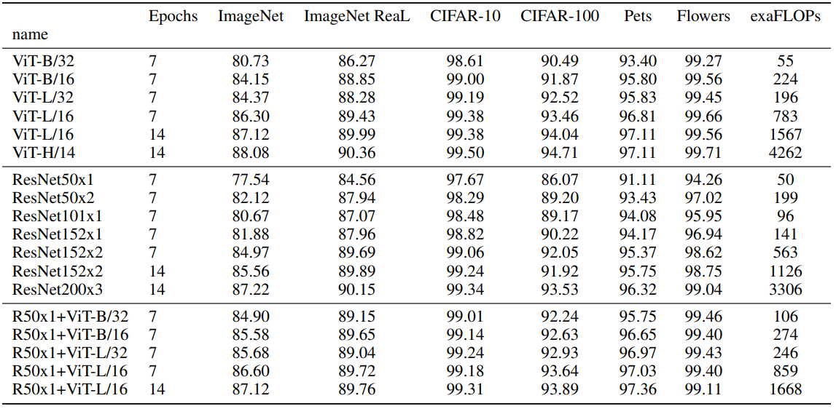
Vision Transformers appear not to saturate within the range tried, motivating future scaling efforts

Slide 13
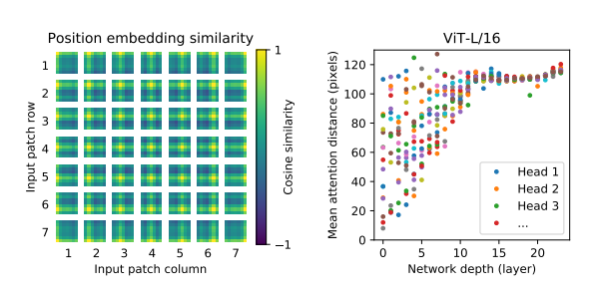
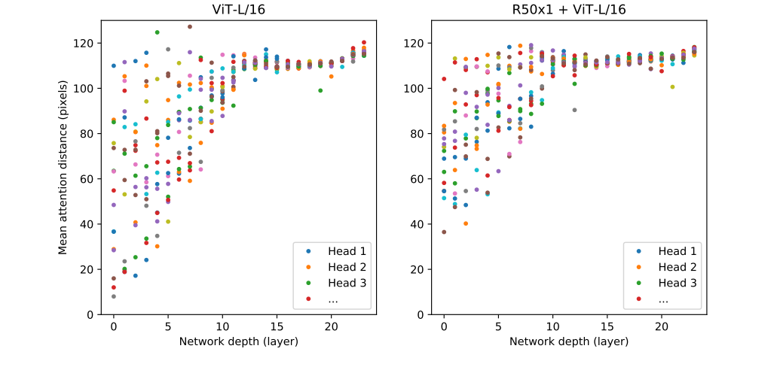
Learnable position embedding -> learned “image” concepts (row, column)
input : sequence of position -> learned relative relations
Self attention allows ViT to integrate even in the lowest layer ~~receptive fields in CNN
초기부터 전체 이미지를 attention을 통해 참조.

