Slide 1
Politifact Text Classification
Mohit Ravi Ghatikar

Slide 2
Overview
Business Understanding
Data Understanding
Data Preparation
Model Building
Evaluation
Conclusion

Slide 3
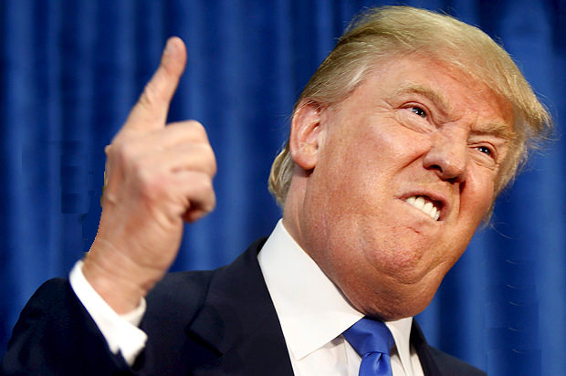

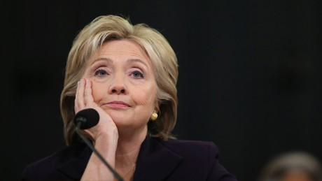
Business Understanding
PolitiFact is a fact-checking website that rates the accuracy of claims by elected officials and others who speak up in American politics.
Our aim is to build a Machine learning model that can detect if a quote said by a politician is True or False.

Slide 4
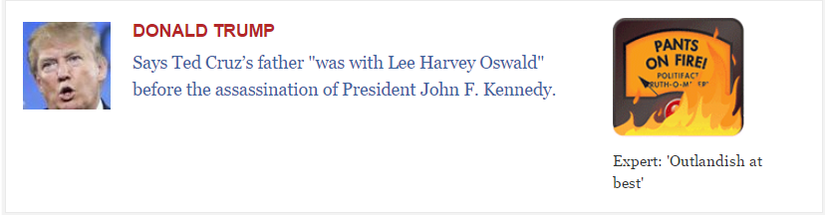
Data Understanding
Data containing the text, the source and the its resulting class was scraped from the Politifact Website.
Data consisted of 3880 records and 3 columns.
The columns are the Person who said the Quote, the actual Quote itself and the veracity of the Quote determined by Politifact.

Slide 5
Data Preparation - 1
The target variable had 7 categories.
The records containing categories – No Flip, Half Flip and Full Flop were removed.
The categories – Half True and Mostly True were discretized into True class.
The categories – Mostly False and Pants on Fire were discretized into False class.

Slide 6
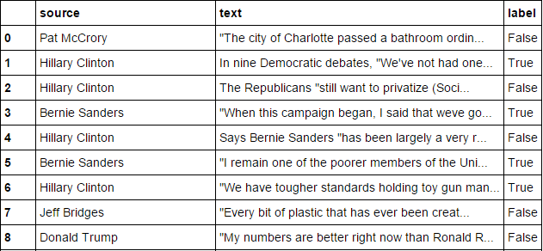
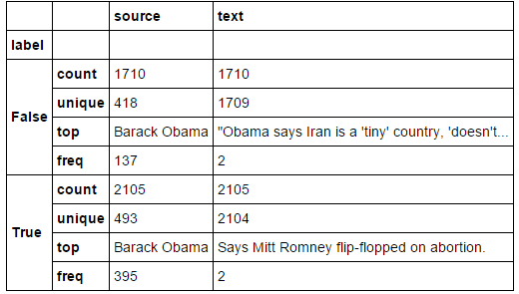
Summary Statistics

Slide 7


Exploratory Data Analysis - 1
Which Politician told the truth most number of times?
Which Politician lies most of the time?
President Barack Obama was the highest in both the categories.

Slide 8
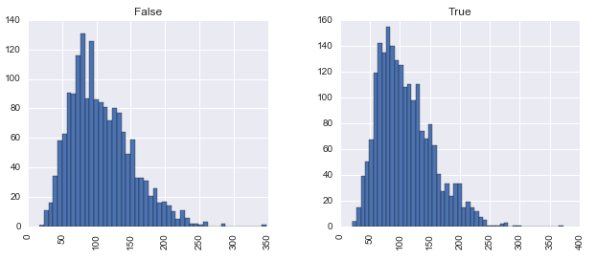
Exploratory Data Analysis - 2
Does the length of the text make any difference in understanding if the statement was true or false?
Apparently they don’t. The frequency distributions for False and True statements seem very similar with a slight right skew.

Slide 9
Data Preparation - 2
Data was cleaned using NLTK package.
Removed Punctuations and Stopwords.
Converted the text into vectors using a bag of words model.
The resulting text was Normalized using TF-IDF.

Slide 10
Model Building
Classification Algorithms used:
Naïve Bayes
Logistic Regression
CART
KNN
Support vector machines
Random Forest

Slide 11
Model Building - 1
Dataset was split into Training and Test (70-30).
At first the model was trained only on the text without including the name of the person who said the Quote.
Evaluation metrics chosen were Accuracy score and AUC value.

Slide 12
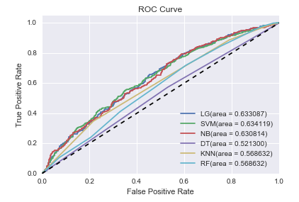
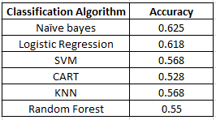
Model Building - 1
Naïve Bayes gives the highest accuracy score of 62.5%
SVM gives the highest AUC value of 0.634

Slide 13
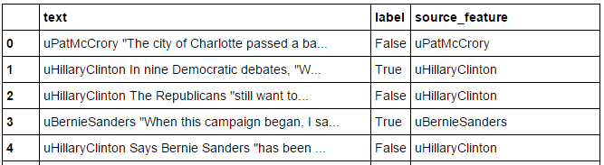
Model Building - 2
To improve the accuracy score, we tried including the source as a feature.
This was done by adding a letter ‘u’ in front of the name.
The model was built again using the same classification algorithms.

Slide 14
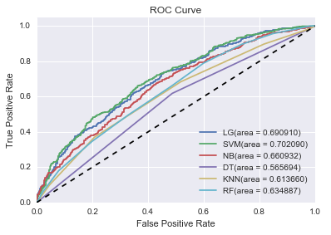
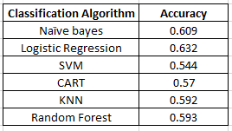
Model Building - 2
Logistic Regression gives the highest accuracy score of 63.2%
SVM gives the highest AUC value of 0.702

Slide 15
Conclusion
Adding the source as a feature improved the model.
Logistic Regression gave the best accuracy rate of 63.2%.
Tree based models and Ensemble methods did not give good results.
The model can be further improved by adding the date of the Quote as a feature.

