Slide 1
芯片软件CI/CD大数据分析与状态监测

Slide 2
Agenda
团队介绍
创新项目概述及演示
创新的价值

Slide 3
团队介绍
余楚志 - Fly (队长)
资深嵌入式软件测试工程师，在欧美企业从事嵌入式软件开发7年，拥有丰富的CI/CD自动化测试项目经验。精通Python，Ruby，Perl，C，C#，Java等编程语言，熟练设计自动化测试案例和优化自动化框架。
袁彬 - Bill
资深嵌入式软件测试工程师，在欧美企业从事嵌入式软件开发14年，目前担任软件测试经理，熟悉嵌入式ARM架构，精通Python，Ruby，C，C#，Java等编程语言。对嵌入式软件CI/CD和自动化测试有透彻的理解，特别是多任务大数据的自动化测试方案上设计和实施有诸多建树。
郭辉 - Haley
高级嵌入式软件测试工程师，在欧美企业从事嵌入式软件开发5年，目前任自动化测试框架架构师，精通Python，Ruby，C，C#，Java，Java Script等编程语言。对嵌入式软件CI/CD自动化测试有深入的研究，特别是在分布式并行化的自动化测试方案上设计和实施有诸多建树

Slide 4




项目背景 MCUXpresso SDK
Main Features
Application Code
Real-time operation systems (RTOS) kernels pre-integrated: Azure® RTOS ThreadX and FreeRTOS™
Enabling software technologies (stacks and middleware) from NXP and partners including:
Graphics and HMI
Audio and voice processing
Cloud connectivity
Motor control
Security
Storage
eIQ Machine Learning
Wireless and wired connectivity
Functional safety
Software examples demonstrating the usage of peripheral drivers, RTOS wrapper drivers, middleware and RTOSes
Free to use Azure RTOS middleware on select platforms, including USBX, GUIX, FileX, LevelX and NetX Duo
Also available as CMSIS Device Family Pack
Stacks /
Middleware
Board Support
RTOS
Peripheral Drivers
CMSIS-CORE and CMSIS-DSP
Microcontroller Hardware

Slide 5
NXP MCU Products
Series | Wireless Connectivity | DSC Series | LPC Series | Kinetis Series | K32 L Series | LPC5500 Series | i.MX RT Crossover MCUs
Description | Wireless of 802.15.4 (Zigbee/Thread), BLE | Combines the best features of microcontrollers (MCU) and powerful digital signal processing (DSP) capabilities in one single chip. | MCU for broad market | MCUs offer optimized performance, scalable integration and low-power capabilities | Optimized for low-leakage applications | Balanced integration, performance and cost with embedded memory | High performance and memory extensibility
Families | KW, QN, JN | 56F8xxxx, 56800E, 56800 | LPC800, LPC1100, LPC1700, LPC52000, LPC53000 LPC54000 | K, KM, KV, KE, KL | K32 L3, K32 L2 | LPC550x/S0x, LPC550x/S0x, LPC552x/S2x, LPC55S6x, LPC553x/S3x | IMXRTxxxx, IMXRTxxx
Architecture | Arm Cortex-M4 | 32-bit DSC Core, 16-bit 56800E DSC core | Cortex-M7/M4/M3/M0+ | Cortex-M4/M0 | ARM Cortex-M4, Cortex-M0 | Cortex-M33 | Cortex-M7 Cortex-M33

Slide 6
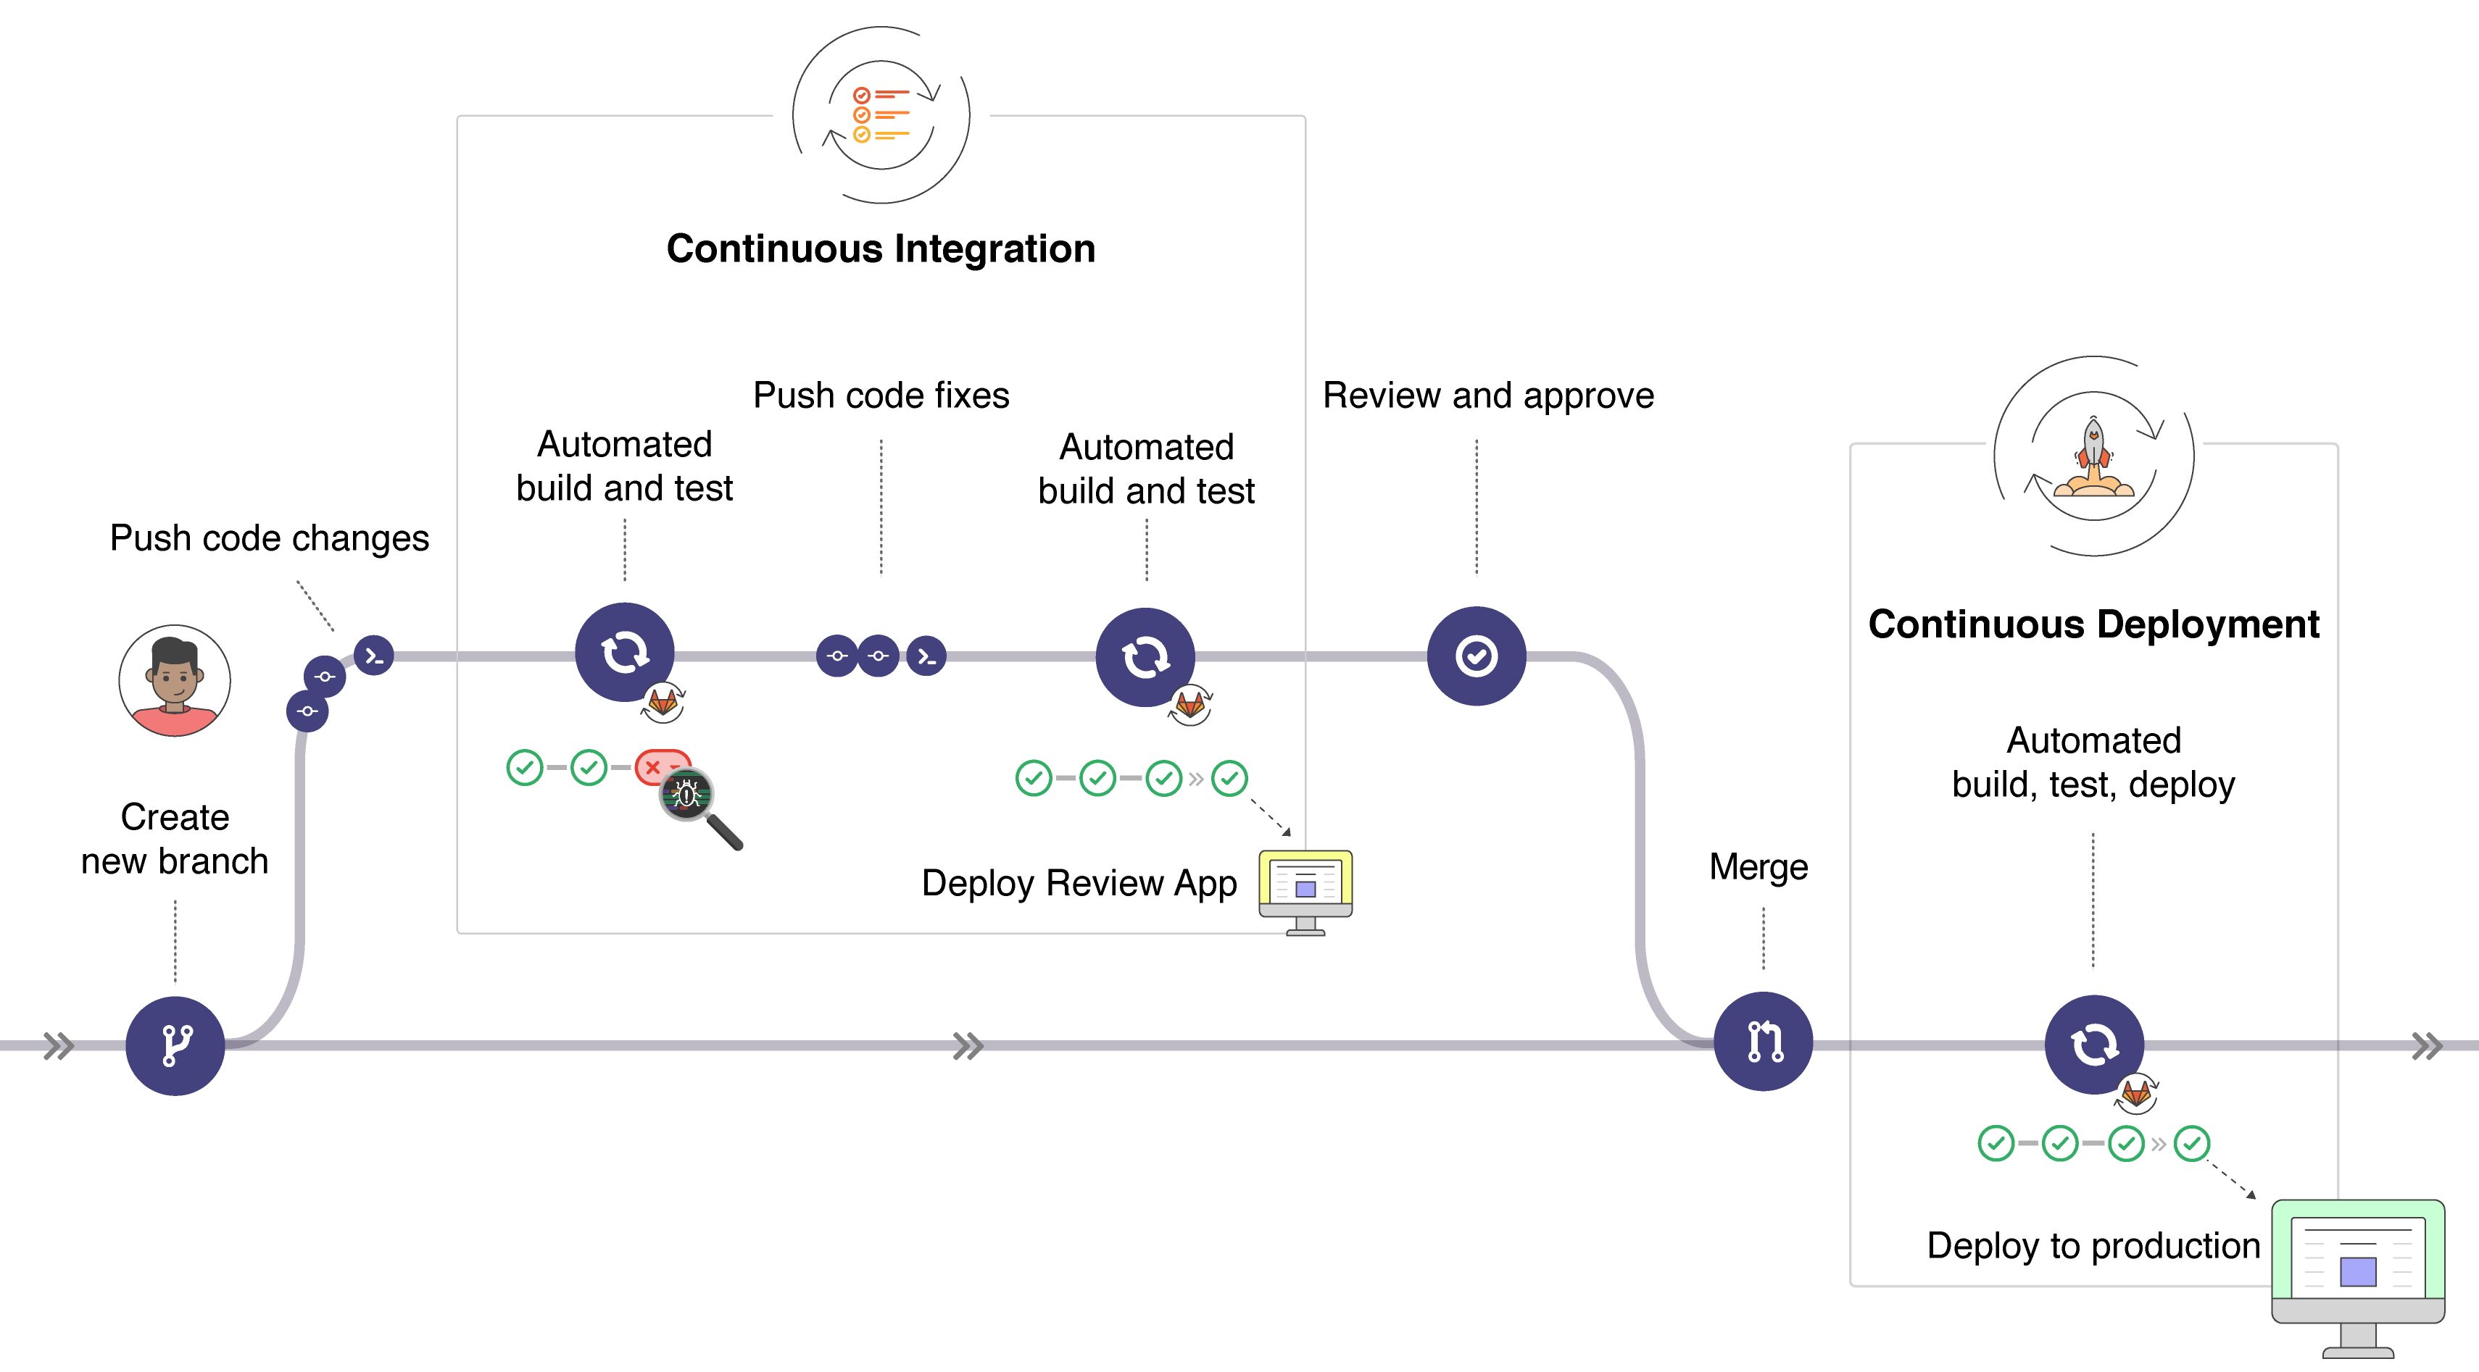
项目背景 SDK CI/CD
项目背景：
日益增长的SDK 编译数量，往往需要投入巨大的人力去分析和跟踪Daily CI编译结果。
历史数据分析？
Bug 追踪？
整体的SDK quality，决策与优化？
开发效率，交付效率？

Slide 7
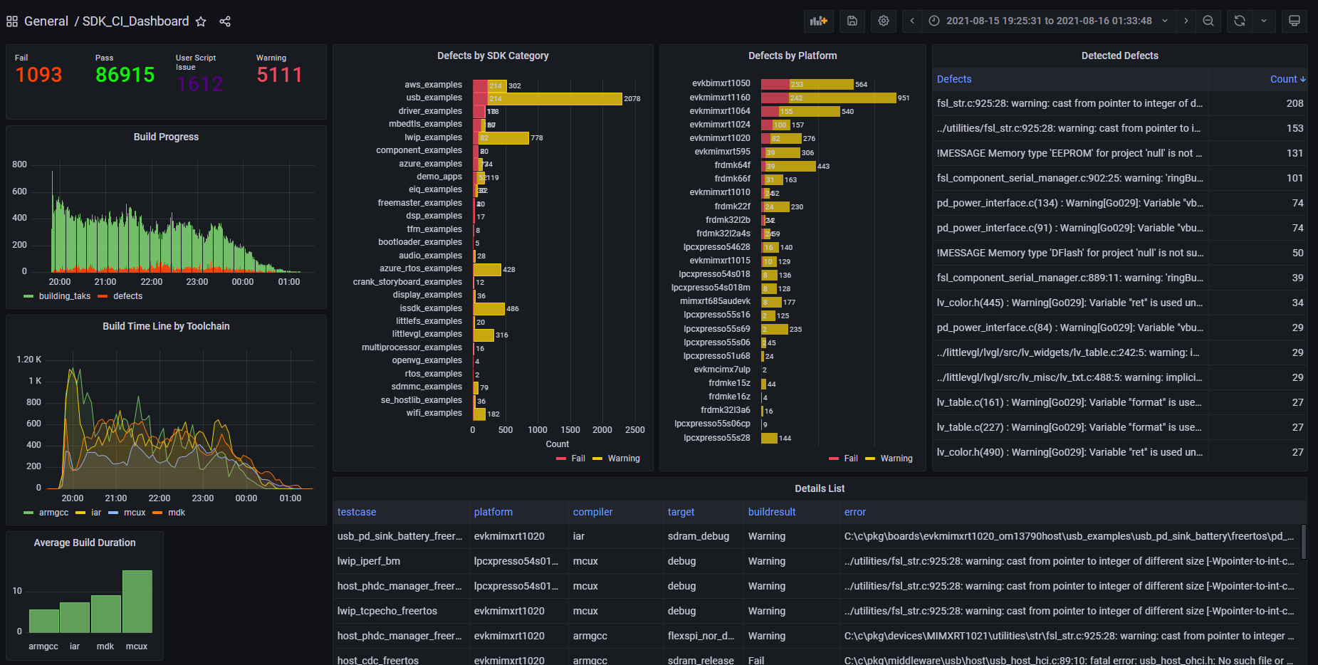


Architecture
项目主页： Hoohaha/FlinkDemo
CI build workers
Build Machine
Pravega
LOG_STREAM
Log collection
Flink Job
Analysis & detect defects by AI Module
Build Machine
Filebeat
Logstash
Build Machine
Parse & Transform
Build Machine
Mysql
Data Visualization

Slide 8
Log Collection & Tranform
arm-none-eabi-gcc -std=gnu99 -DCPU_MIMXRT1064DVL6A -DCPU_MIMXRT1064DVL6A_cm7 -DSDK_DEBUGCONSOLE=1 -DPRINTF_FLOAT_ENABLE=0 -DSCANF_FLOAT_ENABLE=0 -DSCANF_ADVANCED_ENABLE=0 -DXIP_EXTERNAL_FLASH=1 -DXIP_BOOT_HEADER_ENABLE=1 -DSDK_I2C_BASED_COMPONENT_USED=1 -DCR_INTEGER_PRINTF -DPRINTF_ADVANCED_ENABLE=0 -D__MCUXPRESSO -D__USE_CMSIS -DDEBUG -D__REDLIB__ -I../board -I../source -I../ -I../drivers -I../device -I../CMSIS -I../accel -I../utilities -I../component/serial_manager -I../component/uart -I../component/lists -I../xip -O0 -fno-common -g3 -Wall -c -ffunction-sections -fdata-sections -ffreestanding -fno-builtin -mcpu=cortex-m7 -mfpu=fpv5-d16 -mfloat-abi=hard -mthumb -D__REDLIB__ -specs=redlib.specs -MMD -MP -MF"utilities/fsl_assert.d" -MT"utilities/fsl_assert.o" -MT"utilities/fsl_assert.d" -o "utilities/fsl_assert.o" "../utilities/fsl_assert.c"
arm-none-eabi-gcc -std=gnu99 -DCPU_MIMXRT1064DVL6A -DCPU_MIMXRT1064DVL6A_cm7 -DSDK_DEBUGCONSOLE=1 -DPRINTF_FLOAT_ENABLE=0 -DSCANF_FLOAT_ENABLE=0 -DSCANF_ADVANCED_ENABLE=0 -DXIP_EXTERNAL_FLASH=1 -DXIP_BOOT_HEADER_ENABLE=1 -DSDK_I2C_BASED_COMPONENT_USED=1 -DCR_INTEGER_PRINTF -DPRINTF_ADVANCED_ENABLE=0 -D__MCUXPRESSO -D__USE_CMSIS -DDEBUG -D__REDLIB__ -I../board -I../source -I../ -I../drivers -I../device -I../CMSIS -I../accel -I../utilities -I../component/serial_manager -I../component/uart -I../component/lists -I../xip -O0 -fno-common -g3 -Wall -c -ffunction-sections -fdata-sections -ffreestanding -fno-builtin -mcpu=cortex-m7 -mfpu=fpv5-d16 -mfloat-abi=hard -mthumb -D__REDLIB__ -specs=redlib.specs -MMD -MP -MF"xip/evkmimxrt1064_flexspi_nor_config.d" -MT"xip/evkmimxrt1064_flexspi_nor_config.o" -MT"xip/evkmimxrt1064_flexspi_nor_config.d" -o "xip/evkmimxrt1064_flexspi_nor_config.o" "../xip/evkmimxrt1064_flexspi_nor_config.c"
arm-none-eabi-gcc -std=gnu99 -DCPU_MIMXRT1064DVL6A -DCPU_MIMXRT1064DVL6A_cm7 -DSDK_DEBUGCONSOLE=1 -DPRINTF_FLOAT_ENABLE=0 -DSCANF_FLOAT_ENABLE=0 -DSCANF_ADVANCED_ENABLE=0 -DXIP_EXTERNAL_FLASH=1 -DXIP_BOOT_HEADER_ENABLE=1 -DSDK_I2C_BASED_COMPONENT_USED=1 -DCR_INTEGER_PRINTF -DPRINTF_ADVANCED_ENABLE=0 -D__MCUXPRESSO -D__USE_CMSIS -DDEBUG -D__REDLIB__ -I../board -I../source -I../ -I../drivers -I../device -I../CMSIS -I../accel -I../utilities -I../component/serial_manager -I../component/uart -I../component/lists -I../xip -O0 -fno-common -g3 -Wall -c -ffunction-sections -fdata-sections -ffreestanding -fno-builtin -mcpu=cortex-m7 -mfpu=fpv5-d16 -mfloat-abi=hard -mthumb -D__REDLIB__ -specs=redlib.specs -MMD -MP -MF"xip/fsl_flexspi_nor_boot.d" -MT"xip/fsl_flexspi_nor_boot.o" -MT"xip/fsl_flexspi_nor_boot.d" -o "xip/fsl_flexspi_nor_boot.o" "../xip/fsl_flexspi_nor_boot.c"
Finished building: ../xip/evkmimxrt1064_sdram_ini_dcd.c
In file included from ../xip/fsl_flexspi_nor_boot.c:8:0:
../xip/fsl_flexspi_nor_boot.h:12:10: fatal error: board.h: No such file or directory
#include "board.h"
compilation terminated.
Building file: ../utilities/fsl_debug_console.c
make: *** [xip/subdir.mk:24: xip/fsl_flexspi_nor_boot.o] Error 1
make: *** Waiting for unfinished jobs....
Invoking: MCU C Compiler
arm-none-eabi-gcc -std=gnu99 -DCPU_MIMXRT1064DVL6A -DCPU_MIMXRT1064DVL6A_cm7 -DSDK_DEBUGCONSOLE=1 -DPRINTF_FLOAT_ENABLE=0 -DSCANF_FLOAT_ENABLE=0 -DSCANF_ADVANCED_ENABLE=0 -DXIP_EXTERNAL_FLASH=1 -DXIP_BOOT_HEADER_ENABLE=1 -DSDK_I2C_BASED_COMPONENT_USED=1 -DCR_INTEGER_PRINTF -DPRINTF_ADVANCED_ENABLE=0 -D__MCUXPRESSO -D__USE_CMSIS -DDEBUG -D__REDLIB__ -I../board -I../source -I../ -I../drivers -I../device -I../CMSIS -I../accel -I../utilities -I../component/serial_manager -I../component/uart -I../component/lists -I../xip -O0 -fno-common -g3 -Wall -c -ffunction-sections -fdata-sections -ffreestanding -fno-builtin -mcpu=cortex-m7 -mfpu=fpv5-d16 -mfloat-abi=hard -mthumb -D__REDLIB__ -specs=redlib.specs -MMD -MP -MF"utilities/fsl_debug_console.d" -MT"utilities/fsl_debug_console.o" -MT"utilities/fsl_debug_console.d" -o "utilities/fsl_debug_console.o" "../utilities/fsl_debug_console.c"
Finished building: ../utilities/fsl_assert.c
Finished building: ../xip/evkmimxrt1064_flexspi_nor_config.c
Finished building: ../utilities/fsl_debug_console.c
20:05:26 Build Finished (took 532ms)
Fields | Description
task_id | Main Task ID
task_hash | Unique Hash for Task
log_type | Station log or IDE log
message | Log messgae
event_time | Event Timestamp

Slide 9
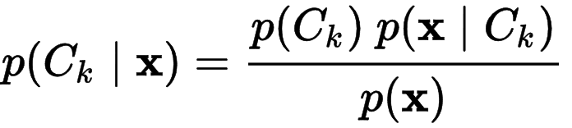
AI Module: Naive Bayes
Advantages
It’s relatively simple to understand and build
It’s easily trained, even with a small dataset
It’s fast!
It’s not sensitive to irrelevant features
Disadvantages
It assumes every feature is independent, which isn’t always the case
Classification
Training workflow
likelihood
Class prior probability
Naive Bayes Classifier
Probability Confidence
Input Text
Training Data Set
Extract Features
Classifier
(Training)
Classifier Module
Posterior Probability
Predictor Prior Probability
Features Extraction:
Words, and weighting of words
Negative words.
Frequently phrases.
Applications of Naive Bayes Algorithms
Text classification
Spam Filtering
Sentiment Analysis
Recommendation System
Pre-processing: remove stop words, punctuation, and other invalid characters..
tokenize
words,
weighting words
Feature set

Slide 10
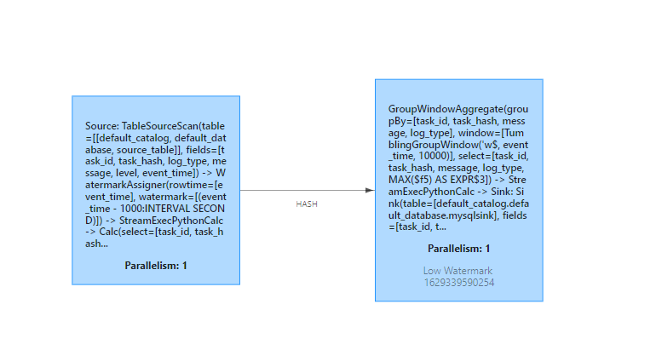
Flink Job
Pravega Table
AI inference
MySQL Table

Slide 11
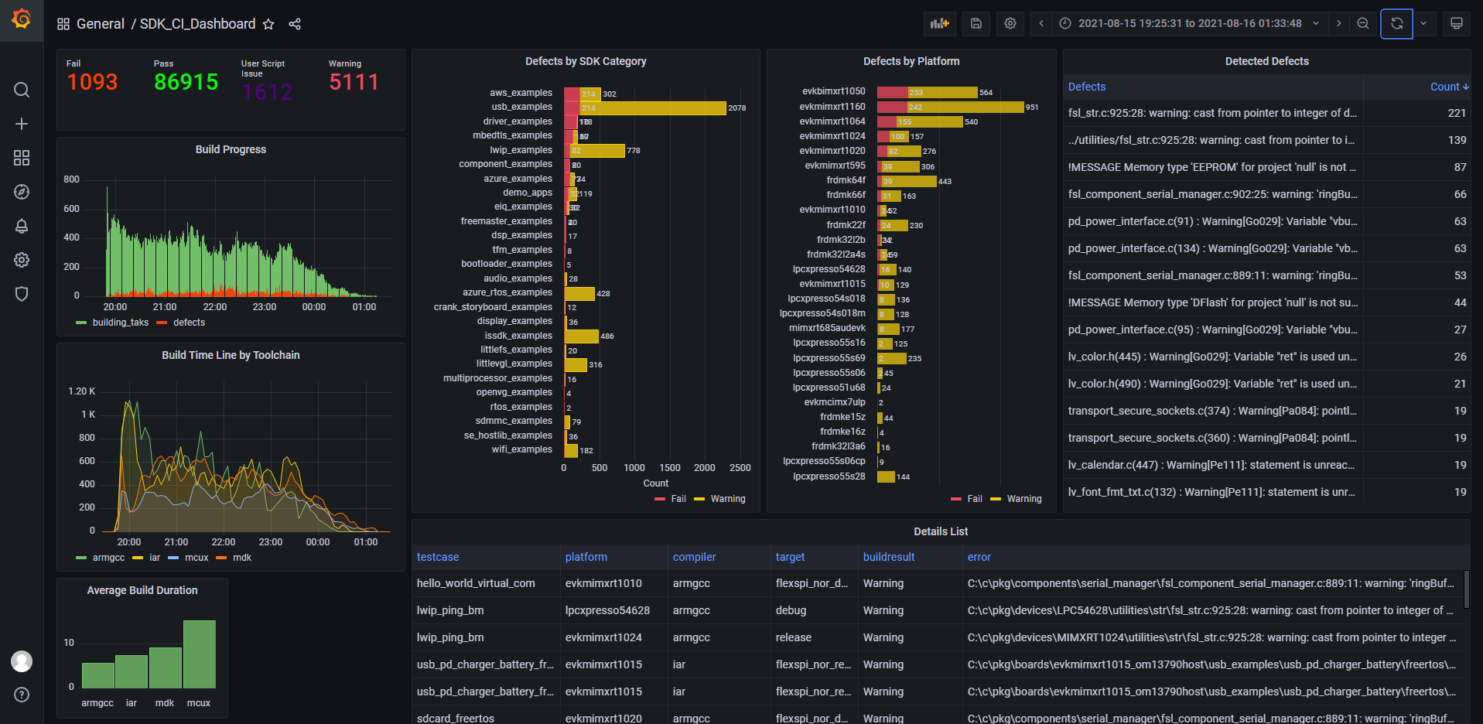
项目演示

Slide 12
Future works
AI 模型的改进，选用CNN or RNN，让结果更加精确；
加入自动化的AI训练和测试，Zion规划完成迭代升级；
使用Pravega 替代Message Queue 实现Live Log, 改进用户的体验；

Slide 13
创新项目的价值
基于贝叶斯算法的AI可以对原始不规则日志进行实时清洗和筛查，解决了如何对嵌入式编译日志错误进行筛查的难点；
实时数据分析和实时可视化呈现，极大的提高了CI结果的分析效率，从而促进了SDK的开发以及迭代效率，减少了整个SDK的开发和测试成本；并且数据对于改进SDK的开发的流程以及优化CI系统提供了可靠的依据；
Pravega 和 Flink 都具有高可用和易于扩展的特性，在实际落地过程中，可以根据实际情况进行适配；并且本项目基于docker容器开发，非常方便测试和部署，极大的简化了落地成本；

Slide 14
Thank You

