Slide 2
Phylogeny project
Introduction to bioinformatics
Group 9: Ditte Jacobs, Michal Jarski, Jakob Siljebo

Slide 3
Are Salamanders more closely related to frogs or lizards?
Salamanders
Frogs
Lizards
Outgroup: Fish

Slide 4
Maximum Parsimony - 16S
-> Lizards

Slide 5
Maximum Parsimony - cytB
-> Frogs

Slide 6
Neighbour joining – 16S
-> Frog

Slide 7
Neighbour joining – cytB
-> Frogs

Slide 8
Maximum likelihood – 16S
-> Frogs

Slide 9
Maximum likelihood - cytB
-> Lizards

Slide 10
Bayesian MCMC – 16S
-> Frogs

Slide 11
Bayesian MCMC – cytB
-> Lizards

Slide 12
Bayesian MCMC – 16S
-> Frogs

Slide 13
Bayesian MCMC - CytB
-> Lizards

Slide 14
Why do the results differ?
Assumptions
Algorithms: evolutionary model vs. Distance matrix vs. Bayesian MCMC

Slide 15
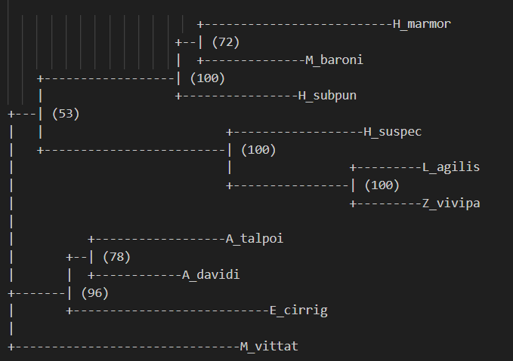
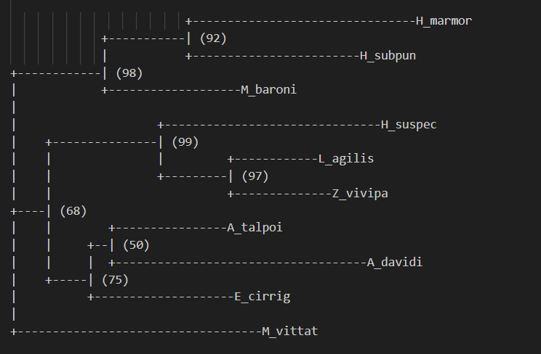
Which trees are most supported? What does the bootstrap analysis tell?
16S
cytB
Notes:
15

Slide 16
Substitution models different? No, TIM2+F+I+G4
16S
cytB
Notes:
Yes
16

Slide 17
Was the choice of species appropriate?
Yes
Frogs, lizards, and salamanders always clustered together
Outgroup was ok

