Slide 1
Pentominoes: Phase 1
Group #25

Slide 2
Group members and roles
Rene Steeman: Editor(joint)
Samuele Torregrossa
Ali Alsaeedi: Presentation coordinator
Lindalee Conradie: Editor(joint)
Max Persoon: General assistant
Michal Jarski: Product coordinator
Drago Stoyanov: Project leader

Slide 3
Choosing parameters
we are using gui, graphic user interface, to give the user the full freedom to choose the parameters
Insert picture here
Choose width of the field.
Choose the height of the field.
Choose the method of approaching the problem(Brute force, Recursion and Algorithm X).
Choose the pieces of pentominoes.

Slide 5
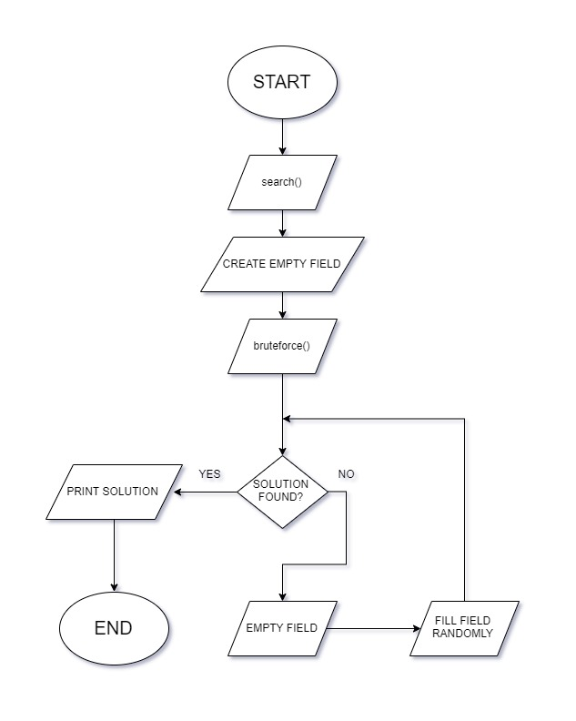
Brute force
(least efficient)
How does it work?
How do we define efficiency?
Why is this the least efficient algorithm ?

Slide 6
Recursion
(More efficient)
How does it work?
It places the first pentominoe in the very top left of the field
It scans for the next empty block(Id=-1), row by row starting from the top to the bottom
Once it finds an empty block, it will place a valid pentominoe in that empty block.
If there is no valid pentominoe it will undo the last decision it made
It will either stop when it has found a solution or when it has gone through all possible combinations and did not find a solution.

Slide 7
Recursion
(More efficient)
Why is it more efficient than brute force?
- It is more efficient because it takes less time due to backtracking.
Brute force is completely random, and it might use the same pattern more than once, while recursion will not go back to a pattern that it has marked as “no solution”.

Slide 8
Algorithm X
(Most efficient)
How does it work?

Slide 9
Algorithm x
(Most efficient)
Why is it more efficient than brute force and recursion?

