Slide 1
Pentominoes: Phase 1
Group #25

Slide 2
Group members and roles
Rene Steeman: Editor(joint)
Samuele Torregrossa: Executive delivery boy
Ali Alsaeedi: Presentation coordinator
Lindalee Conradie: Editor(joint)
Max Persoon: General assistant
Michal Jarski: Product coordinator
Drago Stoyanov: Project leader

Slide 3
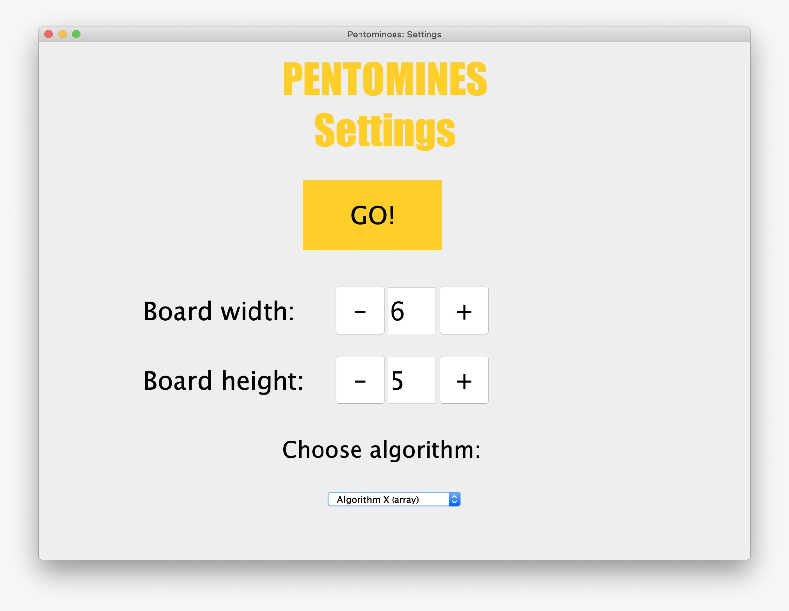
Choosing parameters
we are using gui, graphic user interface, to give the user the full freedom to choose the parameters
Decisions to be made by user:
Choose the width of the field.
Choose the height of the field.
Choose the method of approaching the problem:
Brute force
Algorithm X
Choose the pentominoes to use.

Slide 4
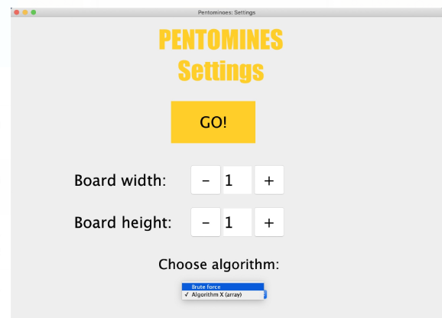
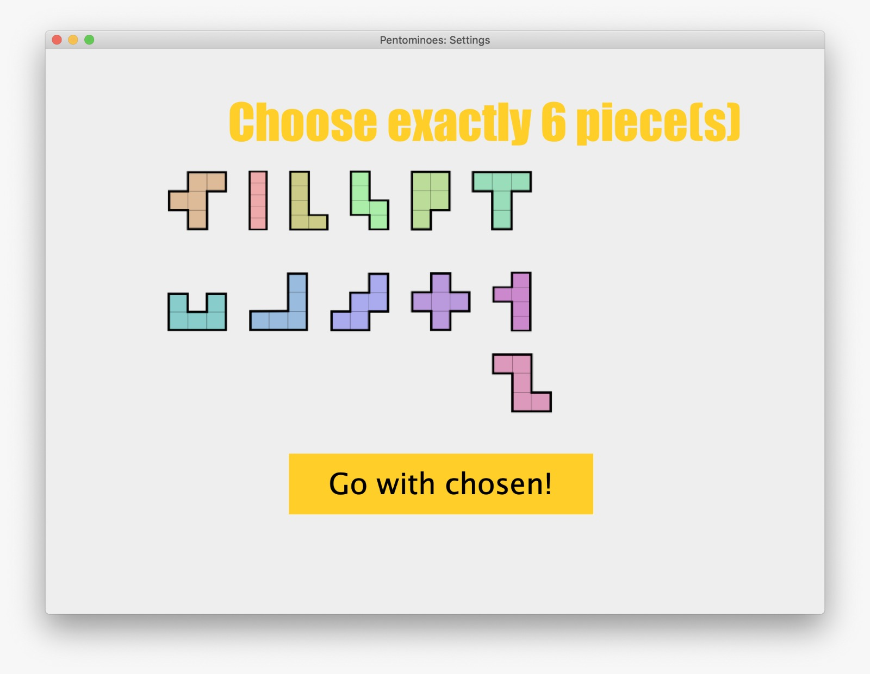
Choosing algorithm(Brute force or
Algorithm X)
Choosing the pentominoes

Slide 5
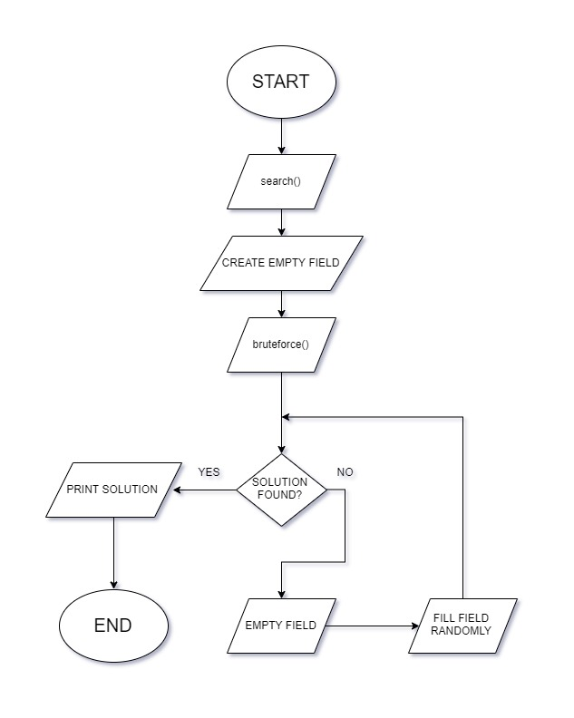
Brute force
(least efficient)
How does it work?
How do we define efficiency?
Why is this the least efficient algorithm?

Slide 6
Back-tracking (recursion)
(More efficient)
How does it work?
The back-tracking algorithm tries to find a solution by going through the possible combinations of pentominoes. It will stop once it has identified a combination as a solution, or when all possible combinations of pentominoes have been tested.
This was our first idea for a branching algorithm. However, in the end it did not work out.

Slide 7
Algorithm x
(Most efficient)
How does it work? Algorithm X determines the position of the next pentomino to be placed by creating a matrix and deleting rows and columns until it finds a valid solution (or not).

Slide 8
Example from Wikipedia:
 | 1 | 2 | 3 | 4 | 5 | 6 | 7
A | 1 | 0 | 0 | 1 | 0 | 0 | 1
B | 1 | 0 | 0 | 1 | 0 | 0 | 0
C | 0 | 0 | 0 | 1 | 1 | 0 | 1
D | 0 | 0 | 1 | 0 | 1 | 1 | 0
E | 0 | 1 | 1 | 0 | 0 | 1 | 1
F | 0 | 1 | 0 | 0 | 0 | 0 | 1
A = {1, 4, 7}
B = {1, 4}
C = {4, 5, 7}
D = {3, 5, 6}
E = {2, 3, 6, 7}
F = {2, 7}

Slide 9
 | 1 | 2 | 3 | 4 | 5 | 6 | 7
A | 1 | 0 | 0 | 1 | 0 | 0 | 1
B | 1 | 0 | 0 | 1 | 0 | 0 | 0
C | 0 | 0 | 0 | 1 | 1 | 0 | 1
D | 0 | 0 | 1 | 0 | 1 | 1 | 0
E | 0 | 1 | 1 | 0 | 0 | 1 | 1
F | 0 | 1 | 0 | 0 | 0 | 0 | 1
 | 1 | 2 | 3 | 4 | 5 | 6 | 7
A | 1 | 0 | 0 | 1 | 0 | 0 | 1
B | 1 | 0 | 0 | 1 | 0 | 0 | 0
C | 0 | 0 | 0 | 1 | 1 | 0 | 1
D | 0 | 0 | 1 | 0 | 1 | 1 | 0
E | 0 | 1 | 1 | 0 | 0 | 1 | 1
F | 0 | 1 | 0 | 0 | 0 | 0 | 1

Slide 10
Add row A to the partial solution.
 | 1 | 2 | 3 | 4 | 5 | 6 | 7
A | 1 | 0 | 0 | 1 | 0 | 0 | 1
B | 1 | 0 | 0 | 1 | 0 | 0 | 0
C | 0 | 0 | 0 | 1 | 1 | 0 | 1
D | 0 | 0 | 1 | 0 | 1 | 1 | 0
E | 0 | 1 | 1 | 0 | 0 | 1 | 1
F | 0 | 1 | 0 | 0 | 0 | 0 | 1
 | 1 | 2 | 3 | 4 | 5 | 6 | 7
A | 1 | 0 | 0 | 1 | 0 | 0 | 1
B | 1 | 0 | 0 | 1 | 0 | 0 | 0
C | 0 | 0 | 0 | 1 | 1 | 0 | 1
D | 0 | 0 | 1 | 0 | 1 | 1 | 0
E | 0 | 1 | 1 | 0 | 0 | 1 | 1
F | 0 | 1 | 0 | 0 | 0 | 0 | 1

Slide 11
 | 2 | 3 | 5 | 6
D | 0 | 1 | 1 | 1
Row A does not result in a solution.

Slide 12
Add row B to the partial solution.
 | 1 | 2 | 3 | 4 | 5 | 6 | 7
A | 1 | 0 | 0 | 1 | 0 | 0 | 1
B | 1 | 0 | 0 | 1 | 0 | 0 | 0
C | 0 | 0 | 0 | 1 | 1 | 0 | 1
D | 0 | 0 | 1 | 0 | 1 | 1 | 0
E | 0 | 1 | 1 | 0 | 0 | 1 | 1
F | 0 | 1 | 0 | 0 | 0 | 0 | 1
 | 1 | 2 | 3 | 4 | 5 | 6 | 7
A | 1 | 0 | 0 | 1 | 0 | 0 | 1
B | 1 | 0 | 0 | 1 | 0 | 0 | 0
C | 0 | 0 | 0 | 1 | 1 | 0 | 1
D | 0 | 0 | 1 | 0 | 1 | 1 | 0
E | 0 | 1 | 1 | 0 | 0 | 1 | 1
F | 0 | 1 | 0 | 0 | 0 | 0 | 1

Slide 13
 | 2 | 3 | 5 | 6 | 7
D | 0 | 1 | 1 | 1 | 0
E | 1 | 1 | 0 | 1 | 1
F | 1 | 0 | 0 | 0 | 1
 | 2 | 3 | 5 | 6 | 7
D | 0 | 1 | 1 | 1 | 0
E | 1 | 1 | 0 | 1 | 1
F | 1 | 0 | 0 | 0 | 1

Slide 14
Add row D to the partial solution.
 | 2 | 3 | 5 | 6 | 7
D | 0 | 1 | 1 | 1 | 0
E | 1 | 1 | 0 | 1 | 1
F | 1 | 0 | 0 | 0 | 1
 | 2 | 3 | 5 | 6 | 7
D | 0 | 1 | 1 | 1 | 0
E | 1 | 1 | 0 | 1 | 1
F | 1 | 0 | 0 | 0 | 1

Slide 15
 | 2 | 3 | 5 | 6 | 7
D | 0 | 1 | 1 | 1 | 0
E | 1 | 1 | 0 | 1 | 1
F | 1 | 0 | 0 | 0 | 1
 | 2 | 7
F | 1 | 1

Slide 16
 | 2 | 7
F | 1 | 1
 | 2 | 7
F | 1 | 1

Slide 17
Add row F to the partial solution.
 | 2 | 7
F | 1 | 1
After deletion, empty matrix,
so there is a solution!
Solution = partial solution
 | 1 | 2 | 3 | 4 | 5 | 6 | 7
B | 1 | 0 | 0 | 1 | 0 | 0 | 0
D | 0 | 0 | 1 | 0 | 1 | 1 | 0
F | 0 | 1 | 0 | 0 | 0 | 0 | 1

Slide 18
Testing

