Slide 1
3D knapsack problem: Phase 3
Group #25

Slide 2
The scene
The main scene is divided into 2 subscenes:
Two dimensional subscene
- gets input from the algorithm
.
2) Three dimensional subscene
-converts the results from the algorithm to shapes

Slide 3
The Slider
The slider plays a big role in what is behind the scenes. It has the ability to change the height of the container and see what’s inside of it.
.
Size of the blocks
The color of the blocks
Notes:
The slider changes the height of the container(it can stay empty,0,or it can be filled,5) and the components of the container is then visible.
The size of each block is 0.5m, and in the slider we choose the number of blocks instead of meters, so for example 5 blocks is 2.5m.
The colors of the blocks correspond to the type(a,b or c) and we chose three colors(RGB)

Slide 4
Communication with the algorithm
A button is used to chose either pentominoes or parcels
Change in algorithm
Scoring method
Score=type*value
Communication between score and Algorithm
Notes:
When either the pentominoes or parcels are chosen, the algorithm changes so it works for one of them.
The scoring method we use is the type of the pentominoe/parcel multiplied by the value of the chosen type.
After we get the score, the score is sent to the algorithm, and this part is the communication between the score and the algorithm.

Slide 5
Dancing links
Dancing links implementation of Algorithm X in addition to an altered version leads to a partial solution.
The use of dancing links is useful because it reuses the objects which prevents insertion of objects.
The algorithm attempts to fill the container and removes overlapping parts.
The solution with the highest score is picked.

Slide 6
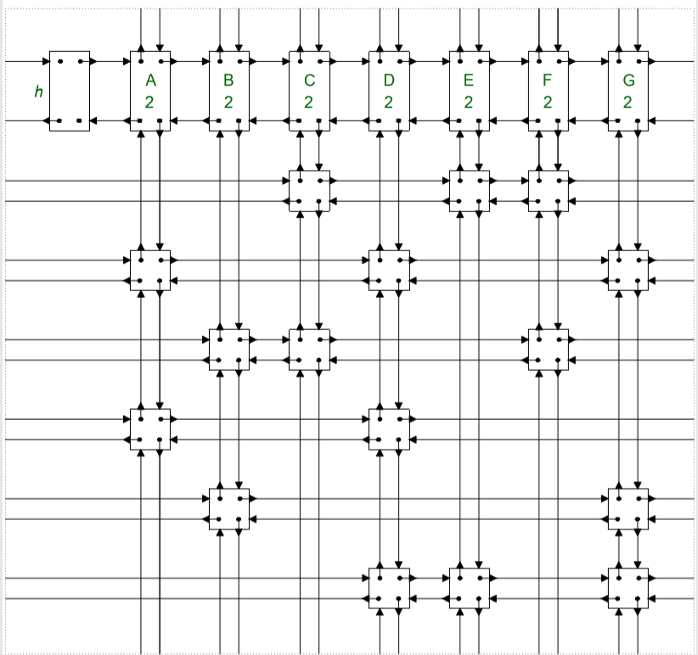
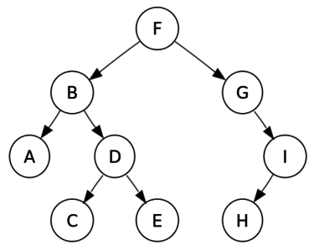
Dancing links

Slide 7
Challenges in dancing links
Array with all possible 3D rotations can be difficult.
The creation of the Dancing links itself can be difficult as it involves a lot of steps.
Dancing links is not meant for solving partial cover problems(the reason behind adding adjustments to fit the problems ).

Slide 8
The greedy algorithm
The algorithm sorts the items in decreasing order of value per unit of weight, v_{i} / w_{i} .
It proceeds to insert them into the sack, starting with as many copies as possible of the first kind of item until there is no longer space in the sack for more.
If m is the maximum value of items the algorithm is guaranteed to achieve at least a value of m/2.
If the supply of each item is limited, this algorithm is far from optimal.

Slide 9
Any questions?

