Slide 1
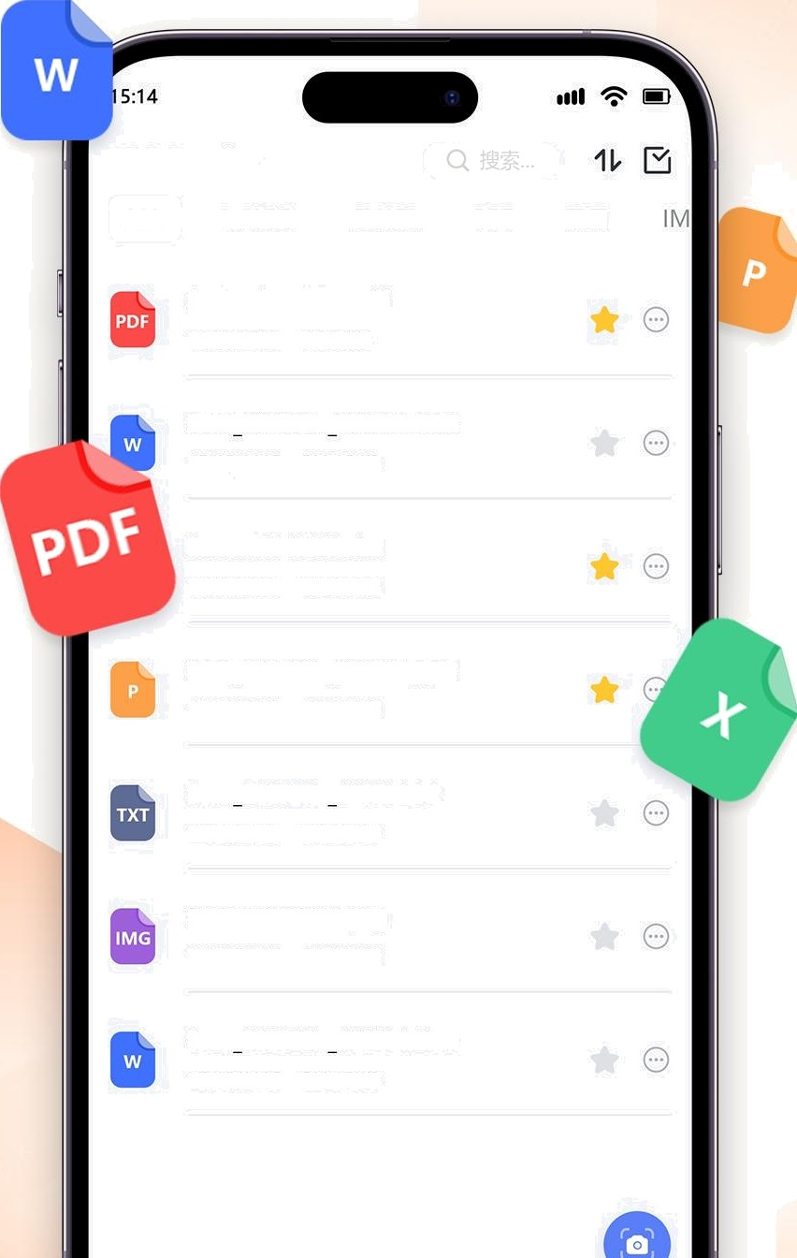
PDF Reader
ALL WORD
EXCEL
PPT TXT
Scriptadvertising.pdf
17/05/2025 32.35 KB
Scan 202505... 10514.docx
17/05/2025 592.35 KB
Present1112024.xIsx
Scan 202505... 110514.pptx I 7/05/2025 592.35 KB
Scan 202505... 110514.txt I 7/05/2025 592.35 KB
Present1112024.png
17/05/2025 592.35 K6
Scan 202505... 110514.docx
17/05/2025 592.35 KB

Slide 2
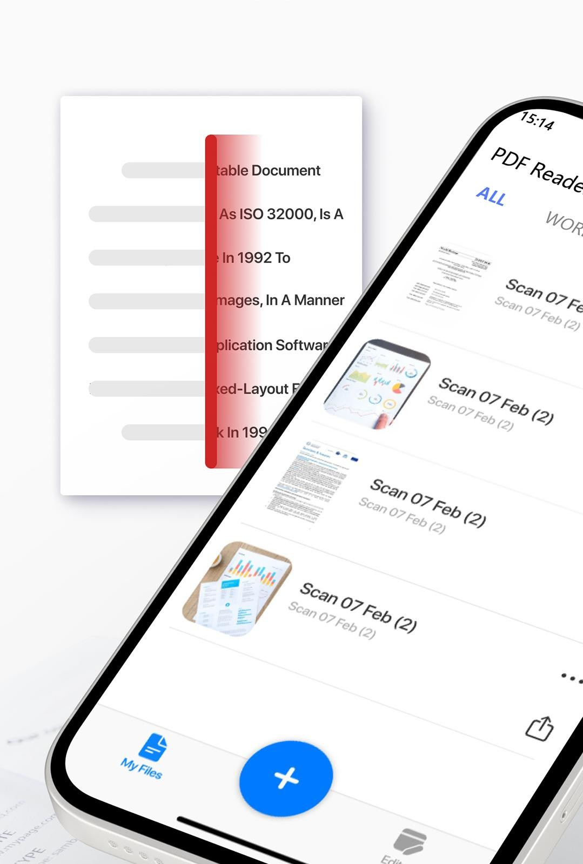

Slide 3
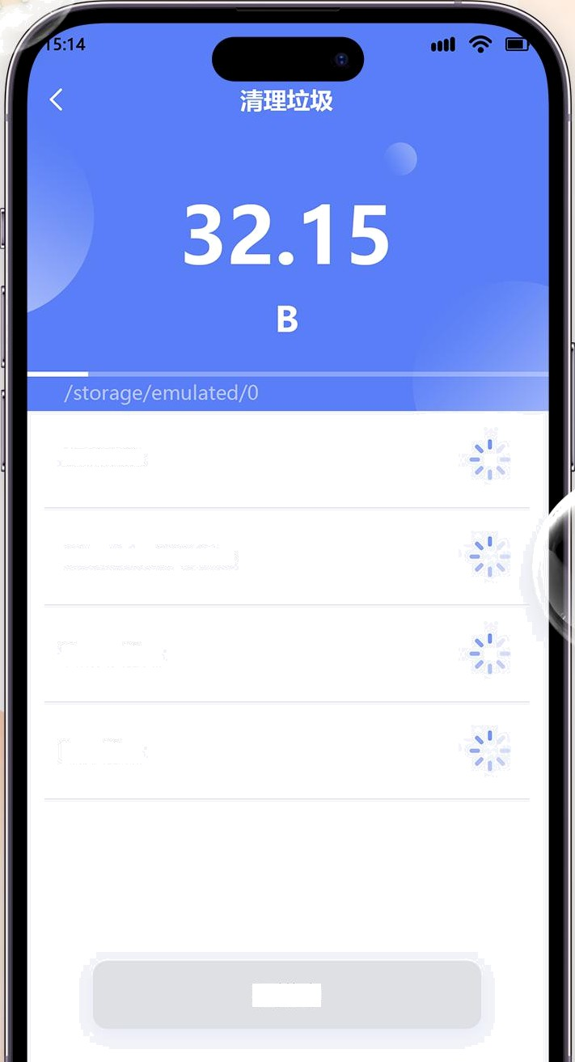

Junk File
Obsolete APK files
Temp Files
Log Files

Slide 4
