Slide 1
Autonomous Sales Engineer
Name: Hoon Chuan Hng
Student ID: TP076259
Title: AI-Powered Autonomous Sales Engineer

Slide 2
Team Composition (Solo)
Hoon Chuan Hng
Agent Framework Diagram
Pitch Deck
Video Demo
Python Source Codes

Slide 3
Problem Statement
Complex purchases require:
• Compatibility checks
• Budget planning
• Shipping & tax calculations
• Technical knowledge

Slide 4
Solution
An AI-powered agent workflow that:
• Understands user requirements
• Selects products
• Applies constraints
• Generates quotations

Slide 5
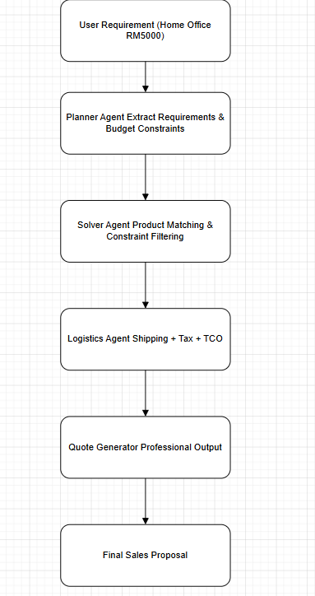
Agent Framework Diagram

Slide 6
Technical Implementation
Technologies:
• Python
• Constraint-based AI
• Autonomous workflow
Core Functions:
• planner()
• solver()
• logistics()
• generate_quote()

Slide 7
Demo Scenario
Input:
'I need a minimalist home office under RM5000'
System performs:
• Requirement extraction
• Product filtering
• Cost calculation
• Quote generation

Slide 8
Business Value
Benefits:
• Faster sales consultation
• Reduced manual work
• Better customer experience
• Scalable AI automation

Slide 9
Future Improvements
• OpenAI / LLM integration
• Real-time product APIs
• Smart recommendation engine
• Web dashboard

Slide 10
Conclusion
Our project demonstrates how AI agents can automate technical sales workflows using reasoning and constraint solving.

