Slide 1
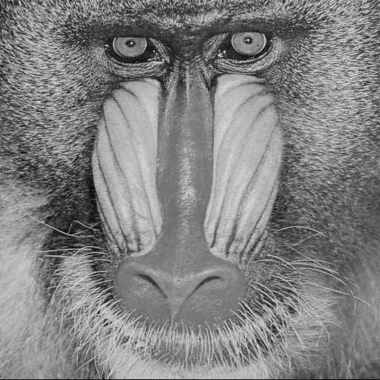
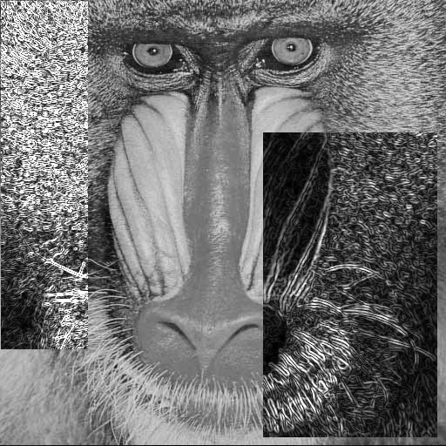
(a)
(b)

Slide 2
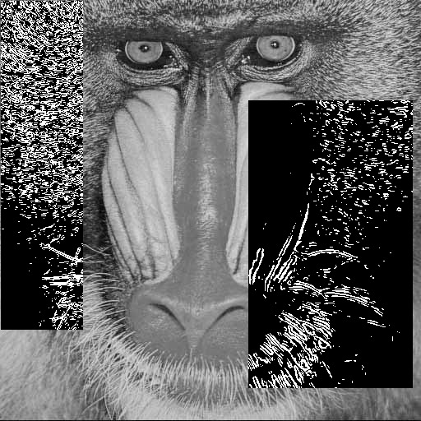
(a)
(b)

Slide 3
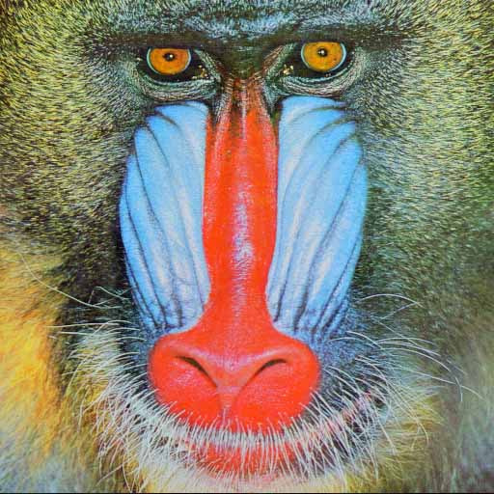
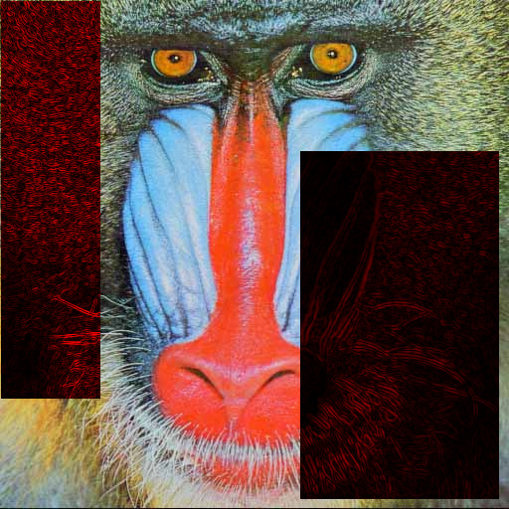
(a)
(b)

Slide 4


(a)
(b)

Slide 5


(a)
(b)

Slide 6


(a)
(b)

Slide 7
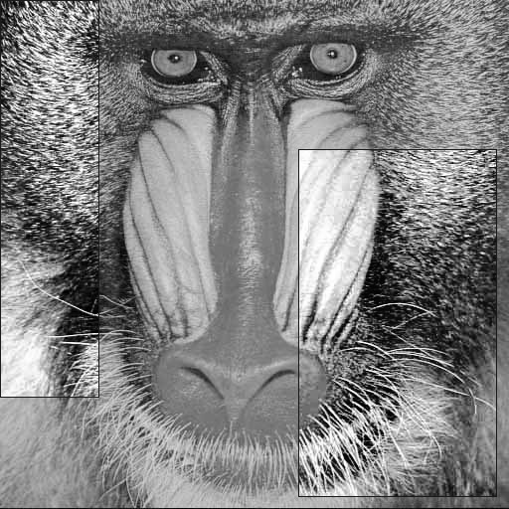
(a)
(b)

Slide 8


(a)
(b)

Slide 9
(a)
(b)

Slide 10
(a)
(b)

Slide 11
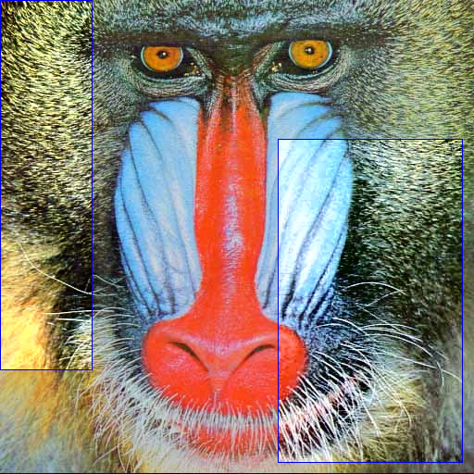
(a)
(b)

Slide 12
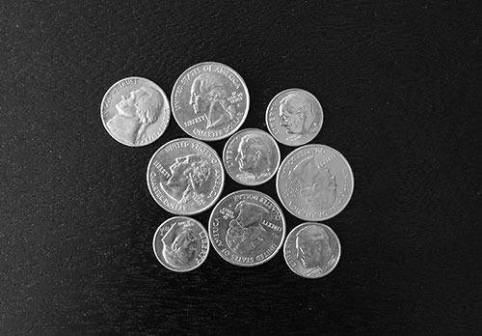

(a)
(b)

