Slide 1
Recognize. Avoid. Report
Phishing Awareness Training

Slide 2
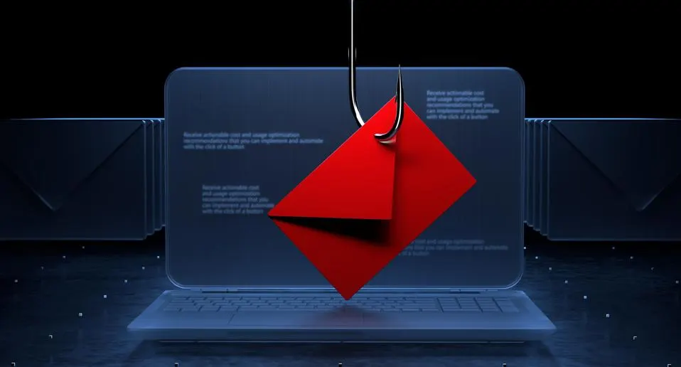
What do you think it is?

Slide 3
What is Phishing?
Definition: Phishing is a type of cyber attack where attackers trick users into revealing sensitive information like passwords, credit card numbers, or personal details.
Phishing is a form of cybercrime where attackers pose as trustworthy entities to trick individuals into revealing sensitive information such as login credentials, credit card numbers, social security numbers, or bank account details.
It's called “phishing” because attackers are “fishing” for victims’ data—just like a fisherman casts bait to catch fish, a cybercriminal sends fake messages to “hook” you into providing your private information.
Key Characteristics of Phishing Attacks:
Disguised as legitimate communication (e.g., emails, websites, phone calls)
Creates a sense of urgency or fear to force quick action
Often impersonates well-known companies, banks, delivery services, or even internal company departments (like HR or IT)

Slide 4
Forms of phishing
Common forms:
Emails
Fake websites
Phone calls (vishing)
SMS (smishing)
Social media messages

Slide 5
Spotting a Phishing Email
Look out for:
Urgent or threatening language ("Your account will be closed!")
Suspicious sender email (e.g., support@amaz0n.com)
Misspellings and poor grammar
Unexpected attachments or links
Requests for personal info

Slide 6
The human mind is the weakest link in cybersecurity.
Social Engineering Tactics

Slide 7
Core Principles Attackers Use:
Tactic | Description
Authority | Pretending to be someone in power (e.g., manager, police, IT admin).
Urgency | Creating panic or deadlines so you act quickly (e.g., “Your account will be disabled in 1 hour!”).
Fear | Threats of fines, job loss, or legal action.
Greed | Promises of gifts, refunds, or prizes.
Curiosity | “Check out this private message/photo of you.”
Helpfulness | Playing the victim: “I’m locked out of my account, can you help me reset it?”

Slide 8
Types of Phishing:
Type | Description
Email Phishing | Most common. Fake emails ask you to click links or download attachments.
Spear Phishing | Targeted attack customized for an individual or organization. Often includes personal information.
Whaling | Targets high-profile individuals like CEOs or executives.
Smishing | Phishing via SMS or messaging apps.
Vishing | Voice phishing via phone calls.
Clone Phishing | Attacker creates a nearly identical copy of a legitimate email and changes links or attachments

Slide 9
What to do
What to Do If You Suspect Phishing
Don’t click or respond
Report it immediately to IT/security
Delete the message
Run a virus scan if you clicked a link or opened an attachment

Slide 10
Vishing
What is Vishing?
Vishing is a type of phishing attack that happens over the phone. Instead of sending fake emails or texts, cybercriminals use voice calls to trick victims into giving up confidential information such as:
Bank account details
Social Security Numbers
Credit card numbers
Login credentials
Company secrets or access codes

Slide 11
Quick Quiz
Question 1: Which of the following is a sign of a phishing email? Question 2: What should you do if you receive a suspicious email? Question 3: True or False: It’s safe to open attachments from unknown senders.

Slide 12
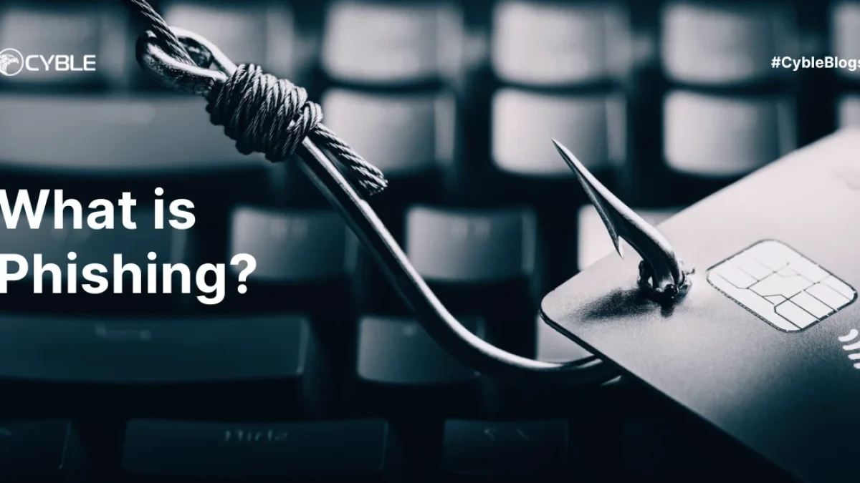
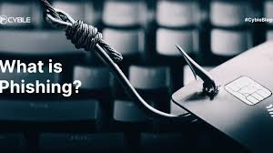
Phishing

Slide 13
Summary & Key Takeaways
Phishing is common but preventable
Always think before you click
Report suspicious activity
Keep security top of mind
“The best defense is awareness.”

