Slide 1


Slide 2
Instagram Insights
Instagram Visits: 0
Total Followers: 233
Top Visitors: Women, 25-34, with 26.3%
Top Country: Bangladesh, with 76.8%

Slide 3
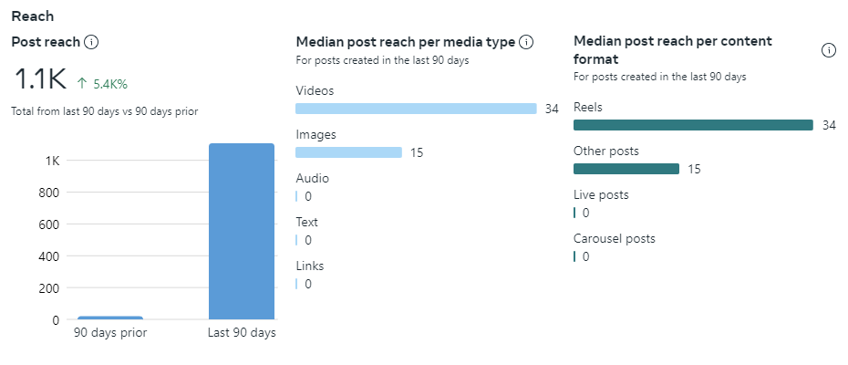

Slide 4
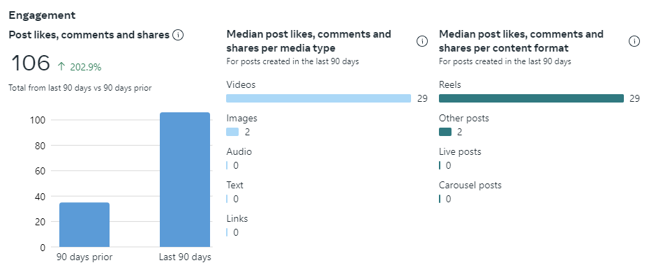

Slide 5
Facebook Insights
Facebook Visits: 0
Total Followers: 0
Top Visitors: N/A
Top Country: N/A

Slide 6
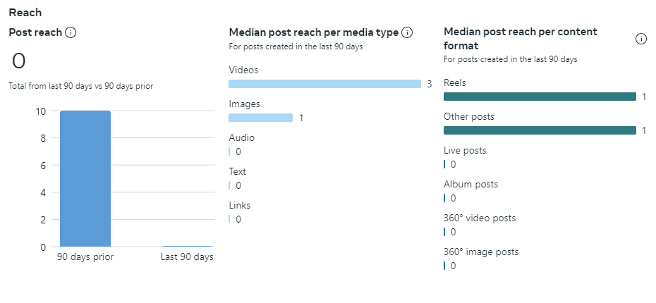

Slide 7
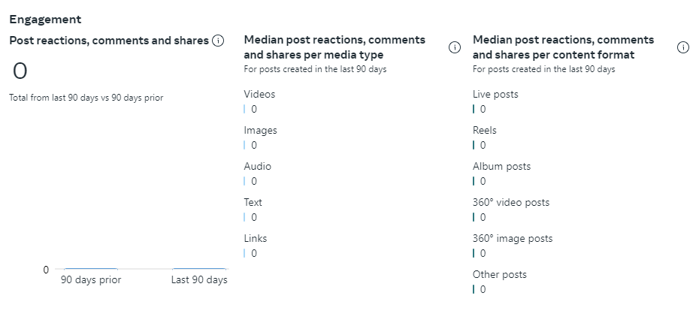

Slide 8


