Slide 1
Chicago Energy Usage
-Projecting energy usage shifts in 2020

Slide 2
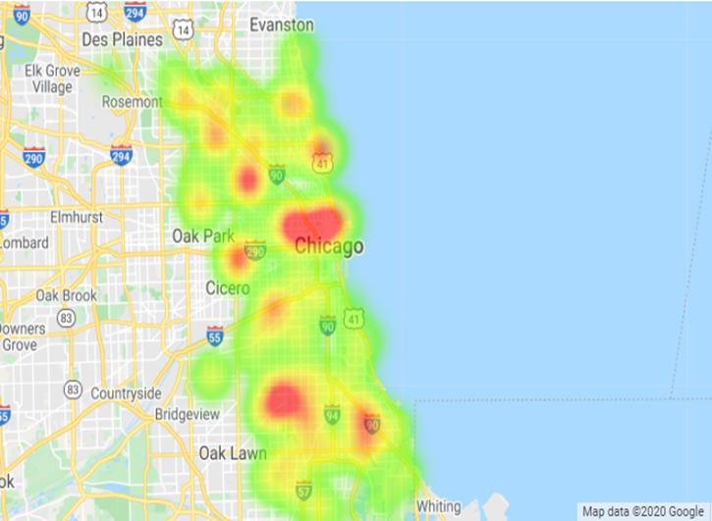
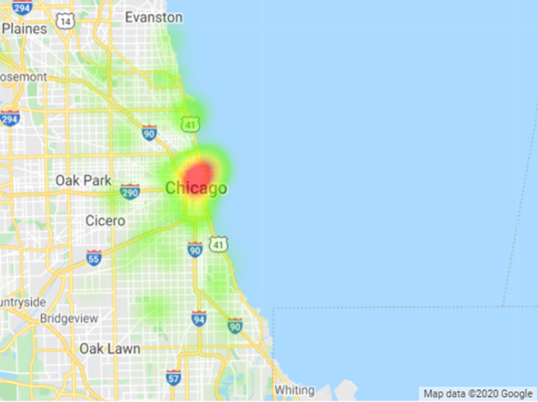
Electricity Usage – 2010
Residential Use
Commercial Use

Slide 3
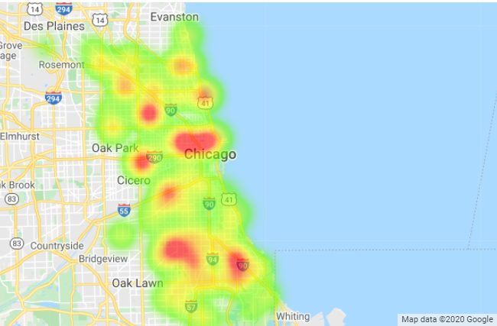
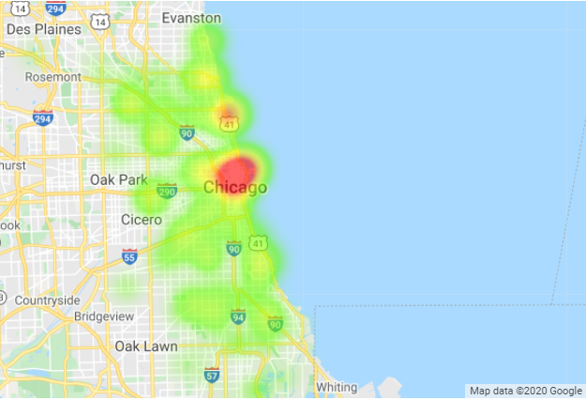
Gas Usage – 2010
Residential Use
Commercial Use

