Slide 1


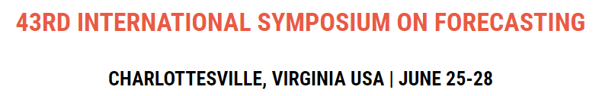


Does Forecast Accuracy Even Matter…
YES, but…
Dr. Jim Hoover
Jack Faricy Professor
Director, Business Analytics & Artificial Intelligence Center
Warrington College of Business
University of Florida
jim.hoover@warrington.ufl.edu
https://warrington.ufl.edu

Slide 2
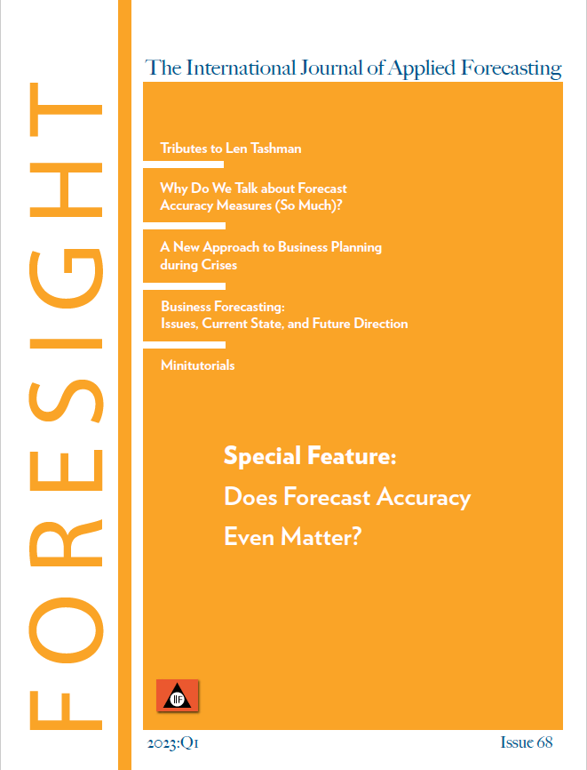
Does Forecast Accuracy Even Matter?
Commercial discussion
Steutermann (2017) - Gartner
1% improvement in forecast accuracy =
2.7% inventory reduction
3.2% transportation cost reduction
3.9% inventory obsolescence reduction
IBF Forecast Error Savings Calculator
Foresight Issue 68 discussion
Robette (2022)
Utilizes a simulation framework
Finding: improved accuracy not always better
Kolassa (2022)
Utilizes a simulation framework
Finding: other decisions impact outcomes
Foresight Issue 68, Spring 2023

Slide 3
Simulation Methods to Determine Outcomes*
Step 1
Step 2
Step 3
Step 4
Step 5
Decide on forecast supported business process(es) outcomes
In our case, we evaluated:
Average inventory levels
Backorder periods
Safety stock levels
Collect time series (and other data) for simulation
We utilized the M5 competition data from Walmart
Simulate multiple forecasts for each time series
Forecasts with errors were perturbated around actuals at 50%, 40%, 30%, 20%, 10%, 5%, 2%, 1%, and 0% error for each period
For each time series and for each forecast for the series:
Calculate forecast accuracy using your various KPIs
Simulate the subsequent business process that relies on the forecast and derive the business outcome KPIs
Accuracy was calculated using Mean Absolute Deviation (MAD) to conform to supply chain calculations
Outcomes simulate the SAP supply chain calculations
Plot or otherwise analyze the relationship between forecast accuracy and business outcomes
Average inventory levels and backorder periods were compared to the forecast accuracy levels
Kolassa (2022)
Hoover (2023)
*Simulation Framework Adapted from Kolassa (2022)

Slide 4
Forecast Method Discussion
Previous articles (Foresight Issue 68)
Robette (2022)
Uses real forecasts from the M5 Competition
Uses naïve forecasts for comparisons (FVA)
Kolassa (2022)
Suggests perturbed forecasts varying from actuals
This analysis utilizes standard perturbated forecasts
Permits analysis of supply chain outcomes at standardized levels of forecast accuracy across SKUs

Slide 5
Simulating Forecast at Levels of Accuracy
Kolassa (2022) – calculate multiple forecasts for each period
Hoover (2023) – perturbate around known forecast error levels
Perturbated Error
Period X
Example perturbated forecast
+50% error
Forecasted demand = Round (52 + (0.5 x 52)) = 52+26 = 78 forecasted
Randomly select upper or lower forecast for each period
Actual demand = 52
-50% error
Forecasted demand = Round (52 – (0.5 x 52)) = 52-26 = 26 forecasted

Slide 6
Simulating Forecast at Levels of Accuracy
Forecast Error Level | Forecast | Error
Actual value | 52
+50% | 78 | 26
+40% | 73 | 21
+30% | 68 | 16
+20% | 62 | 10
+10% | 57 | 5
+5% | 55 | 3
+2% | 53 | 1
+1% | 53 | 1
0% (Perfect) | 52 | 0
Randomly select either the positive or the negative forecast value at each forecast error level
Store forecasts for each period at each error level
Utilize the forecasts errors within supply chain calculations
Forecast Error Level | Forecast* | Error
Actual value | 52
-50% | 26 | -26
-40% | 31 | -21
-30% | 36 | -16
-20% | 42 | -10
-10% | 47 | -5
-5% | 49 | -3
-2% | 51 | -1
-1% | 51 | -1
0% (Perfect) | 52 | 0
*Lower Forecast Bounded by 0 (zero)

Slide 7
Simulating Forecast at Levels of Accuracy
By preserving forecasts at each error level for each period for each SKU, comparisons of different supply chain outcomes can be calculated

Slide 8
Simulation Methods to Determine Outcomes
Assumptions must be made about the supply chain replenishment process – Theodoru & Spiliotis (2022)
SAP provides one of the most utilized supply chain planning systems – enlyft (2023)
Utilized the supply chain formulas from SAP’s Sourcing and Procurement (Materials Management) – SAP S/4 HANA | 2020 FP502 (May 2021)
Key formulas contained in Appendix:
Mean absolute deviation (MAD) utilizes an exponentially smoothed MAD
Standard deviation = MAD x 1.25
Service Level
Safety Stock
Economic Order Quantity (EOQ)
Reorder Level (assumes SAP is configured to use the R, Q replenishment policy)

Slide 9

Data Used – M5 Competition SKUs
30,490 different SKUs (provided by Walmart for the competition)
1,913 daily demand observations per SKU
Daily demand periods (1/29/2011 – 4/24/2016)
Demand is at the store / SKU level
Average daily demand is low
Lots of periods with 0’s
90% of SKUs have demand < 3 per day
364 SKUs > 10 per day
https://www.kaggle.com/competitions/m5-forecasting-accuracy/data

Slide 10
Assumptions
Monthly levels calculations and use
Constant values for decisions updated periodically
Many firms update monthly
Why?
SAP Supply Chain Calculations
ROQ – Optimal Order Quantity
Limits the number of orders trading off costs of transactions
Lot size
Reorder Review Period, Reorder Point, Inventory Position
Safety Stock
Service Level
Backorders permitted?

Slide 11
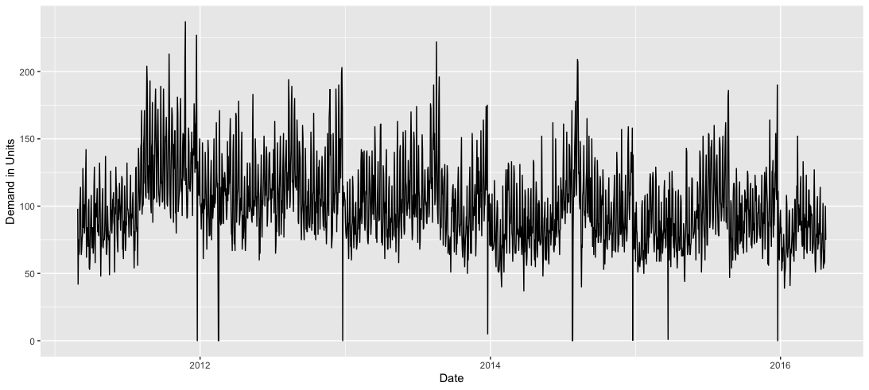
Simulation Methods to Determine Outcomes
SKU “FOODS_3_586_TX_2_validation” demand observations over the simulation period

Slide 12
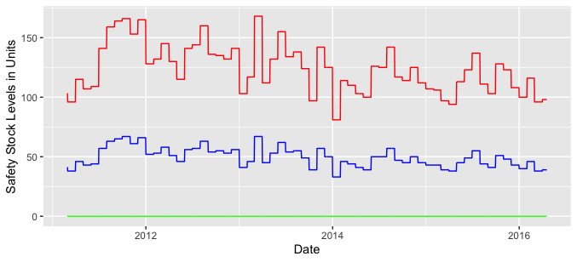
Supply Chain Results – Safety Stock Levels
Safety Stocks (SS) are calculated with a monthly periodicity
Monthly “levels” calculations are common in commercial supply chain software (like SAP)
Red = SS at 50% error
Blue = SS at 20% error
Green = SS at 0% error
Safety Stock Levels
% Error Level | Average SS
50% error | 124 units
20% error | 50 units
0% error | 0 units
Forecast error introduced

Slide 13
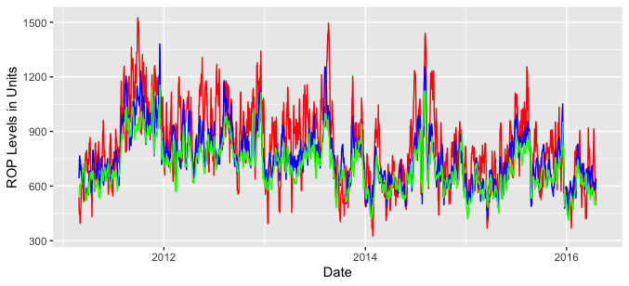
Supply Chain Results – Reorder Points
Reorder points are calculated using the forecasts over lead time at each date
Lead time was an assumption of the model = 7 days
% Error Level | Average ROP
50% error | 822 units
20% error | 759 units
0% error | 709 units
Red = ROP at 50% error
Blue = ROP at 20% error
Green = ROP at 0% error

Slide 14
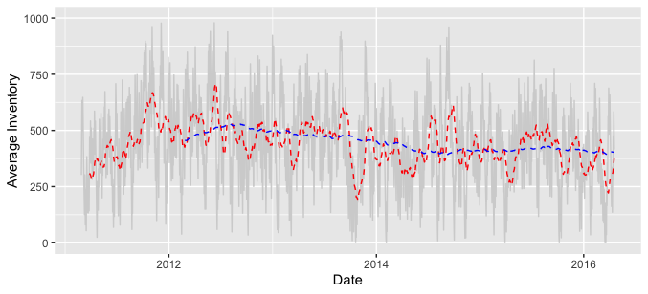
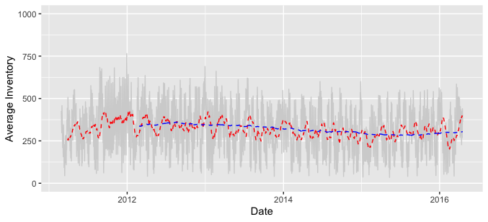
Supply Chain Results – Average Inventory
Average Inventory on hand goes down as accuracy goes up
1% reduction in forecast error ~ 0.8% reduction in Average Inventory on hand
50% error
Average Inventory on hand
% Error Level | Average Inv OH
50% error | 439 units
20% error | 368 units
0% error | 318 units
0% error
Forecast error introduced
Average on hand primarily driven by reorder quantity Q*

Slide 15
Outcome Measures – Backorder Periods
Backorder periods are not well correlated to forecast error
Percent of Periods with Backorders
Forecast Error Perturbation Induced

Slide 16
Outcome Measures – Backorder Quantities
% Error Level | Backorder Quantity
50% error | 1,450 units
20% error | 376 units
5% error | 105 units
0% error | 248 units
Total Backorders Quantity
Backorder quantities seems to increase with forecast error below 5%
Forecast Error Perturbation Induced

Slide 17
Outcome Measures – Backorder Quantity Percentage
% Error Level | Backorder Percentage
50% error | 0.76%
20% error | 0.20%
5% error | 0.06%
0% error | 0.13%
Backorders Percentage
Backorder quantity percentage seems to increase with forecast error below 5%
Forecast Error Perturbation Induced

Slide 18
Outcome Measures – Inventory Holding Costs
% Error Level | Inventory Costs
50% error | $1,128
20% error | $1,057
5% error | $1,021
0% error | $1,007
Annual Inventory Cost
Linear relationship between annual inventory costs and forecast error introduced
$2.45 per every 1% reduction in forecast error
Forecast Error Perturbation Induced

Slide 19
Conclusions
As accuracy goes up:
Safety stock and inventory goes down
Savings from inventory holding cost perspective
Backorder periods can go up when accuracy is very high
Due to Safety Stock 0 and monthly calculated reorder quantity (Q*)
The ratio of Safety Stock to Order Quantity and demand decreases
Implications:
Forecast accuracy does matter, but…
Supply chain planning configurations matter a great deal… maybe more
These results will change as the supply chain planning configurations change

Slide 20
Next Steps
Complete simulations of all M5 SKUs
Summarize results by A, B, C inventory analysis - Hyperlink
Submit to IJF / Foresight
Rerun with other datasets

Slide 21
Appendix

Slide 22
References
Code hosted on GitHub - Hyperlink
https://github.com/Hoover-code/Forecasts_matter/tree/main

Slide 23
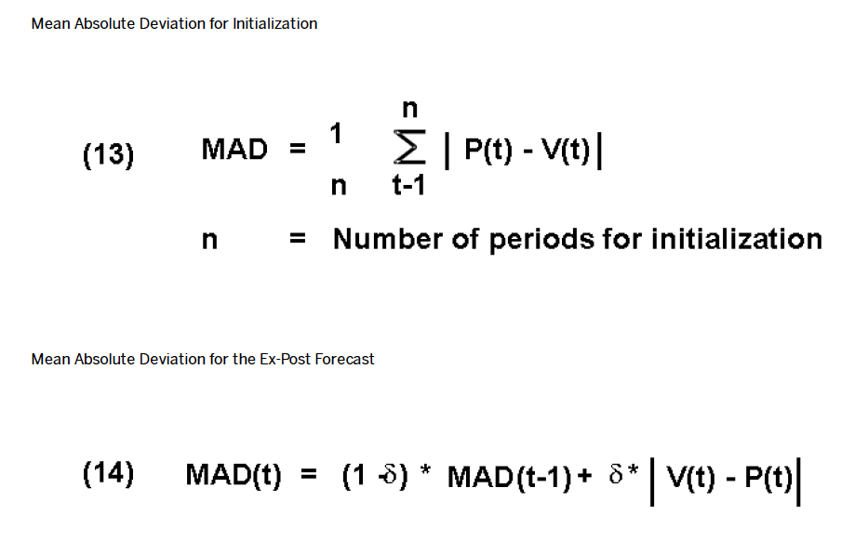
Formulas - MAD
Formulas 13 & 14 from SAP documentation
n >= 4
alpha = 0.2

Slide 24
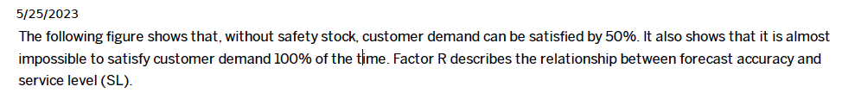
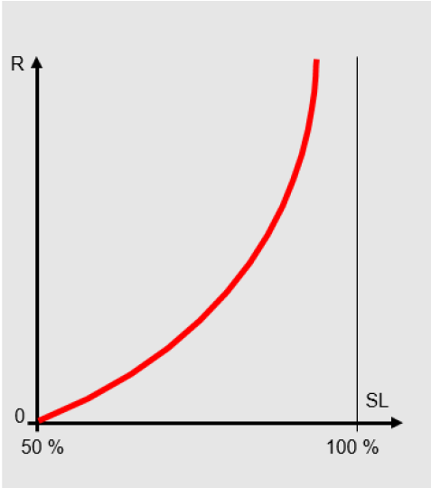
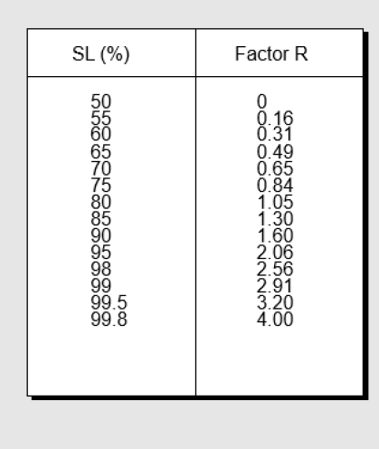
Formulas – Service Level (Look-up Table)
Supports Safety Stock Calculation

Slide 25
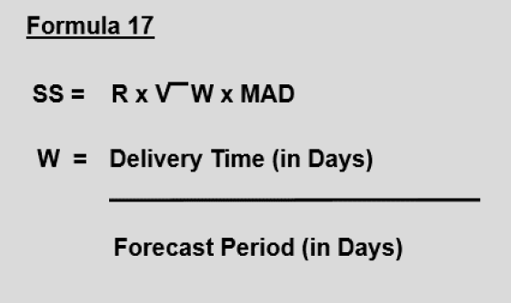
Formulas – Safety Stock
Safety Stock Calculation – Formula 17

Slide 26
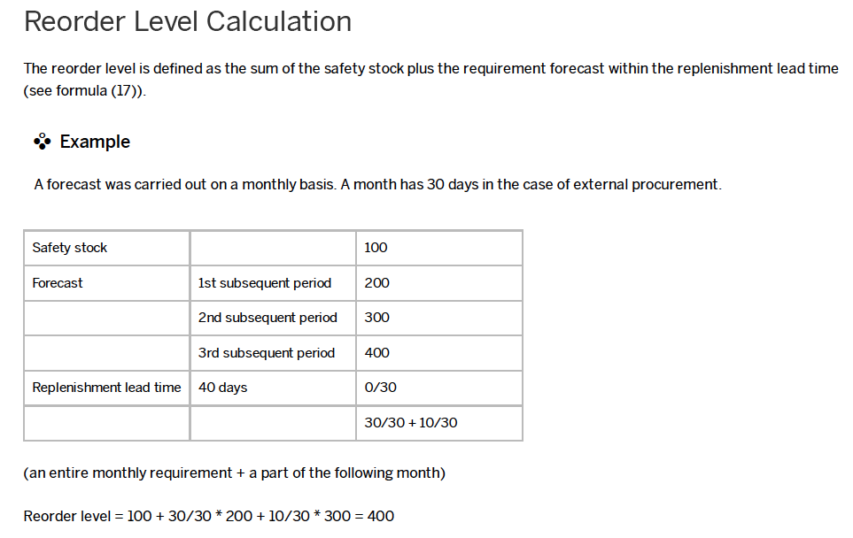
Formulas – Reorder Level (ROP)

Slide 27
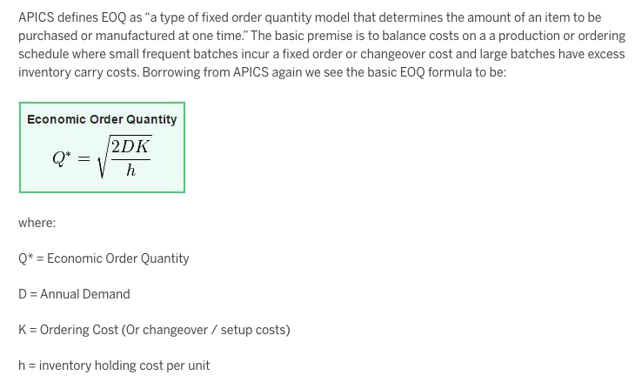
Formulas – Classic Wilson’s EOQ
Blog Post by SAP on calculation of the EOQ - Hyperlink
Calculated monthly using levels update
Note: Other methods for calculating the order quantity in SAP exist (e.g., SAP APO calculation of EOQ and safety stock together using a normal curve). This method requires a substantial amount of knowledge of the system configuration. The Wilson EOQ method is discussed and suggested as a potential setting.

Slide 28
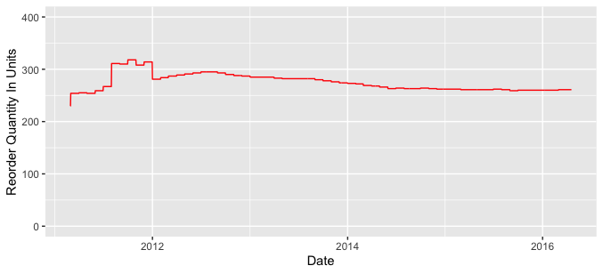
Formulas – EOQ results
ROQ averages 275 units over the simulation period
ROQ = the amount ordered when reorder point is reached
ROQ calculated monthly using Wilson’s EOQ

Slide 29
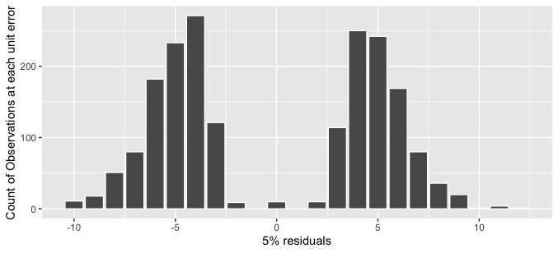
Formulas – Error Permutation Illustration
*
*If actual = 0, then perturbated forecast will also be 0

Slide 30
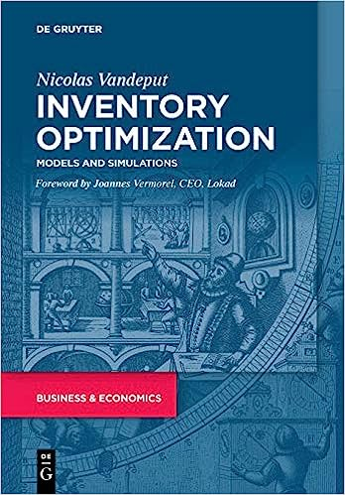
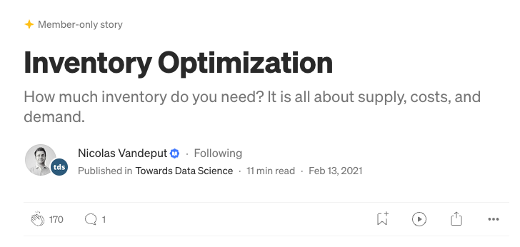
Other References
Thorough article on Medium.com by Nicolas Vandeput on concepts - Hyperlink
Great book by Nicolas Vandeput on setting up simulations - Hyperlink

