Slide 1




Does Forecast Accuracy Even Matter – Findings from a Retail Dataset
Dr. Jim Hoover
Jack Faricy Professor
Director, Business Analytics & Artificial Intelligence Center
Warrington College of Business
University of Florida
jim.hoover@warrington.ufl.edu
https://warrington.ufl.edu

Slide 2
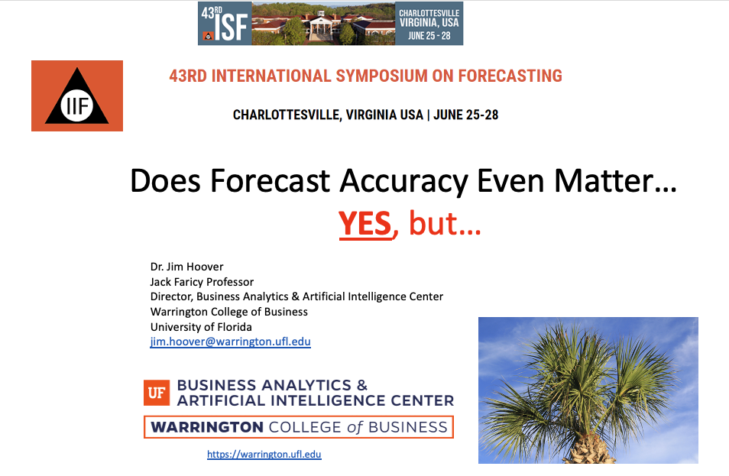
Does Forecast Accuracy Even Matter?
Commercial discussion
Steutermann (2017) - Gartner
1% improvement in forecast accuracy =
2.7% inventory reduction
3.2% transportation cost reduction
3.9% inventory obsolescence reduction
ISF 2023 – Charlottesville, VA
Methodology reviewed
Single SKU example presented
Next steps to include expansion to entire 30,490 SKUs from the M5 competition
“ABC” analysis
Foresight Issue 68, Spring 2023
Special Feature:
Does Forecast Accuracy Even Matter?

Slide 3
Does Forecast Accuracy Even Matter?
Forecasting and S&OP processes
Expectations of management about forecast accuracy?
Limited human resources to perform forecast improvements
High number of SKU forecasts when measured at a store / SKU level
Walmart has over 4,600 stores and 600 Sam’s Club locations in the U.S.¹
Each store has an average of 142,000 SKUs²
Walmart has 210 distribution centers³
Forecasting SKUs monthly at the store level represents 738,000,000 forecasts
Forecasting SKUs across Walmart > 1 billion SKUs per month
https://www.cnbc.com/2024/01/31/walmart-plans-to-add-150-more-stores-across-us.html
https://inventory-management.com/inventory-management/inventory-management-at-walmart/
https://corporate.walmart.com/about

Slide 4
Simulation Methods to Determine Outcomes
Determine Outcome Metrics (KPIs)
Import SKU data and analyze demand
Calculate forecasts for each SKU at different accuracy levels
Perform Supply Chain Simulation for each accuracy level per SKU
Measure supply chain outcomes at each accuracy level per SKU
Metrics evaluated:
Average inventory levels
Backorder periods
Safety stock levels
M5 competition data from Walmart
30,490 SKUs
Determine A,B,C assignments
Forecasts with errors were perturbated around actuals at 50%, 40%, 30%, 20%, 10%, 5%, 2%, 1%, and 0% error for each period
Accuracy was calculated using Mean Absolute Deviation (MAD) to conform to supply chain calculations
Outcomes simulate the SAP supply chain calculations
Average inventory levels and backorder periods were compared to the forecast accuracy levels at each A,B,C category

Slide 5
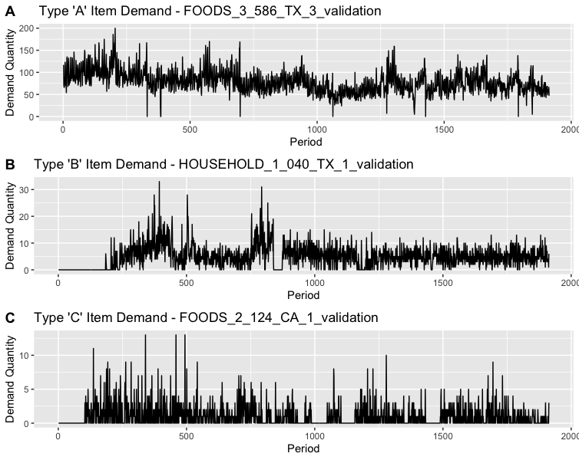
Data Profile and ABC Analysis
Example SKUs from each A,B, C level
>=10
>2 &
<10
<=2

Slide 6
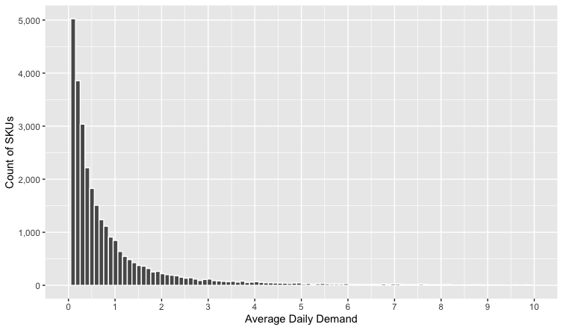
Data Profile and ABC Analysis
30,490 SKUs ABC analysis:
ADD = Average Daily Demand
C
B
A
n = 26,618
n = 3,507
n = 365
ADD <= 2
ADD > 2 & < 10
ADD >= 10
https://www.kaggle.com/competitions/m5-forecasting-accuracy/data

Slide 7
Simulating Forecast Levels of Accuracy
By preserving forecasts at each error level for each period for each SKU, comparisons of different supply chain outcomes can be calculated

Slide 8
Supply Chain Simulation Assumptions
Monthly levels calculations and use
Constant values for decisions updated periodically
Many firms update monthly
Why?
SAP Supply Chain Calculations
ROQ – Optimal Order Quantity
Limits the number of orders trading off costs of transactions
Lot size
Reorder Review Period, Reorder Point, Inventory Position
Safety Stock
Service Level
Backorders permitted?

Slide 9
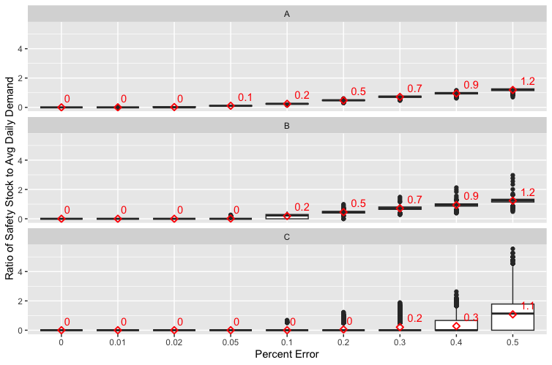
Forecast Error & Safety Stock Impact
Outcome Measure: Ratio of Safety Stock to Average Daily Demand
Conclusion: Similar pattern between A, B, C except that C items have little safety stock until higher levels of forecast error

Slide 10
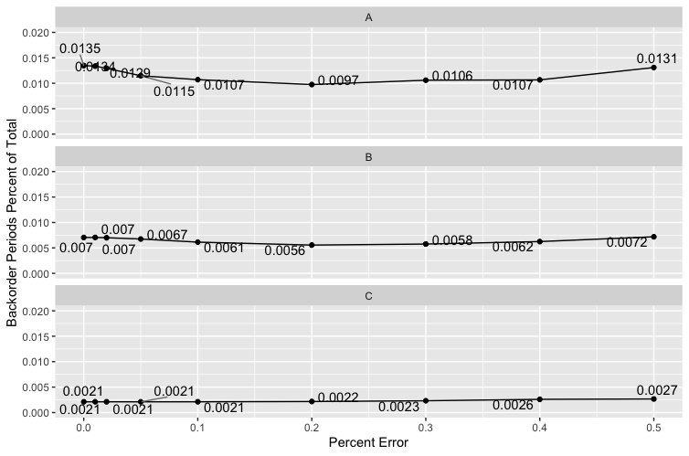
Forecast Error & Backorder Periods
Outcome Measure:
Average Number of Periods with Backorders
Conclusion: Backorder periods decline until forecast accuracy exceeds 80%... then backorders begin to go up again… “safety stock effect”

Slide 11
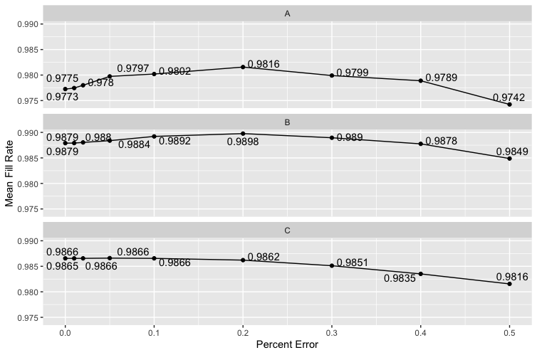
Forecast Error & Fill Rates
Outcome Measure:
Mean Fill Rates
Conclusion: Fill rates increase until 80% forecast accuracy achieved then decline… biggest impact on categories A & B… category C has no impact

Slide 12
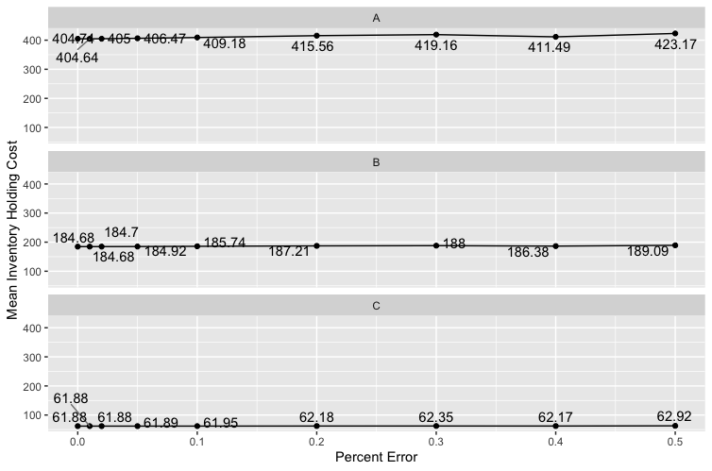
Forecast Error & Inventory Holding Costs
Outcome Measure:
Inventory Holding Costs
Conclusion: Inventory Holding Costs decline as forecast accuracy increases across all A,B, C categories

Slide 13
Conclusions Summary
As accuracy goes up:
Safety stock and inventory goes down
Savings from inventory holding cost perspective
Backorder periods can go up when accuracy is very high
Due to Safety Stock 0 and reorder quantity (Q*)
The ratio of Safety Stock to Order Quantity and demand decreases
Mostly affects higher demand items and not low intermittent demand items

Slide 14
Implications
Implications for forecast accuracy improvement:
Forecast accuracy does matter, but…
Supply chain planning configurations matter a great deal… maybe more
Set A, B, C classifications on SKUs
Consider setting floors on safety stock levels for key items
These results will change as the supply chain planning configurations change
Spend limited demand planning and forecasting improvement efforts on forecast improvements on A & B category items
Don’t try to improve forecasts where accuracy is at or above 80% accuracy

Slide 15

Code for Completing Supply Chain Simulations
Code hosted on GitHub – Hyperlink
Each SKU approximately 1 minute to complete analysis
30,490 SKU’s – 2 weeks to analyze
Analysis only needs to be completed once
QR Code for GitHub Repository

Slide 16
Appendix

Slide 17
Simulation Methods to Determine Outcomes
Assumptions must be made about the supply chain replenishment process – Theodoru & Spiliotis (2022)
SAP provides one of the most utilized supply chain planning systems – enlyft (2023)
Utilized the supply chain formulas from SAP’s Sourcing and Procurement (Materials Management) – SAP S/4 HANA | 2020 FP502 (May 2021)
Key formulas contained in Appendix:
Mean absolute deviation (MAD) utilizes an exponentially smoothed MAD
Standard deviation = MAD x 1.25
Service Level
Safety Stock
Economic Order Quantity (EOQ)
Reorder Level (assumes SAP is configured to use the R, Q replenishment policy)

Slide 18
Simulation Methods to Determine Outcomes*
Step 1
Step 2
Step 3
Step 4
Step 5
Decide on forecast supported business process(es) outcomes
In our case, we evaluated:
Average inventory levels
Backorder periods
Safety stock levels
Collect time series (and other data) for simulation
We utilized the M5 competition data from Walmart
Simulate multiple forecasts for each time series
Forecasts with errors were perturbated around actuals at 50%, 40%, 30%, 20%, 10%, 5%, 2%, 1%, and 0% error for each period
For each time series and for each forecast for the series:
Calculate forecast accuracy using your various KPIs
Simulate the subsequent business process that relies on the forecast and derive the business outcome KPIs
Accuracy was calculated using Mean Absolute Deviation (MAD) to conform to supply chain calculations
Outcomes simulate the SAP supply chain calculations
Plot or otherwise analyze the relationship between forecast accuracy and business outcomes
Average inventory levels and backorder periods were compared to the forecast accuracy levels
Kolassa (2022)
Hoover (2023)
*Simulation Framework Adapted from Kolassa (2022)

Slide 19
Simulating Forecast at Levels of Accuracy
Kolassa (2022) – calculate multiple forecasts for each period
Hoover (2023) – perturbate around known forecast error levels
Perturbated Error
Period X
Example perturbated forecast
+50% error
Forecasted demand = Round (52 + (0.5 x 52)) = 52+26 = 78 forecasted
Randomly select upper or lower forecast for each period
Actual demand = 52
-50% error
Forecasted demand = Round (52 – (0.5 x 52)) = 52-26 = 26 forecasted

Slide 20
Simulating Forecast at Levels of Accuracy
Forecast Error Level | Forecast | Error
Actual value | 52
+50% | 78 | 26
+40% | 73 | 21
+30% | 68 | 16
+20% | 62 | 10
+10% | 57 | 5
+5% | 55 | 3
+2% | 53 | 1
+1% | 53 | 1
0% (Perfect) | 52 | 0
Randomly select either the positive or the negative forecast value at each forecast error level
Store forecasts for each period at each error level
Utilize the forecasts errors within supply chain calculations
Forecast Error Level | Forecast* | Error
Actual value | 52
-50% | 26 | -26
-40% | 31 | -21
-30% | 36 | -16
-20% | 42 | -10
-10% | 47 | -5
-5% | 49 | -3
-2% | 51 | -1
-1% | 51 | -1
0% (Perfect) | 52 | 0
*Lower Forecast Bounded by 0 (zero)

Slide 21

Data Used – M5 Competition SKUs
30,490 different SKUs (provided by Walmart for the competition)
1,913 daily demand observations per SKU
Daily demand periods (1/29/2011 – 4/24/2016)
Demand is at the store / SKU level
Average daily demand is low
Lots of periods with 0’s
90% of SKUs have demand < 3 per day
364 SKUs > 10 per day
https://www.kaggle.com/competitions/m5-forecasting-accuracy/data

Slide 22
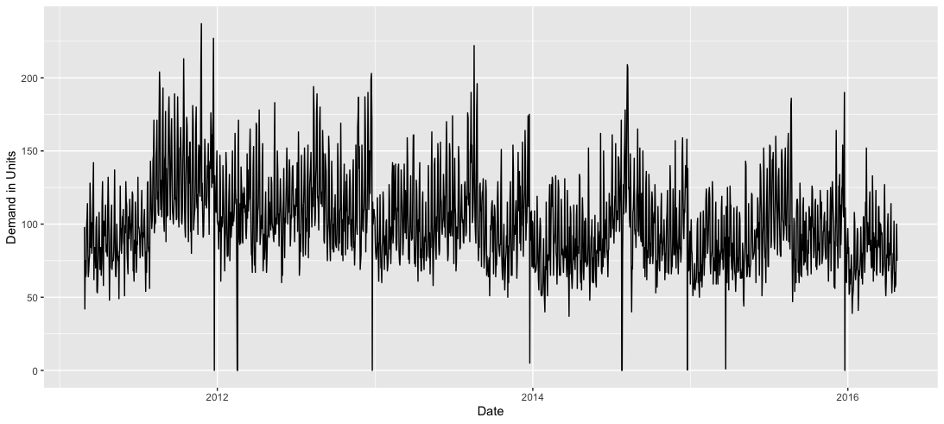
Simulation Methods to Determine Outcomes
SKU “FOODS_3_586_TX_2_validation” demand observations over the simulation period

Slide 23
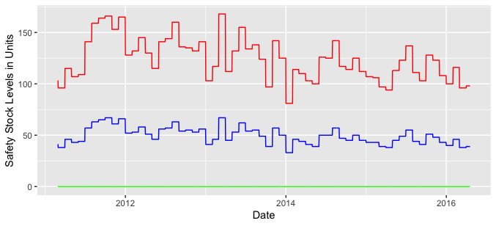
Supply Chain Results – Safety Stock Levels
Safety Stocks (SS) are calculated with a monthly periodicity
Monthly “levels” calculations are common in commercial supply chain software (like SAP)
Red = SS at 50% error
Blue = SS at 20% error
Green = SS at 0% error
Safety Stock Levels
% Error Level | Average SS
50% error | 124 units
20% error | 50 units
0% error | 0 units
Forecast error introduced

Slide 24
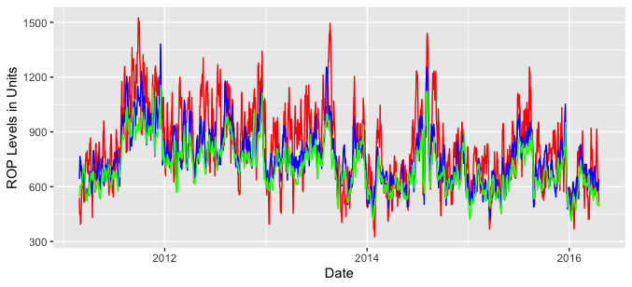
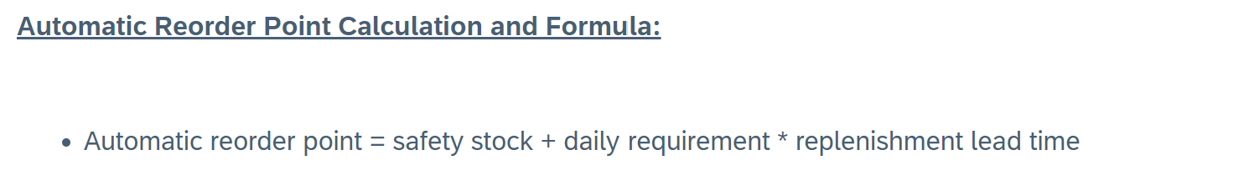
Supply Chain Results – Reorder Points
Reorder points are calculated using the forecasts over lead time at each date
Lead time was an assumption of the model = 7 days
% Error Level | Average ROP
50% error | 822 units
20% error | 759 units
0% error | 709 units
Red = ROP at 50% error
Blue = ROP at 20% error
Green = ROP at 0% error
https://community.sap.com/t5/enterprise-resource-planning-blogs-by-members/automatic-reorder-point-mrp-type-v2-or-vm-planning-part-1/ba-p/13569776

Slide 25
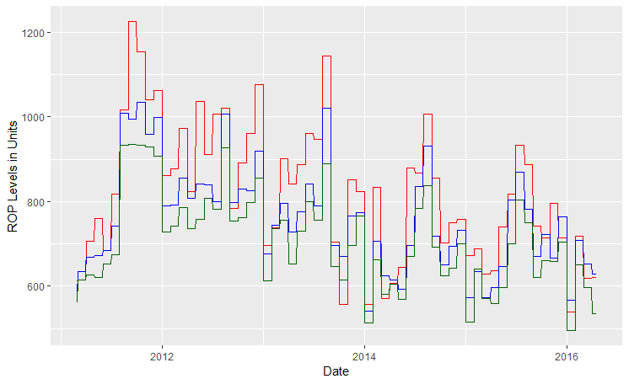
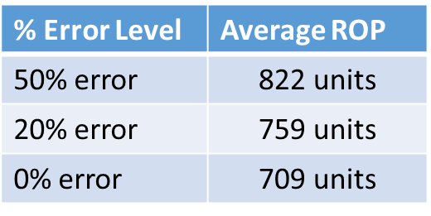
Supply Chain Results – Reorder Points
https://community.sap.com/t5/enterprise-resource-planning-blogs-by-members/automatic-reorder-point-mrp-type-v2-or-vm-planning-part-1/ba-p/13569776
RoP level expressed as monthly average
Red = ROP at 50% error
Blue = ROP at 20% error
Green = ROP at 0% error

Slide 26
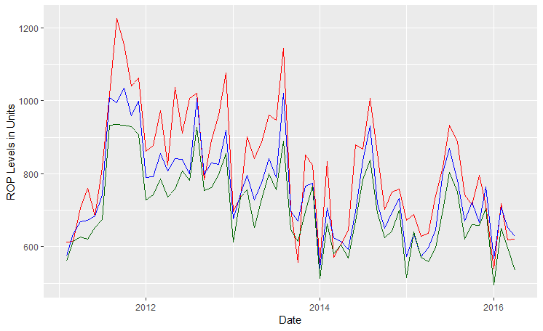
Supply Chain Results – Reorder Points
https://community.sap.com/t5/enterprise-resource-planning-blogs-by-members/automatic-reorder-point-mrp-type-v2-or-vm-planning-part-1/ba-p/13569776
RoP level expressed as monthly average
Red = ROP at 50% error
Blue = ROP at 20% error
Green = ROP at 0% error

Slide 27
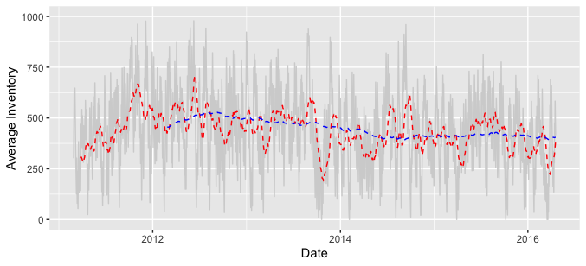
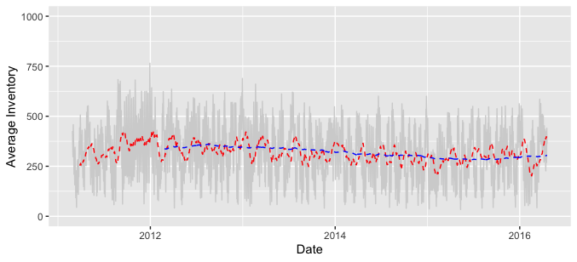
Supply Chain Results – Average Inventory
Average Inventory on hand goes down as accuracy goes up
1% reduction in forecast error ~ 0.8% reduction in Average Inventory on hand
50% error
Average Inventory on hand
% Error Level | Average Inv OH
50% error | 439 units
20% error | 368 units
0% error | 318 units
0% error
Forecast error introduced
Average on hand primarily driven by reorder quantity Q*

Slide 28
Outcome Measures – Backorder Periods
Backorder periods are not well correlated to forecast error
Percent of Periods with Backorders
Forecast Error Perturbation Induced

Slide 29
Outcome Measures – Backorder Quantities
% Error Level | Backorder Quantity
50% error | 1,450 units
20% error | 376 units
5% error | 105 units
0% error | 248 units
Total Backorders Quantity
Backorder quantities seems to increase with forecast error below 5%
Forecast Error Perturbation Induced

Slide 30
Outcome Measures – Backorder Quantity Percentage
% Error Level | Backorder Percentage
50% error | 0.76%
20% error | 0.20%
5% error | 0.06%
0% error | 0.13%
Backorders Percentage
Backorder quantity percentage seems to increase with forecast error below 5%
Forecast Error Perturbation Induced

Slide 31
Outcome Measures – Inventory Holding Costs
% Error Level | Inventory Costs
50% error | $1,128
20% error | $1,057
5% error | $1,021
0% error | $1,007
Annual Inventory Cost
Linear relationship between annual inventory costs and forecast error introduced
$2.45 per every 1% reduction in forecast error
Forecast Error Perturbation Induced

Slide 32
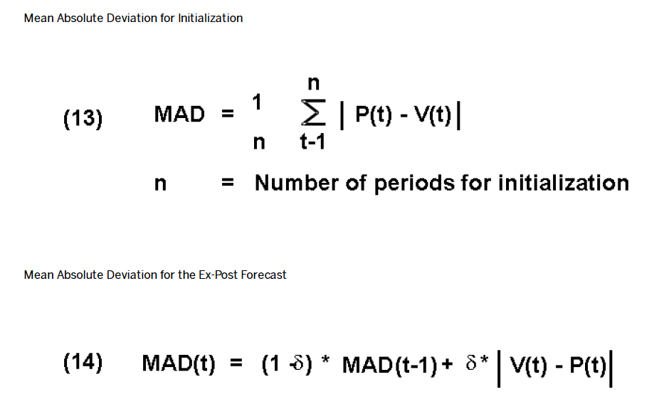
Formulas - MAD
Formulas 13 & 14 from SAP documentation
n >= 4
alpha = 0.2

Slide 33
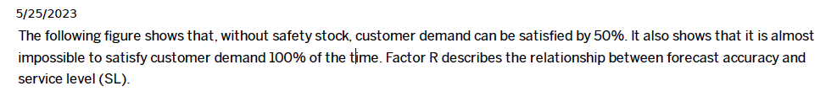
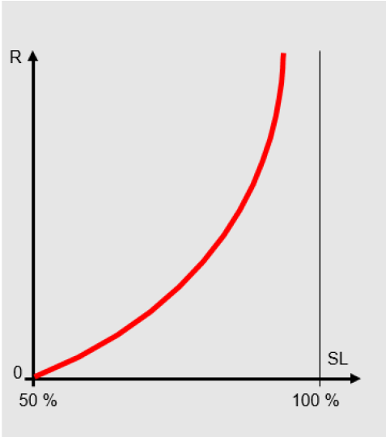
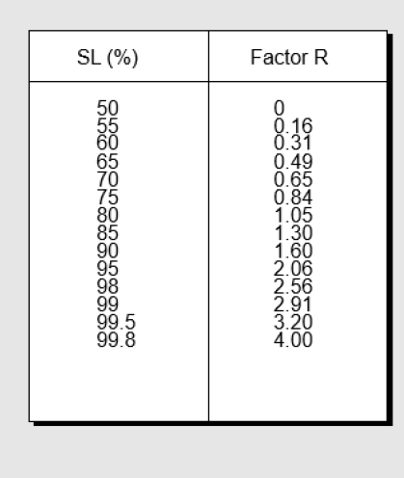
Formulas – Service Level (Look-up Table)
Supports Safety Stock Calculation

Slide 34
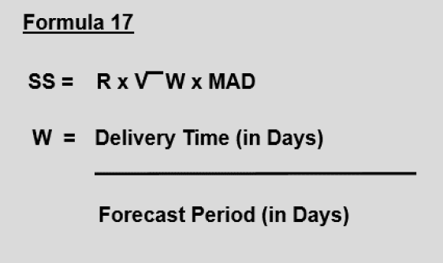
Formulas – Safety Stock
Safety Stock Calculation – Formula 17

Slide 35
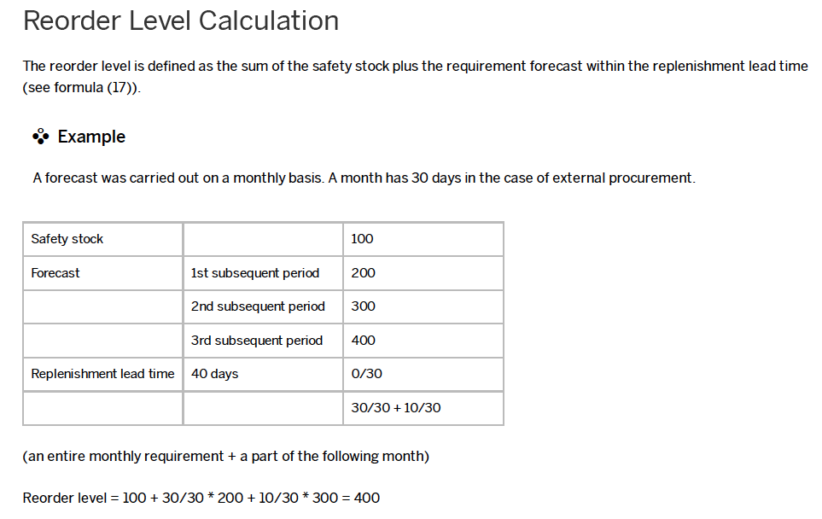
Formulas – Reorder Level (ROP)

Slide 36
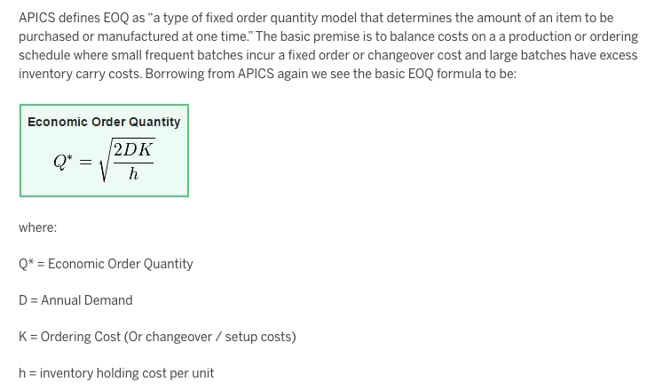
Formulas – Classic Wilson’s EOQ
Blog Post by SAP on calculation of the EOQ - Hyperlink
Calculated monthly using levels update
Note: Other methods for calculating the order quantity in SAP exist (e.g., SAP APO calculation of EOQ and safety stock together using a normal curve). This method requires a substantial amount of knowledge of the system configuration. The Wilson EOQ method is discussed and suggested as a potential setting.

Slide 37
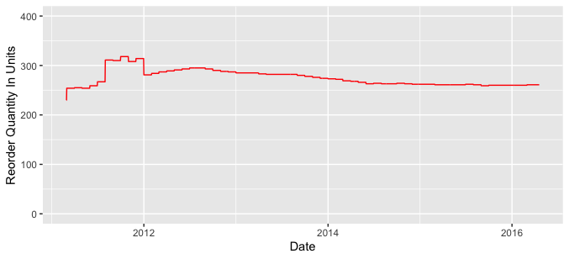
Formulas – EOQ results
ROQ averages 275 units over the simulation period
ROQ = the amount ordered when reorder point is reached
ROQ calculated monthly using Wilson’s EOQ

Slide 38
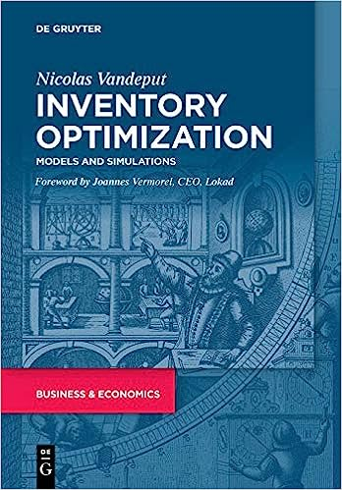
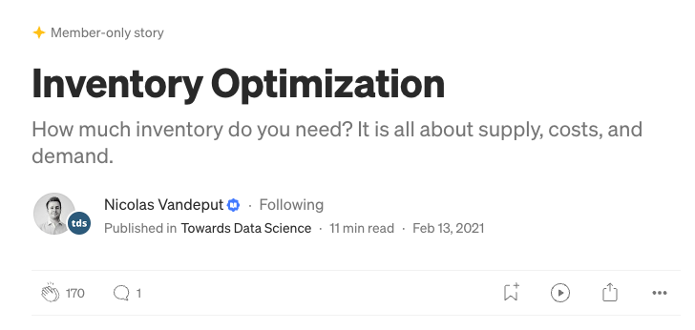
Other References
Thorough article on Medium.com by Nicolas Vandeput on concepts - Hyperlink
Great book by Nicolas Vandeput on setting up simulations - Hyperlink

