Slide 1
Gold Price Prediction using GAN
Leveraging Generative Adversarial Networks for Probabilistic Forecasting

Slide 2
Introduction and Background
Forecasting gold prices using Generative Adversarial Networks (GANs) combines advanced machine learning techniques with the need for accurate financial predictions.

Slide 3
Objective
The project's goal is to forecast gold prices using GANs. These models are adept at capturing complex patterns in financial time series and providing probabilistic forecasts, enhancing accuracy in predictions.

Slide 4
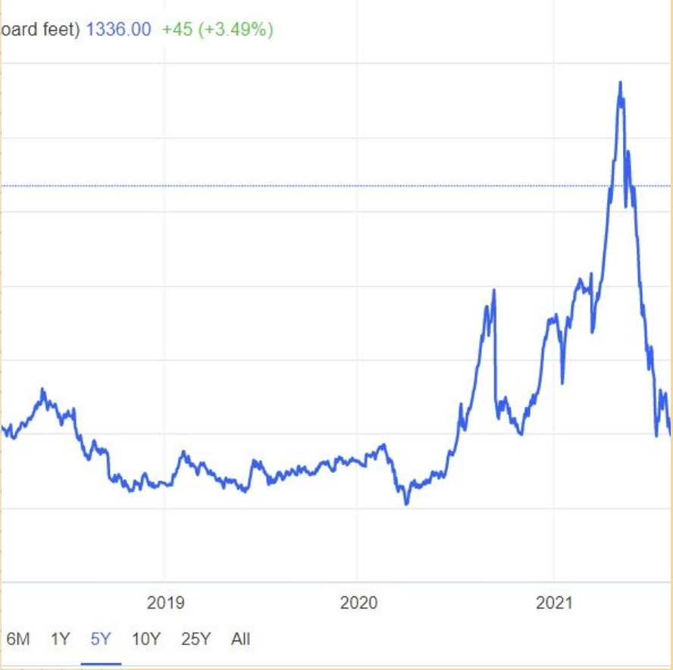
Motivation and Importance
Gold serves as a critical financial asset, utilized as a hedge against inflation and currency fluctuations. Accurate predictions benefit investors and policymakers in making informed decisions in volatile markets.

Slide 5
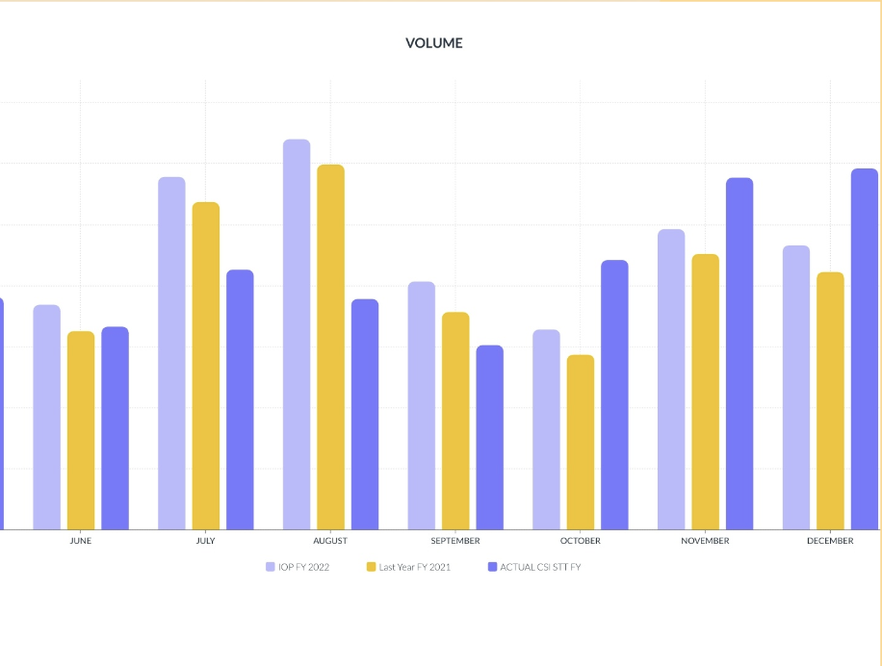
Why GANs for Time Series Prediction?
Traditional models like ARIMA and GARCH face limitations due to rigid assumptions and lack of uncertainty estimates. GANs, in contrast, generate full probability distributions, accommodating non-linear dependencies in time series data.

Slide 6
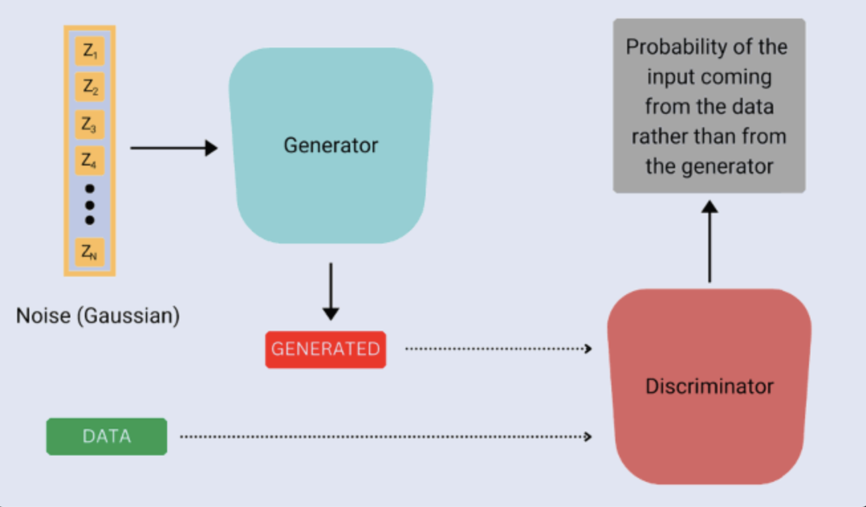
What are GANs?
Generative Adversarial Networks (GANs), introduced by Goodfellow et al. in 2014, comprise two neural networks: a generator that produces synthetic data and a discriminator that evaluates its authenticity against real data.
GANs operate through adversarial training, creating a zero-sum game between the generator and discriminator. This dynamic encourages the generator to refine its outputs based on the discriminator's feedback, facilitating continuous improvement.

Slide 7
Literature Review

Slide 8
Enhancing Stock Return Prediction in the Chinese Market: A GAN-Based Approach (Wu et al., 2025
Key Ideas:
• Proposes a GAN-based model for predicting stock returns in China’s A-share market.
• Integrates LSTM, attention mechanisms, and CNN to handle time dependencies and the low signal-to-noise ratio in financial data.
• The model outperforms traditional approaches (ARIMA, LSTM) in predictive accuracy and generalization.
• Incorporates macroeconomic predictors to improve stability and robustness.
• Highlights the importance of transaction-related and profitability-related predictors in stock return prediction.
Relevance to our Project:
• Demonstrates how GANs can be used for financial forecasting, relevant to gold price prediction.
• Uses LSTM and attention mechanisms, which could be beneficial for modeling time series in gold price prediction.
• Addresses macroeconomic factors, which could also impact gold prices.

Slide 9
Modeling Financial Time-Series with Generative Adversarial Networks (Takahashi et al., 2019)
Key Ideas:
• Introduces a GAN-based approach for modeling financial time-series data.
• Demonstrates how GANs can reproduce stylized facts of financial time series, such as:
• Heavy-tailed distribution of price returns
• Volatility clustering
• Leverage effects
• Coarse-fine volatility correlation
• Gain/loss asymmetry
• Suggests that GANs can generate realistic synthetic financial data, which can be used for forecasting or market simulation.
Relevance to Our Project:
• Emphasizes the importance of capturing stylized facts in financial time series, which could be useful for gold price forecasting.
• Shows how GANs can learn complex market behaviors, making them a strong candidate for gold price modeling.
• Highlights volatility clustering and heavy-tailed distributions, both of which are characteristics of gold price movements.

Slide 10
VGC-GAN: A Multi-Graph Convolution Adversarial Network for Stock Price Prediction (Ma et al., 2024)
Key Ideas:
• Proposes VGC-GAN, a graph-based GAN framework for stock price prediction.
• Uses multi-graph convolutional networks (Multi-GCNs) to model relationships between stocks.
• Combines Gated Recurrent Units (GRUs) and CNNs for time-series forecasting.
• Incorporates Variational Mode Decomposition (VMD) to filter noise and improve predictive accuracy.
• Implements adversarial training with a Wasserstein GAN (WGAN) for better generalization.
Relevance to our Project:
• Introduces a graph-based approach, which might be useful if you consider modeling gold price dependencies on multiple economic factors.
• Uses Wasserstein GAN (WGAN), which is known to be more stable than standard GANs—potentially useful for financial forecasting.
• GRU-based modeling might be an alternative to LSTM for capturing time dependencies in gold prices.

Slide 11
Generative Adversarial Networks for Time Series Simulation
Generative Adversarial Networksin TimeSeries: A Systematic Literature Review
Generating Stock Market Data and Making Predictions Using GAN and Neural Networks
Stock Price Prediction Using TCN-GAN Hybrid Model
Stock Market Prediction Based on Generative Adversarial Network
Cross-modal scenario generation for stock price forecasting using Wasserstein GAN and GCN
Stock market forecasting using DRAGAN and feature matching
Fin-GAN: Forecasting and Classifying Financial Time Series via Generative Adversarial Networks

Slide 12
A Deep Dive into Stock Forecasting: Insights from LSTM, GRU, GAN, and WGAN-GP
WASSERSTEIN GAN: DEEP GENERATION APPLIED ON FINANCIAL TIME SERIES
An Efficient GAN‑Based Multi‑classification Approach for Financial Time Series Volatility Trend Prediction
Predicting Stocks with LSTM-based DRNN and GAN
The Signature-Wasserstein GAN for Time Series Generation and Beyond
Stock Market Prediction on High-Frequency Data Using Generative Adversarial Nets
STOCK MARKET PREDICTION USING GENERATIVE ADVERSARIAL NETWORK (GAN) – STUDY CASE GERMANY STOCK MARKET
Stock Price Forecasting by a Deep Convolutional Generative Adversarial Network

Slide 13
Proposed Design (Methodology)
1. Model Architecture
• Use a Generative Adversarial Network (GAN) for probabilistic forecasting rather than point predictions.
• Implement LSTM-based GAN to capture time dependencies in gold price data.
• Consider using Wasserstein GAN (WGAN) to improve stability and avoid mode collapse.
• Integrate attention mechanisms to focus on significant price patterns.

Slide 14
2. Data Collection & Preprocessing
• Data Sources: Historical gold price data from Yahoo Finance, Bloomberg, or central banks.
• Features to Include:
• Macroeconomic indicators (inflation, interest rates, USD index).
• Market trends (commodity index, stock market trends).
• Technical indicators (moving averages, RSI, Bollinger bands).
• Preprocessing Steps:
• Normalization and scaling.
• Sliding window approach for time-series forecasting.
• Handling missing values and outliers.

Slide 15
3. Training Strategy & Loss Function
• Generator: Predicts future gold prices based on historical patterns.
• Discriminator: Differentiates between real and generated price trends.
• Loss Function:
• MSE (Mean Squared Error) for accuracy.
Economic driven loss function
PnL
• Sharpe Ratio-based loss for financial relevance.
• Standard deviation term to control risk.

Slide 16
4. Evaluation & Benchmarking
• Compare the GAN-based model with ARIMA, LSTM, and traditional ML models.
• Use metrics like RMSE, MAE, Sharpe Ratio, and directional accuracy.
• Backtest on historical data for real-world applicability.

Slide 17
Future Works
1. Enhancing Model Performance
• Hybrid Models: Combine GANs with reinforcement learning or transformers for better predictions.
• Graph-Based Learning: Incorporate Graph Neural Networks (GNNs) to model relationships between gold prices and economic factors.
• Explainability: Improve model interpretability by using attention-based visualizations.
2. Expanding the Scope of Prediction
• Multi-Horizon Forecasting: Extend predictions from daily to weekly/monthly forecasts.
• Portfolio Optimization: Use predicted prices to design an investment strategy.
• Multi-Asset Modeling: Extend the model to other commodities like silver, oil, and cryptocurrency.
3. Real-World Application & Deployment
• Live Market Integration: Develop an API for real-time gold price forecasting.
• Trading Strategy Implementation: Apply model predictions to automated trading algorithms.
• Collaboration with Financial Analysts: Validate the model with expert insights.

