Slide 1
Basic Overview
Client-side local 2 player game of tic tac toe
Displays scores
Standard number of games (3)
Start game button under scores
EVENTUALLY:
Center scoreboard vertically
AI opponent
Online play supported
Customizable number of games
Enter player names
Databased high score board using SQL

Slide 2
UI Controller
Client-side local 2 player game of tic tac toe
Displays scores
Standard number of games (3)
Data Controller
Controller Module
Display scores
Display current player
Display selected square
Display/restart round counter upon start new game
Player Assignments
Assign game piece (X or O) to players
Random generator to choose who goes first
Is winner
Score comparison
Round winner
Game winner
Round counter
Game over
Event handler for
Click on square
Start New Game button

Slide 3
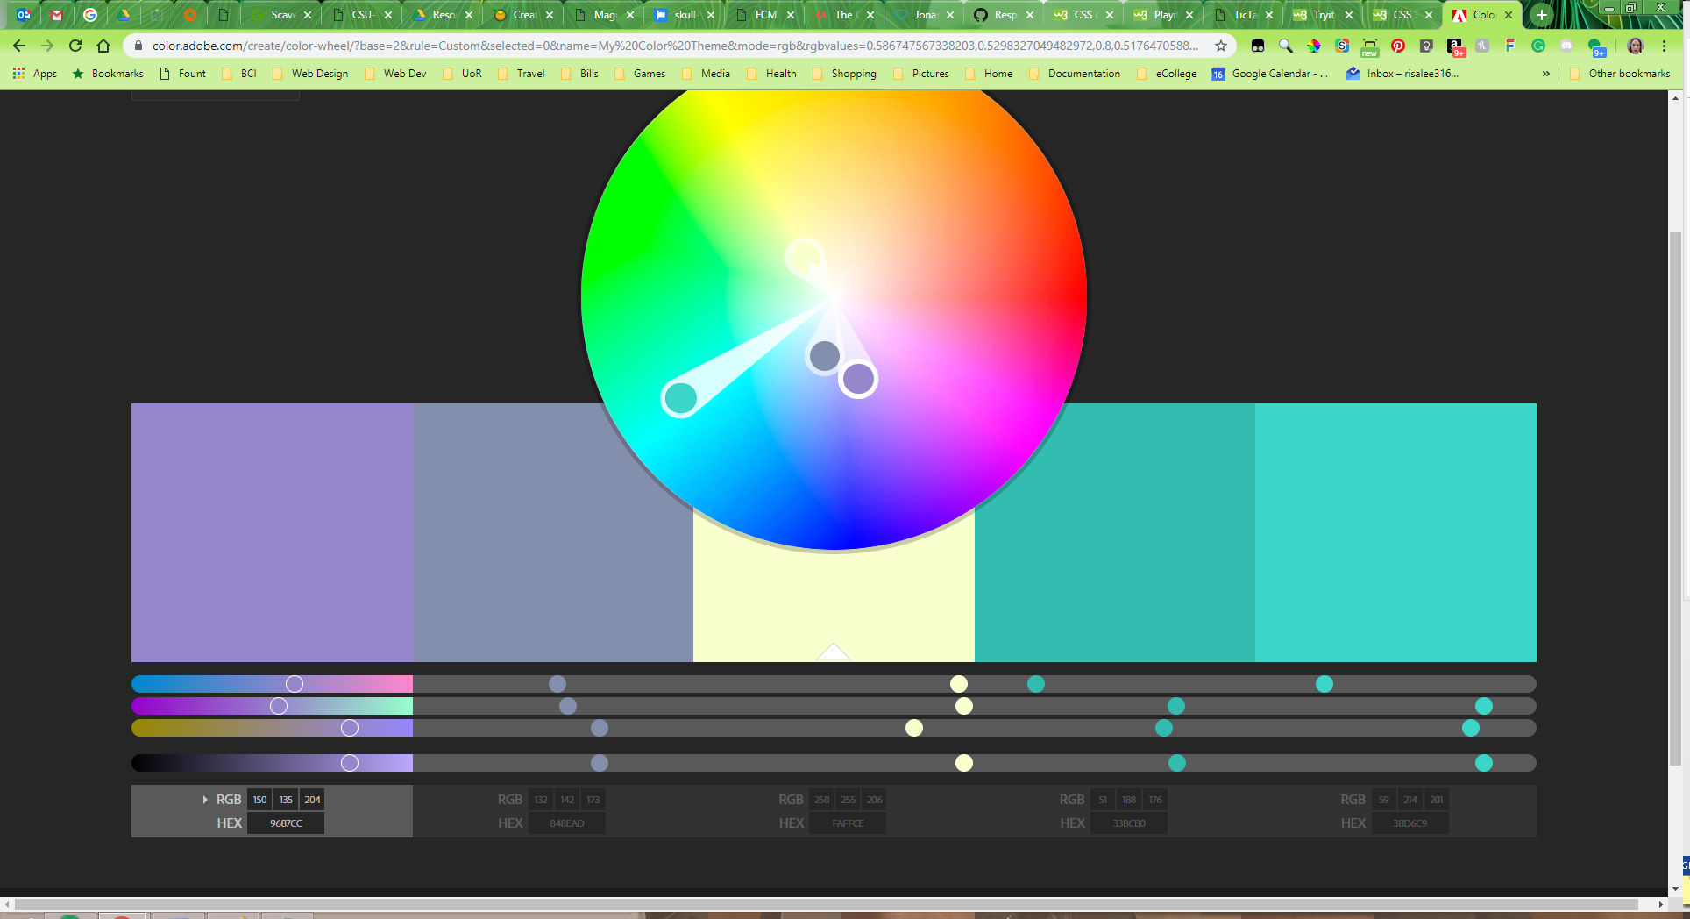

Slide 4
UI Controller
Controller Module
Data Controller
mainView.js
Main.js
AIsingle.js
index.js
scoreBoardView.js
ScoreBoard.js
base.js
OnlineMulti.js

