Slide 1
Big Mountain Resort Ticket Strategy
Modeled and Presented By Hope Frost Guided by Springboard

Slide 2
Big Mountain resort’s problem
The new chair lift increased operations cost by 1,500,00 last season. Looking to increase income to balance the new cost, the ticket pricing strategy and optimal use of facilities has been called into question.
Current Ticket price is $81

Slide 3
Big Mountains current ticket price challenge
Big mountain’s ticket price comes in just above the average for US ski resorts.
The state of Montana has a limited scope for ticket price putting Big Mountain at the top of the price bracket.
The price of tickets in Montana is an indicator that Big Mountain should proceed with caution as they implement their new ticket pricing strategy.

Slide 4
Big Mountain should increase the vertical drop by 150 feet and install an additional chair lift.
Benefits:
•Increase three of the features that most affect higher ticket price.
•Cover the increase in operations cost from last season
•Cover expected addition of the new chair •Allow time to build money for next steps
While opening the new features would be a good time to raise the ticket price to: $98.
In future adding 4 Snow Making AC units could be considering. Spreading updates out can create another step in raising the ticket price even close to expected value.

Slide 5
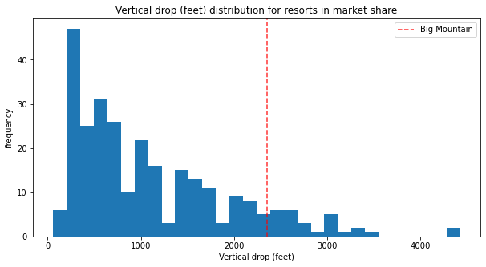
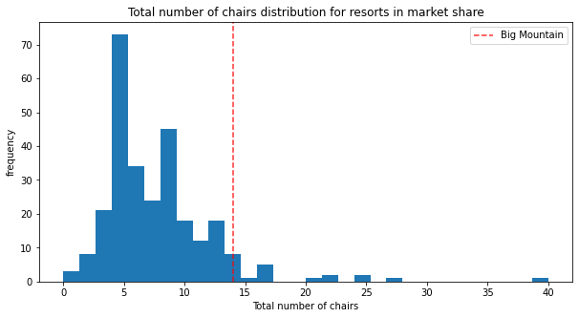
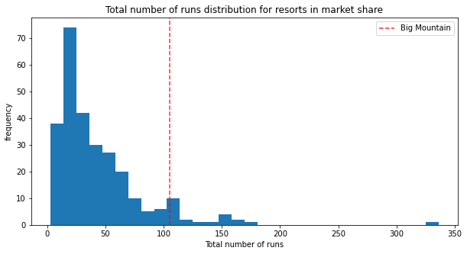
The proposed plan would increase Big Mountain Resorts vertical drop by 150 ft , add one chair lift and open a new run.
Since these updates increase Big Mountain’ resort’s expected ticket price by $23.48 from the current price, it could be the catalyst for advertising as they increase the ticket price. This may keep volume of visitors stedy and justify the budget for construction and increased operations cost.
To the left the charts show Big mountains current placement on each of these key features.

Slide 6
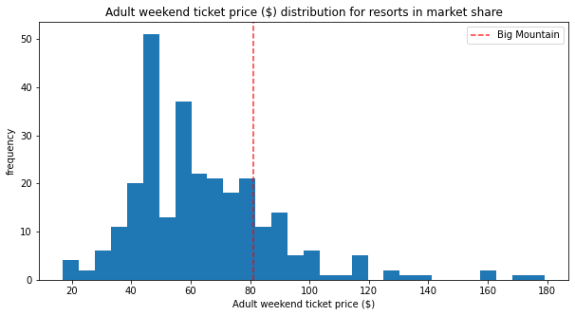
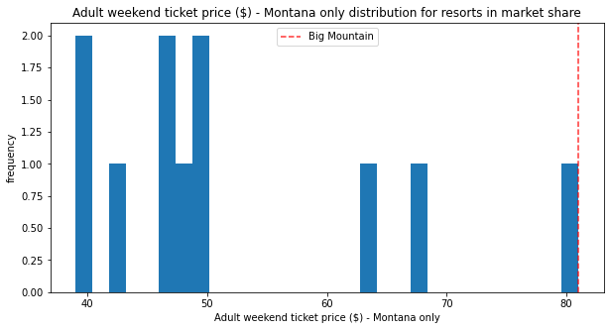
Big Mountain Resort’s
New ticket Price effect:
Will reasonably widens the gap between ticket prices in Montana
Place price average within $10.39 error window of our model
Be more intune with expected facilities value
Figures indicate Big Mountain resorts current price within the market

Slide 7
In the next season see
$29,750,000
increase in ticket revenue

