Slide 1

Cross-Platform User Interface with Xamarin Forms
Joseph Christopher Cadag
Jr. Mobile App Developer at Tianggee

Slide 2
UI Views in Xamarin Forms
Button
Entry
Image
Slider
Picker
BoxView
StackLayout
Grid
ListView
CollectionView, etc

Slide 3
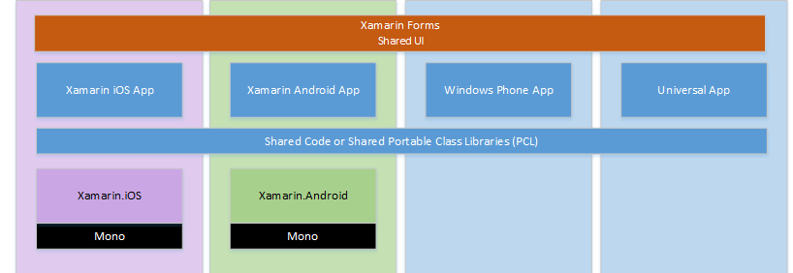
Hierarchy of Xamarin Forms UI

Slide 4
Effects?
Effects allow the native controls on each platform to be customized, and are typically used for small styling changes

Slide 5
Custom Renderers?
Xamarin.Forms user interfaces are rendered using the native controls of the target platform, allowing Xamarin.Forms applications to retain the appropriate look and feel for each platform. Custom Renderers let developers override this process to customize the appearance and behavior of Xamarin.Forms controls on each platform.

Slide 6
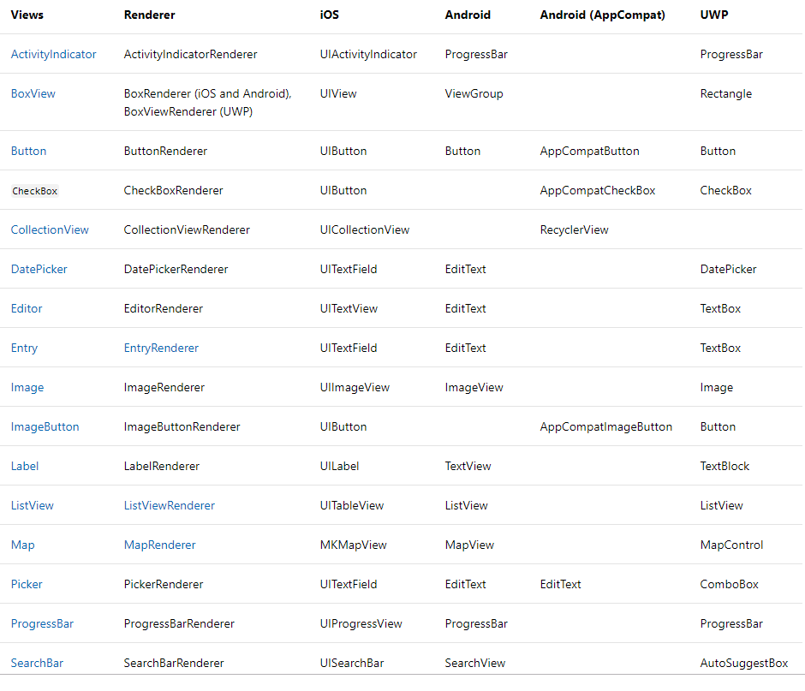
Forms UI to Native

Slide 7




Tools for Designing UI

Slide 8
DEMO

Slide 9

Questions?

