Slide 1



Journey from Being a Java Dev to a Net Dev
Joseph Christopher Cadag
Junior Mobile App Developer at Tianggee
Joseph Christopher Cadag
josephcadag

Slide 2
Ways to Access Android/Java Library
Create a Bindings Library that automatically wraps the library with C# wrappers so you can invoke Java code via C# calls.
Use the Java Native Interface (JNI) to invoke calls in Java Library code directly. JNI is a programming framework that enables Java code to call and be called by native applications or libraries.

Slide 3
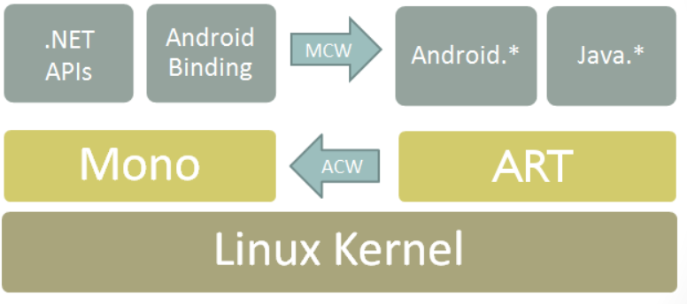
Xamarin Android Architecture

Slide 4
Binding a Java Library
Java Bindings library
Make the APIs in the .JAR file available to C# code through automatically-generated code wrappers.
Wraps one or more existing Java libraries into an assembly that you can link in to application.
Managed Callable Wrappers (MCW)
Used by Xamarin Android to implement bindings
Provide support for subclass Java types and for overriding virtual methods on Java types.

Slide 5
Demo

Slide 6
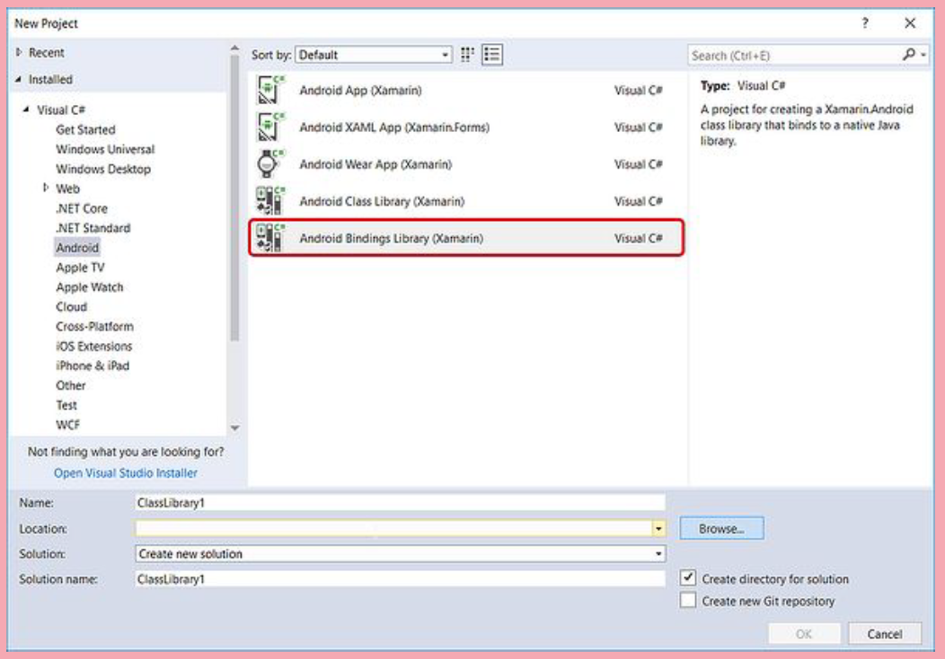
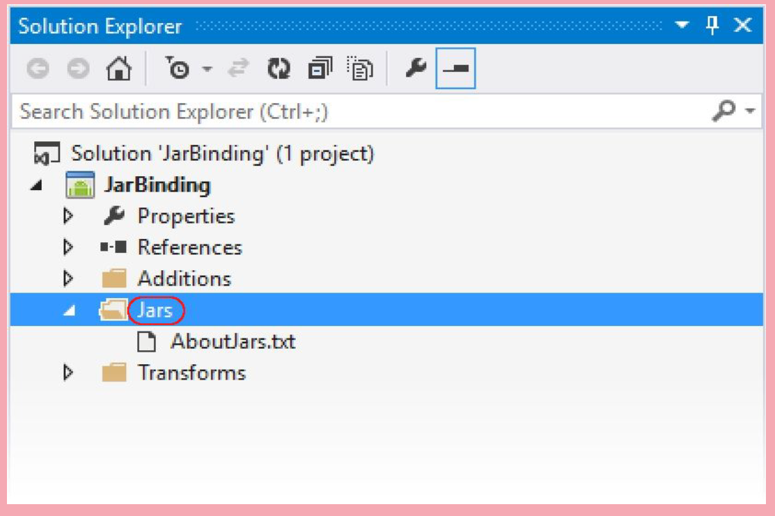
Creating the Binding Library
1
2
In Visual Studio for Mac or Visual Studio, create a new Solution and select the Android Bindings Library template.
The template includes a Jars folder where you add your .JAR(s) to the Bindings Library project. Right-click the Jars folder and select Add > Existing Item.

Slide 7
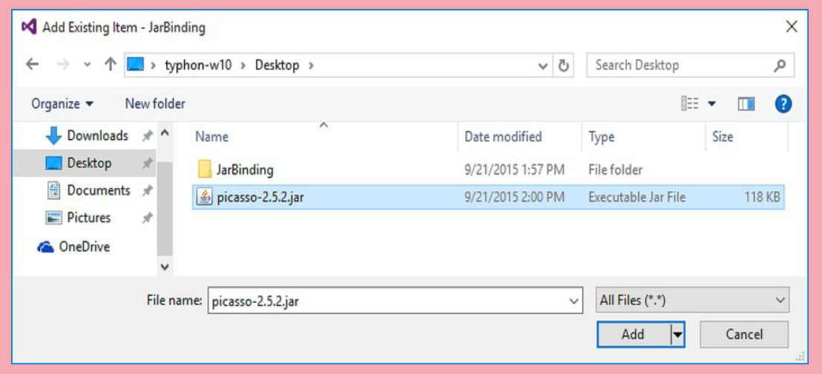
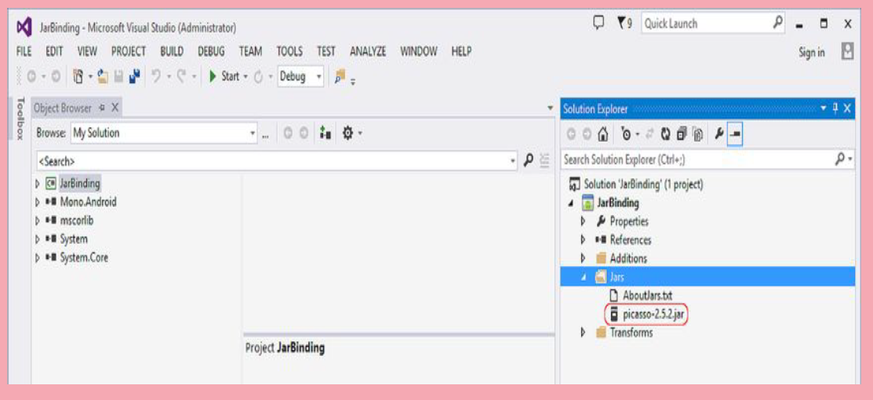
Creating the Binding Library
3
4
Navigate to the .jar file, select it and
click Add.
Verify that the .jar file was
successfully added to the project.

Slide 8
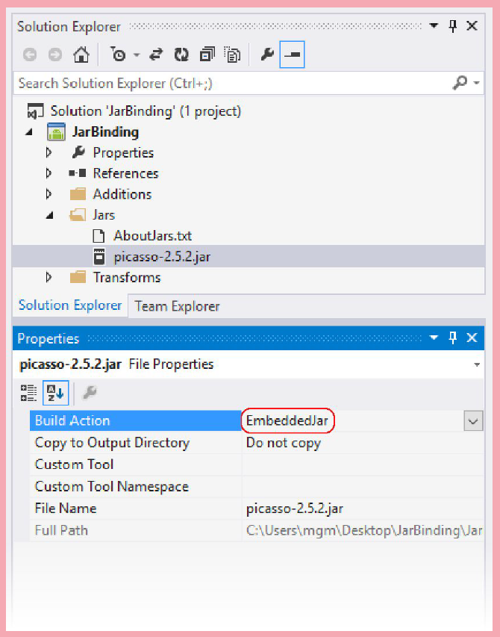
Creating the Binding Library
5
Set the build action to EmbeddedJar.
Right-click the .jar file and select Properties > Build Action.
EmbeddedJar – the JAR will be embedded in the Bindings Library
InputJar – the JAR will be kept separate from the Bindings Library

Slide 9
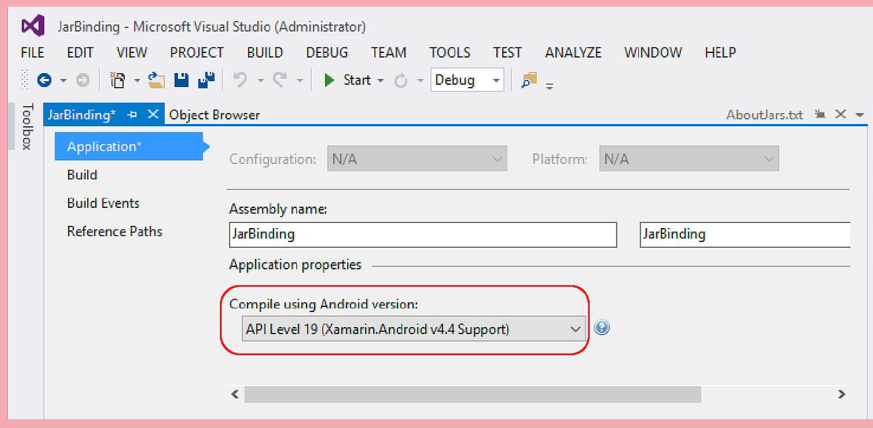
Creating the Binding Library
6
Set the target API level for your Bindings Library
7
Finally, build the Bindings Library. Bindings Library project should build successfully and produce an output .DLL at the following location: JarBinding/bin/Debug/JarBinding.dll

Slide 10

Thank you!

