Slide 1

Final PROJECT – informatica industriale
Group 2:
Mattia Vincenzi (860579)
Francesco Porto (816042)
Link to GitHub repository: https://github.com/HopedWall/LightControlSystem

Slide 2
OUTLINE
Introduction
Symbol
I/O ports
Top-view block scheme
Internal signals
VHDL Design of all stages
Simulation results
Conclusion

Slide 3
OUTLINE
Introduction
Symbol
I/O ports
Top-view block scheme
Internal signals
VHDL Design of all stages
Simulation results
Conclusion

Slide 4
Introduction
Initial assumptions:
Red will be modulated along with Green
(i.e. setting MOD12 makes both Red and Green last 12 seconds)
We decided to add an initial OFF state
It can only be left by setting the MAINTENANCE state
A FAULT signal has been added to report errors (due to setting conflicting inputs)
We decided to set the clock period to 1 sec (1 Hz)
However, for testing purposes, we set it to 20 ns
Simulating a 1 sec clock period with ModelSim was too expensive
Notes:
Periodo di clock ad 1 secondo perché le luci devono essere modulate in termini di secondi, periodo minimo necessario per le luci

Slide 5
OUTLINE
Introduction
Symbol
I/O ports
Top-view block scheme
Internal signals
VHDL Design of all stages
Simulation results
Conclusion

Slide 6
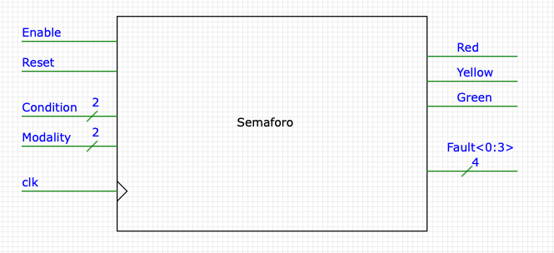
SYMBOL

Slide 7
OUTLINE
Introduction
Symbol
I/O ports
Top-view block scheme
Internal signals
VHDL Design of all stages
Simulation results
Conclusion

Slide 8
I/O Ports
Name | Direction | Resolution | Comment
Enable | Input | 1 | Active High, Synchronous.
Reset | Input | 1 | Active Low, Asynchronous.
Condition | Input | 2 | 00 -> Maintenance 01 -> Nominal 11 -> Standby 10 not used
Modality | Input | 2 | 00 -> MOD5 01 -> MOD12 11 -> MOD15 10 not used
Clk | Input | 1
Notes:
Con <= 4 stati anche con Gray abbiamo comunque unwanted states

Slide 9
I/O Ports
Name | Direction | Resolution | Comment
Red | Output | 1
Yellow | Output | 1
Green | Output | 1
Fault | Output | 4 | 0000 -> Enable is set to 0 0001 -> Everything working correctly 0010 -> Condition error 0100 -> Modality error 1000 -> Condition AND Modality error
Notes:
Non abbiamo usato Gray perché in FD c’è un decoder

Slide 10
OUTLINE
Introduction
Symbol
I/O ports
Top-view block scheme
Internal signals
VHDL Design of all stages
Simulation results
Conclusion

Slide 11
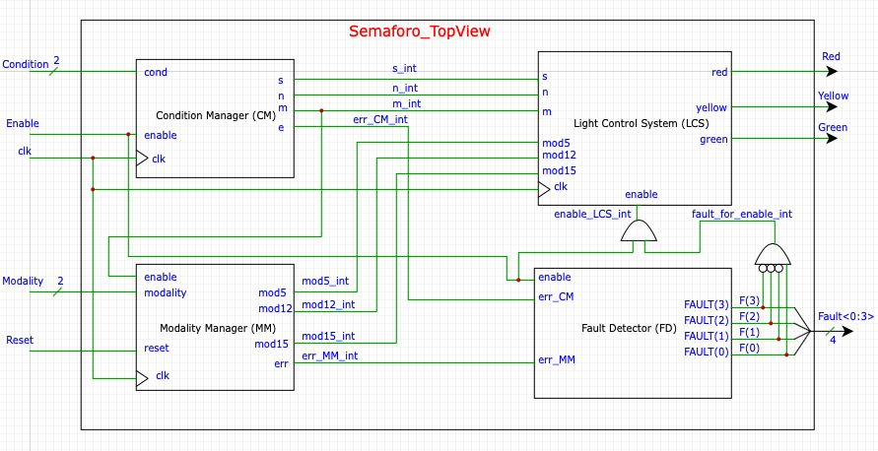
TOP-VIEW BLOCK SCHEME
(Link to code: SemaforoTopView.vhdl)
Notes:
Dire a voce da qualche parte che l'LCS è attivo se non c'è FAULT e se enable generale attivo.

Slide 12
OUTLINE
Introduction
Symbol
I/O ports
Top-view block scheme
Internal signals
VHDL Design of all stages
Simulation results
Conclusion

Slide 13
INTERNAL SIGNALS
Name | Resolution | Comment
mod5_int | 1 | Connects MM and LCS. It is 1 when mod5 is set.
mod12_int | 1 | Connects MM and LCS. It is 1 when mod12 is set.
mod15_int | 1 | Connects MM and LCS. It is 1 when mod15 is set.
err_MM_int | 1 | Connects MM and FD. It is 1 when the input modality is 10.
m_int | 1 | Connects CM and LCS. It is 1 when MAINTENANCE is set.
n_int | 1 | Connects CM and LCS. It is 1 when NOMINAL is set.
s_int | 1 | Connects CM and LCS. It is 1 when STANDBY is set.
err_CM_int | 1 | Connects CM and FD. It is 1 when the input condition is 10.
fault_for_enable_int | 1 | It is 1 when FAULT is 0001 (everything works correctly)
enable_LCS_int | 1 | Enables LCS. It is 1 iff fault_for_enable_int AND (global) Enable.

Slide 14
OUTLINE
Introduction
Symbol
I/O ports
Top-view block scheme
Internal signals
VHDL Design of all stages
Simulation results
Conclusion

Slide 15
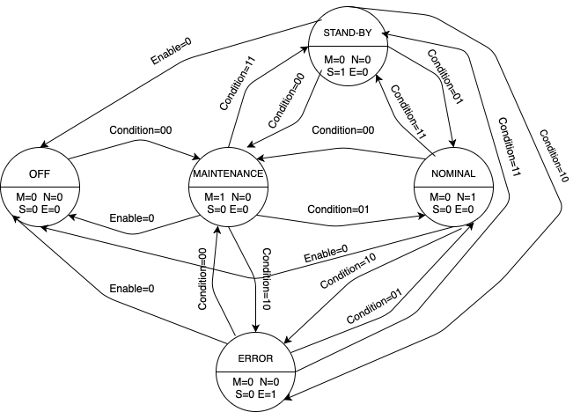
CONDITION MANAGER
(Link to code: ConditionManager.vhdl)
It is a Moore FSM
The starting state is OFF, which can be left only by setting Condition to 00, thus entering the MAINTENANCE state
OFF can be reached again only by setting Enable=0 from each state
Gray code has been used to minimize transitions to a unwanted states
Note: We omitted the loops when ENABLE=1 or when the condition remains the same for the sake of clarity

Slide 16
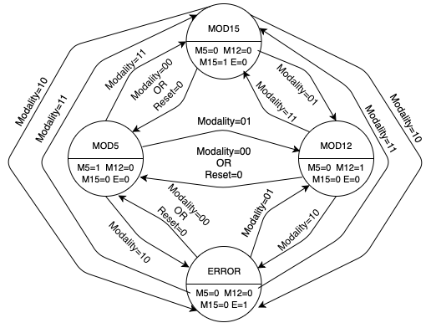
MODALITY MANAGER
(Link to code: ModalityManager.vhdl)
It is a Moore FSM
The starting state is MOD5
The modality can only be changed when the circuit is in the MAINTENANCE state
Otherwise the circuit ignores the modality change
When Reset is set to 0 (Active Low) the FSM returns to MOD5
Note: We omitted the loops when RESET=1 or when the modality remains the same for the sake of clarity

Slide 17
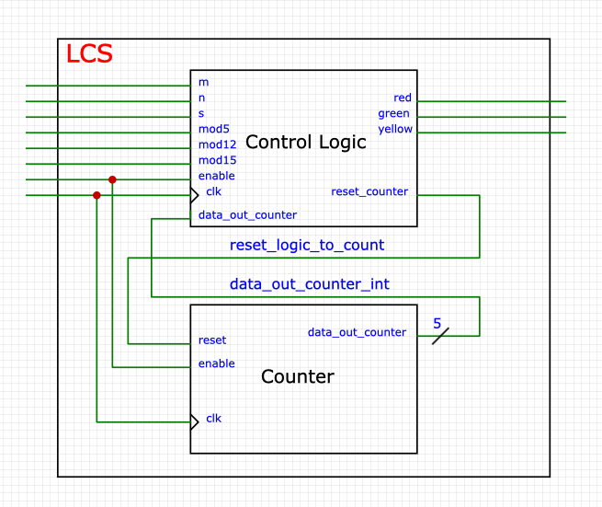
LIGHT CONTROL SYSTEM
(Link to code: LightControlSystem.vhdl)
It is made by two sub-components:
Control Logic: a process that sets the lights according to the current condition and modality.
Counter (w/ Reset): a simple counter that keeps track of time
By using both components, it is possible to handle the timings for the three lights
The two components cooperate as follows:
The Control Logic can reset the Counter
The Counter is read by the Control Logic

Slide 18
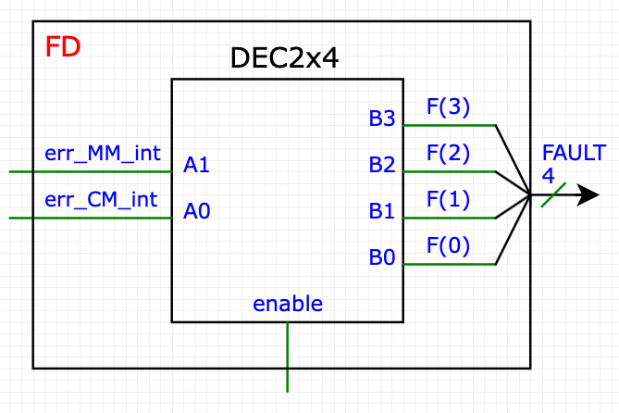
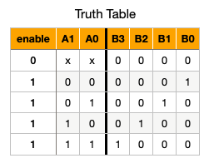
Fault Detector
(Link to code: FaultDetector.vhdl)
Detects whether or not the circuit is working correctly
Takes as input the error bit from CM and MM
Uses a 2x4 Decoder for returning a bit sequence that represents the error type
It is a combinatory component
When an error is found, the Enable for the LCS is set to 0

Slide 19
OUTLINE
Introduction
Symbol
I/O ports
Top-view block scheme
Internal signals
VHDL Design of all stages
Simulation results
Conclusion

Slide 20
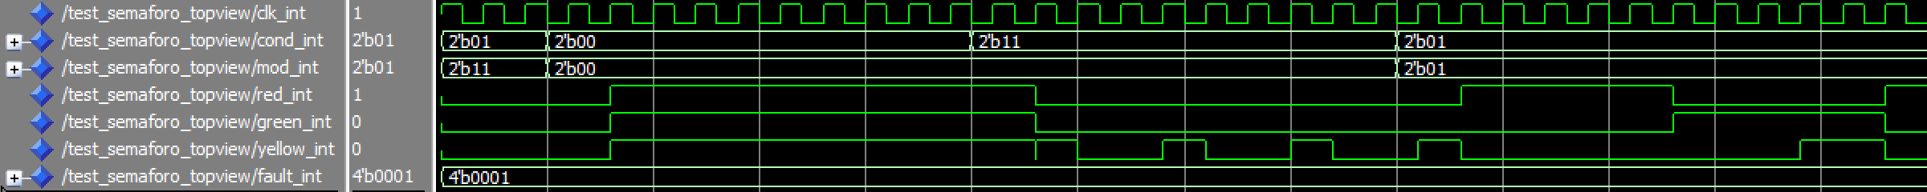
SIMULATION RESULTS
Scenario #1: Everything working correctly
OFF

Slide 21
SIMULATION RESULTS
Delay between internal state change and lights update
Notes:
Delay nella simulazione potrebbe essere dovuto al fatto che si usano due compoennti sincrone una dopo l'altra. La prima sul fronte di salita porta il segnale in output sull'uscita parziale, la seconda sull'altro fronte di salita la porta in output finale, cioè le luci.

Slide 22
SIMULATION RESULTS
MAINTENANCE

Slide 23
SIMULATION RESULTS
STANDBY

Slide 24
SIMULATION RESULTS
NOMINAL (MOD-5)

Slide 25
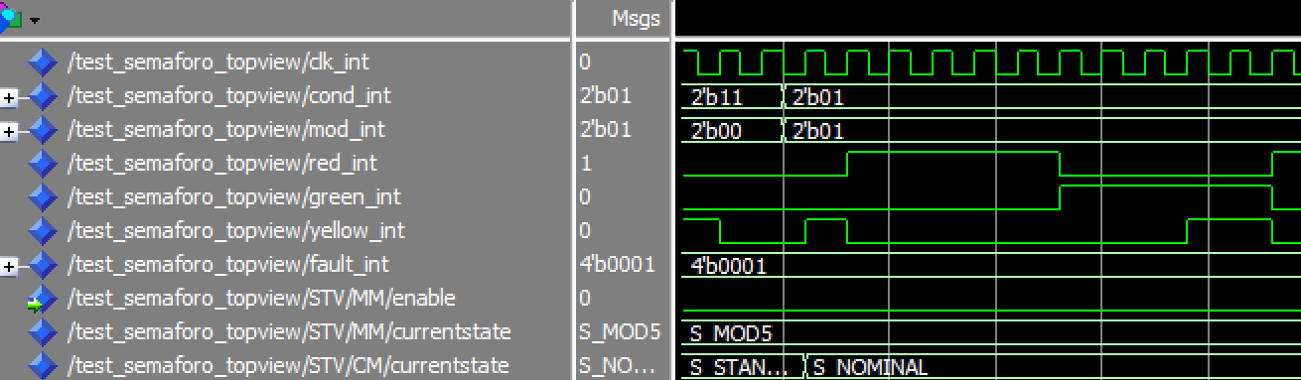
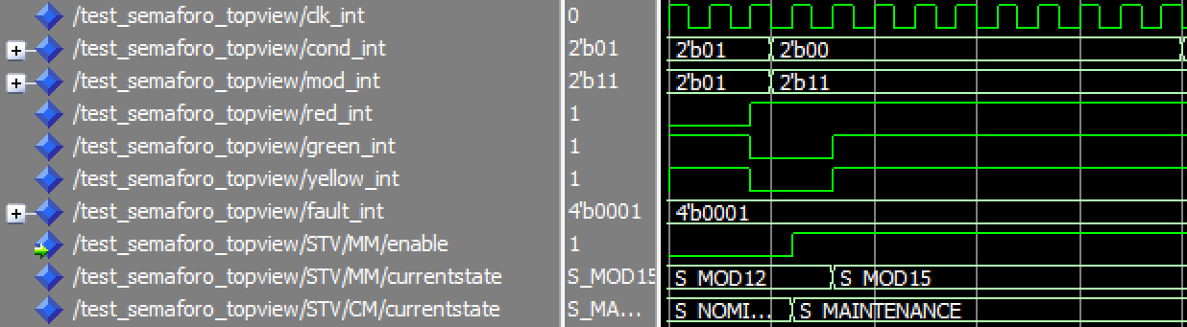
SIMULATION RESULTS
The modality does not change since the traffic light is not in the MAINTENANCE state, therefore the Enable for Modality Manager is 0
The modality does change since the traffic light is in the MAINTENANCE state, therefore the Enable for Modality Manager is 1

Slide 26
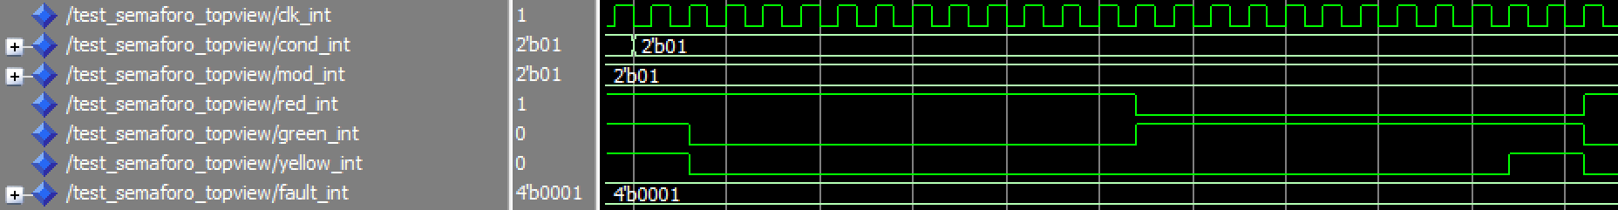
SIMULATION RESULTS
NOMINAL (MOD-12)

Slide 27
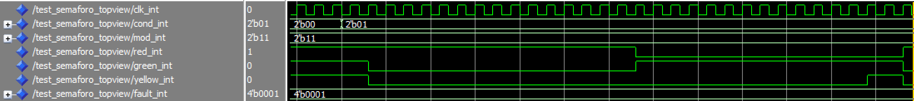
SIMULATION RESULTS
NOMINAL (MOD-15)

Slide 28
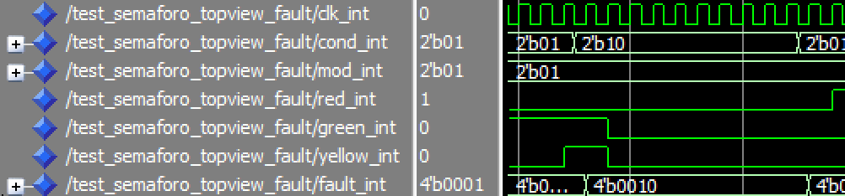
SIMULATION RESULTS
Scenario #2: FAULT Configuration
10 is an invalid input Condition, so Fault is set to 0010 that represents this type of error
Lights are turned off until a valid Condition is set

Slide 29
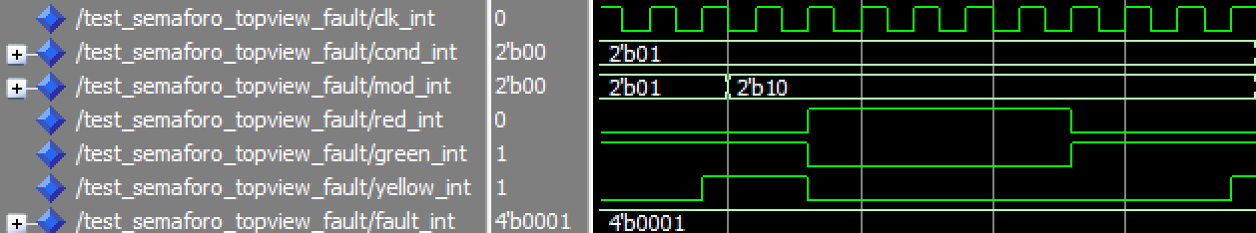
SIMULATION RESULTS
10 is an invalid input Modality, but it is ignored because the modality cannot be changed since the traffic light is not in the MAINTENANCE state

Slide 30
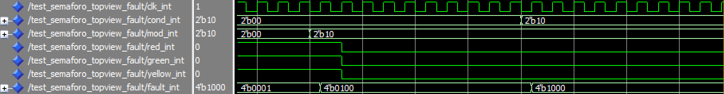
SIMULATION RESULTS
10 is an invalid input Modality, so Fault is set to 0010 that represents this type of error.
This is detected because the traffic light is in the MAINTENANCE state and therefore the Modality can be modified.
Lights are turned off until a valid Condition is set
Notes:
Ogni condizione va bene, non deve necessariamente essere MAINTENANCE (vedi fsm)

Slide 31
SIMULATION RESULTS
10 is an invalid input Condition
10 is an invalid input Modality
Fault is set to 1000 that represents an error on both
Lights are turned off until a valid Condition is set

Slide 32
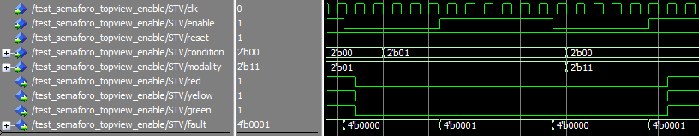
SIMULATION RESULTS
Scenario #3: Enable
ENABLE:
Active High
Synchronous
All lights are off and it is not sensitive to condition changes
When ENABLE becomes 1 the OFF condition can be changed only by setting MAINTENANCE

Slide 33
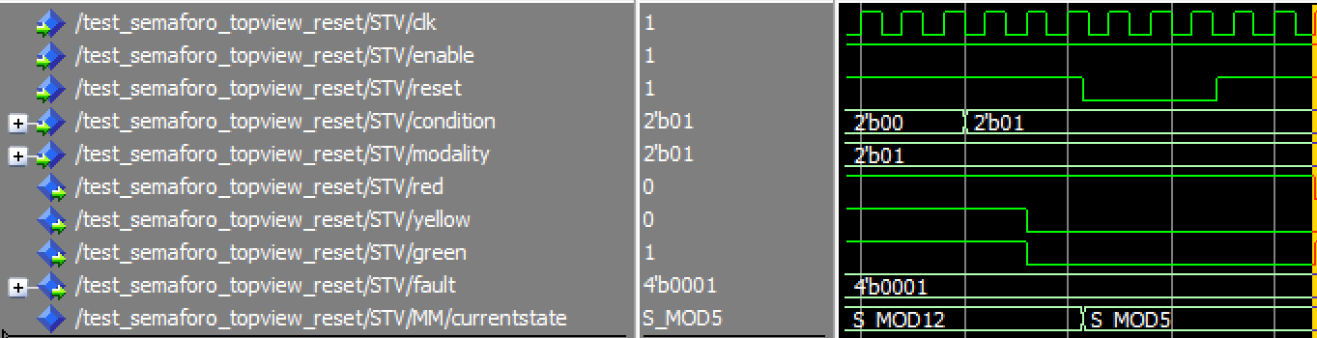
SIMULATION RESULTS
Scenario #4: Reset
RESET:
Active Low
Asynchronous
When RESET becomes 0 the modality becomes MOD5

Slide 34
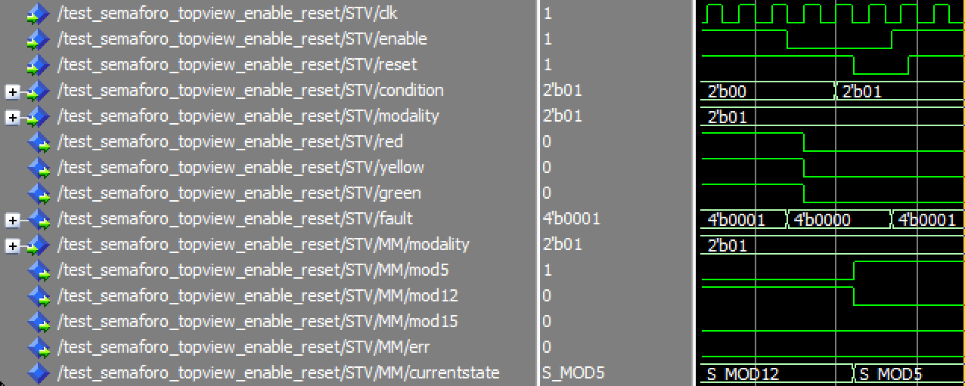
SIMULATION RESULTS
Scenario #5: Enable and Reset
RESET (Asynchronous) is prioritary over ENABLE (Synchronous)
ENABLE = 0 makes the circuit insensitive to external signals and turns all the lights off
But when RESET = 0, the modality changes nonetheless

Slide 35
OUTLINE
Introduction
Symbol
I/O ports
Top-view block scheme
Internal signals
VHDL Design of all stages
Simulation results
Conclusion

Slide 36
Conclusion
Starting by the top-view block scheme, each component has been implemented in VHDL
Each entity has been tested independently with its own testbench, before being connected
As shown by the simulation results, and according to the initial assumptions, the circuit works as expected

Slide 37
OUTLINE
Introduction
Symbol
I/O ports
Top-view block scheme
Internal signals
VHDL Design of all stages
Simulation results
Conclusion

