Slide 1

PROGETTO INFORMATICA INDUSTRIALE
Gruppo 2:
Mattia Vincenzi (860579)
Francesco Porto (816042)

Slide 2
OUTLINE
Introduction
Symbol
I/O ports
Top-view block scheme
Internal signals
VHDL Design of all stages
Simulation results
Conclusion

Slide 3
OUTLINE
Introduction
Symbol
I/O ports
Top-view block scheme
Internal signals
VHDL Design of all stages
Simulation results
Conclusion

Slide 4
Introduction
Initial assumptions:
Red will be modulated along with Green
(i.e. setting MOD12 makes BOTH Red and Green last 12 seconds)
OFF state which can exited only by setting the MAINTENANCE state
A FAULT signal has been added to report errors (due to setting conflicting inputs)
We decided to set the clock period to 1 sec (1 Hz)
However, for testing purposes, we set it to 20 ns.
Simulating a 1 sec clock with ModelSim was too expensive.

Slide 5
OUTLINE
Introduction
Symbol
I/O ports
Top-view block scheme
Internal signals
VHDL Design of all stages
Simulation results
Conclusion

Slide 6
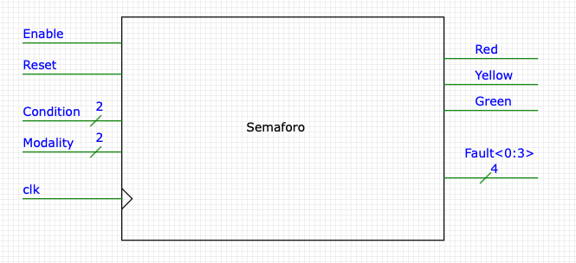
SYMBOL

Slide 7
OUTLINE
Introduction
Symbol
I/O ports
Top-view block scheme
Internal signals
VHDL Design of all stages
Simulation results
Conclusion

Slide 8
I/O Ports
Name | Direction | Resolution | Comment
Enable | Input | 1 | Active High, Synchronous.
Reset | Input | 1 | Active Low, Asynchronous.
Condition | Input | 2 | 00 -> Maintenance 01 -> Nominal 11 -> Standby 10 not used
Modality | Input | 2 | 00 -> MOD5 01 -> MOD12 11 -> MOD15 10 not used
Clk | Input | 1

Slide 9
I/O Ports
Name | Direction | Resolution | Comment
Red | Output | 1
Yellow | Output | 1
Green | Output | 1
Fault | Output | 4 | 0000 -> Enable is set to 0 0001 -> Everything working correctly 0010 -> Condition error 0100 -> Modality error 1000 -> Condition AND Modality error

Slide 10
OUTLINE
Introduction
Symbol
I/O ports
Top-view block scheme
Internal signals
VHDL Design of all stages
Simulation results
Conclusion

Slide 11
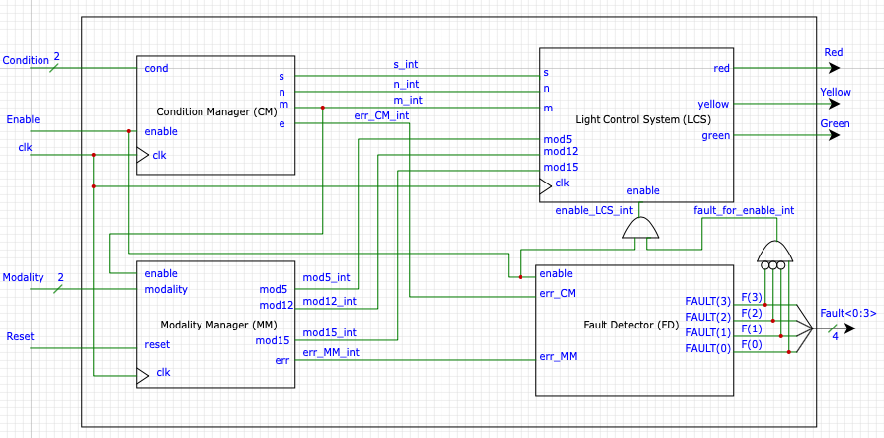
TOP-VIEW BLOCK SCHEME

