Slide 1

Architecture for reddit data analysis – scalability analysis
Project for the large scale data management course
Francesco Porto 816042 Mattia Vincenzi 860579

Slide 2
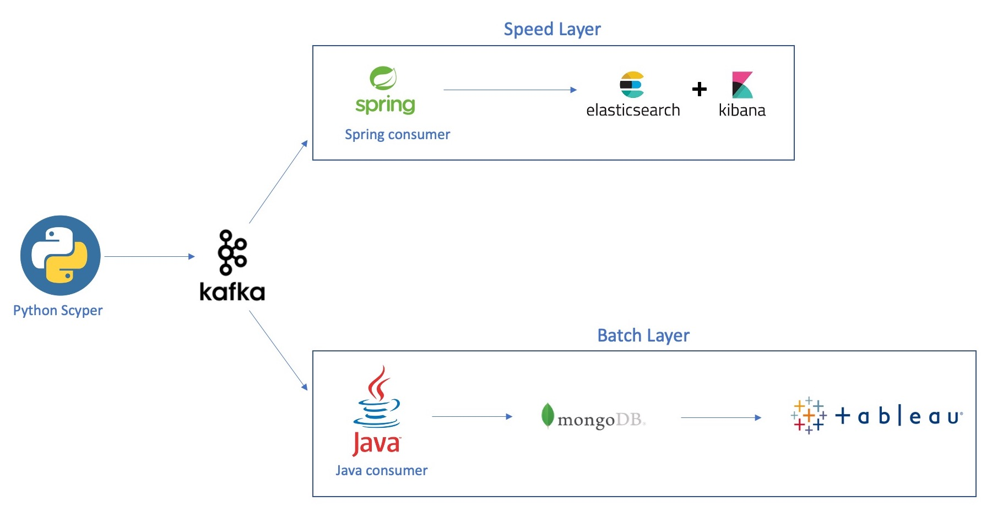
Recap - Architecture
Lambda Architecture:
Scryper
Apache Kafka
Speed Layer
Spring Consumer
Elasticsearch
Kibana
Batch Layer
Java Consumer
MongoDB
Tableau

Slide 3
Scalability problems
Project problems:
What’s the amount of data managed by the application?
We have chosen wallstreetsbets subreddit because there are more active users, thus more overall messages.
Previously we used the destinythegame subreddit.
How does the application behave when the load increases? (Scalability)
What are the bottlenecks?
How can we address these problems?

Slide 4
Comparison between subreddits
 | destinythegame | wallstreetsbets
Subscribed users as of 27/03/2021 | 2’038’100 | 9’670’987
Monitored threads (updates) ~ 6 hour | 210 (16883) | 196 (24042)
Monitored comments (updates) ~ 6 hour | 2516 (18214) | 11933 (38792)
Monitored users (updates) ~ 6 hour | 2084 (72176) | 8631 (97134)
The number of monitored threads is higher in destinythegame, this is because in wallstreetsbets the hottest threads stay in this state for more time.
However, all the other numbers are much higher for wallstreetsbets.

Slide 5
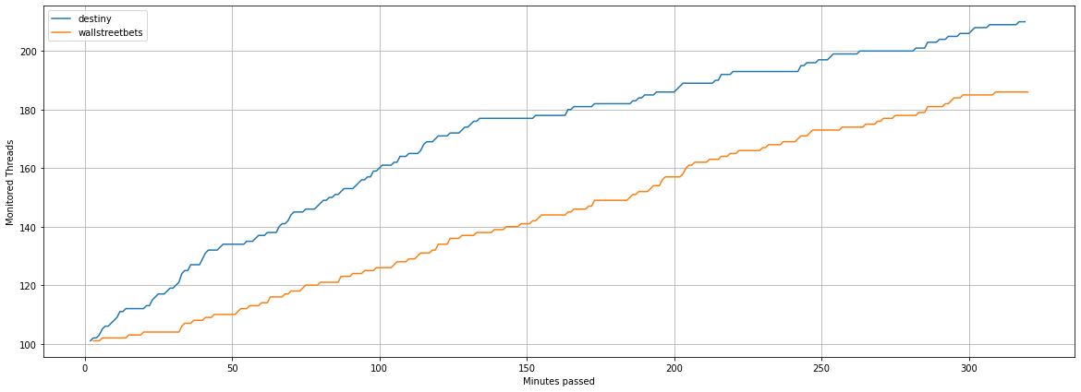
COMPARISON - THREADS

Slide 6
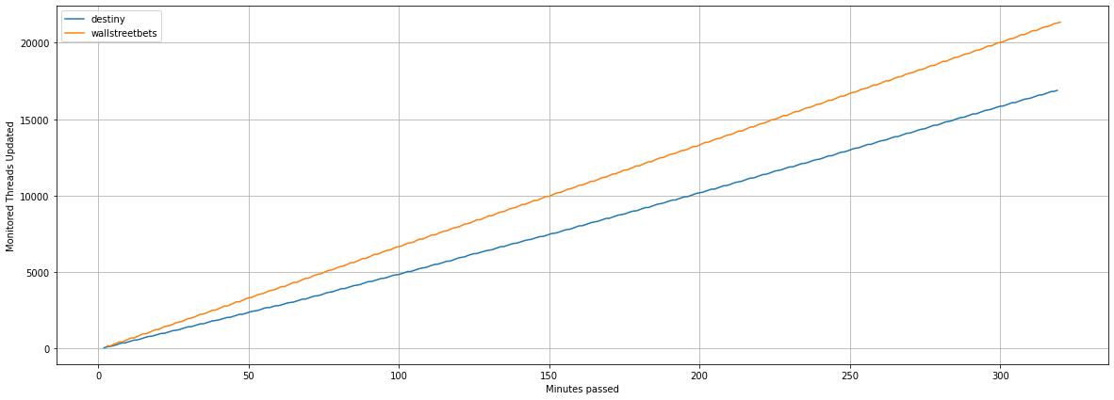
COMPARISON THREADS UPDATED

Slide 7
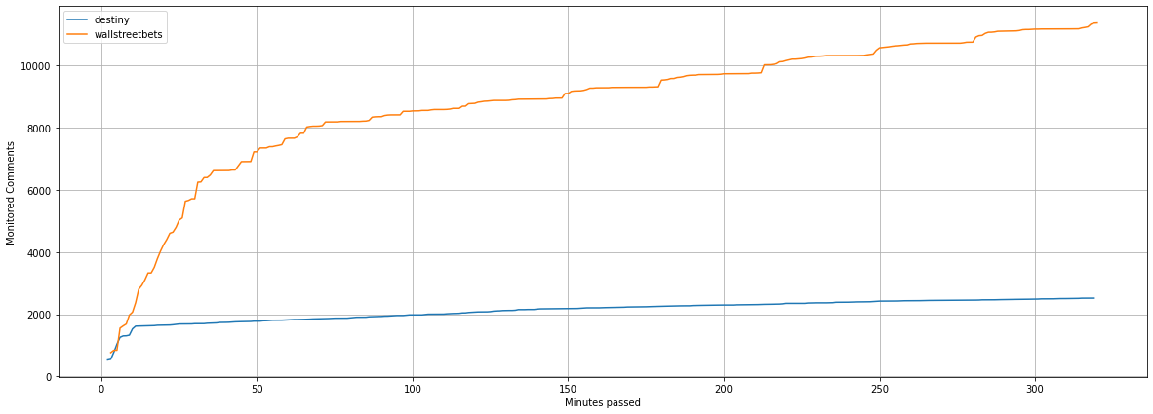
COMPARISON - COMMENTS

Slide 8
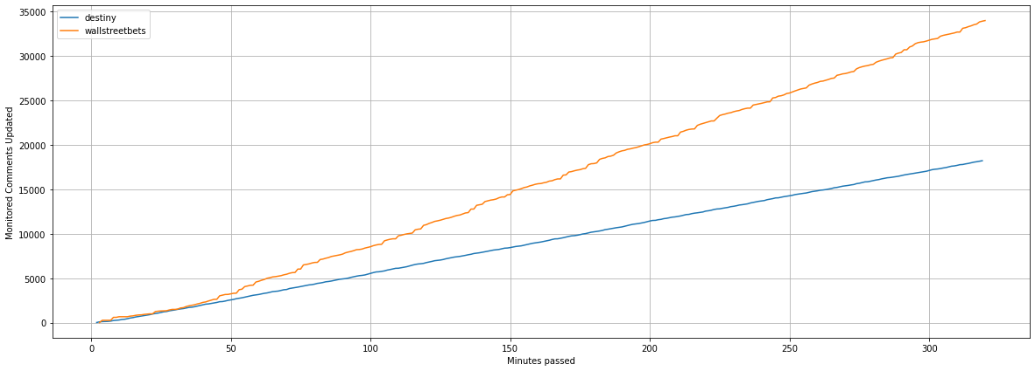
COMPARISON – COMMENTS UPDATED

Slide 9
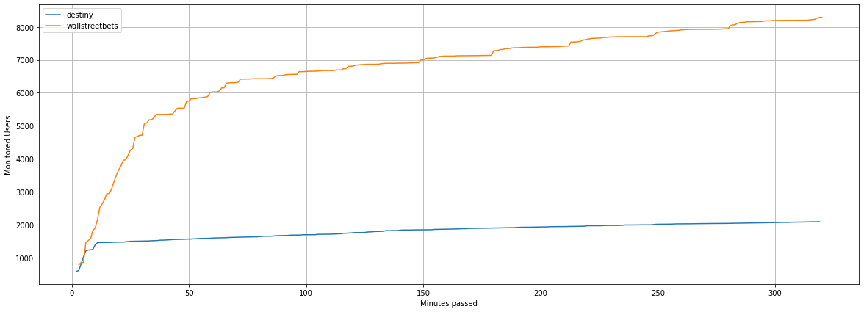
COMPARISON – USERS

Slide 10
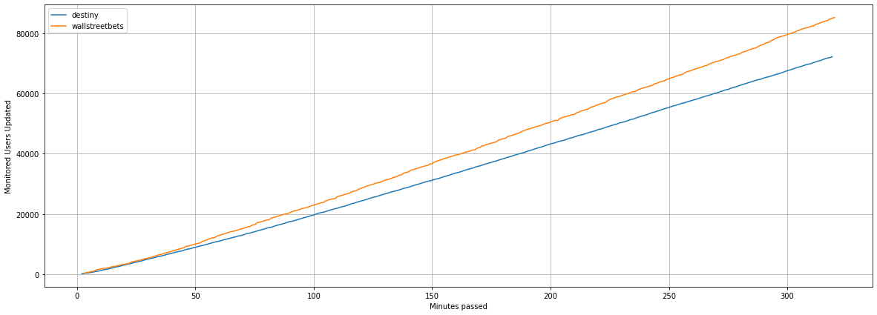
COMPARISON – USERS updated

Slide 11
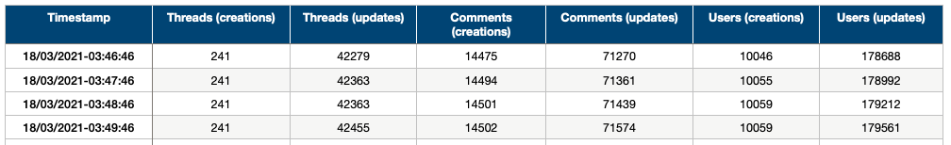
Methodology (1/3)
Scryper
We modified the scryper so that it periodically prints to a file the number of messages that it has handled thus far.
This file contains:
Post creations and updates
Comments creations and updates
Users creations and updates

Slide 12
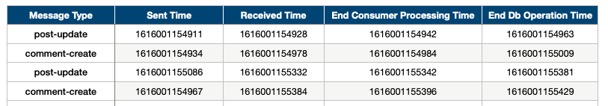
Methodology (2/3)
Speed/Batch consumers
We modified the consumers so that they print information about various times and delays.
This file contains:
Message Type, string that represent the type of message being processed by the consumer
Sent Time, timestamp representing when the message was pushed to Kafka by the scryper
Received Time, timestamp representing when the message was received by the consumer
End Consumer Processing Time, timestamp representing when the message was ready to be pushed to the database
End Db Operation Time, timestamp representing when the message had finished being processed by the database

Slide 13
Methodology (3/3)
Speed/Batch consumers
From the fields above, we can derive the following during our analyses:
Queue time, how long the message stays in the queue
Queue Time = Received Time – Sent Time
Consumer processing time, how long does the consumer take to fully process the message
Consumer Processing Time = End Consumer Processing Time – Received Time
Database operation time, how long does the db take to store the message
Database operation time = End Db Operation Time – End Consumer Processing Time

Slide 14
Understanding the limits of our application
We decided to run the application on a VM equipped with:
CPU: Intel Xeon E5-2660 4x2.195 GHz 8 gb RAM
RAM: 8 Gb
This should represent a configuration similar to our PCs.
The VM crashed after 5 hours
Why did this happen?

Slide 15
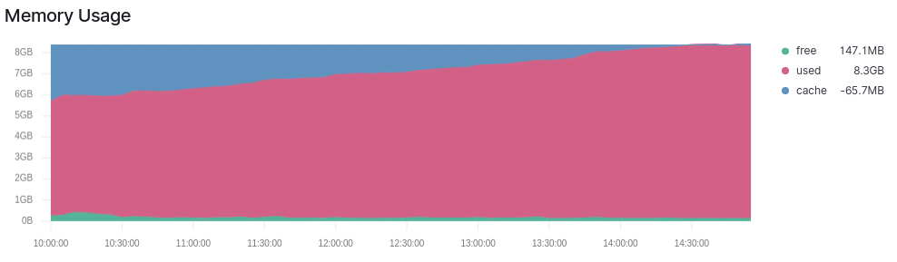
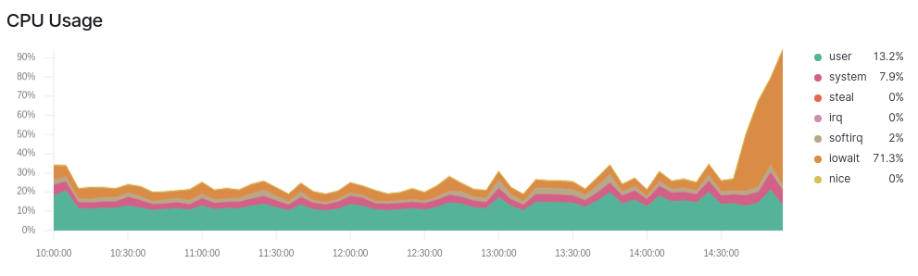
Monitoring the app through kibana
The crash is due to the lack of available space on the RAM
After 5 hours, the app starts to use more than the 8 Gb that are available
This leads to a slowdown of the overall perfomance (and the VM to become unusable)
Since the RAM is full, the OS is forced to use swapping
We think this is the reason why the CPU usage increases (iowait)

Slide 16
Understanding scalability (1/2)
We then move our application to another more powerful VM
CPU: Xeon Platinum 8171M 4x2.095 GHz
RAM: 16 Gb
We decided to experiment with different loads:
25 starting* posts
50 starting* posts
75 starting* posts
100 starting* posts
* Starting does not mean that we handle only X posts, but that we consider the top X hottest posts at a given time, which may change during the monitoring period. Thus the final number of posts will be higher.

Slide 17
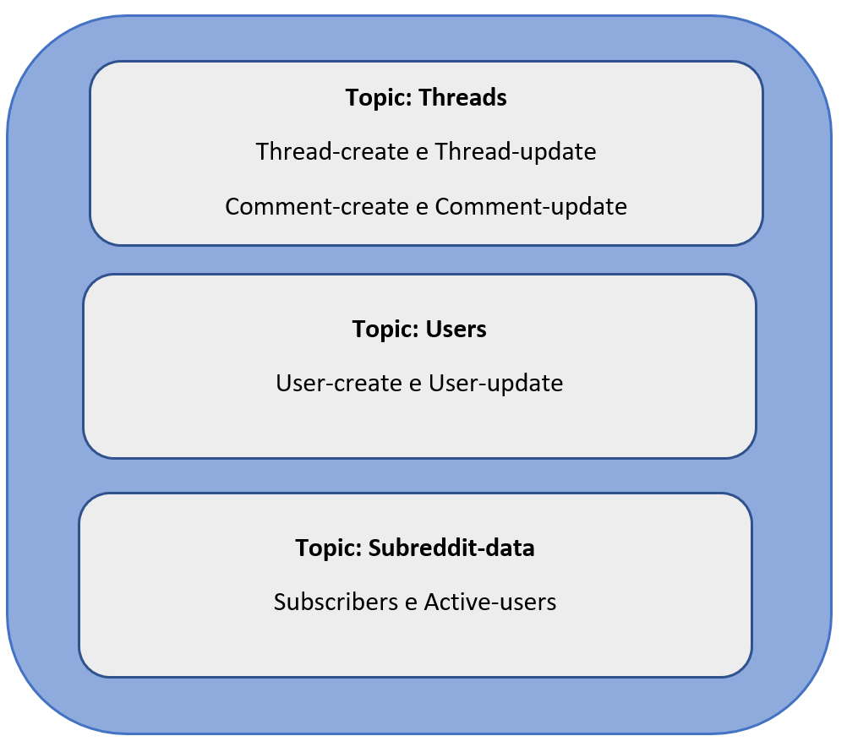
Recap – our topics and their messages

Slide 18
Understanding scalability (2/2)
Each experiment (25%, 50%, 75% and 100%) lasted ~15 hours
We run the experiments in parallel (25-50 and 75-100) during different nights
We wanted the time intervals to always be the same across the experiments.
We wanted the time intervals to be meaningful considering the US time zones, since Reddit is targeted primarily to american users
Italian time: 18:00-8:00
American time: 13:00-3:00
For each experiment we collected the metrics presented before (Queue time, Processing time, etc.)
Times have been measured for each layer (Speed and Batch); for each layer, each distinct topic has been analyzed.
Presenting them all would be too much, so we will focus only on the relevant ones.
The notebook containing all experiments in detail can be retrieved from this link

Slide 19
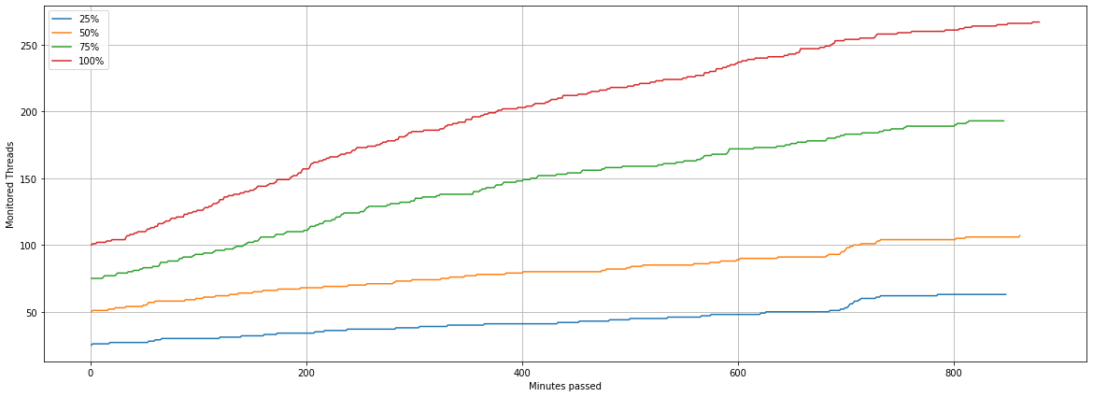
Monitored threads (posts)
We first compare the different loads in terms of number of posts, comments and users

Slide 20
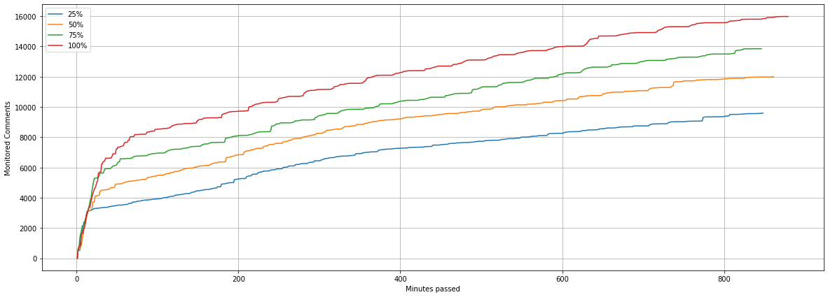
Monitored comments

Slide 21
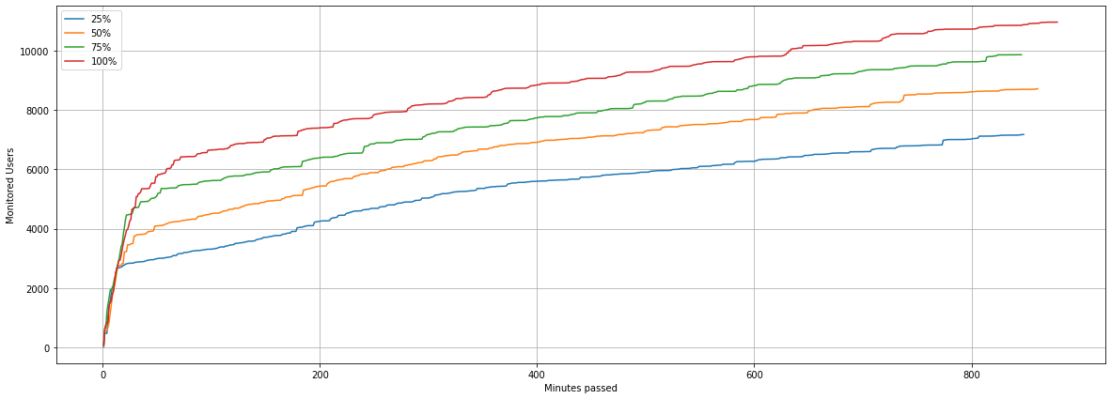
Monitored users

Slide 22
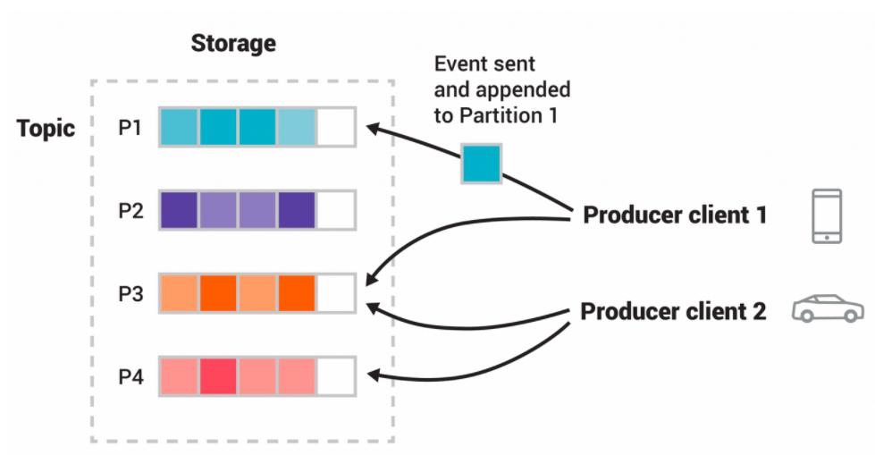
KAFKA PARTITIONS – AN OVERVIEW
Partitions are logic groupings of related messages.
Messages in Kafka are key-value pairs.
All messages having the same key end up in the same partition.
When there are more keys than partitions, messages with different keys will start sharing the partition.

Slide 23
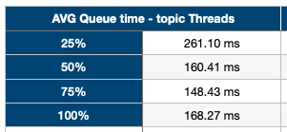
Speed layer – avg queue time
We configured Kafka so that it uses 100 partitions for each topic.
A thread and its related comments share the same key (thus the same partition).
This approach is called event sourcing.
Why is the AVG queue time higher in the 25%?
In the 25% a lower number of partitions will be occupied, each with a high number of messages.
In the 50% and 75% cases there will be more partitions with fewer messages. This could lead to a decrease in the queue time.
In the 100% case, since all partitions will be instantly occupied, different threads will start sharing the same partitions, so the queue time will increase (compared to 50% and 75%).
Queue time represents the time the message has spent inside a Kafka queue. We consider the AVG for each experiment.

Slide 24
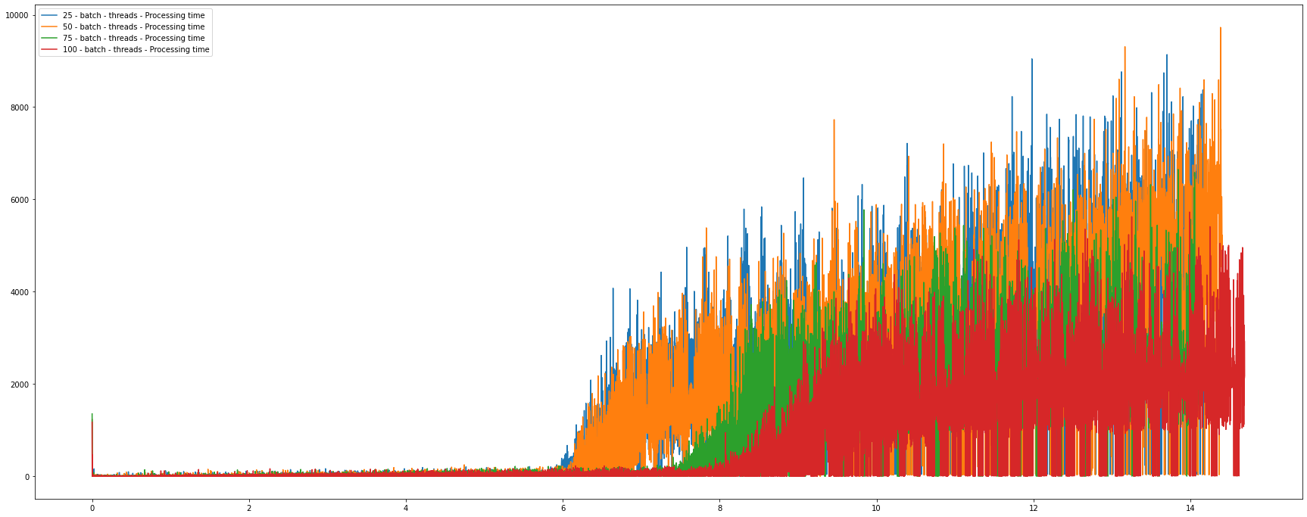
Batch layer – processing time threads
Processing Time (ms)
Monitoring hours
Processing time represents how long the consumer takes before actually pushing the message to the database. This includes retrieving the old value in case of an update.

Slide 25
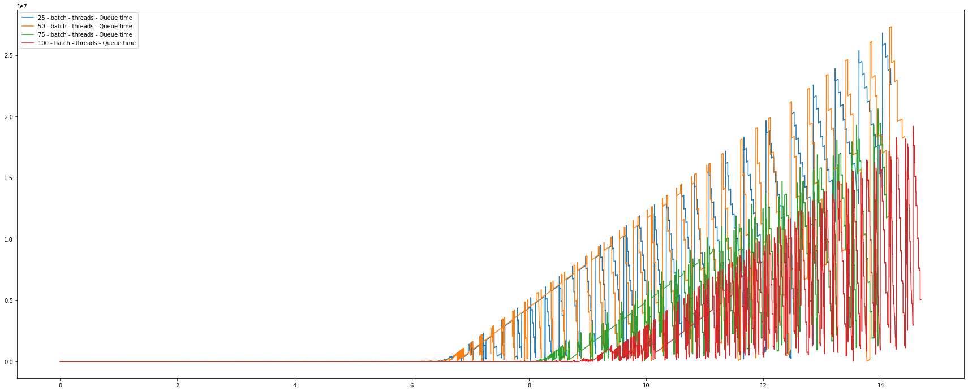
Batch layer – AVG QUEUE TIME threads
Queue Time (ms)
Monitoring hours
Notes:
Quando presenteremo qui si potrebbe mettere una slide dopo con le forme delle curve printate sugli indici per parlare della forma della «vela» e tutto quel discorso li.

Slide 26
Batch layer – QUEUE & PROCESSING TIME CONSIDERATIONS
Starting from hour 6 of monitoring, there are sudden increases in Processing Time first and AVG Queue Time second
Why does the Processing Time increase?
This is mostly due to the usage of Embeddings in MongoDB.
Comments are embedded in the post the refer to.
This means that for each comment-update it is necessary to find the post first, and then look for the specific comment to update.
This is made worse by the fact that most comments refer to the hottest threads, which have more comments!
Why does the AVG Queue Time increase?
We notice that this increase is slightly delayed with respect to Processing Time increase.
Since comment-updates take longer to be fully executed, messages in the queue will have to wait more time.

Slide 27
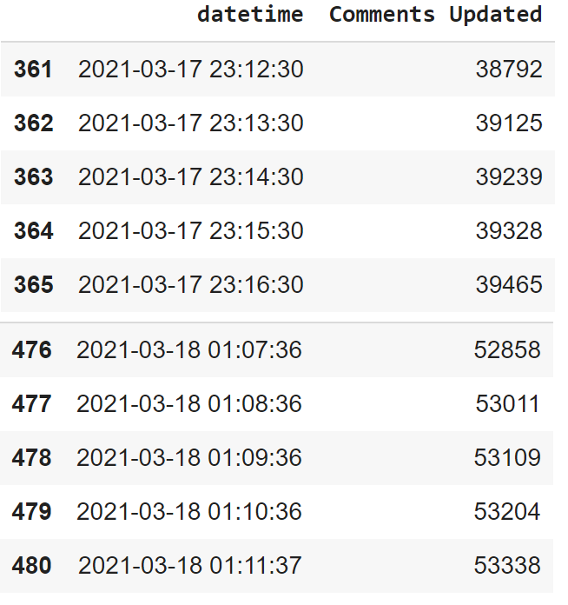
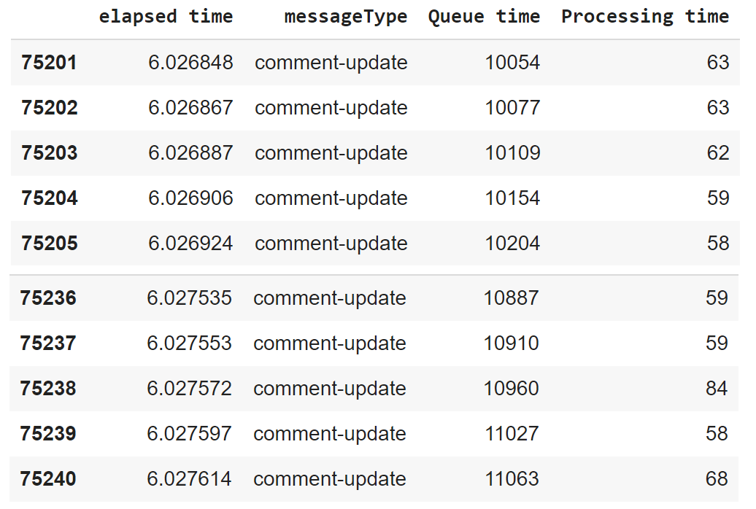
Let’s zoom in the 6-8 hours interval
Scryper
Batch consumer
In this time period the number of comment-updates increases from 38792 to 53338 (see the second image).
This increase leads to another increment in Queue and Processing Time, as can be seen in the first image.
Why are comment-updates so critical? Each comment-update must first find the post, and then look for the specific comment to update.

Slide 28
Summary of encountered bottlenecks
In our first experiment, the bottleneck was the 8 Gb of RAM
However, when moving to a machine equipped with 16 Gb of RAM, we were able to run the app for 16 hours without any kind of issue in terms of hardware resources. At the end of the experiment, the memory usage was 11.4 Gb.
This allowed us to discover the bottlenecks related to our application.
In the Speed Layer, we found out that the AVG queue time wasn’t increasing as we expected
This made us think about the way Kafka topics were organized.
In the Batch Layer, we found out that the DB Processing Time and the AVG queue time were increasing starting from the six-hour mark
Document embedding in MongoDB is the true bottleneck of the application.

Slide 29
Possible improvements
Would changing the way topics are organized make sense?
We could move the comments to a specific, separated topic.
In this new topic, the messages would have as keys their Ids, so that all the messages related to that comment would end up in the same partition.
This would, however, cause issues in the Speed layer, as there could be comments which get processed before the creation of their parent post. In a real-time monitoring, this would cause loss of events.
Would using referencing instead of document embedding in MongoDB make sense?
We could create an additional collection for the comments.
In this way, the embedding from the posts collection would be removed.
In order to keep track of the which post a comment belongs to we would have to add another field in the comment collection.
This could actually be done, we decided to go with the Embedding at first because it made more sense for the purpose of our analyses.
However, in hindsight, using Referencing would have been the better choice, as comment-updates wouldn’t have been as impactful as they are now.

