Slide 1

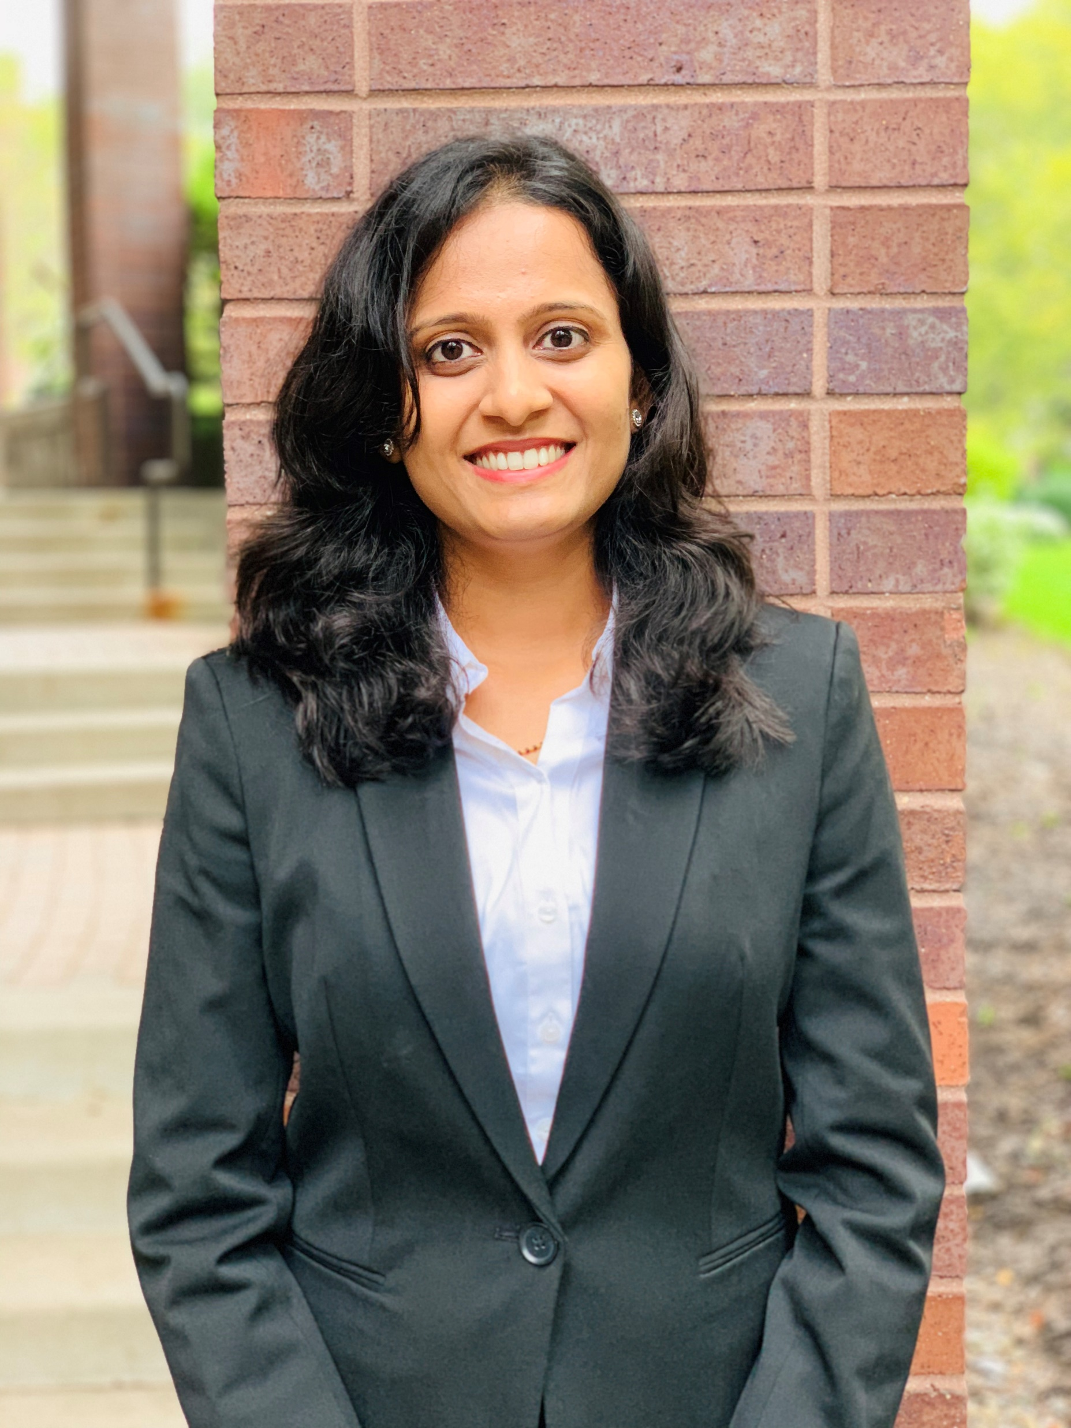
TEAM PICTURES
BIA 678 – BIG DATA TECHNOLOGIES
Kaviya Priya Kanakaraj
Revathy Ramasundaram
Vidya Maiya

