Slide 1

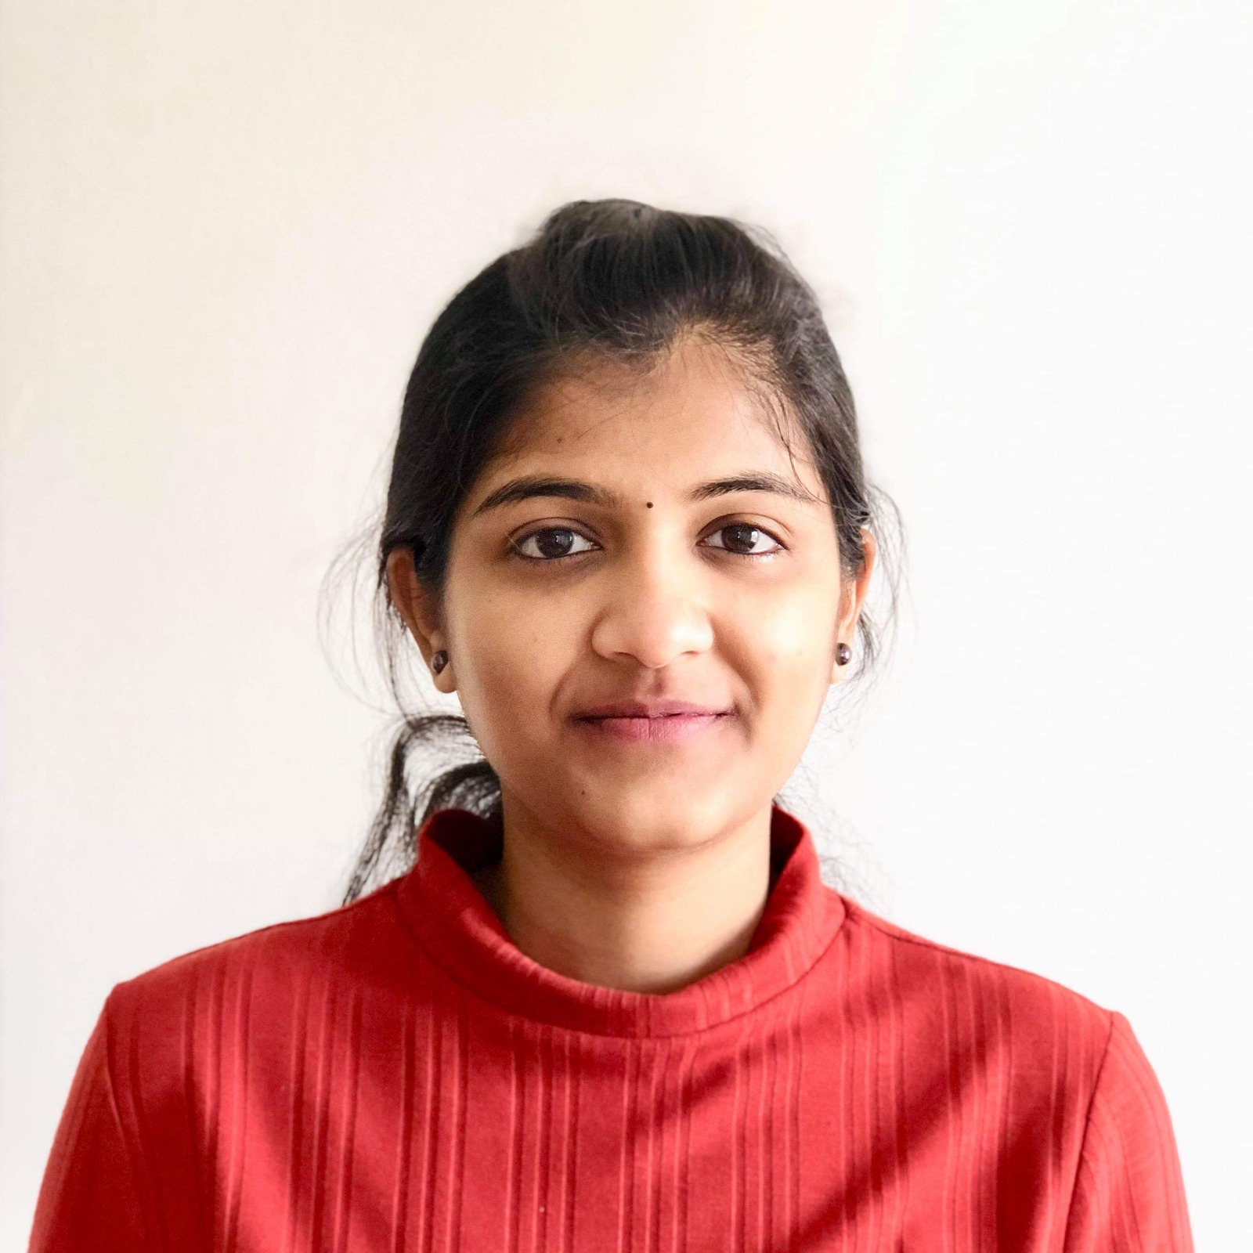
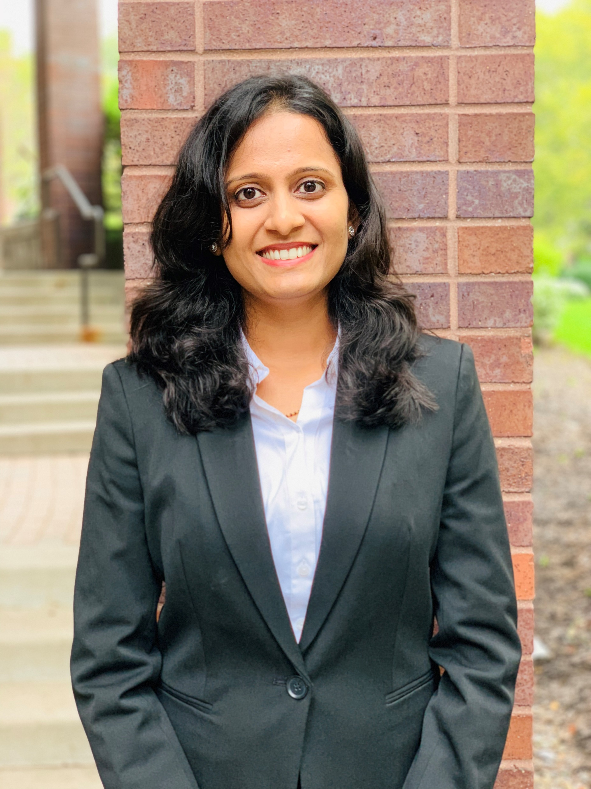
TEAM PICTURES
BIA 678 – BIG DATA TECHNOLOGIES
Kaviya Priya Kanakaraj
Revathy Ramasundaram
Vidya Maiya
Keep Exploring
Yoga Enthusiast
Travel Lover and a shutterbug

