Slide 1
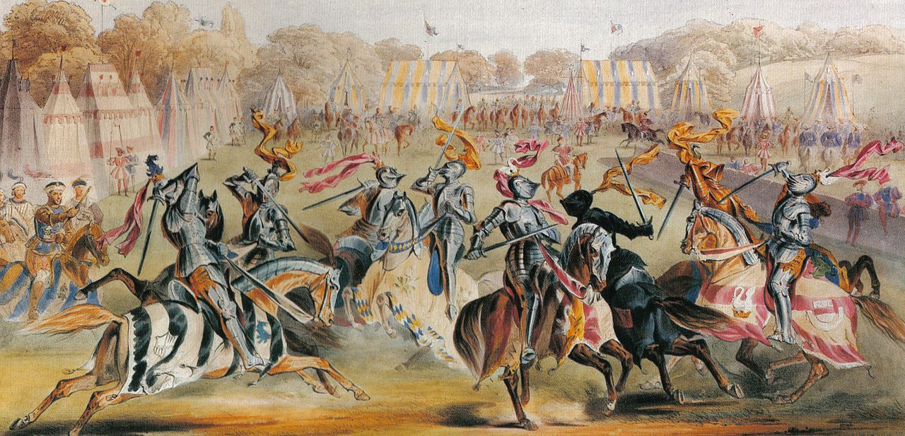
England
In the Middle Ages

Slide 2
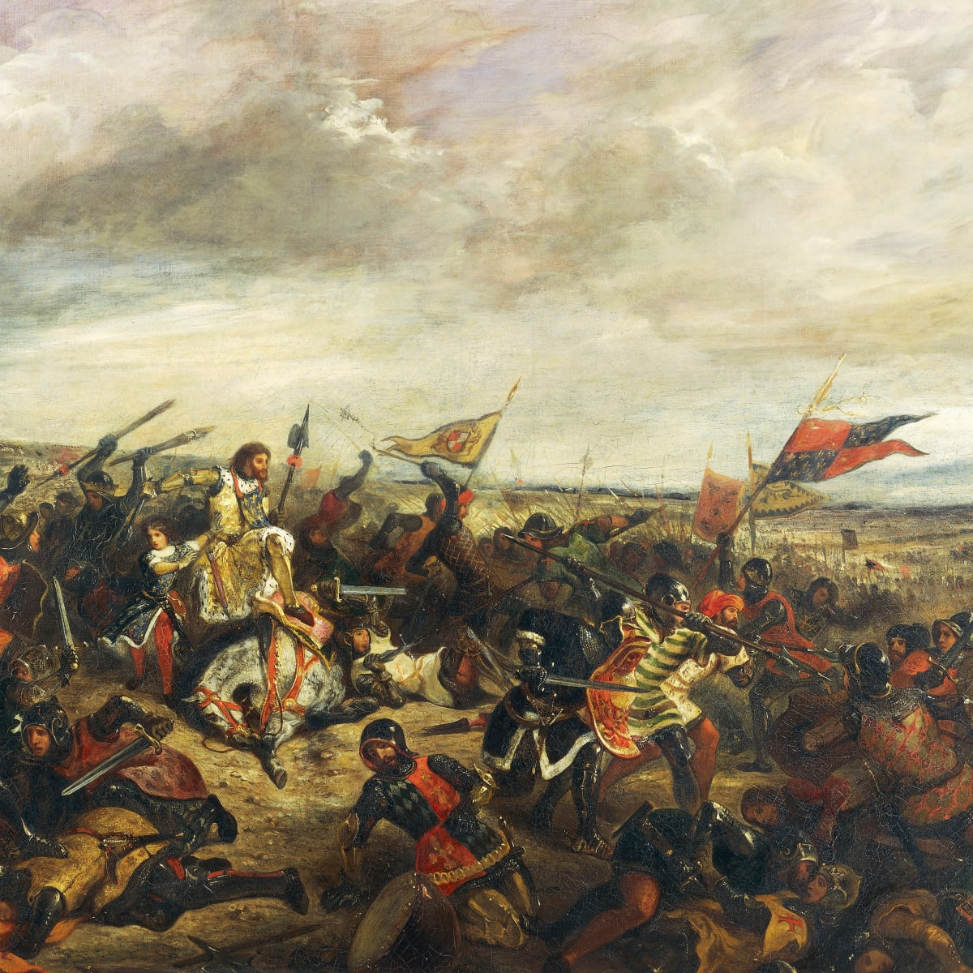

Introduction
England Middle Ages is about everything that happened from the end of the 5th century through to the start of the Early Modern period in 1485.
Notes:
England Middle Ages is about everything that happened from the end of the 5th century through to the start of the Early Modern period in 1485. It started from the Fall of the Roman Empire. At that time the economy of the England was terrible so many of the settlers left the land.

Slide 3
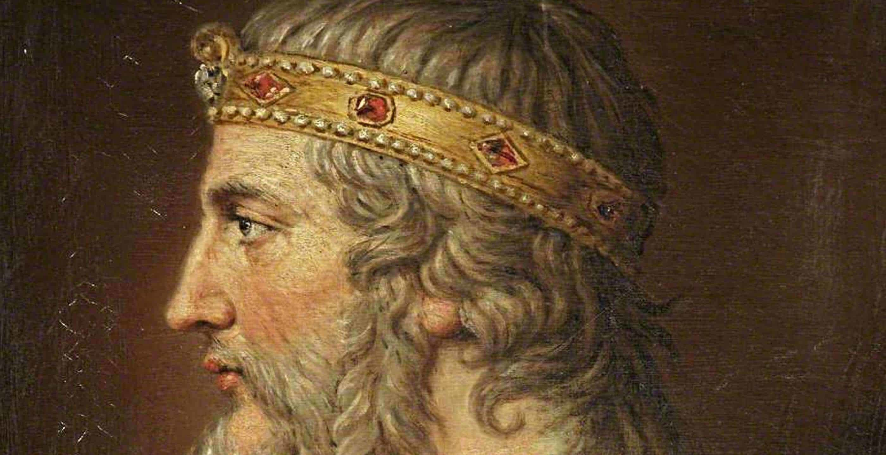
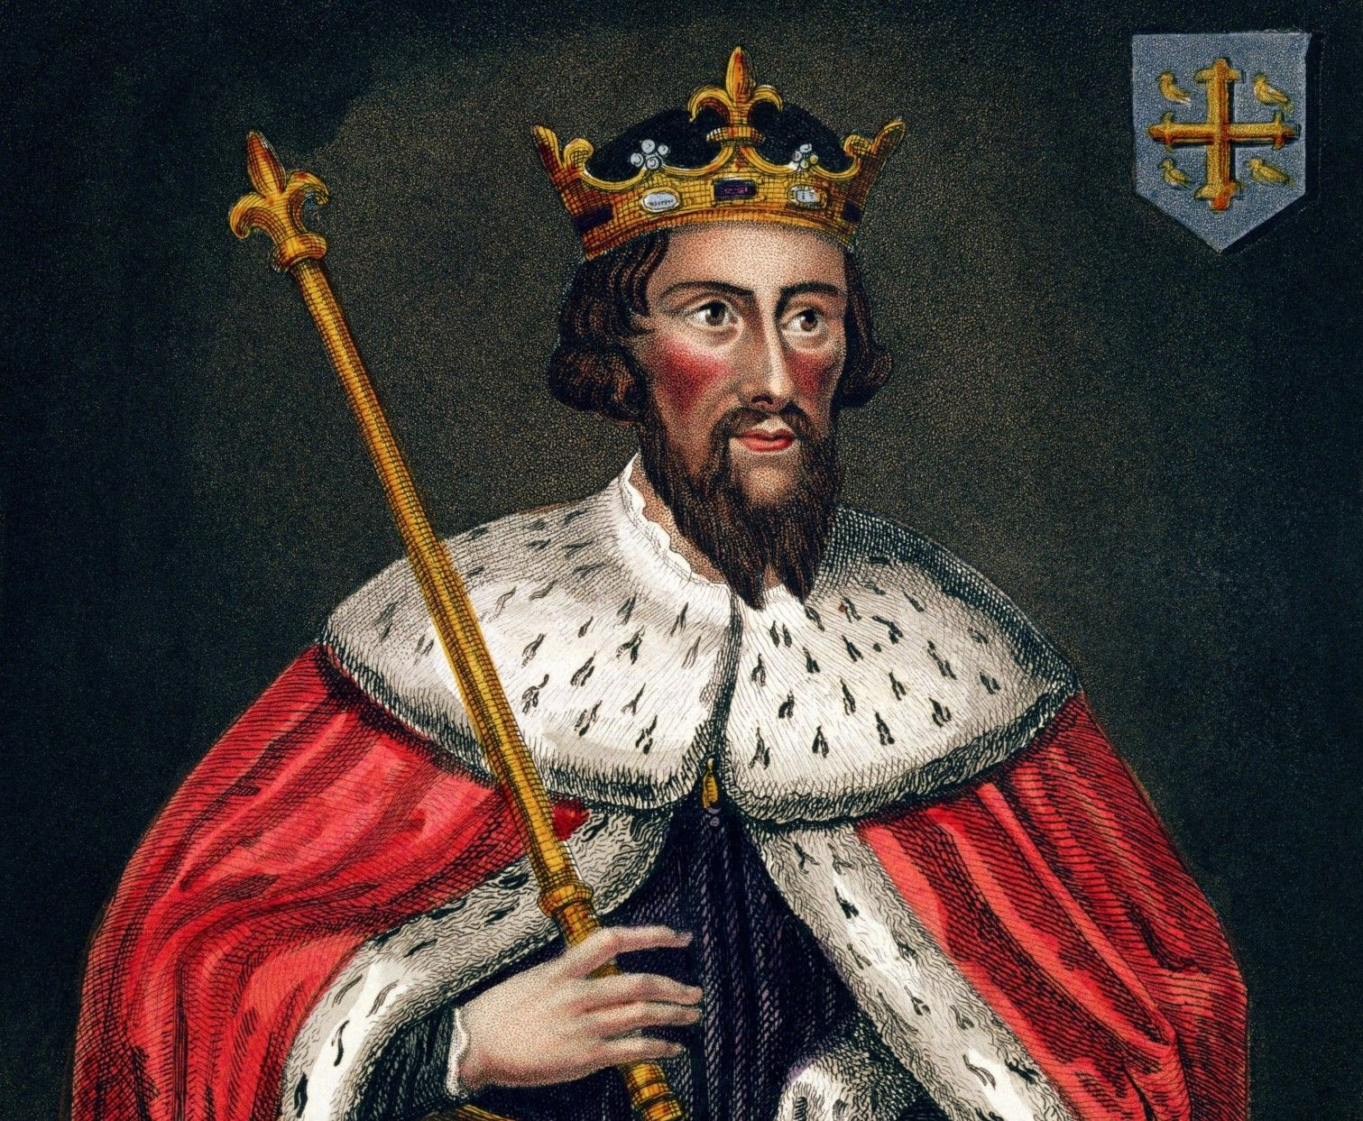

Alfred the Great
Alfred the Great, united both of these two groups and formed “Anglo-Saxons” and drove out the Vikings from England.
Notes:
After several centuries of Germanic immigration, new identities and cultures began to emerge, developing into kingdoms that competed for power. Two main group of settlers in England were Angles and Saxons. During the Viking invasion, King Alfred of Wessex, also known as Alfred the Great, united both of these two groups and formed “Anglo-Saxons” and drove out the Vikings from England.

Slide 4
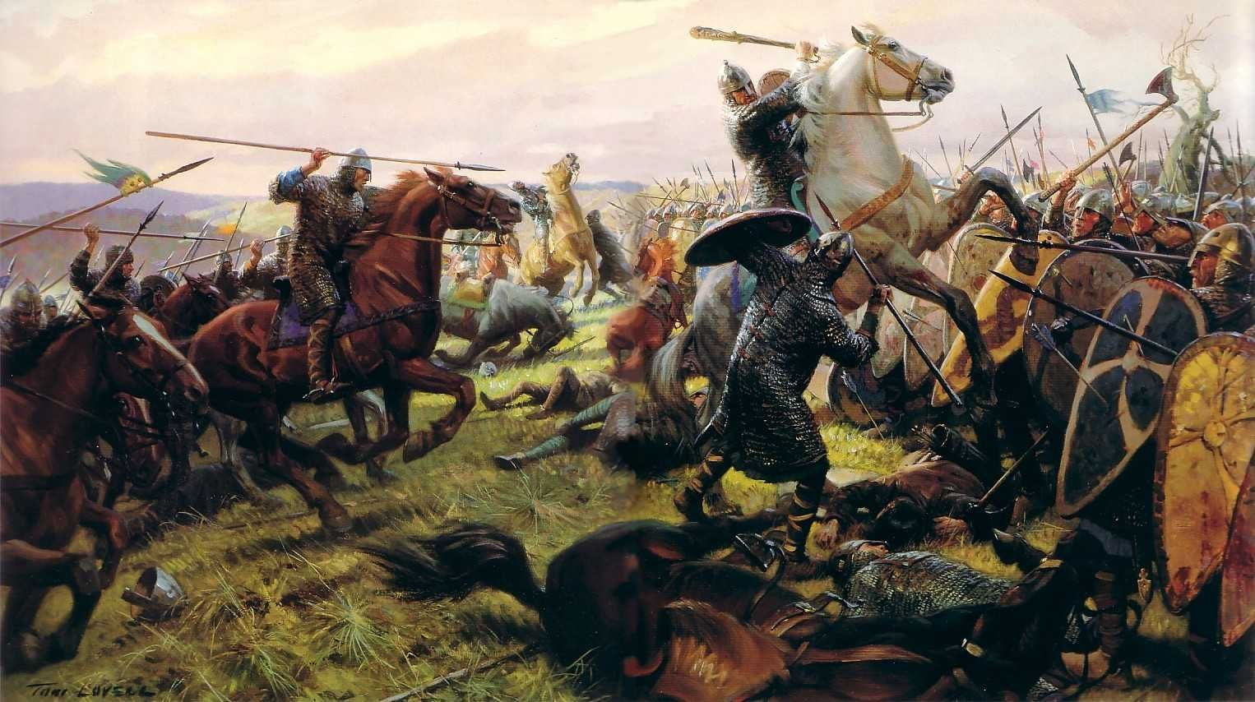
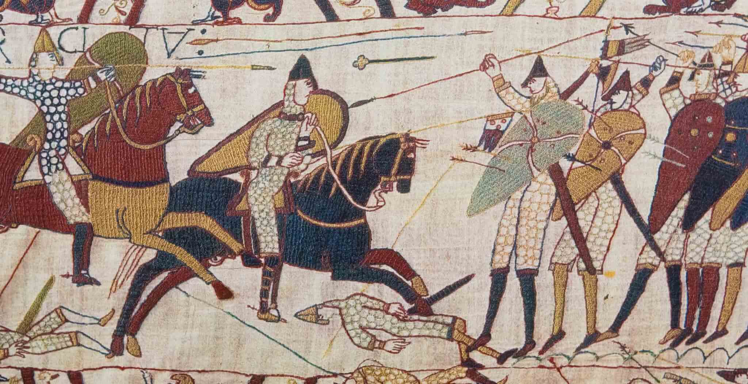
Battle of Hasting
Alfred the Great, united both of these two groups and formed “Anglo-Saxons” and drove out the Vikings from England.
Notes:
In the A.D. 900s, the Vikings conquered part of western France across the English Channel from England. This region came to be called Normandy. By the middle of the A.D. 1000s, Normandy was ruled by William, a descendant of the Viking ruler who had conquered Normandy. William was also a cousin of King Edward of England. When Edward died, a noble named Harold Godwinson claimed England’s throne. However, William believed that he, not Harold, should be king of England. In 1066, William and his army of knights landed in England. They defeated Harold and his foot soldiers at the Battle of Hastings. William was then crowned king of England and became known as William the Conqueror.

Slide 5
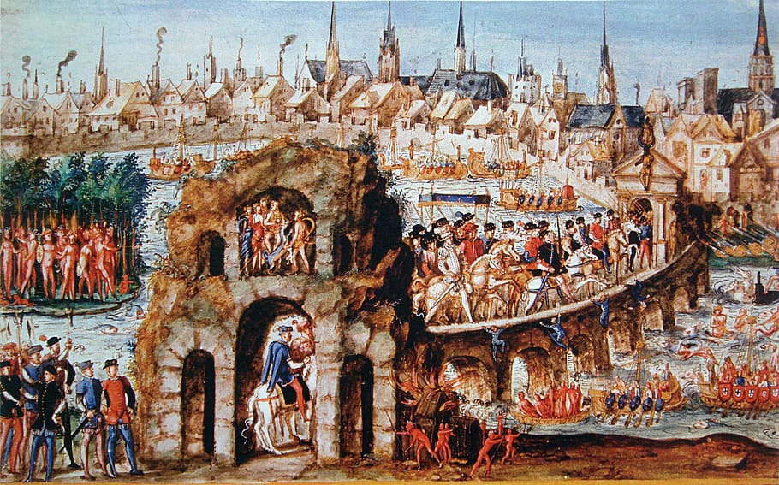
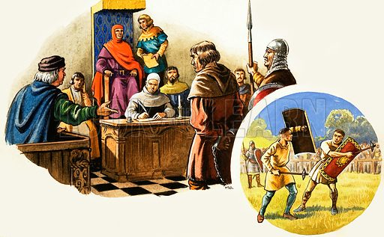

Henry II
Alfred the Great, united both of these two groups and formed “Anglo-Saxons” and drove out the Vikings from England.
Notes:
The power of the English king increased under Henry II. Henry ruled England from 1154 to 1189. He also established common law, or law that was the same throughout the whole kingdom. Henry set up juries to handle arguments over land. In time, two kinds of juries developed. The grand jury decided whether people should be accused of a crime. The trial jury decided whether an accused person was innocent or guilty.

Slide 6
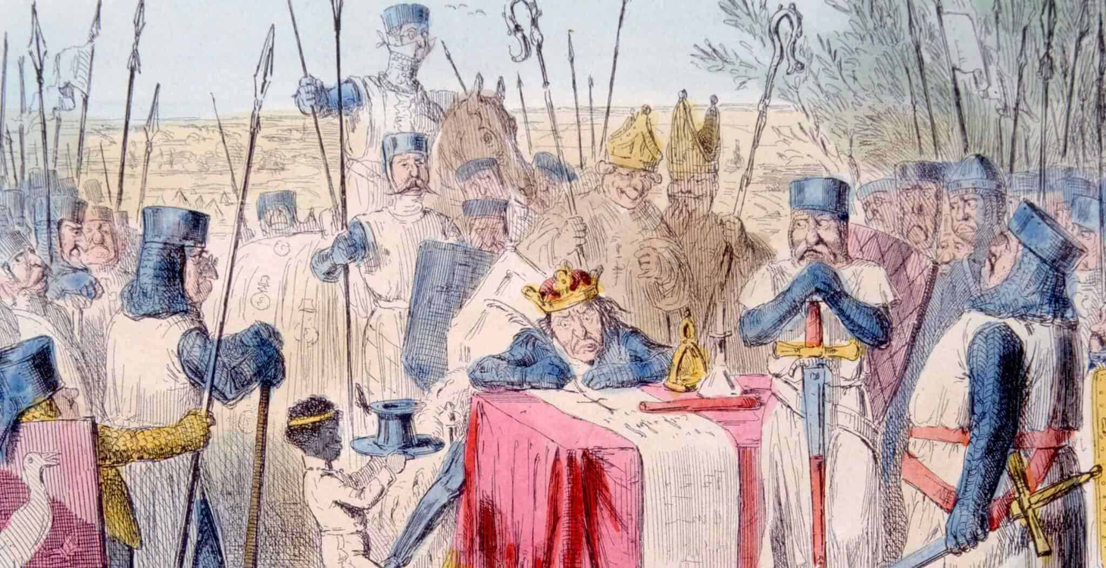
Magna Carta
King John raised taxes in England and punished his enemies without trials. The nobles met with King John at a meadow called Runnymede in 1215 and forced king to sign Magna Carta
Notes:
Henry’s son John became king of England in 1199. King John raised taxes in England and punished his enemies without trials. Many English Nobles started to refused to obey him unless he agreed to guarantee certain rights. The nobles met with King John at a meadow called Runnymede in 1215. There they forced John to sign a document of rights called the Magna Carta, or the Great Charter. The Magna Carta took away some of the king’s powers. He could no longer collect taxes unless a group called the Great Council agreed. The Magna Carta was important because it helped to establish the idea that people have rights and that the power of the government should be limited.

Slide 7
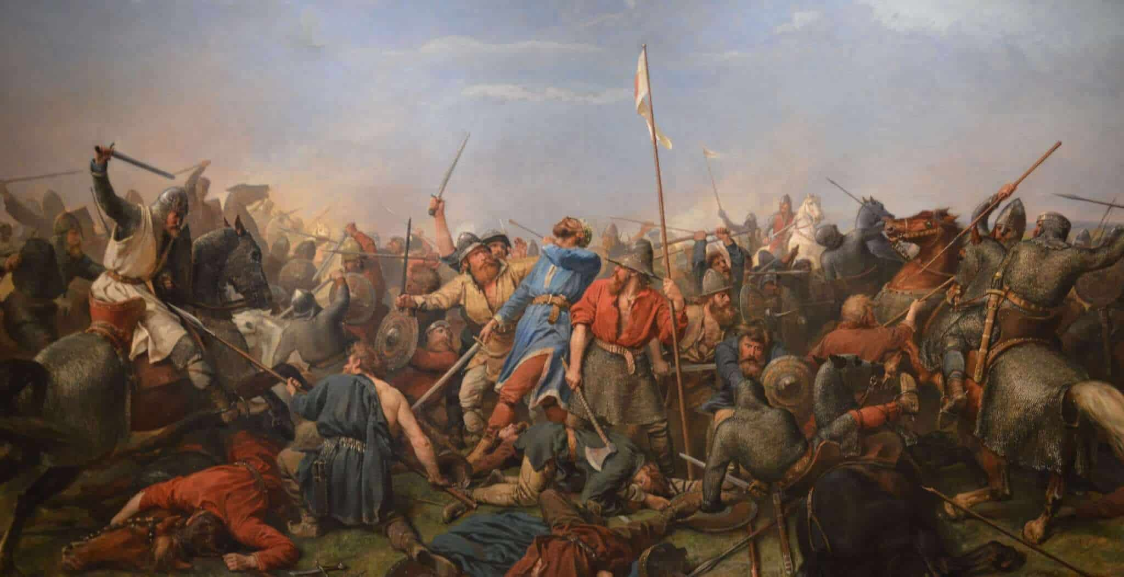
The End
Thx for listening <3

