Slide 1
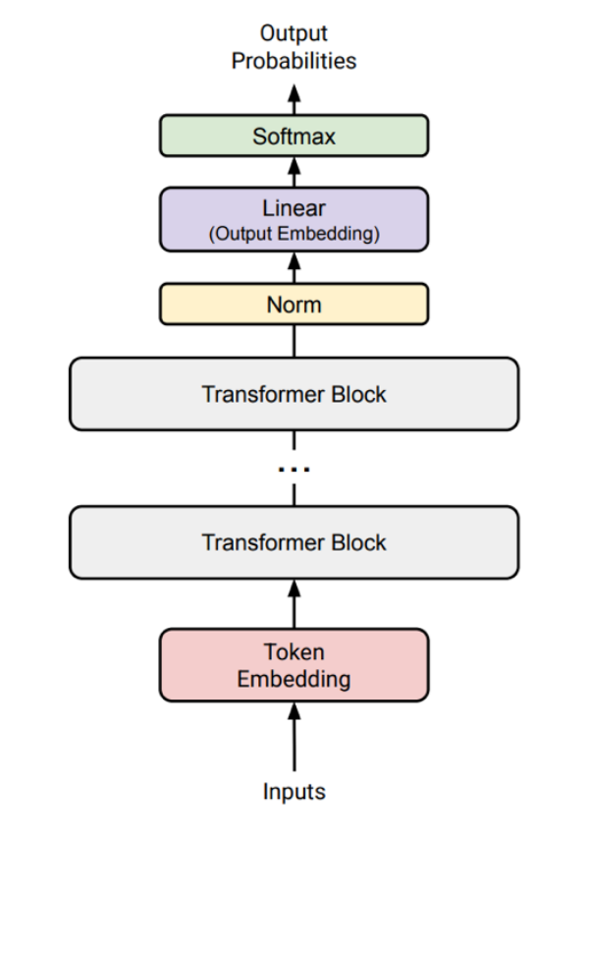
COMP7608B · LECTURE 1
DECODER-ONLY TRANSFORMER · ONE NEXT-TOKEN PASS
Large Language Models
Foundations and inference
Wenbo Sun
School of Computing and Data Science · HKU
2026–27 · Semester 1
Architecture adapted from Hashimoto, CS336 Lecture 3
01

Slide 2
WELCOME
Your instructor
COURSE PERSPECTIVE
Research and industry shape this course.
HOW THIS SHAPES THE COURSE
1
Understand the computation precisely enough to implement and measure it.
TU Delft PhD work — efficient LLM inference
Database-system design for AI
Fintech, Beijing — algorithm engineer
Two years managing algorithmic trading
2
Treat memory, hardware and deployment constraints as design inputs.
3
Explain architecture choices clearly to engineers, managers and users.
The course connects mathematical mechanisms with the constraints of real systems.
COMP7608B · Lecture 1
02

Slide 3

WELCOME
About You

Slide 4
COURSE
Two connected parts
PART I · 3 or 4 LECTURES
PART II · 6 or 7 LECTURES
Inside the LLM
LLM as a tool
Architecture, inference, training, and fine-tuning
Small implementations; industry efficiency choices
Retrieval, tools, memory, and agent workflows
Real systems and invited industry practitioners
architecture and inference
RAG and memory
training and fine-tuning
agent workflows and harnesses
efficiency and deployment cost
industry cases and failure modes
COMP7608B · Lecture 1
04

Slide 5
COURSE
Why learn the internals?
WHY LEARN THE INTERNALS?
QUESTIONS YOU SHOULD BE ABLE TO REASON ABOUT
Understanding the computation transfers to new designs.
Why divide attention scores by √dₕ?
Interviews may ask for formulas, code, or cost estimates
Implementation reveals what the architecture really does
New model design → identify which operations change
Agent projects expose integration and evaluation problems
Why does an FFN expand before contracting?
Which tensor or matrix dominates cost?
How would a new architecture change the code?
For agentic systems, implementation experience also exposes workflow traps, integration limits and evaluation problems.
COMP7608B · Lecture 1
05

Slide 6
COURSE
Assessment: Group Project
WHAT COUNTS AS A PROJECT?
POSSIBLE DIRECTIONS
Build a working agentic application and defend its design.
financial-news research assistant
domain RAG with source verification
Start with a user problem and clear motivation
Propose a stack; identify risks and alternatives
Evaluate quality, reliability, latency, or cost
Submit runnable code and explain limitations
data-analysis and visualization agent
coding, testing or support workflow
personal or organizational knowledge assistant
Benchmarking should support a design decision—for example, retrieval quality, latency, cost or tool-use reliability.
COMP7608B · Lecture 1
07

Slide 7
COURSE
Scoring
20%
30%
50%
PROPOSAL
PRESENTATION
REPORT + CODE
problem, motivation, provisional stack and risks
show the system and defend its design
architecture, evaluation, limitations and runnable artifact
GROUPING
Groups of 3–4. Form your team by 21 September; anyone without a group will be assigned randomly.
Detailed presentation arrangements and final deadlines will be announced after the teaching team completes the instructions.
COMP7608B · Lecture 1
06

Slide 8
COURSE
AI assistance and ownership
PERMITTED ASSISTANCE
WHAT IS NOT ACCEPTABLE
AI tools and open-source libraries allowed
Try guided exercises yourself first
Explain your code and architecture choices
1
Submitting another group's work or a complete copied project as your own.
2
Presenting code whose architecture and behavior you cannot explain.
3
Hiding external sources, datasets, generated content or major dependencies.
The presentation may include design questions or a live modification. If ownership is not demonstrated, marks may be deducted.
COMP7608B · Lecture 1
08

Slide 9
HISTORY
Let’s play a game
Starting from the left of a row, say one word, trying to keep the whole sentence meaningful.
Large
language
models
can
predict
…
In
Hong
Kong
the
weather
…
What context helped you choose your next word?
COMP7608B · Lecture 1
10

Slide 10
HISTORY
Language Models
FORMAL DEFINITION
A sequence probability is built from next-token probabilities.
P(x₁,…,x_T) = ∏ₜ P(xₜ | x₁,…,xₜ₋₁)
Each prediction depends on the existing prefix
Chain rule combines the conditional probabilities
Inference evaluates the next-token distribution
Selection turns that distribution into a continuation
Large
language
models
predict
tokens
prefix
next-token target
The model supplies probabilities; decoding selects the next token.
COMP7608B · Lecture 1
11

Slide 11
HISTORY
Language Models - Training
TRAINING VIEW
Large
→ language
Predict the next token at every valid position.
Large language
→ models
Inputs and targets are shifted by one token
The target is the observed next token
Future positions are hidden by a causal mask
Known training positions can be processed together
Large language models
→ predict
Large language models predict
→ tokens
loss = − Σₜ log P(xₜ | x₍<t₎)
COMP7608B · Lecture 1
12

Slide 12
HISTORY
The Starting Point
1951 · CLAUDE SHANNON
Likely events are less surprising.
surprisal(x) = −log₂ P(x)
Surprisal measures information in one outcome
Entropy averages surprise over a distribution
Shannon studied prediction of printed English
Next-token training uses a related cross-entropy objective
entropy = 𝔼[surprisal]
P(x)=1/2 → 1 bit
P(x)=1/8 → 3 bits
Cross-entropy and negative log-likelihood turn this idea into a trainable objective.
Shannon, “Prediction and Entropy of Printed English” (1951)
COMP7608B · Lecture 1
13

Slide 13
HISTORY
N-grams
STATISTICAL LANGUAGE MODELS
An n-gram sees only the previous n−1 tokens.
P(xₜ | x₁,…,xₜ₋₁) ≈ P(xₜ | xₜ₋₂,xₜ₋₁)
Trigram example — predict from two preceding tokens
Count frequent local combinations
Rare combinations require smoothing or backoff
Long dependencies remain outside the window
the
stock
market
closed
higher
trigram context
target
N-grams store local statistics explicitly; neural models learn continuous representations that can generalize across similar contexts.
COMP7608B · Lecture 1
14

Slide 14
HISTORY
Neural Language Models
2003 ONWARD
token IDs
[B,T]
Learn token vectors and a shared predictor.
embedding
[B,T,d]
Bengio et al. — neural prediction with learned word vectors
Similar contexts can share statistical strength
Word2vec later popularised embedding geometry
Modern token embeddings are learned with the model
network
context features
softmax
[B,T,V]
Modern LLMs learn token embeddings end to end, but embedding lookup is still the first learned operation in inference.
Bengio et al. (2003); Mikolov et al. (2013)
COMP7608B · Lecture 1
15

Slide 15
HISTORY
Transformers VS. RNN
2017 · TRANSFORMER
RECURRENCE
Self-attention removes the recurrent step dependency.
h1
h2
h3
h4
RNN state at step t depends on earlier steps
Transformer training already knows the input sequence
Attention compares positions in parallel within a layer
Dense attention introduces quadratic pairwise work
step t waits for t−1
SELF-ATTENTION
x1
x2
x3
x4
known positions interact in one layer
The Transformer did not make sequence modeling free; it exchanged recurrence for a highly parallel but potentially quadratic interaction.
Vaswani et al. (2017), “Attention Is All You Need”
COMP7608B · Lecture 1
16

Slide 16
HISTORY
Generative pretraining and scaling laws
2018–2022
GPT
generative pretraining
2018
One training objective can support many downstream tasks.
2020
Scaling laws
power-law trends
GPT — reuse a generatively pretrained model
Scaling studies relate loss to data, parameters, and compute
Chinchilla — balance model size with training data
Results depend on the data and training recipe
2022
Chinchilla
compute-optimal balance
NOW
Post-training
instructions and tools
Scaling helps explain why larger training runs can improve loss, but it does not say that the largest model is always best for a particular domain or budget.
Radford et al. (2018); Kaplan et al. (2020); Hoffmann et al. (2022)
COMP7608B · Lecture 1
17

Slide 17
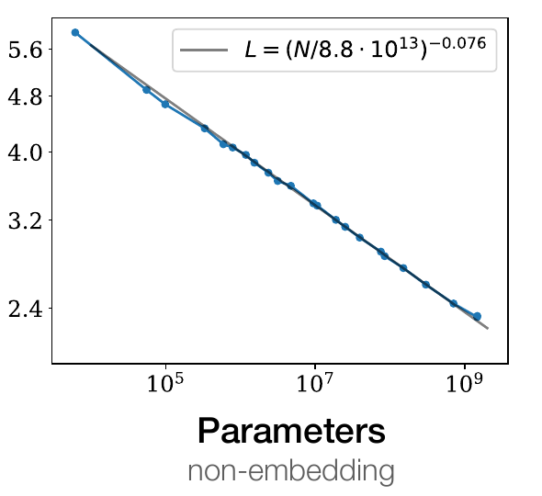
SCALING LAWS
Scaling laws
KAPLAN ET AL. · 2020
Prediction improves smoothly as training scales up.
N — model parameters
D — training tokens
C — training compute (FLOPs)
Power law → similar % loss reduction for each × increase in scale
Test loss ↓ · log–log axes
Use small runs to forecast larger runs.
Keep model size, data and compute in balance.
Kaplan et al. (2020), Figure 1, model-size panel. Lower loss = better next-token prediction.
COMP7608B · Lecture 1
S01

Slide 18
SCALING LAWS
Balance model size with training data
FIXED TRAINING BUDGET
HOFFMANN ET AL. · CHINCHILLA (2022)
C ≈ 6 × N × D
4× smaller model
Dense-model training estimate
2× parameters at fixed compute
→ roughly ½ as many tokens
Gopher: 280B · 300B tokens
Chinchilla: 70B · 1.4T tokens
More budget → grow N and D
Same training compute budget
2× N and 2× D → ≈4× compute
MMLU 5-shot: 60.0% → 67.6%
≈20 tokens/parameter: a guide*
Less compute per inference
*A training-compute guide, not a universal ratio.
High serving demand can favour smaller models trained longer.
COMP7608B · Hoffmann et al. (2022), Tables 1 & 6; Sardana et al. (2024)
S02

Slide 19
LANDSCAPE · SEPTEMBER 2026
The landscape is now a systems story
THREE QUESTIONS FOR AN ENGINEER
OPEN WEIGHTS
What can we run, what does it cost, and what can we build?
Qwen 3.5 · Llama 4 · DeepSeek V4
MULTIMODAL INPUT
Text, images and documents together
Model access and size
Training and inference budgets
Tools, data and agent control
REASONING EFFORT
More inference work before answering
AGENT HARNESSES
Context, tools, state and execution
A strong model is the starting point; useful applications need an engineered system.
COMP7608B · LLM landscape · 8 Sep 2026
L01

Slide 20
LANDSCAPE · SEPTEMBER 2026
Open weights span very different scales
SELECTED DOWNLOADABLE MODELS · B = BILLION · T = TRILLION
MODEL / FAMILY
TOTAL
ACTIVE
WEIGHT LICENSE
Qwen3.5-9B
9B
9B (dense)
Apache 2.0
Qwen3.5-35B-A3B
35B
3B
Apache 2.0
Llama 4 Scout
109B
17B
Llama 4 terms
Llama 4 Maverick
400B
17B
Llama 4 terms
DeepSeek V4 Flash
284B
13B
MIT
DeepSeek V4 Pro
1.6T
49B
MIT
Active counts per token; rounded LM sizes. V4 updates add a decoding module. Qwen figures exclude vision.
Open weights let you run a model; they do not necessarily reveal its training data.
COMP7608B · LLM landscape · 8 Sep 2026
L02

Slide 21
LANDSCAPE · SEPTEMBER 2026
Model size becomes a memory bill
18 GB
70 GB
3.2 TB
9B PARAMETERS
35B PARAMETERS
1.6T PARAMETERS
9 billion × 2 bytes
A dense-model scale
35 billion × 2 bytes
Even if only 3B are active
1.6 trillion × 2 bytes
A distributed-system scale
ASSUMPTION
Illustrative 16-bit weight payload only. Actual checkpoints may use fewer bits.
MoE reduces active computation; the complete set of weights still needs storage.
COMP7608B · LLM landscape · 8 Sep 2026
L03

Slide 22
LANDSCAPE · SEPTEMBER 2026
Creating a model has several stages
Pretrain
Post-train
Serve
LEARN FROM A CORPUS
SHAPE BEHAVIOUR
RUN REAL REQUESTS
Data → token batches
Next-token prediction
General capability
Demonstrations → SFT
Preference tuning + RL
Useful task behaviour
Load and execute weights
Manage context and tools
Measure quality and cost
DIFFERENT BILLS
Data preparation, training runs, evaluation and serving consume different resources.
COMP7608B · LLM landscape · 8 Sep 2026
L04

Slide 23
LANDSCAPE · SEPTEMBER 2026
Training cost needs a clear boundary
DEEPSEEK-V3 · 2024 DISCLOSURE
LLAMA 3.1 405B · 2024 DISCLOSURE
$5.576M
$61.7–123.4M*
Reported run-cost estimate
2.788M H800 GPU-hours
Assumed rental rate $2/hour
Our illustrative rental estimate
30.84M H100 GPU-hours
Assume $2–4/GPU-hour
Pretraining — 14.8T tokens
*Not a bill reported by Meta
2,048 GPUs; under two months
≈78 days at 16,384 GPUs†
Prior research / ablations excluded
†Idealised GPU-hour conversion
GPU-hours measure total work. Calendar time and the full development budget differ.
COMP7608B · LLM landscape · 8 Sep 2026
L05

Slide 24
LANDSCAPE · SEPTEMBER 2026
API prices are quoted per million tokens
USD PER 1M TOKENS · TEXT · UNCACHED INPUT · CHECKED 8 SEP 2026
MODEL / SERVICE
INPUT
OUTPUT
PRICE BASIS
DeepSeek V4 Flash
$0.22
$0.66
Off-peak
DeepSeek V4 Flash
$0.44
$1.32
Peak
Gemini 3.8 Flash
$0.75
$3.75
Introductory*
Claude Sonnet 5
$2.00
$10.00
Standard
Claude Opus 5
$5.00
$25.00
Standard
*Gemini rate through 31 Dec 2026. Batch, cache, tools and taxes are excluded. Prices can change.
At $10 per million output tokens, one output token costs $0.00001.
COMP7608B · LLM landscape · 8 Sep 2026
L06

Slide 25
LANDSCAPE · SEPTEMBER 2026
Budget the complete task
ONE RESPONSE · SONNET 5 EXAMPLE
EIGHT-CALL AGENT · SAME RATES
$0.009 / task
$0.10 / task
2,000 input + 500 output tokens
$0.004 input + $0.005 output
10,000 tasks → $90
30,000 input + 4,000 output
$0.060 input + $0.040 output
10,000 tasks → $1,000
Input $2 / 1M; output $10 / 1M
Input grows 2,000 → 5,500 / call
All input uncached in this example
500 output tokens on each call
No paid tools or other fees included
≈11× the single-response cost
Task cost = all input charges + all output charges + tools and infrastructure.
COMP7608B · LLM landscape · 8 Sep 2026
L07

Slide 26
LANDSCAPE · SEPTEMBER 2026
Three common application architectures
RAG
Tool agent
Multi-agent
RETRIEVE → ANSWER
ACT → OBSERVE
DELEGATE → COMBINE
Search a document index
Pass evidence to the LLM
Answer with references
LLM selects a tool call
Code executes the tool
LLM uses the result
Delegate subtasks
Run workers in parallel
Combine their results
CONTROL
A fixed workflow chooses steps in code. An agent chooses some steps dynamically.
RAG can be a tool inside an agent. Multiple agents add coordination and token cost.
COMP7608B · LLM landscape · 8 Sep 2026
L08

Slide 27
LANDSCAPE · SEPTEMBER 2026
An agent is a controlled execution loop
THE HARNESS RUNS AROUND THE MODEL
The model proposes an action; software executes it.
Context
LLM
choose
Tool
execute
Context — instructions, evidence, state
Tools — search, code, business APIs
Runtime — permissions, retries, limits
Results — observations for the next call
Observation
update context
Answer
complete
Ask user
clarify
Stop
at limit
A tool call is structured model output. The application supplies the actual action.
COMP7608B · LLM landscape · 8 Sep 2026
L09

Slide 28
ARCHITECTURE
Today — one prompt, one next token
LM head → logits
ONE ORGANIZING QUESTION
Final RMSNorm
What happens between a prompt and its next token?
× N
+
SwiGLU FFN
RMSNorm
+
1
text → token IDs
MHA + RoPE(Q,K)
2
vectors → decoder blocks
RMSNorm
Token embedding
3
hidden state → logits → sampled token
Token IDs
We will return to this map throughout the lecture.
COMP7608B · Lecture 1
09

Slide 29
COMP7608B · TOKENIZATION
Tokens are the model’s text units
•
A token is one minimum unit of a language.
•
A token ID is the integer label for that unit.
Text
One possible split
Token IDs
lower
low
e
r
257, 101, 114
•
Tokens may be words, word fragments, spaces or individual bytes.
The tokenizer chooses the units. The model receives their IDs.
Lecture 1 · Foundations and inference
19

Slide 30
COMP7608B · TOKENIZATION
Why choosing tokens is a trade-off
English
unhappiness, GPT-6, 3.14
New words, names and numbers keep appearing.
Chinese
我喜欢机器学习
Word boundaries are usually not marked by spaces.
Bytes
cat → 63 61 74 猫 → E7 8C AB (hex)
256 byte values cover UTF-8; byte sequences can be long.
Compression gives us compact units while retaining byte coverage.
Lecture 1 · Foundations and inference
20

Slide 31
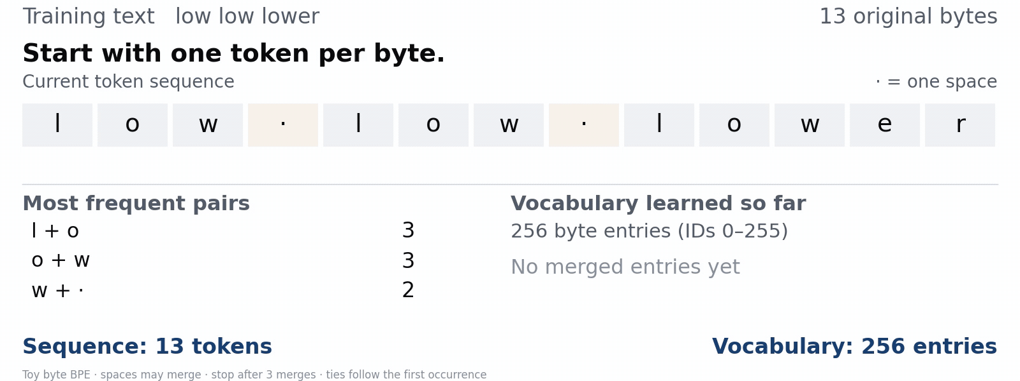
COMP7608B · TOKENIZATION
Byte-pair encoding (BPE)
Count adjacent pairs → merge the most frequent → repeat
Gage (1994): compression origin · Sennrich et al. (2016): subword tokenization
Lecture 1 · Foundations and inference
21

Slide 32
COMP7608B · TOKENIZATION
Train once, reuse the learned merges
Learn once
Apply many times
Rank
Merge
New ID
•
Use the saved merges in priority order.
1
l + o → lo
256
•
Create no new vocabulary entries.
2
lo + w → low
257
3
low + · → low·
258
New text: low lower
low·
low
e
r
Space merges depend on
pre-tokenization rules.
258
257
101
114
Use the trained tokenizer; its token IDs select embedding rows.
Lecture 1 · Foundations and inference
22

Slide 33
TOKENS
Vocabulary size trades sequence length for storage
TOKENIZER HYPERPARAMETER
SMALLER V
LARGER V
Shorter sequences require a larger embedding vocabulary.
1
longer token sequences
1
shorter token sequences
Larger V can reduce the number of tokens T
Input embedding stores V × d weights
An untied output head stores another d × V
Rare vocabulary pieces receive less training
2
smaller V×d matrices
2
larger V×d matrices
3
more byte fragmentation
3
more rare pieces
embedding params = Vd · untied input + output ≈ 2Vd
Multilingual tokenizers often use larger vocabularies because useful pieces must be shared across many scripts and languages.
COMP7608B · Lecture 1
23

Slide 34
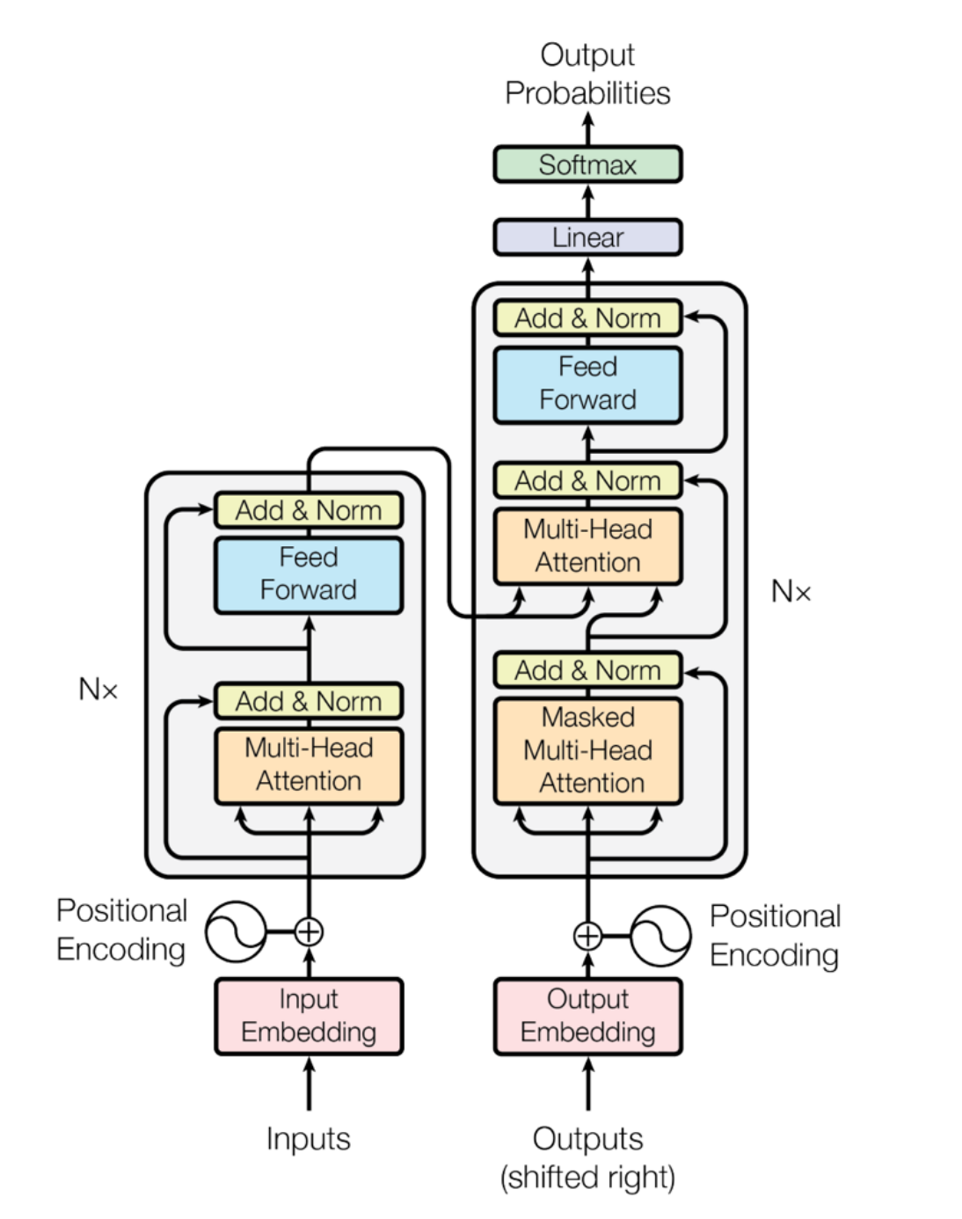
ARCHITECTURE
Transformer
2017 ARCHITECTURE
The encoder reads the source; the decoder predicts the target.
Encoder output — one contextual vector per source token
Decoder self-attention reads the target prefix
Cross-attention reads encoder outputs as K and V
Examples — T5, BART, and translation models
Examples include T5, BART, MarianMT and many translation models.
Vaswani et al. (2017), Figure 1. Original figure reproduced in the supplied CS336 lecture.
COMP7608B · Lecture 1
24

Slide 35
ARCHITECTURE
Our toy decoder configuration
TEACHING INSTANCE
One small configuration for shapes and cost calculations.
HYPERPARAMETER
SYMBOL
VALUE
batch
B
1
sequence
T
16
One block with four independent MHA heads
RMSNorm, RoPE, and a SwiGLU FFN
d = H × dₕ = 4 × 32 = 128
d_ff = 344; input and output embeddings tied
vocabulary
V
2,048
model width
d
128
blocks
N
1
heads
H
4
head width
dₕ
32
SwiGLU width
d_ff
344
Teaching assumptions: bias-free projections, MHA, pre-RMSNorm, RoPE, SwiGLU, tied embeddings.
COMP7608B · Lecture 1
26

Slide 36
ARCHITECTURE
One rule for counting matrix-multiply FLOPs
THE REUSABLE RULE
[m,k] × [k,n] → [m,n]
Count the outputs, then the work per output.
Example — three QKV projections
[m,k] × [k,n] produces m × n outputs
Each output is a length-k dot product
One multiply + one add count as two FLOPs
Leading cost ≈ 2mkn
One projection
[B,T,d] × [d,d] → [B,T,d]
2BTd² FLOPs
Three projections = 6BTd²
B=1, T=16, d=128 → 1.573 MFLOPs
Leading matrix counts omit biases and smaller elementwise operations; weight storage is counted separately.
COMP7608B · Lecture 1
27

Slide 37
ARCHITECTURE
Tensor shapes through the decoder
SHAPE SCAFFOLD
Track temporary shapes as well as the residual stream.
IDs
[B,T]
stream
[B,T,d]
heads
[B,H,T,dₕ]
block
[B,T,d]
logits
[B,V]
Residual stream stays [B,T,d] between blocks
Attention introduces a head axis and pairwise scores
FFN temporarily expands d to d_ff
Generation selects the final position before the LM head
temporary shapes determine memory and FLOPs
[1,16] → [1,16,128] → … → h_T [1,128] → [1,2048]
Whenever two tensors are added by a residual connection, their shapes must match.
COMP7608B · Lecture 1
28

Slide 38
TRANSFORMER
Embedding lookup selects learned rows
LM head → logits
FROM INTEGERS TO VECTORS
Final RMSNorm
Token ID i selects row i of the embedding table.
E ∈ ℝⱽˣᵈ IDs [B,T] → X = E[IDs] [B,T,d]
× N
+
SwiGLU FFN
Separate small example — E [3,4]
RMSNorm
E has V rows and d learned features per row
Gather rows in the order of the input IDs
Repeated IDs initially select identical vectors
Training learns the table; inference only reads it
ID
f₁
f₂
f₃
f₄
+
0
.2
.1
0
−.1
1
1
0
.5
−.5
MHA + RoPE(Q,K)
2
0
1
−.5
.5
RMSNorm
IDs [1,2,1] → select rows 1, 2, 1
Token embedding
1
0
.5
−.5
Token IDs
0
1
−.5
.5
Check — same ID twice: same initial vector?
1
0
.5
−.5
INPUT
OUTPUT
PARAMETERS
FLOPs
IDs [1,16]
X [1,16,128]
Vd = 262,144
≈0 · gather
Embedding lookup
COMP7608B · Lecture 1
29

Slide 39
TRANSFORMER
Positional Encoding
LM head → logits
MISSING COORDINATE SYSTEM
Final RMSNorm
Order and distance help distinguish contextual roles.
a
dog
bites
man
× N
+
SwiGLU FFN
RMSNorm
Token identity alone does not specify relative distance
A dog bites a man; a man bites a dog
Original model — add positional vectors to embeddings
Our model — inject position inside attention with RoPE
a
man
bites
dog
+
MHA + PE(Q,K)
RMSNorm
same words · different order · different meaning
Token embedding
Token IDs
Original Transformers add position to embeddings; many recent decoder models rotate Q and K with RoPE.
COMP7608B · Lecture 1
30

Slide 40
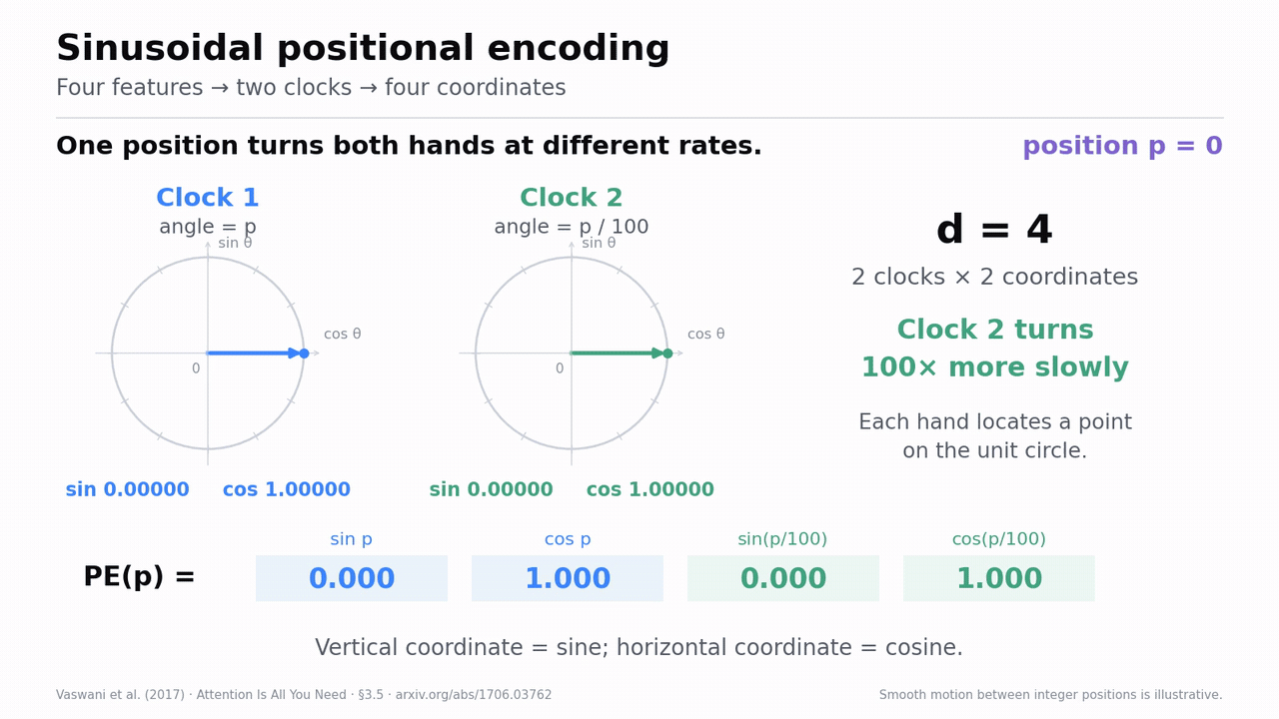
TRANSFORMER
Sinusoidal Positions Encoding
ORIGINAL TRANSFORMER
Two coordinates locate one hand; different clocks rotate at different rates.
d = 4 → two clocks; positions p = 0, 1, 2
Clock 1 angle p; clock 2 angle p/100
Compute sin and cos for every position
Add PE [3,4] to embeddings X [3,4] once
COMP7608B · Lecture 1
31

Slide 41
TRANSFORMER
LayerNorm
LM head → logits
GENERAL NORMALIZATION IDEA
Final Norm
Compute statistics across the features of one token.
LN(x)=γ ⊙ (x−μ)/√(σ²+ε) + β
× N
+
SwiGLU FFN
Same vector for both normalization examples
Norm
Subtract that token’s feature mean
Divide by its feature standard deviation
Apply learned scale γ and offset β
No mixing across tokens; same [B,T,d] shape
x = [1, 2, 3, 4]
+
MHA + RoPE(Q,K)
μ = 2.5 σ² = 1.25
Norm
LN(x) ≈ [−1.34, −0.45, 0.45, 1.34]
Token embedding
Token IDs
Here γ=1, β=0; tiny ε omitted in the arithmetic.
INPUT
OUTPUT
PARAMETERS
FLOPs
[1,16,128]
same shape
2d = 256
≈7BTd
Ba et al. (2016)
COMP7608B · Lecture 1
32

Slide 42
TRANSFORMER
RMSNorm
LM head → logits
COMMON MODERN REPLACEMENT
Final RMSNorm
RMSNorm(x)=γ ⊙ x / √(mean(x²)+ε)
Divide by root-mean-square magnitude; apply learned γ.
× N
+
SwiGLU FFN
Compute the mean of squared features
Divide by its square root, with ε for stability
Keep learned γ; omit mean subtraction and β
Same shape; one learned parameter per feature
Compare using x = [1, 2, 3, 4]
RMSNorm
+
mean(x²) = 7.5
RMS(x) = √7.5 ≈ 2.74
MHA + RoPE(Q,K)
RMSNorm
RMSNorm(x) ≈ [0.37, 0.73, 1.10, 1.46]
Token embedding
Token IDs
Here γ=1; ε omitted. The mean is not forced to zero.
INPUT
OUTPUT
PARAMETERS
FLOPs
[1,16,128]
same shape
d = 128
≈4BTd
Zhang & Sennrich (2019)
COMP7608B · Lecture 1
33

Slide 43
TRANSFORMER
Pre-norm or Post-norm
PLACEMENT CHOICE
Each branch adds an update to the existing hidden state.
POST-NORM · ORIGINAL
y = Norm(x + F(x))
Residual addition — x + F(x), with matching shapes
Post-norm — normalize after adding the update
Pre-norm — normalize only the branch input
Our decoder uses pre-norm and a final RMSNorm
PRE-NORM · MODERN
y = x + Norm(F(x))
Pre-norm often improves optimization stability; it does not guarantee a better final model under every training recipe.
Xiong et al. (2020)
COMP7608B · Lecture 1
34

Slide 44
TRANSFORMER
Queries, keys, and values
LM head → logits
THREE LEARNED VIEWS
Q
Query
Final RMSNorm
Three learned views of the same hidden state.
What information do I need?
× N
+
SwiGLU FFN
RMSNorm
Q — what information this position seeks
K — how another position can match it
V — the information it can contribute
Every token produces all three; features are learned
K
Key
+
When should another query select me?
MHA + RoPE(Q,K)
RMSNorm
V
Value
Token embedding
What do I contribute if selected?
Token IDs
Q · K · V
A high Q–K score decides where to read; V decides what information is read.
COMP7608B · Lecture 1
35

Slide 45
TRANSFORMER
Project QKV, then split into heads
One projection, then reorganize features
W_Q
[d,d]
Q
[B,H,T,dₕ]
Project
XW_Q
[B,T,d] = [1,16,128]
X
[B,T,d]
W_K
[d,d]
K
[B,H,T,dₕ]
Reshape
d = H × dₕ
[B,T,H,dₕ] = [1,16,4,32]
W_V
[d,d]
V
[B,H,T,dₕ]
Transpose
Move the head axis
[B,H,T,dₕ] = [1,4,16,32]
Each projection keeps width d before the head reshape.
Do the same for K and V. Next, rotate Q and K.
INPUT
OUTPUT
PARAMETERS
FLOPs
X [1,16,128]
3× head tensors
3d² = 49,152
6BTd²
COMP7608B · Lecture 1
36

Slide 46
TRANSFORMER
Queries and keys produce pairwise scores
S = QKᵀ / √dₕ
W_Q
[d,d]
Q
[B,H,T,dₕ]
S = QKᵀ / √dₕ
Q
[1,4,16,32]
×
Kᵀ
[1,4,32,16]
=
S
[1,4,16,16]
X
[B,T,d]
W_K
[d,d]
K
[B,H,T,dₕ]
A = softmax(S+M)
W_V
[d,d]
V
[B,H,T,dₕ]
For T=16, each head contains 16×16 pair scores.
C = AV
Each row compares one query with all keys. Add M before softmax to hide future positions.
Q and K include RoPE; M excludes future positions.
INPUT
OUTPUT
PARAMETERS
FLOPs
Q,K head tensors
S [1,4,16,16]
0
2BT²d
COMP7608B · Lecture 1
38

Slide 47
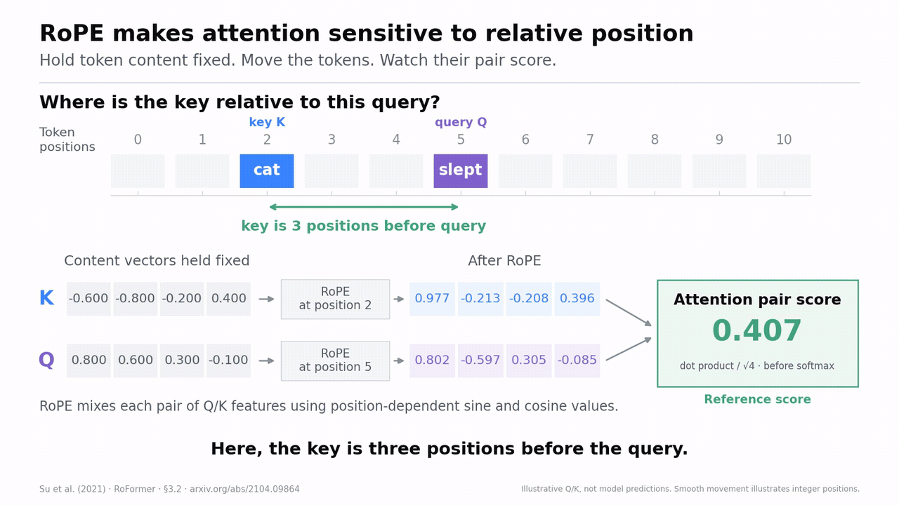
TRANSFORMER
Rotary Positional Encoding (RoPE)
LM head → logits
Final RMSNorm
× N
+
SwiGLU FFN
RMSNorm
+
MHA + RoPE(Q,K)
RMSNorm
Token embedding
Token IDs
COMP7608B · Lecture 1
37

Slide 48
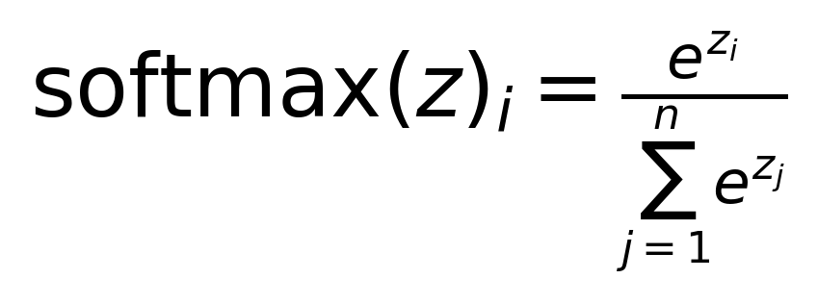
TRANSFORMER
Score Scaling
NUMERICAL STABILITY
Divide scores by √dₕ before softmax.
Var(q·k)≈dₕ ⇒ Var(q·k/√dₕ)≈1
A dot product sums dₕ products
Under simple assumptions, its variance grows with dₕ
Large scores can make softmax overly concentrated
Scaling controls variance without changing shape
SOFTMAX EXAMPLE
large scores
controlled scores
Scores [4, 1, 0]
Probabilities
93.6%, 4.7%, 1.7%
Scores [2, 0.5, 0]
Probabilities
73.6%, 16.4%, 10.0%
Example dₕ = 4, so divide scores by 2. Softmax changes; tensor shape stays fixed.
INPUT
OUTPUT
PARAMETERS
FLOPs
S [B,H,T,T]
Scaled S; same shape
0
lower-order
COMP7608B · Lecture 1
39

Slide 49
TRANSFORMER
Attention Scores
One head; three visible keys; values have width 2
W_Q
[d,d]
Q
[B,H,T,dₕ]
S row = [2, 1, 0]
S = QKᵀ / √dₕ
A = softmax(S+M) ≈ [0.665, 0.245, 0.090]
X
[B,T,d]
W_K
[d,d]
K
[B,H,T,dₕ]
key
weight
value
A = softmax(S+M)
1
0.665
[2,0]
2
0.245
[0,2]
W_V
[d,d]
V
[B,H,T,dₕ]
C = AV
3
0.090
[1,1]
C = 0.665[2,0] + 0.245[0,2] + 0.090[1,1]
≈ [1.420, 0.580]
Q and K include RoPE; M excludes future positions.
Check — change V only: do the weights change?
INPUT
OUTPUT
PARAMETERS
FLOPs
A [B,H,T,T], V
C [B,H,T,dₕ]
0
2BT²d
COMP7608B · Lecture 1
40

Slide 50
TRANSFORMER
QKV Concat
RETURN TO MODEL WIDTH
head 1
[1,16,32]
Concatenation restores width d; W_O mixes heads.
head 2
[1,16,32]
concat
[1,16,128]
Each head returns [B,T,dₕ]
Concatenate H heads into [B,T,d]
Apply W_O [d,d] to mix their outputs
Add the result to the unchanged residual input
head 3
[1,16,32]
W_O
[128,128]
head 4
[1,16,32]
+ residual x
→ [1,16,128]
INPUT
OUTPUT
PARAMETERS
FLOPs
4×[1,16,32]
[1,16,128]
W_O: d²=16,384
2BTd²
COMP7608B · Lecture 1
41

Slide 51
TRANSFORMER
Attention Computing Cost
LM head → logits
LAYER CHECKPOINT
Dense projections grow with T; pairwise work grows with T².
MHA FLOPs ≈ 8BTd² + 4BT²d
Final RMSNorm
× N
+
SwiGLU FFN
QKV projections
6BTd²
1.573M
RMSNorm
QKV and output matrices contribute 8BTd² FLOPs
Score and value products contribute 4BT²d
Short toy context — dense projections dominate
Long context — pairwise work grows faster
+
MHA + RoPE(Q,K)
QKᵀ + AV
4BT²d
0.131M
RMSNorm
Token embedding
output projection
2BTd²
0.524M
Token IDs
ATTENTION COMPLETE
parameters = 4d² = 65,536
COMP7608B · Lecture 1
42

Slide 52
TRANSFORMER
Activation: Rationale
LM head → logits
NEURAL-NETWORK FOUNDATION
W₂(W₁x+b₁)+b₂ = (W₂W₁)x + (W₂b₁+b₂)
Final RMSNorm
Purely affine layers collapse into one affine map.
× N
+
SwiGLU FFN
Two affine maps combine into another affine map
An activation adds nonlinear feature responses
Depth can then express more complex transformations
This argument concerns the FFN’s affine layers
WITHOUT ACTIVATION
RMSNorm
+
linear → linear → still linear
MHA + RoPE(Q,K)
RMSNorm
WITH ACTIVATION σ
Token embedding
linear → σ → nonlinear features
Token IDs
Linear layers mix features; activations allow the network to construct new nonlinear features.
COMP7608B · Lecture 1
43

Slide 53
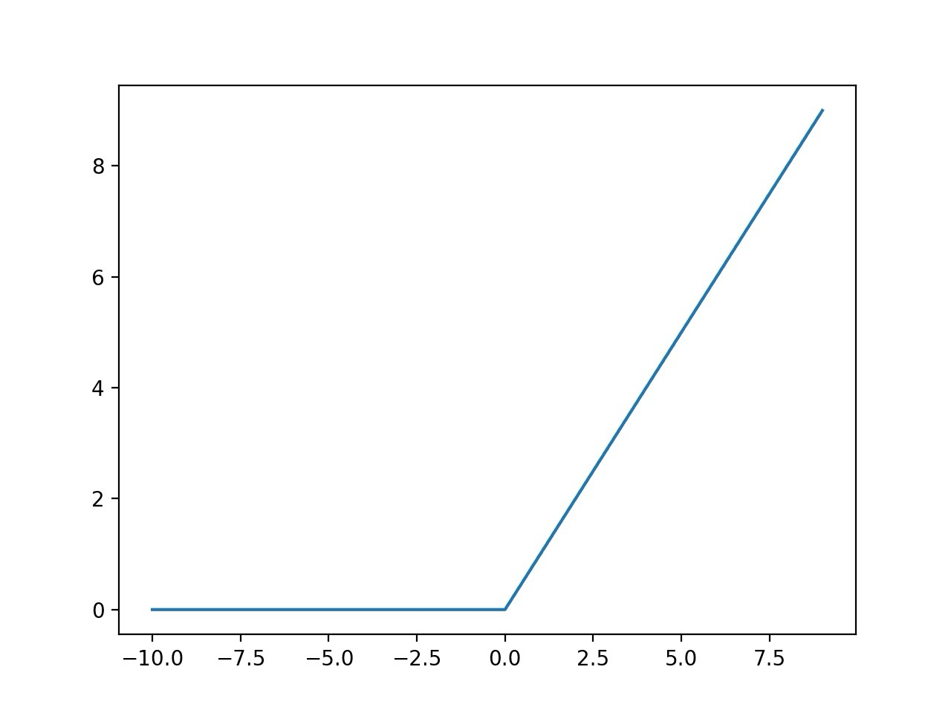
TRANSFORMER
Activation: ReLU
ORIGINAL TRANSFORMER
A separate feature transformation at every token position.
FFN(x)=ReLU(xW₁+b₁)W₂+b₂
x
[1,16,128]
up W₁
[1,16,512]
ReLU
same
down W₂
[1,16,128]
4d is an empirical convention; cost depends on the chosen intermediate width.
ReLU(z) = max(0,z)
INPUT
OUTPUT
PARAMETERS
FLOPs
[1,16,128]
[1,16,128]
8d²=131,072
4BTd·d_ff
COMP7608B · Lecture 1
44

Slide 54
TRANSFORMER
Gated ReLU (*GLU)
TWO INTERMEDIATE BRANCHES
FFN(X) = [φ(XW_g) ⊙ (XW_u)]W_d
Both branches receive the same input.
X [B,T,d]
Content branch proposes features
Gate branch modulates those features
Multiply the branches elementwise
A third matrix projects the result back to d
φ(XW_g)
[B,T,d_ff]
XW_u
[B,T,d_ff]
⊙ elementwise
× W_d → [B,T,d]
ReGLU uses ReLU; GEGLU uses GELU; SwiGLU uses SiLU on the gate branch.
Shazeer (2020)
COMP7608B · Lecture 1
45

Slide 55
TRANSFORMER
SwiGLU
COMMON MODERN CHOICE
SwiGLU(X) = [SiLU(XW_g) ⊙ (XW_u)]W_d
SiLU(z) = z × sigmoid(z); also called Swish with β = 1.
X [B,T,128]
Gate and content projections each produce 344 features
SiLU changes the gate values without changing shape
Elementwise product stays 344 wide
Down projection returns to d = 128
SiLU(XW_g)
[B,T,344]
XW_u
[B,T,344]
⊙ elementwise
× W_d → [B,T,128]
INPUT
OUTPUT
PARAMETERS
FLOPs
[1,16,128]
[1,16,128]
3d·344=132,096
6BTd·344
PyTorch SiLU / Swish
COMP7608B · Lecture 1
46

Slide 56
TRANSFORMER
FFN Expansion Ratios
CAPACITY ALLOCATION
2d(4d) = 3d(8d/3) = 8d²
The 8/3 ratio matches a three-matrix FFN to a two-matrix 4d FFN.
MODEL
FFN
d_ff/d
Original Transformer
ReLU
4.00
Plain FFN — 2d × d_ff parameters
Gated FFN — 3d × d_ff parameters
Matching budgets gives d_ff = 8d/3
Real models choose and round different widths
Phi-3 Mini
SwiGLU
2.67
Llama 3 8B
SwiGLU
3.50
Mistral 7B
SwiGLU
3.50
Gemma 2 9B
gated GELU
4.00
Qwen2.5 7B
SwiGLU
5.29
Ratio alone is insufficient: check matrix count, rounding, and whether experts are routed.
Publisher configurations — references at end
COMP7608B · Lecture 1
47

Slide 57
TRANSFORMER
Summary for Transformer Blocks
LM head → logits
COMPLETE COMPUTATION
Final RMSNorm
Attention mixes positions; the FFN transforms features.
× N
+
SwiGLU FFN
RMSNorm
RMSNorm → MHA with RoPE → residual addition
RMSNorm → SwiGLU → residual addition
Both updates return to [B,T,d]
The next block receives exactly the same outer shape
+
MHA + RoPE(Q,K)
RMSNorm
Token embedding
Token IDs
x′ = x + MHA(RMSNorm(x))
one block · input and output [B,T,d]
y = x′ + SwiGLU(RMSNorm(x′))
COMP7608B · Lecture 1
48

Slide 58
INFERENCE
Output Logits
LM head → logits
OUTPUT PROJECTION
z = h_T W_U h_T:[B,d], W_U:[d,V], z:[B,V]
Final RMSNorm
Project the final-position hidden state from d features to V logits.
× N
+
SwiGLU FFN
final stream
[1,16,128]
RMSNorm
Take h_T [B,d] after the final RMSNorm
Multiply by W_U [d,V] → logits [B,V]
Logits are scores; they need not sum to one
With weight tying, W_U = Eᵀ
+
take position T
[1,128]
MHA + RoPE(Q,K)
RMSNorm
LM head
[128,2048]
Token embedding
logits
[1,2048]
Token IDs
LM HEAD → LOGITS
Tied W_U = Eᵀ; output multiplication still costs FLOPs.
INPUT
OUTPUT
PARAMETERS
FLOPs
h_T [1,128]
z [1,2048]
0 extra — tied to Eᵀ
2BdV=0.524M
COMP7608B · Lecture 1
50

Slide 59
INFERENCE
Temperature
DECODING HYPERPARAMETER
P(i)=exp(zᵢ/τ) / Σⱼ exp(zⱼ/τ)
Divide logits by positive τ, then apply softmax.
Toy logits z = [2,1,0] — a 3-token vocabulary
Low τ — sharper distribution
High τ — flatter distribution
Model weights and original logits stay fixed
Positive τ preserves the greedy argmax
τ=0.5
τ=1
τ=2
A
86.7%
A
66.5%
A
50.6%
B
11.7%
B
24.5%
B
30.7%
C
1.6%
C
9.0%
C
18.6%
sharper
baseline
flatter
Check — can a positive temperature change the greedy choice?
COMP7608B · Lecture 1
51

Slide 60
INFERENCE
Sampling
TOKEN SELECTION
Different decoding rules can produce different continuations.
GREEDY
TOP-k
TOP-p
SAMPLE
argmax
keep k
cum. p
random draw
Greedy — choose the largest logit
Top-k — retain k highest-probability candidates
Top-p — retain the smallest set reaching mass p
Renormalize retained probabilities, then sample
same token
fixed count
adaptive set
variation
temperature → top-k/top-p → renormalize → sample
Once one sampled token differs, it becomes part of the next prefix and can change the remainder of the generated sequence.
Nucleus sampling: Holtzman et al. (2020)
COMP7608B · Lecture 1
52

Slide 61
INFERENCE
Auto-regressive Generation
AUTOREGRESSIVE GENERATION
Append the selected ID and run the model again.
current IDs
forward pass
sample
Each pass produces a next-token distribution
The selected ID becomes part of the next prefix
EOS or an application rule ends generation
The same model weights are reused every step
append token and repeat
EOS
learned end marker
max tokens
hard length limit
stop/tool rule
application boundary
The vanilla loop may repeat earlier computation. KV-cache reuse is the central optimization introduced next lecture.
COMP7608B · Lecture 1
53

Slide 62
INFERENCE
One complete inference pass
LM head → logits
1
Tokenize
text → IDs [B,T]
BPE applies fixed merges
Final RMSNorm
× N
+
2
Represent
IDs → X [B,T,d]
embedding; position enters attention
SwiGLU FFN
RMSNorm
3
Attention
[B,T,d] → [B,T,d]
RMSNorm → QKV → RoPE → A V → W_O → add
+
MHA + RoPE(Q,K)
4
Activation
[B,T,d] → [B,T,d]
RMSNorm → SwiGLU → residual add
RMSNorm
Token embedding
5
Score
h_T → logits [B,V]
final norm and LM head
Token IDs
6
Select
probabilities → token ID
temperature, filtering and sampling
complete decoder-only pass
COMP7608B · Lecture 1
54

Slide 63
COST
Compare computation across the layers
TOY COST MODEL
SwiGLU FFN
4.227M
For this short prompt, FFN and dense projections dominate.
QKV + output
2.097M
Main example — B=1, T=16, d=128, N=1
SwiGLU width 344; final-position LM head only
Count multiply and add separately
FLOPs describe arithmetic, not measured latency
LM head
0.524M
QKᵀ + AV
0.131M
Other operations
small*
toy total ≈ 7.0 MFLOPs
*Norms, RoPE, softmax, activation and additions omitted from the leading matrix total.
COMP7608B · Lecture 1
55

Slide 64
COST
Count stored weights as well as FLOPs
SAME TOY MODEL
Component
Parameters
Large weight storage does not imply large arithmetic cost.
Embedding / tied head
262,144
MHA projections
65,536
Embedding and LM head share one matrix
Attention — four d × d matrices
FFN — two d × d_ff; one d_ff × d
Three RMSNorm scales; no linear biases
SwiGLU FFN
132,096
RMSNorm scales
384
Total
460,160
FP16 / BF16 weights ≈ 0.92 MB
FP32 weights ≈ 1.84 MB
Untied head adds 262,144 weights. These are decimal MB of weights only; runtime buffers need extra memory.
COMP7608B · Lecture 1
56

Slide 65
COST
Architecture hyperparameters
ENGINEERING CHOICES
KNOB
AFFECTS
COST
NOTE
Choose dimensions together, then validate experimentally.
V
embedding / LM head
∝Vd
may reduce T
T
token-wise + attention
∝T and T²
context cost
V trades vocabulary storage against token length
d, N, and d_ff allocate capacity and computation
H and dₕ define the attention layout
Data, hardware, and task determine useful choices
d
most dense matrices
∝d²
width and heads
N
repeated blocks
∝N
depth
d_ff
FFN capacity
∝d·d_ff
2 vs 3 matrices
H,dₕ
attention layout
d = H·dₕ
grouping later
Part science: derive effects. Part engineering: choose and validate under constraints.
V and T trade off; width and depth allocate capacity. Evaluate the complete configuration.
COMP7608B · Lecture 1
57

Slide 66
CLOSE
Next — faster inference and smaller memory use
LOOKING AHEAD
CAUSAL MASK
KV CACHE
Separate exact execution changes from architecture trade-offs.
visibility
reuse
GQA / MQA
MLA
share K,V
compress state
KV cache and exact kernels reuse or reorganize computation
GQA, MQA, and MLA change attention design
Quantization reduces bytes with numerical approximation
Measure quality, latency, throughput, and memory
QUANTIZATION
KERNELS
fewer bytes
better execution
BENCHMARKS
measure reality
CPU toolkit on Moodle; bring a laptop for announced hands-on sessions.
COMP7608B · Lecture 1
58

Slide 67
REFERENCES
References — language modelling and architecture
Shannon (1951)
Kaplan et al. (2020)
Prediction and Entropy of Printed English
Scaling Laws for Neural Language Models
Bengio et al. (2003)
Hoffmann et al. (2022)
A Neural Probabilistic Language Model
Training Compute-Optimal Large Language Models
Mikolov et al. (2013)
Gage (1994); Sennrich et al. (2016)
Efficient Estimation of Word Representations
BPE compression and neural translation with subwords
Vaswani et al. (2017)
Hashimoto — Stanford CS336
Attention Is All You Need; original architecture figure
Supplied Lecture 3 figures; architecture teaching reference
Radford et al. (2018)
Improving Language Understanding by Generative Pre-Training
Click a linked title for the source. Numerical examples in this lecture are illustrative calculations.
COMP7608B · Lecture 1
59

Slide 68
REFERENCES
References — components and model configurations
Ba et al. (2016); Zhang & Sennrich (2019)
Ainslie et al. (2023)
LayerNorm and RMSNorm
Grouped-query attention and checkpoint uptraining
Su et al. (2021)
Llama 3 8B; Mistral 7B
RoFormer — Rotary Position Embedding
Publisher configurations — width, depth, FFN dimensions
Xiong et al. (2020)
Phi-3 Mini; Gemma 2 9B
On Layer Normalization in the Transformer Architecture
Publisher configurations — FFN comparison
Shazeer (2020); PyTorch SiLU
Qwen2.5 7B
GLU Variants Improve Transformer; SiLU = Swish at β=1
Publisher configuration — d=3584; d_ff=18944
Holtzman et al. (2020)
The Curious Case of Neural Text Degeneration
Click a linked title for the source. Numerical examples in this lecture are illustrative calculations.
COMP7608B · Lecture 1
60

