Slide 1
COMP7608B · LECTURE 2
A decoder deployed for repeated inference
Next-token probabilities
Efficient LLM
Inference
Norm, projection, softmax
Block × L
+
Low-bit
weights
FFN / MoE
Architecture and
high-performance serving
Norm
+
Paged
KV cache
Attention
GQA / MLA + Flash
Wenbo Sun
Norm
School of Computing and Data Science
HKU
Token embedding
Input tokens
2026–27 · Semester 1
01

Slide 2
INFERENCE ECONOMICS
What inference costs
The company pays
The user waits
GPU count × rental rate
× billed hours
Queue
Prompt
processing
Token
generation
Memory determines what fits.
Throughput determines how much
traffic each GPU can serve.
Time to first token
Time between generated tokens
Time to the complete answer
A deployable service must meet a quality target and a latency target at an affordable cost.
COMP7608B · Lecture 2
02

Slide 3
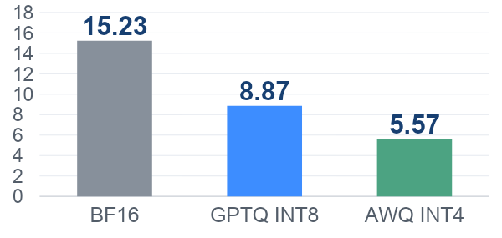
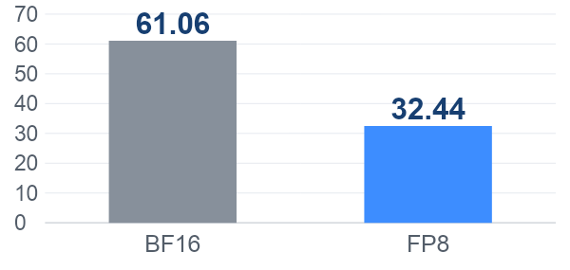
INFERENCE ECONOMICS
Quantization changes the memory requirement
Stored tensor payload (GB), including scales and higher-precision tensors.
Dense · Qwen2-7B-Instruct
MoE · Qwen3-30B-A3B
30.5B total, 3.3B active per token
INT8 retains 58.2% of BF16 tensor bytes.
FP8 retains 53.1% of BF16 tensor bytes.
MoE still stores all experts. Lower precision reduces this stored weight state.
GB = 10⁹ bytes. Tensor payload from checkpoint indices, including scale tensors. Excludes file headers, KV cache and runtime buffers. Separate chart scales.
COMP7608B · Lecture 2
03

Slide 4
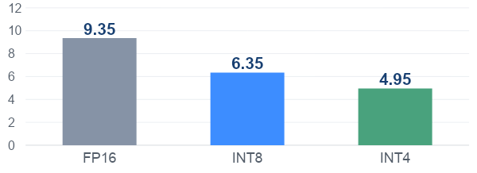
INFERENCE ECONOMICS
Quantization reduces token-generation latency
Llama-7B on one A100 80GB, batch size 1, GPU power limited to 330 W
Decoding time per token (ms), lower is better
47%
less decoding time
with INT4
All three paths use compilation. INT4 also uses calibration and specialized kernels.
Lower precision can reduce weight-transfer time when the runtime has efficient kernels.
PyTorch, GPT Fast (2023)
COMP7608B · Lecture 2
04

Slide 5
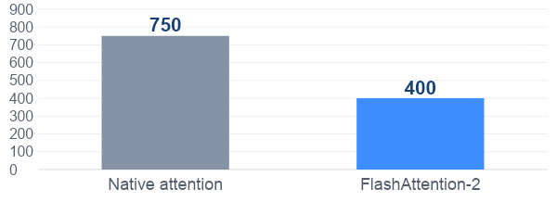
INFERENCE ECONOMICS
FlashAttention reduces prompt latency
Llama-2-7B on one NVIDIA A100, batch size 1, 4,096 tokens, no padding
One full-model forward pass (ms), approximate figure readings
~47%
less time per
forward pass
This measures prompt-style computation. It does not include a complete generated answer.
FlashAttention reduces attention memory traffic while preserving the attention calculation.
Published Llama-2-7B timing figure
COMP7608B · Lecture 2
05

Slide 6
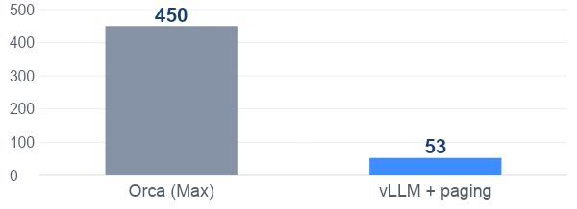
INFERENCE ECONOMICS
PagedAttention helps latency under traffic
OPT-13B on one A100 40GB, ShareGPT chatbot trace, 0.55 requests/s
Mean of request time / output-token count (ms/token)
~88%
lower normalized
request latency
Includes queueing and prompt work. Approximate values from the published curve.
Paging allows more live requests to fit. The system’s batching and scheduling also contribute.
Kwon et al., PagedAttention (2023), Fig. 17
COMP7608B · Lecture 2
06

Slide 7
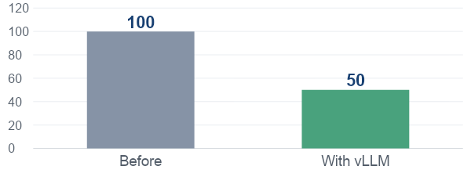
INFERENCE ECONOMICS
A public service used half as many GPUs
LMSYS adopted FastChat-vLLM for Vicuna and Chatbot Arena in 2023
GPU count, indexed to the previous deployment = 100
30,000
requests per day
on average
60,000
requests on peak days
The team reported a 50% GPU reduction. Efficient serving changed the hardware requirement.
vLLM, FastChat / LMSYS deployment (2023)
COMP7608B · Lecture 2
07

Slide 8
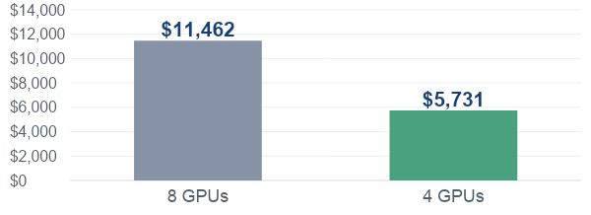
INFERENCE ECONOMICS
What a smaller public-service fleet saves
Planning example: 8 to 4 A100 40GB GPUs, each billed for 720 hours/month
Monthly GPU rental (USD) at $1.99 per GPU-hour
$5,731
saved per month
$68,774 per year
Assumption: the optimized fleet handles the same workload and meets the same service target.
8 × $1.99 × 720 = $11,462/month. Halving billed capacity halves this rental cost.
Lambda pricing, checked 10 Sep 2026 / vLLM, FastChat / LMSYS deployment (2023)
COMP7608B · Lecture 2
08

Slide 9
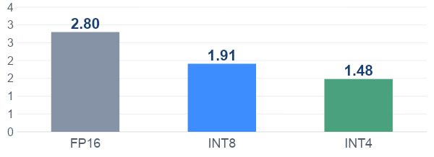
INFERENCE ECONOMICS
An internal assistant can return answers sooner
Example workload: 1,000 employees × 20 answers/day × 22 working days
Decoding time for a 300-token answer (s), derived from slide 4
1.32 s
less waiting per answer
with INT4
440,000 answers/month = 132 million output tokens.
These are decoding-time estimates. Queueing and prompt processing add to the complete response time.
PyTorch, GPT Fast (2023)
COMP7608B · Lecture 2
09

Slide 10
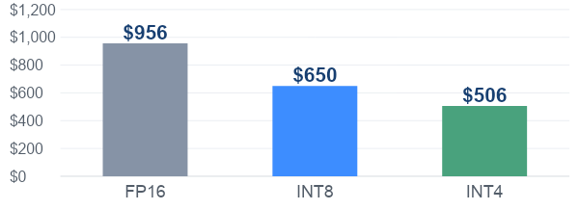
INFERENCE ECONOMICS
Internal usage also accumulates compute cost
132 million output tokens/month, using the same measured generation rates
Allocated decoding cost (USD/month) at $2.79 per GPU-hour
$450
lower monthly
GPU-time allocation
GPU-hours = output tokens / tokens per second / 3,600. Prefill and idle time are excluded.
Lower billed GPU-hours produce cash savings. Idle reserved capacity still costs money.
PyTorch, GPT Fast (2023) / Lambda pricing, checked 10 Sep 2026
COMP7608B · Lecture 2
10

Slide 11
TODAY
The engineering questions for Lecture 2
Part | Constraint | Question
Quantization | Weight bytes and bandwidth | How much precision can the task afford?
GQA, MQA | KV state per active request | How much context can we keep?
Flash + PagedAttention | Attention traffic and allocation | How should the engine move and store data?
MoE architecture | Active work and expert storage | Which parameters run for each token?
Serving systems | Concurrency and queueing | Which configuration meets the latency target?
Success means acceptable task quality, low tail latency and enough sustained throughput for the workload.
COMP7608B · Lecture 2
11

Slide 12
QUANTIZATION
FP32, FP16 and BF16 bit layouts
Sign sets polarity. Exponent sets range. Fraction sets precision.
FP32
s
e
e
e
e
e
e
e
e
f
f
f
f
f
f
f
f
f
f
f
f
f
f
f
f
f
f
f
f
f
f
f
32 bits = 1 sign + 8 exponent + 23 fraction
FP16
s
e
e
e
e
e
f
f
f
f
f
f
f
f
f
f
More fraction bits than BF16
16 bits = 1 sign + 5 exponent + 10 fraction
BF16
s
e
e
e
e
e
e
e
e
f
f
f
f
f
f
f
Same exponent width as FP32
16 bits = 1 sign + 8 exponent + 7 fraction
Both 16-bit formats halve FP32 storage. BF16 keeps a wider range, while FP16 keeps finer precision.
NVIDIA, reduced-precision formats
COMP7608B · Lecture 2
Q02

Slide 13
QUANTIZATION
How computers store floating-point numbers
The same value in FP32 and BF16 x = 6.5078125
s = sign, E = stored exponent, B = bias, F = fraction as an integer, m = fraction bits
Format | Sign | Exponent | Fraction bits | Stored value
FP32 | 0 | 10000001 | 10100000100000000000000 | 6.5078125
BF16 | 0 | 10000001 | 1010000 | 6.5
FP32: m = 23, F = 5,259,264 BF16: m = 7, F = 80 Both: E = 129, B = 127
BF16 stores 6.5. Absolute error = 0.0078125, or about 0.12% of the original value.
Round to nearest. FP16 represents this particular value exactly. Formula applies to normal finite values. Source: NVIDIA, Floating Point and IEEE 754.
COMP7608B · Lecture 2
13

Slide 14
QUANTIZATION
Quantization formula and parameter selection
q = clip(round(x / s) + z, qmin, qmax) x̂ = s × (q − z)
s > 0 is the step size. z is the integer code for zero. x̂ approximates x.
1 Choose bit width and integer range
2 Select a real range [a, b] including zero
Unsigned 4-bit uses [0, 15].
Symmetric signed 4-bit often uses [−7, 7],
leaving the −8 storage code unused.
Use weight statistics or representative
activation samples. Start with min/max.
Percentile or error-based clipping may help.
Asymmetric
s = (b − a) / (qmax − qmin)
z = clip(round(qmin − a / s), qmin, qmax)
Symmetric
A = max(|a|, |b|) s = A / 7 z = 0 (4-bit example)
PyTorch, Practical Quantization
COMP7608B · Lecture 2
Q04

Slide 15
QUANTIZATION
Two 4-bit quantization examples
Symmetric weights
Asymmetric range
Observed range [−3.5, 3.5]
q range [−7, 7]
Observed range [−1.0, 2.0]
q range [0, 15]
s = 3.5 / 7 = 0.5
z = 0
s = 3 / 15 = 0.2
z = round(0 − (−1) / 0.2) = 5
x = 1.3
q = round(1.3 / 0.5) = 3
Stored bits 0011
x̂ = 0.5 × 3 = 1.5
x = 0.74
q = round(0.74 / 0.2) + 5 = 9
Stored bits 1001
x̂ = 0.2 × (9 − 5) = 0.8
Absolute errors are 0.20 and 0.06. Reconstructing either value requires its scale and zero-point.
COMP7608B · Lecture 2
Q05

Slide 16
QUANTIZATION
Outliers make one scale too coarse
One symmetric 4-bit scale for all five values
A = 7.0 s = 7.0 / 7 = 1.0 z = 0
Original x | −0.4 | −0.2 | 0.1 | 0.3 | 7.0
Stored q | 0 | 0 | 0 | 0 | 7
Reconstructed x̂ | 0.0 | 0.0 | 0.0 | 0.0 | 7.0
The outlier preserves its value, while four ordinary weights collapse to zero. Clipping trades one error for another.
COMP7608B · Lecture 2
Q06

Slide 17
QUANTIZATION
Smaller groups can use different scales
Symmetric INT4, round to nearest even
Group | Original values | Scale | Stored q
A | [−0.4, −0.2, 0.1, 0.3] | 0.4 / 7 | [−7, −4, 2, 5]
B | [7.0, 3.5, 0.0, −7.0] | 1.0 | [7, 4, 0, −7]
For 128 weights, 4-bit values occupy 64 bytes.
One FP16 scale adds 2 bytes, or 3.1%, before zero-points and other metadata.
Smaller groups adapt to local ranges, but require more scales and support from the inference kernel.
COMP7608B · Lecture 2
Q07

Slide 18
QUANTIZATION
Error accumulation and mixed precision
Start at 2048. Add 1 four times. The exact answer is 2052.
Accumulator | After +1 | After +1 | After +1 | After +1 | Final error
FP32 reference | 2049 | 2050 | 2051 | 2052 | 0
FP16 each step | 2048 | 2048 | 2048 | 2048 | 4
FP16 inputs, FP32 sum | 2049 | 2050 | 2051 | 2052 | 0
At 2048, FP16 spacing is 2. Each 2048 + 1 rounds back to 2048.
Use higher precision for sums, normalization and softmax to limit further error.
Upcasting cannot recover bits already lost. Storage and computation can use different precisions.
Quantized models already mix formats
Qwen2-7B-Instruct-AWQ
INT4 linear weights with FP16 activations.
Qwen3-30B-A3B-FP8
FP8 weights, with routers and LM head kept in BF16.
Toy sequential sum, round-to-nearest-even. Actual accumulation depends on the kernel. Sources: NVIDIA accuracy guidance and the named model configs.
COMP7608B · Lecture 2
18

Slide 19
QUANTIZATION
Post-training quantization and QAT
Post-training quantization (PTQ)
A trained checkpoint is already available. Quantize it using weight statistics
and, for methods such as GPTQ or AWQ, representative calibration inputs.
Checkpoint
Calibration + conversion
Quantized checkpoint
Quantization-aware training (QAT)
Simulate quantize + dequantize in the forward pass, then update weights
with gradients. Export real low-bit weights after training or fine-tuning.
Rounding uses an approximate backward gradient, often a straight-through estimator.
PTQ is a low-cost first deployment candidate. QAT adds training cost to help recover quality.
PyTorch, Quantization-Aware Training for LLMs / Frantar et al., GPTQ / Lin et al., AWQ
COMP7608B · Lecture 2
Q09

Slide 20
QUANTIZATION
Common quantization methods
Method | Typical use | What it changes
RTN | PTQ baseline | Round each value to a chosen grid.
GPTQ | PTQ, often W4A16 | Use calibration inputs and curvature information to reduce layer-output error.
AWQ | PTQ, often W4A16 | Use activation statistics to rescale important weight channels.
SmoothQuant | PTQ, W8A8 | Rescale activation outliers into weights so both can use INT8.
QAT | Training / fine-tuning | Learn with simulated quantization error, then convert for inference.
GPTQ and AWQ commonly appear in model cards.
FP8 / FP4 are formats. PTQ / QAT describe how a quantized model is produced.
Frantar et al., GPTQ / Lin et al., AWQ / Xiao et al., SmoothQuant / PyTorch, Quantization-Aware Training for LLMs
COMP7608B · Lecture 2
Q10

Slide 21
QUANTIZATION
Quantization, speed, storage and accuracy
Qwen2-7B-Instruct, one A100 80GB, vLLM 0.4.2
Batch 1, 1 input token, 2,048 output tokens
Quantization | Speed (tokens/s) | Speedup | Weight payload (GB) | Mean score (%) | Loss (pp)
BF16 | 80.45 | 1.00× | 15.23 | 66.9 | 0.0
GPTQ INT8 | 114.32 | 1.42× | 8.87 | 66.2 | 0.7
GPTQ INT4 | 143.40 | 1.78× | 5.58 | 64.1 | 2.8
AWQ INT4 | 96.65 | 1.20× | 5.57 | 64.1 | 2.8
Payload = bytes of stored tensors, including scales and unquantized tensors.
Mean score = reported mean of MMLU, C-Eval and IFEval. Loss is in percentage points.
Historical results. Payload excludes runtime memory. Quality uses separate task evaluations.
Qwen2 speed benchmark (2024) / Qwen2 quantized-model evaluation (2024) / Qwen official checkpoint tensor indexes
COMP7608B · Lecture 2
Q12

Slide 22
TRANSFORMER
Recap of multi-head attention
S = QKᵀ / √dₕ
W_Q
[d,d]
Q
[B,H,T,dₕ]
S = QKᵀ / √dₕ
Q
[1,4,16,32]
×
Kᵀ
[1,4,32,16]
=
S
[1,4,16,16]
X
[B,T,d]
W_K
[d,d]
K
[B,H,T,dₕ]
A = softmax(S+M)
W_V
[d,d]
V
[B,H,T,dₕ]
For T=16, each head contains 16×16 pair scores.
C = AV
Each row compares one query with all keys. Add M before softmax to hide future positions.
Q and K include RoPE; M excludes future positions.
INPUT
OUTPUT
PARAMETERS
FLOPs
Q,K head tensors
S [1,4,16,16]
0
2BT²d
COMP7608B · Lecture 1
38

Slide 23
PREFILL, DECODING AND KV CACHE
Attention over a causal sequence
Example sequence The sky is blue
Keys, by token position
The
sky
is
blue
M[i,j] = 0 when j ≤ i
M[i,j] = −∞ when j > i
q1
•
×
×
×
q2
•
•
×
×
Each query combines only its prefix.
All prompt positions are already known,
so their rows can run together.
q3
•
•
•
×
q4
•
•
•
•
The final row provides the last token’s hidden state. A vocabulary projection predicts the next token.
Vaswani et al., Attention Is All You Need
COMP7608B · Lecture 2
I02

Slide 24
PREFILL, DECODING AND KV CACHE
The prompt is prefill, then decoding repeats
Illustrative tokens The sky is blue today .
Phase | New input to the model | Next token selected
Prefill | The sky is Positions 1–3 together | blue (position 4)
Decode step 1 | blue Position 4 only | today (position 5)
Decode step 2 | today Position 5 only | . (position 6)
Prefill produces the first generated token. Each decoding step consumes the last selected token to predict another.
NVIDIA, LLM Inference Optimization
COMP7608B · Lecture 2
I03

Slide 25
PREFILL, DECODING AND KV CACHE
What the user waits for
Queue
Prefill
Decode 1
Decode 2
Token 1
Token 2
Token 3
Time to first token (TTFT)
Time per output token (TPOT)
Queue + prompt processing
+ first-token selection
Repeated decode work
+ scheduling and delivery
Batching can improve weight reuse and throughput. Every active request also adds KV reads and cache capacity.
JAX Scaling Book, Transformer Inference
COMP7608B · Lecture 2
I15

Slide 26
PREFILL, DECODING AND KV CACHE
The same weights, different amounts of reuse
One D × D projection, one request
Prefill
Incremental decoding
X
T × D
W
D × D
W
D × D
×
xₜ 1 × D
×
2TD² FLOPs
D² × bytes/weight to read W
2D² FLOPs
D² × bytes/weight to read W
Prefill reuses weights across P rows. Small-batch decoding uses one new row and reuses cached K/V for the prefix.
JAX Scaling Book, Transformer Inference
COMP7608B · Lecture 2
I04

Slide 27
PREFILL, DECODING AND KV CACHE
Why earlier keys and values remain valid
In causal inference, a token’s hidden state depends only on its prefix.
At position t | Earlier positions 1 … t−1 | New position t
Queries | Earlier Q is no longer needed | Compute qₜ
Keys and values | Reuse cached K and V | Compute kₜ and vₜ
Attention output | Earlier rows stay unchanged | Compute the new output row
oₜ = softmax(qₜ [K_past ; kₜ]ᵀ / √d) [V_past ; vₜ]
Fixed weights, fixed positions and an unchanged prefix make earlier K/V reusable at every layer.
Hugging Face, How caching works
COMP7608B · Lecture 2
I09

Slide 28
PREFILL, DECODING AND KV CACHE
Prefill fills the KV cache
Prefill processes positions 1–3
Input this step The sky is
One head in one layer
K/V cache after this update
1
2
3
4
5
Compute Q₁:₃
K₁:₃ and V₁:₃
Causal attention
positions 1–3
write
k1
v1
k2
v2
k3
v3
read
3 positions written together
Use Q₁:₃
After all layers
sample “blue”
Prefill stores K and V for the prompt. Its last-position output produces the first generated token.
NVIDIA, LLM Inference Optimization
COMP7608B · Lecture 2
I10

Slide 29
PREFILL, DECODING AND KV CACHE
Decoding reads the cache and appends one token
Decode processes position 4
Input this step blue
One head in one layer
K/V cache after this update
1
2
3
4
5
Compute q4
k4 and v4
Attention
positions 1–4
write
k1
v1
k2
v2
k3
v3
k4
v4
read
Green = reused Orange = appended
Use q4
After all layers
sample “today”
q4 attends to K₁:₄ and V₁:₄. Earlier Q values and earlier token computations are unnecessary.
NVIDIA, LLM Inference Optimization
COMP7608B · Lecture 2
I11

Slide 30
PREFILL, DECODING AND KV CACHE
KV belongs to a token and a layer
Each cell contains one token’s K and V for all H heads
Token 1
Token 2
Token 3
New token 4
K(1,1)
V(1,1)
K(1,2)
V(1,2)
K(1,3)
V(1,3)
K(1,4)
V(1,4)
Layer 1
K(2,1)
V(2,1)
K(2,2)
V(2,2)
K(2,3)
V(2,3)
K(2,4)
V(2,4)
Layer 2
K(L,1)
V(L,1)
K(L,2)
V(L,2)
K(L,3)
V(L,3)
K(L,4)
V(L,4)
Layer L
Each layer has its own projection weights and hidden states, so its cache entries differ.
Hugging Face, How caching works
COMP7608B · Lecture 2
I13

Slide 31
PREFILL, DECODING AND KV CACHE
How large does the KV cache become?
MHA stores K and V per layer as [B, H, T, d]. B is the number of requests.
KV bytes = 2 × L × B × T × H × d × precision
32 layers, 32 heads, d = 128, BF16
Per token per request 2 × 32 × 32 × 128 × 2 = 512 KiB
Context length | One request | Eight requests
4,096 tokens | 2 GiB | 16 GiB
8,192 tokens | 4 GiB | 32 GiB
Full attention, equal lengths, no allocation overhead. Weight quantization leaves KV bytes unchanged
unless KV precision also changes. GQA, MQA and MLA reduce the attention state in different ways.
Hugging Face, How caching works / Shazeer, Fast Transformer Decoding
COMP7608B · Lecture 2
I14

Slide 32
PREFILL, DECODING AND KV CACHE
FLOPs in prefill and one decoding step
One layer, one request. Decoding uses cached earlier K and V.
Operation | Prefill, P input tokens | Decode, T context tokens
Q, K and V projections | 6PD² | 6D²
QKᵀ and attention × V | 2P(P + 1)D | 4TD
Output projection WO | 2PD² | 2D²
SwiGLU FFN, width F | 6PDF | 6DF
A multiply-add counts as 2 FLOPs. Multiply by the number of layers L.
T includes the new token. Attention counts useful causal pairs.
Counts exclude softmax, normalization and elementwise work. Full-square attention adds masked work.
Shazeer, Fast Transformer Decoding
COMP7608B · Lecture 2
I05

Slide 33
PREFILL, DECODING AND KV CACHE
Data I/O in prefill and one decoding step
One layer, one request. I/O here means traffic to and from GPU HBM.
Data movement | Prefill | Decode
Read projection + FFN weights | Nℓ × bW | Nℓ × bW
Read earlier cached K/V | No earlier cache | 2(T − 1)D × bKV
Write new K/V to the cache | 2PD × bKV | 2D × bKV
Nℓ = 4D² + 3DF weights per layer. bW and bKV are bytes per value.
This is a minimum of one weight read and one read/write per cache element.
Activations and attention intermediates add traffic. Materializing P × P attention matrices adds quadratic I/O.
Shazeer, Fast Transformer Decoding / Dao et al., FlashAttention
COMP7608B · Lecture 2
I06

Slide 34
PREFILL, DECODING AND KV CACHE
A worked cost estimate
32 layers, MHA, D = 4,096, H = 32, F = 11,008
P = T = 4,096, batch 1, BF16 weights and KV (2 bytes each)
Across the Transformer blocks | Prefill | One decode step
Projection + FFN parameters | 6.48 billion | 6.48 billion
FLOPs, including causal attention | 57.45 TFLOPs | 15.10 GFLOPs
Weight reads | 12.95 GB | 12.95 GB
New KV writes / old KV reads + writes | 2.15 GB | 2.15 GB
Weight + KV traffic floor | 15.10 GB | 15.10 GB
Calculated model, not a benchmark. Decimal GB. Embeddings, vocabulary head, other activations,
intermediates and runtime overhead are excluded. Equal P and T compare two separate stage inputs.
COMP7608B · Lecture 2
I07

Slide 35
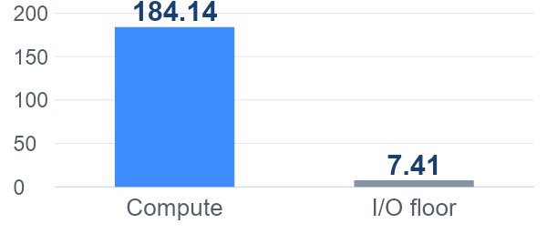
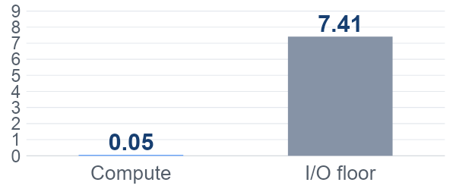
PREFILL, DECODING AND KV CACHE
Compute bound and memory bandwidth bound
A100 80GB SXM, dense BF16 peak 312 TFLOP/s, HBM 2,039 GB/s
Time ≥ max(FLOPs / compute rate, bytes / bandwidth)
4,096-token prefill (ms)
One decode step (ms)
Calculated floors from the previous slide. The plots use different scales. Actual I/O and latency are higher.
Long prefill is often compute bound. Small-batch decoding is often bandwidth bound.
Short prompts, batch size and kernels can change the bottleneck.
NVIDIA A100 datasheet, 80GB SXM / JAX Scaling Book, Transformer Inference
COMP7608B · Lecture 2
I08

Slide 36
ATTENTION ARCHITECTURES
Multi-head attention (MHA)
Residual path
Q = X̃WQ
H query heads
QKᵀ
Y [B, S, D]
÷ √d
+ causal mask
+ X
X
[B, S, D]
RMSNorm
X̃
K = X̃WK
H key heads
Softmax
over keys
Output × WO
V = X̃WV
H value heads
Attention × V
Concat heads
B requests, S input tokens, H heads, d = D/H. Each head runs its own attention.
Attention sublayer only. RoPE omitted. The FFN follows this residual in a complete Transformer block.
Vaswani et al., Attention Is All You Need / Meta, The Llama 3 Herd of Models, Table 3
COMP7608B · Lecture 2
A01

Slide 37
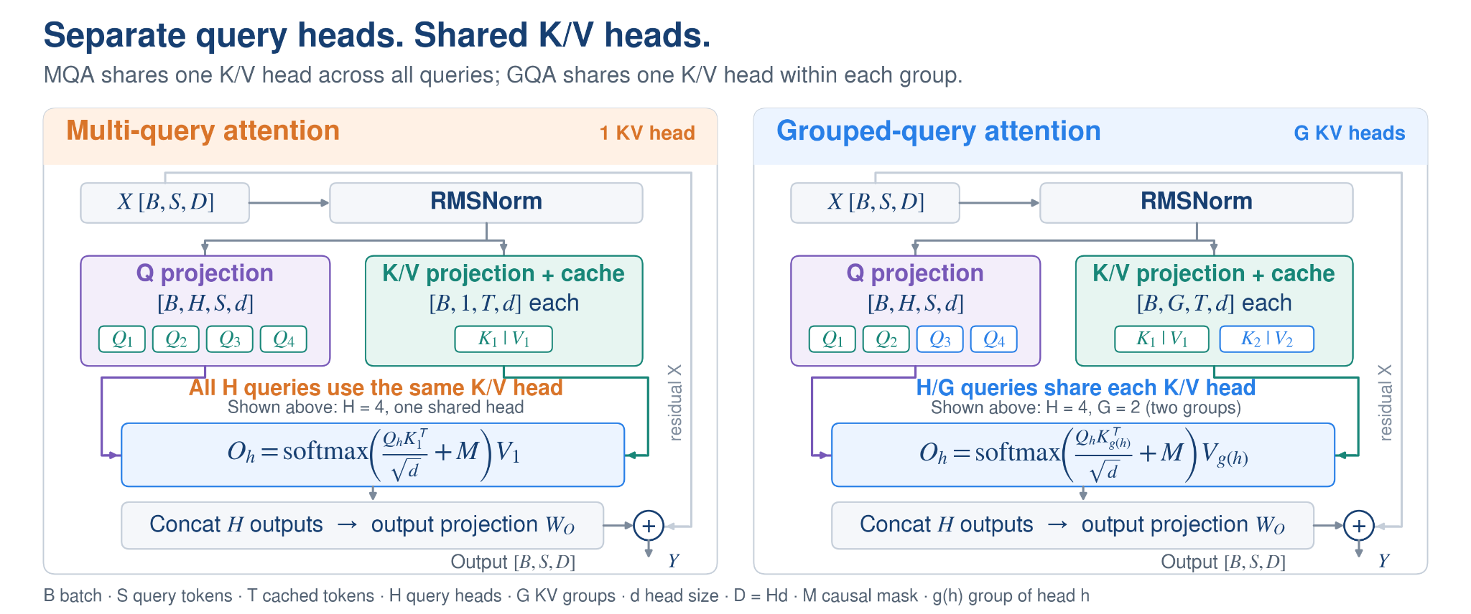
ATTENTION ARCHITECTURES
MQA and GQA
Shazeer, Fast Transformer Decoding / Ainslie et al., GQA H query heads, G K/V heads, d = D/H. S = 1 in decoding. T includes cached tokens.
COMP7608B · Lecture 2
A02

Slide 38
ATTENTION ARCHITECTURES
Cache savings exceed FLOP savings
Same dimensions as the exercise. Only the K/V head count changes.
Measure | MHA, G=64 | GQA, G=8 | MQA, G=1
Projection weights / layer | 512 MiB | 288 MiB | 260 MiB
Projection weight saving | Baseline | 43.75% | 49.22%
Prefill FLOPs / layer | 2.474 TF | 1.512 TF | 1.392 TF
Decode FLOPs / layer | 671.09 MF | 436.21 MF | 406.85 MF
KV cache / 80 layers | 10 GiB | 1.25 GiB | 160 MiB
GQA-8
8× smaller KV cache, 35% fewer decode attention FLOPs
QKᵀ and attention × V still run for all 64 query heads.
Calculated matmul FLOPs include Q/K/V/O projections and attention. Excludes FFN, norms, RoPE and softmax.
COMP7608B · Lecture 2
A04

Slide 39
FLASHATTENTION AND PAGEDATTENTION
Memory: closer is faster, but smaller
CPU teaching example: registers → caches → DRAM → storage
Where data lives | Illustrative access cost | Role
Registers | Already in the core | Operands for instructions
L1 cache (SRAM) | ~4 CPU cycles | Very small, very fast
L2 cache (SRAM) | ~10 CPU cycles | Larger on-chip cache
Main memory (DRAM) | ~100 CPU cycles | Working data and model weights
SSD storage | 50 µs ≈ 150,000 cycles* | Persistent files
Hard disk storage | ~10,000,000 cycles | Persistent files
*SSD conversion assumes a 3 GHz CPU. These are teaching estimates,
not a specification for a modern CPU or GPU.
CMU 15-213, Memory Hierarchy (2015)
COMP7608B · Lecture 2
F01

Slide 40
FLASHATTENTION AND PAGEDATTENTION
One addition can spend most time waiting
Toy dependency: load one operand, then perform a 1-cycle integer add.
Operand from L1
Load: 4 cycles
Add: 1
5 cycles
Operand from DRAM
Load: 100 cycles
Add: 1
101 cycles
The dependent add must wait until its operand arrives.
•
Reuse data near the compute units to avoid fetching it repeatedly.
•
Overlap independent work to hide latency; bandwidth still limits bytes/s.
Illustrative serial path, not to scale. Pipelines, prefetching and parallel work are omitted.
CMU 15-213, Memory Hierarchy (2015) / NVIDIA, GPU Performance Background
COMP7608B · Lecture 2
F02

Slide 41
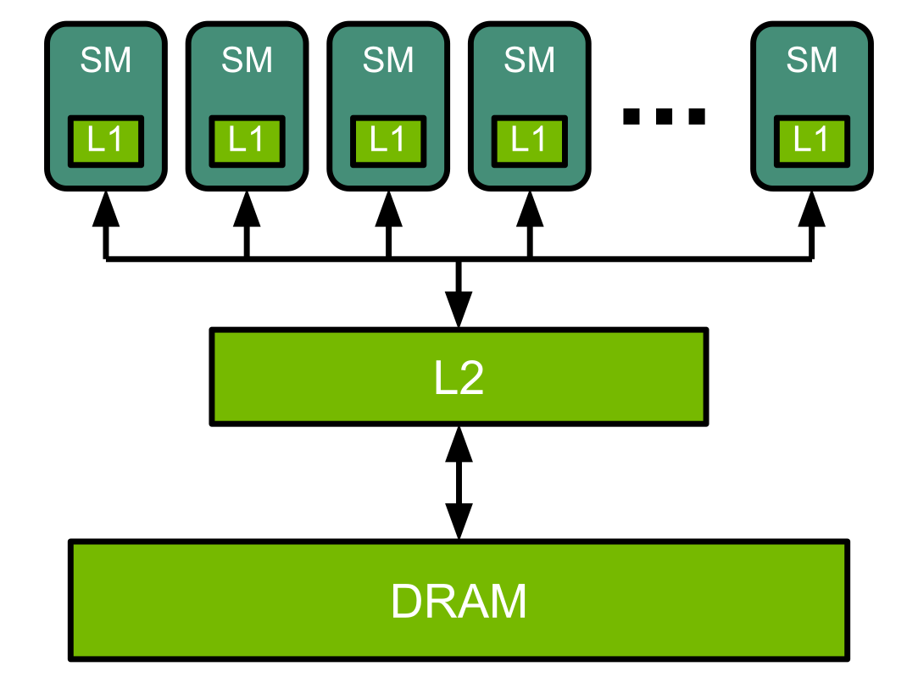
FLASHATTENTION AND PAGEDATTENTION
A GPU moves tiles to many compute units
NVIDIA A100 example: 108 streaming multiprocessors (SMs)
•
Read tiles from HBM through L2 into fast on-chip storage.
•
SMs compute: tensor cores handle matrix products; other units do reductions.
•
Warps contain 32 threads. Ready warps run while others wait for data.
HBM = high-bandwidth GPU DRAM
Reuse a tile in shared SRAM / registers before loading the next tile.
NVIDIA, GPU Performance Background / NVIDIA, Ampere Architecture
COMP7608B · Lecture 2
F03

Slide 42
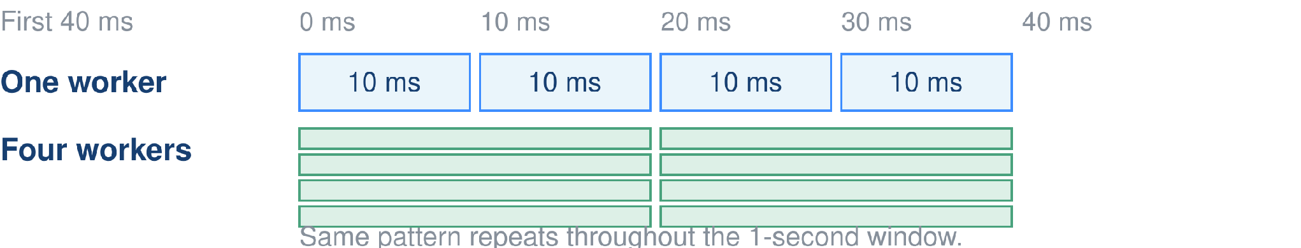
FLASHATTENTION AND PAGEDATTENTION
Latency versus throughput
Latency: time for one request. Throughput: completed requests per second.
Fully busy for 1 second | Request latency | Completed in 1 second
One worker | 10 ms | 1,000 / 10 = 100
Four concurrent workers | 20 ms | 4 × (1,000 / 20) = 200
Assume four workers can run concurrently, no queueing and negligible overhead.
COMP7608B · Lecture 2
F04

Slide 43
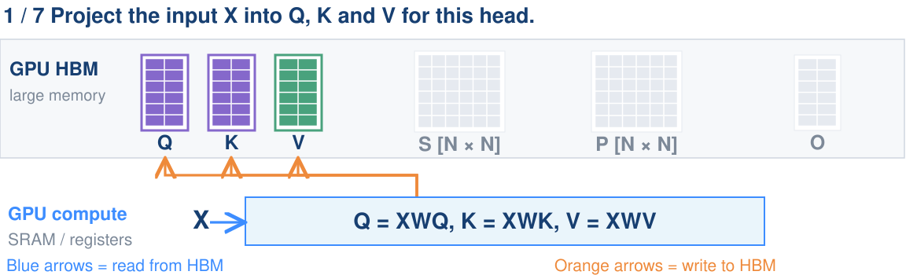
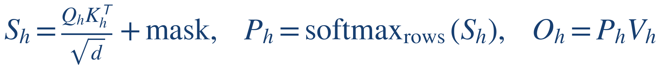
FLASHATTENTION AND PAGEDATTENTION
Bottleneck 1: MHA score matrices
32-head MHA, N = 8,192 tokens, BF16: S alone occupies 4 GiB.
Dao et al., FlashAttention (2022)
COMP7608B · Lecture 2
F05

Slide 44
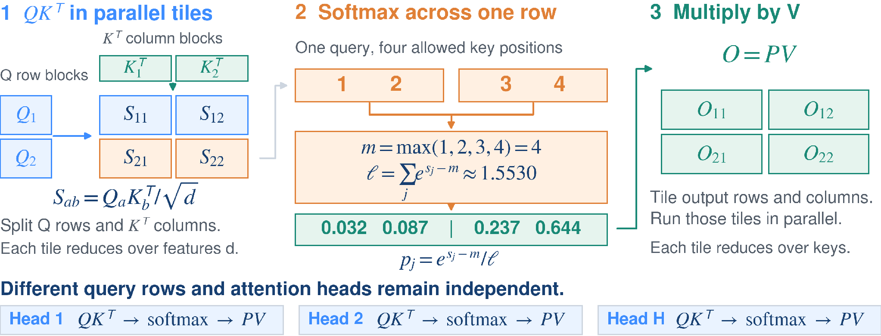
FLASHATTENTION AND PAGEDATTENTION
Tile-wise computation and softmax
A softmax row shares one maximum and one denominator across all its key blocks.
Row reductions can run in parallel. Online softmax merges statistics across tiles.
COMP7608B · Lecture 2
F05a

Slide 45
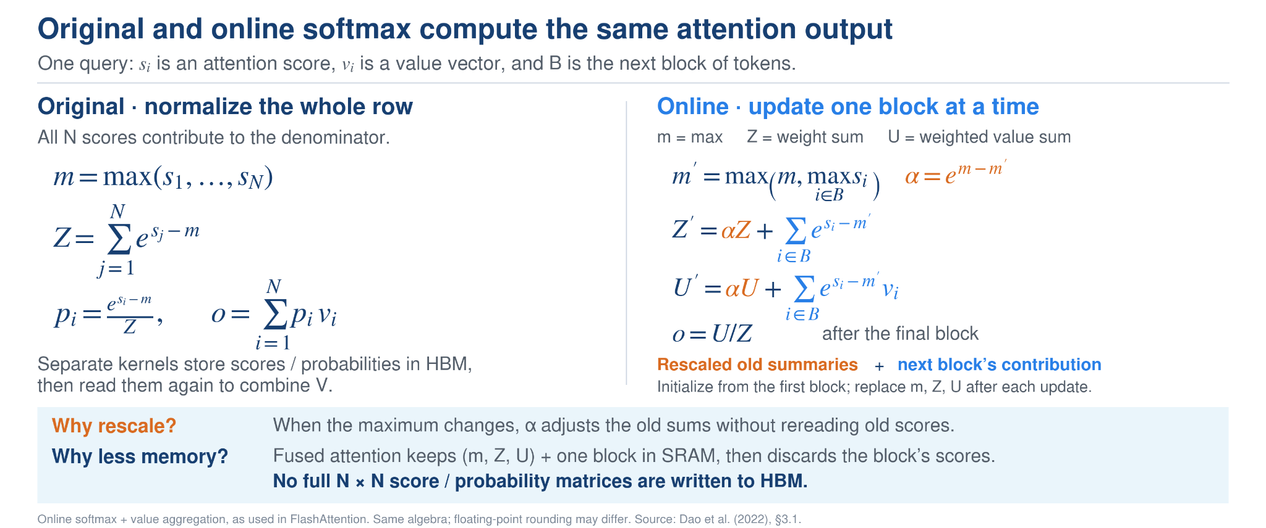
FLASHATTENTION AND PAGEDATTENTION
COMP7608B · Lecture 2
F07

Slide 46
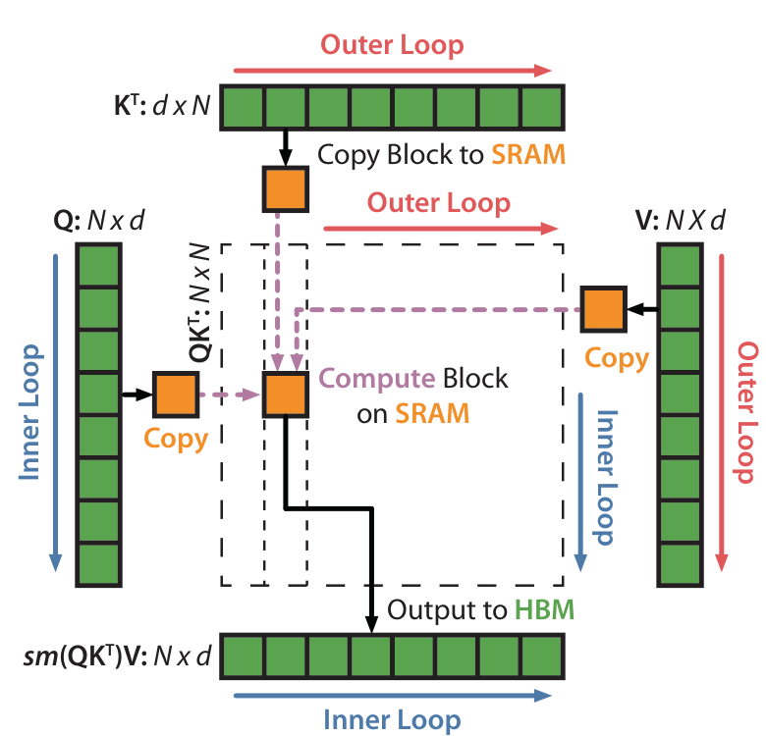
FLASHATTENTION AND PAGEDATTENTION
FlashAttention
Online softmax combines
the results of small blocks.
1
Load one K/V block into SRAM
(red outer loop).
2
Reuse it for blocks of Q
(blue inner loop).
3
Compute scores and softmax
(sm) on chip.
4
Rescale and update the output
using online softmax.
Dao et al., FlashAttention (2022)
COMP7608B · Lecture 2
F08

Slide 47

FLASHATTENTION AND PAGEDATTENTION
FlashAttention-2 reduces forward latency
Llama-2-7B • NVIDIA A100 • batch 1 • 4,096-token unpadded input
One forward pass (ms), lower is better
≈1.9×
faster forward pass
≈47% lower latency
Rounded readings from the published chart: about 750 ms → 400 ms.
This measures a long-prompt forward pass; generation and request queueing are excluded.
Hugging Face, Transformers v4.39.3 benchmark / Dao, FlashAttention-2 (2023)
COMP7608B · Lecture 2
F09

Slide 48
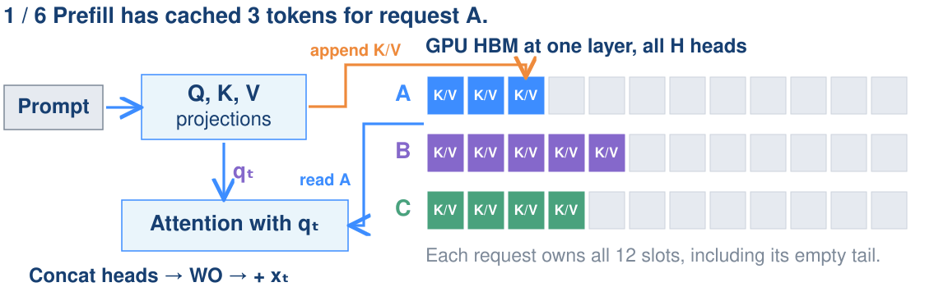

FLASHATTENTION AND PAGEDATTENTION
Bottleneck 2: the growing MHA KV cache
Each new token adds K/V. Its query reads the request’s full cached history.
L layers, H heads, d values/head
b bytes/value, Tᵢ tokens in request i
Kwon et al., PagedAttention (2023) / vLLM, PagedAttention launch results (2023)
COMP7608B · Lecture 2
F06

Slide 49
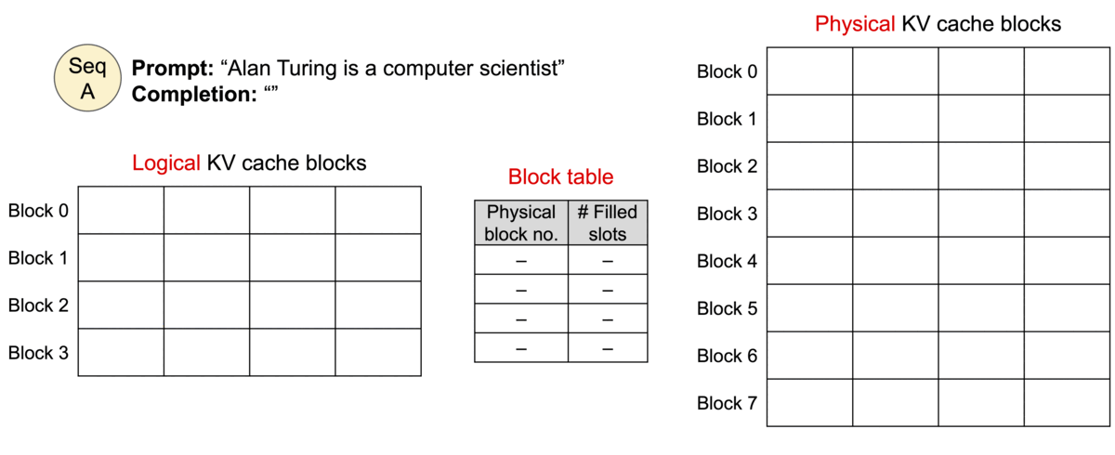
FLASHATTENTION AND PAGEDATTENTION
PagedAttention allocates KV blocks as needed
Follow the growing sequence, its block table and the physical GPU blocks.
vLLM, PagedAttention launch results (2023) / Kwon et al., PagedAttention (2023)
COMP7608B · Lecture 2
F10

Slide 50
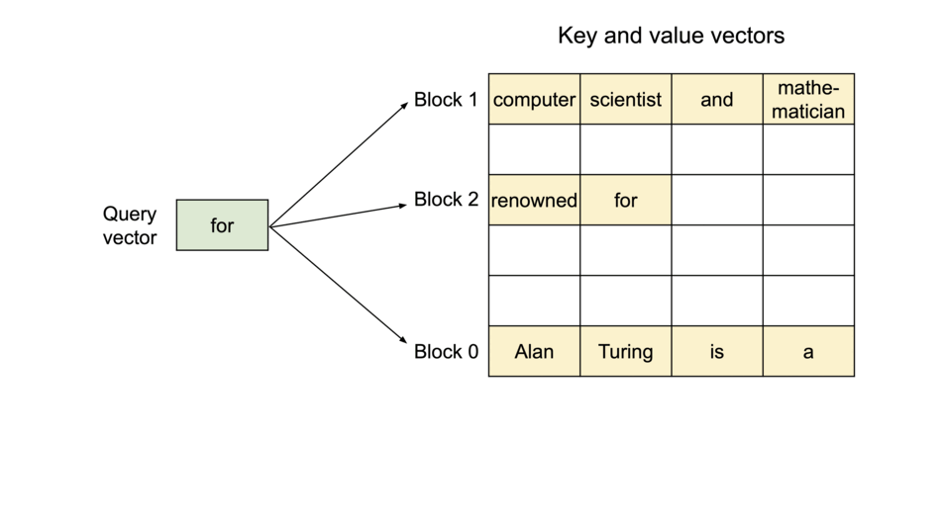
FLASHATTENTION AND PAGEDATTENTION
PagedAttention reads scattered KV blocks
1 Locate blocks
Follow this request’s block table.
2 Read K/V
Normalize scores across all blocks and combine V.
Block labels 0, 1 and 2 denote logical order; their physical locations can differ.
vLLM, PagedAttention launch results (2023) / Kwon et al., PagedAttention (2023)
COMP7608B · Lecture 2
F11

Slide 51
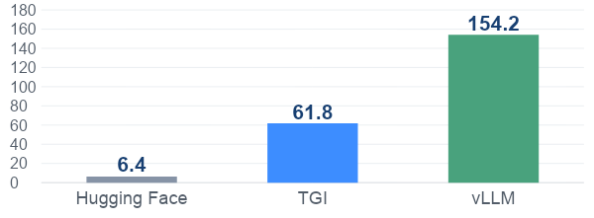
FLASHATTENTION AND PAGEDATTENTION
Paged KV storage enables higher throughput
LLaMA-13B • A100 40 GB • ShareGPT request lengths • one completion
Serving throughput (requests/min), higher is better
2.5×
throughput vs TGI
154.2 / 61.8
Less KV waste → more requests fit → larger effective batches.
Published 2023 engine comparison. Includes scheduling and kernels, beyond PagedAttention alone.
vLLM, PagedAttention launch results (2023) / Kwon et al., PagedAttention (2023)
COMP7608B · Lecture 2
F12

Slide 52
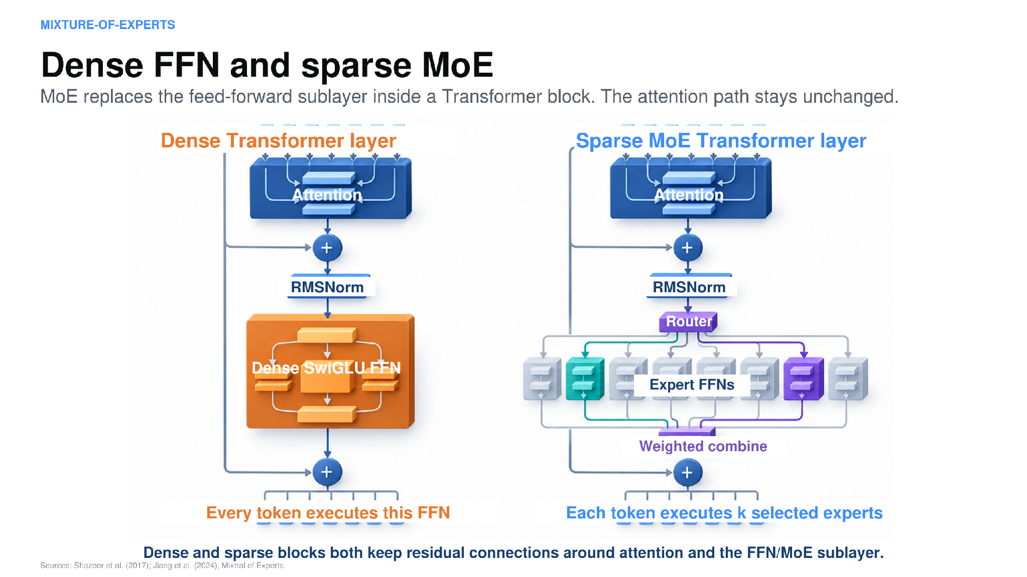

Slide 53
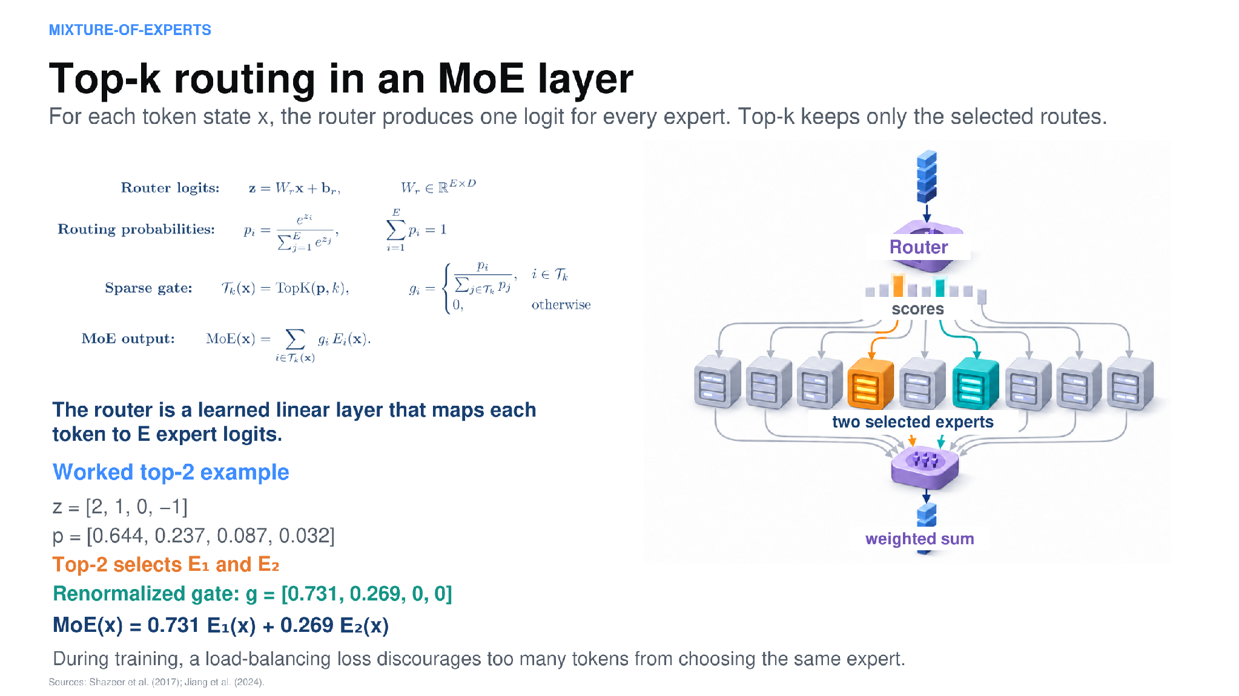

Slide 54
MIXTURE-OF-EXPERTS
Total and active parameters
Published model | Total parameters | Active per token
Mixtral 8×7B | 46.7B | 12.9B
DeepSeek-V3 | 671B | 37B
•
Total parameters influence stored weight capacity.
•
Active parameters help describe per-token work.
Mixtral 8×7B shares attention and other components, so its total is not simply 8 × 7B.
Jiang et al., Mixtral of Experts (2024) · DeepSeek-V3 report (2024/2025)
COMP7608B · Lecture 2
47

Slide 55
MIXTURE-OF-EXPERTS
Expert parallelism moves token vectors
Router
Device 1
Experts 1 and 2
Device 2
Experts 3 and 4
Combine expert outputs
Communication and uneven expert load can limit speed even when active computation is small.
vLLM optimization and tuning · DeepSeek-V3 report (2024/2025)
COMP7608B · Lecture 2
49

Slide 56
MIXTURE-OF-EXPERTS
Serving an MoE model
Deployment issue | What to inspect
Many distinct experts in one batch | Expert coverage and weight traffic
Popular experts receive more tokens | Load balance and overloaded devices
Experts spread across devices | Interconnect bandwidth and communication time
Experts offloaded to host memory | Transfer volume, reuse and scheduling
COMP7608B · Lecture 2
50

Slide 57
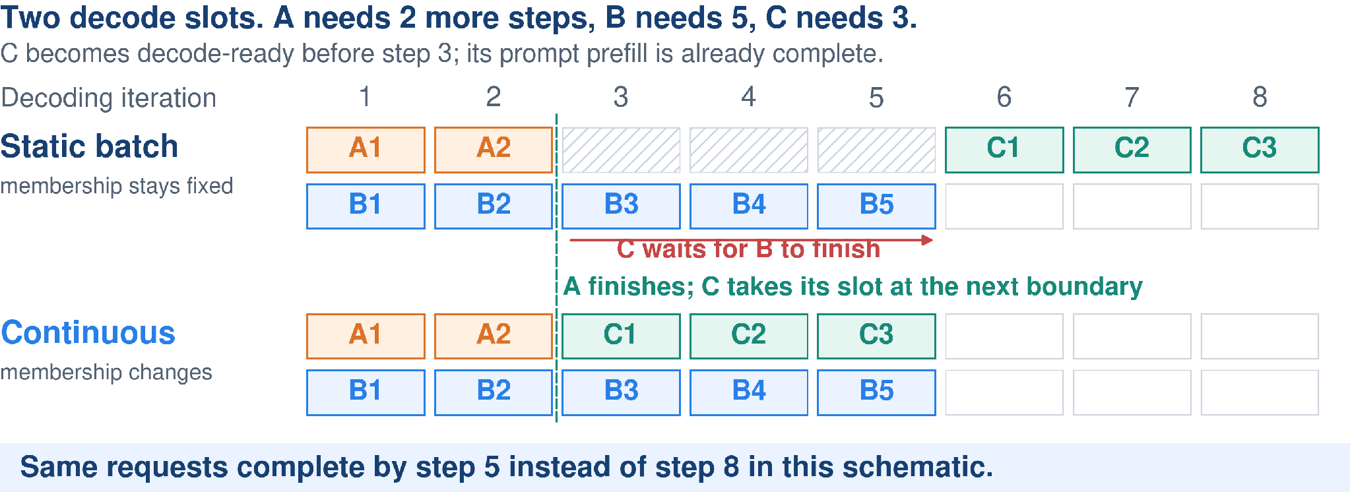
CONTINUOUS BATCHING
Continuous batching: refill freed slots
Reuse a free slot at the next iteration boundary; other requests continue.
Schedule at token-step boundaries, not only after an entire batch finishes.
Steps are schematic: step time may change with the batch, so this is not a measured speedup.
Orca, OSDI 2022. Illustrative request lengths; not a latency benchmark.
1

Slide 58
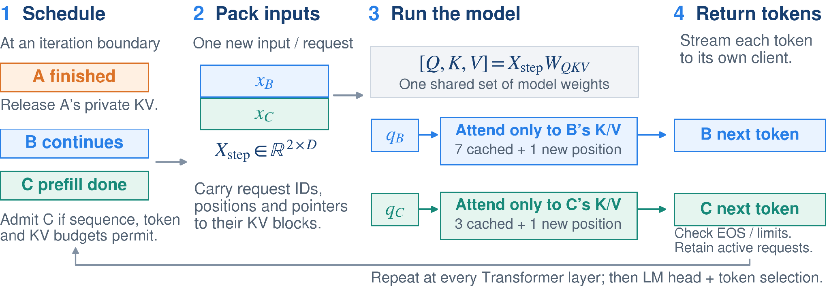
CONTINUOUS BATCHING
Continuous batching: one decode iteration
Batch the new token states for computation; keep each request’s attention history separate.
Weights are shared; token positions, attention history and K/V writes remain request-specific.
Released K/V blocks and scheduler budgets determine whether a waiting request can enter.
Orca (2022); vLLM optimization documentation. D = hidden width; EOS = end-of-sequence.
2

Slide 59
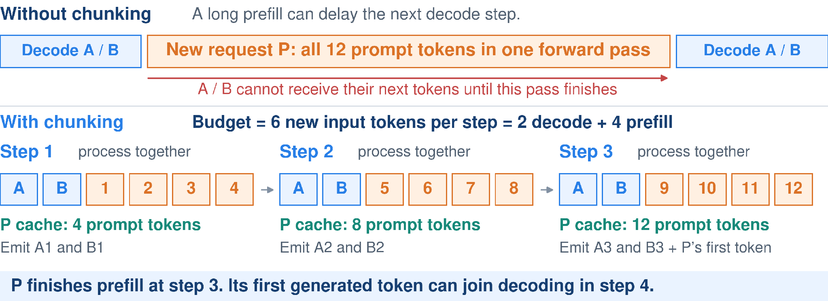
CHUNKED PREFILL
Chunked prefill: share each serving step
Split a long prompt into pieces so ongoing requests can keep receiving tokens.
Decode-first example: reserve 2 tokens for A/B, then use the remaining 4-token budget for P.
Chunk size trades prompt completion time against decode interruptions; tokens are not a time budget.
SARATHI (2023); Sarathi-Serve, OSDI 2024; vLLM optimization documentation. Schematic schedule.
3

Slide 60
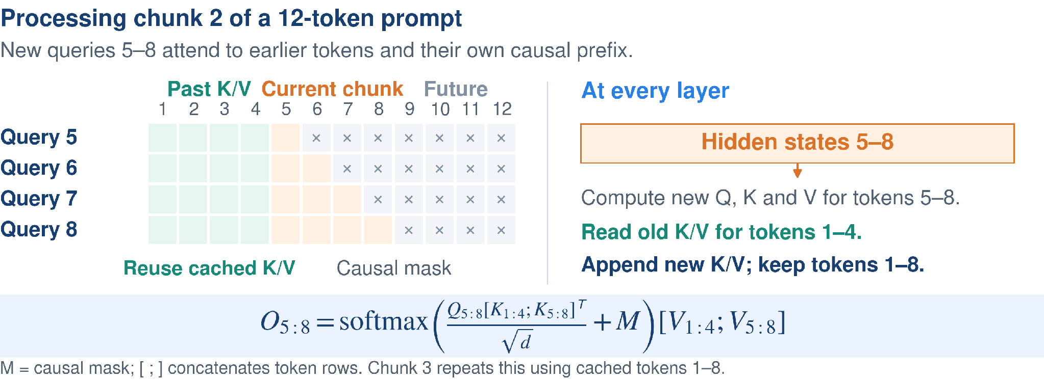
CHUNKED PREFILL
Chunked prefill: keep the full causal history
Chunking changes when computation runs—not which earlier tokens a query can attend to.
Do not restart attention at each chunk. Reuse earlier K/V, preserve positions, and keep the causal mask.
Only new tokens run through the layers; append their K/V to the same request’s per-layer cache.
SARATHI (2023); Sarathi-Serve (2024). Equation shows one attention head; d = head dimension.
4

Slide 61
HIGH-PERFORMANCE SERVING
Prefix caching
Two requests share an exact token prefix
System prompt + shared document
Question A
System prompt + shared document
Question B
Reuse the shared prefix’s KV state when the cache contains a valid match.
Prefix caching saves repeated prefill work. Each new answer still requires decoding.
vLLM automatic prefix caching
COMP7608B · Lecture 2
52

Slide 62
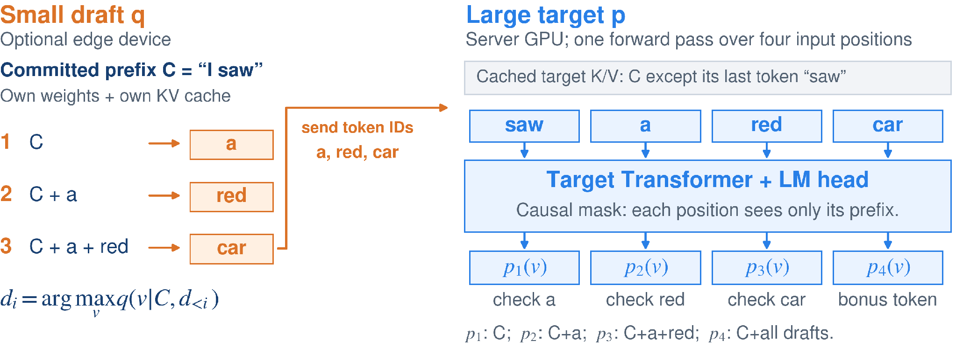
SPECULATIVE DECODING
Speculative decoding: draft, then verify
A small model proposes three tokens; the large model checks them in one causal forward pass.
Drafting is autoregressive. The target checks all positions together without future-token leakage.
Each model owns its K/V cache. An edge draft adds a network round trip per speculative round.
Leviathan et al., ICML 2023; Hugging Face, Assisted Generation (2023). Greedy, shared-tokenizer example.
5

Slide 63
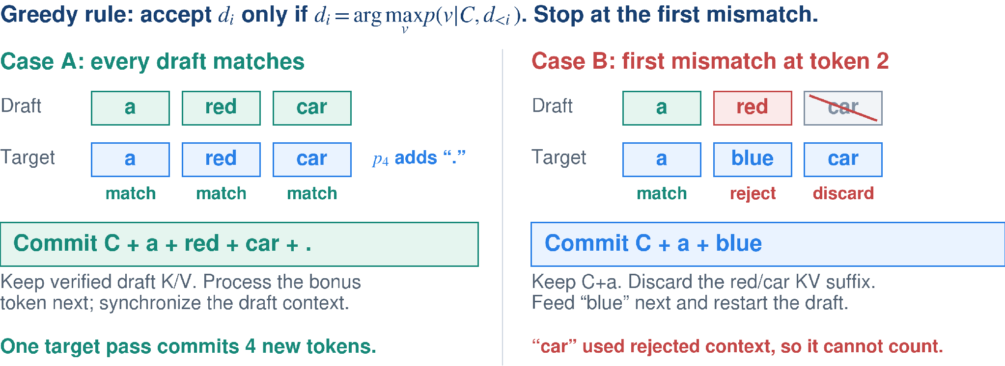
SPECULATIVE DECODING
Speculative decoding: accept or roll back
Greedy example: accept matching tokens in order and stop at the first mismatch.
Commit only the accepted prefix; return the verified result so the draft resumes from the same context.
Shown: exact greedy decoding. Sampling requires probability-based acceptance and corrected resampling.
Leviathan et al. (2023); Chen et al. (2023); Hugging Face, Assisted Generation (2023).
6

Slide 64
EFFICIENT LLM INFERENCE
Lecture 2 recap
How each technique changes inference
Quantization | Fewer bits reduce storage and reads. Higher precision protects sensitive operations.
Prefill / decode / KV cache | Prefill processes the prompt. Decoding reuses earlier K/V at every layer and processes each new token.
MQA / GQA | Shared K/V heads reduce per-layer KV cache and cache traffic during decoding.
FlashAttention / PagedAttention | FlashAttention avoids large attention intermediates. PagedAttention manages persistent K/V in blocks.
MoE | Each token activates selected FFN experts. All expert weights still need storage.
Speculative decoding | A small model drafts. The target verifies, then accepts a prefix or corrects a rejected token.
COMP7608B · Lecture 2
64

Slide 65
LECTURE CHECKPOINT
A deployment decision you can defend
Question | Evidence to use
Can the workload fit? | Weight bytes plus KV and runtime memory
What is the bottleneck? | Prefill / decode timing and resource use
Which technique addresses it? | Precision, architecture, kernel or scheduling
Did the change help? | Quality, latency and useful throughput
Can others reproduce it? | Pinned model, runtime and test workload
Next lecture · training and fine-tuning the parameters whose execution we have now studied.
COMP7608B · Lecture 2
63

