Slide 1
Lecture-3
Types of Array and Memory Representation of array
By : Mr. Jigar Bhawsar
Asst. Prof.

Slide 2
Types of an array
One dimensional (1-D)
Two dimensional (2-D)
Multi-dimensional

Slide 3
One dimensional array
A list of data item that can be represented by one variable name using only one subscript operator ([ ]), then such variable is called one-dimensional array.
For example : a 1-D array of type integers can be-
int marks[10];
where int is the type of elements in the array and “marks” is an array variable name. Here size of array is 10.
Note: Subscript value can start with number 0 in C/C++.
Example : A character array should be-
char name [ ]={‘s’,’a’,’c’,’h’,’i’,’n’, ’\0’ }; //string value terminated by \0
Or char name[ ]=”sachin”; //Here \0 is not necessary, it is inserted automatically.

Slide 4
Two dimensional arrays
If we have to use the values in the form of table for storing then we use 2-D array. It is also called matrix because of it is used in matrix programming. In this we use two subscripts – first for row number and second for column number. That is-
int n[2][3]; // Declare a two –D array for integers with row size 2 and column size 3.
We have to initialize this as-
int n[2][3]={1,2,3,4,5,6};
or int n[2][3]={{1,2,3},{4,5,6}};
Multi-dimensional
We can use more than two –dimensional array. For ex. – int n[2][3][4].

Slide 5
Memory Representation of 1-D array and 2-D array

Slide 6
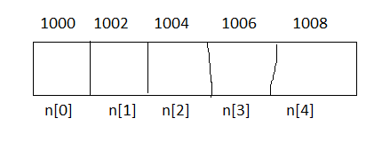
Memory Representation of 1-D array
A one dimensional array can be represented in the memory of computer easily. The C declaration:
int n[5]; reserved 5 successive memory locations as-
The address of a particular element in a one-D array is given by the relation-
Add of an element, n[k] = B + W * k
Where – B: Base Address, W: size of each element, k: index of element

Slide 7
Memory Representation of 2-D array
A two dimensional array can be represented in the memory in two ways-
Row-major implementation
Column-major implementation
For calculating the amount of memory required to store a 2-D array is depend on the type of that array. If we use int then it uses 2 bytes of memory for each value. Similarly if we use char and float type then they use 1 byte and 4 bytes of memory for each value respectively.
For example-
int num[4][3], then total elements =12
so memory required=12X2=24 bytes.

Slide 8
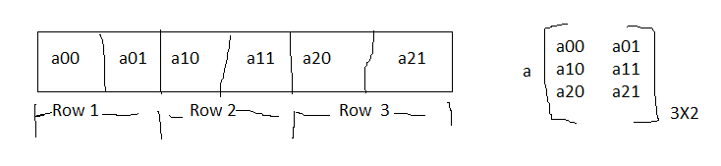
Row-major implementation
Row-major implementation is a linearization technique in which elements of an array are read from keyboard row-wise. It means that the complete first row is stored and then complete second row is stored and so on.
For example- An array a[3][2] is stored in the memory as-
Address of element in row-major implementation-
Add of a[i][j]th element = BA+[ N*(i-LBR) + (j-LBC) ] * W
Where :
BA: Base Address , N : Number of columns, LBR: Lower bound of row,
LBC: Lower bound of column , W: Number of bytes occupied by each element

Slide 9
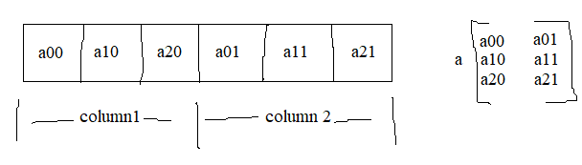
Column-major implementation
In column-major implementation, the elements of an array are read from the keyboard column wise. It means that the complete first column is stored and then complete second column and so on.
For example- An array a[3][2] is stored in the memory as-
Address of element in column-major implementation-
Add of a[i][j]th element = BA + [ (i-LBR) + M * (j-LBC) ] * W
Where:
BA : Base Address LBR : Lower Bound of Row
M: No. of rows LBC : Lower bound of column
W: Number of bytes occupied by each element

Slide 10
End of lecture 3.

