Slide 1
Mahajanga I
Number of Vaccination Cards
Maravoay
4000
Tulear I
Manakara
2000
Vohipeno
1000
Tulear II

Slide 2
Birth
Early
On time
Late
1-year old
1st Dose
<6 weeks
6 – 10 weeks
>10 weeks
2nd Dose
<4 weeks
4 – 8 weeks
>8 weeks
3rd Dose
<4 weeks
4 – 8 weeks
>8 weeks

Slide 4
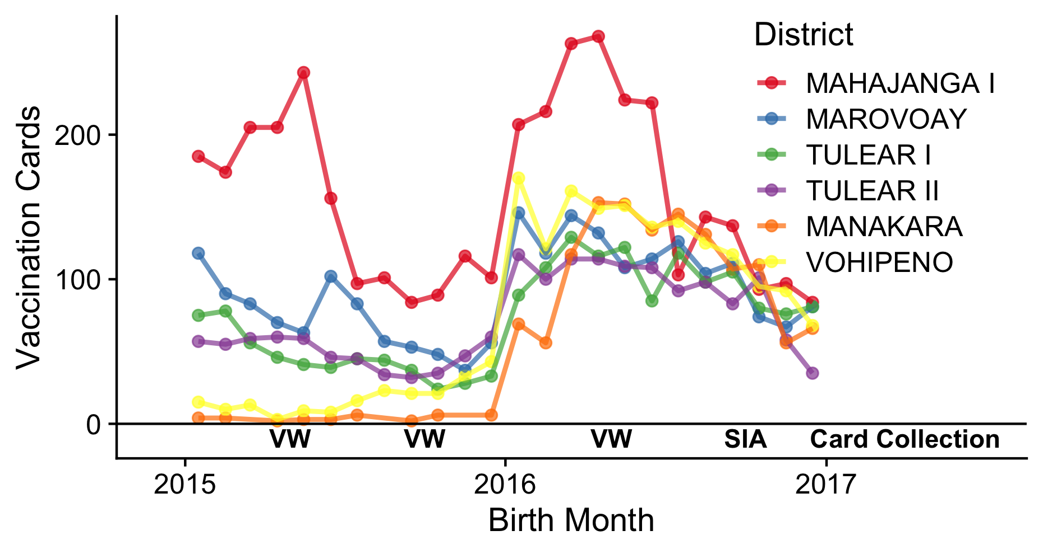
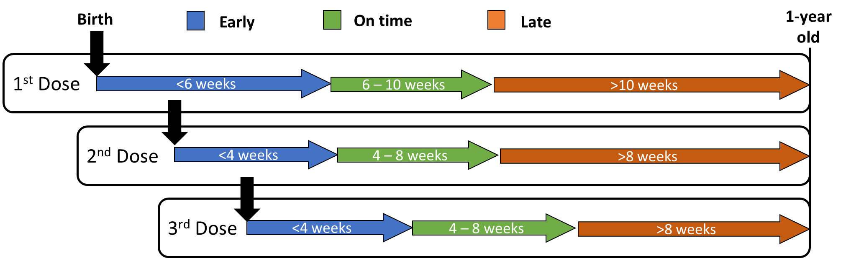
A
B
Mahajanga I
Number of Vaccination Cards
Maravoay
4000
Tulear I
Manakara
2000
Vohipeno
1000
Tulear II
C

