Slide 1
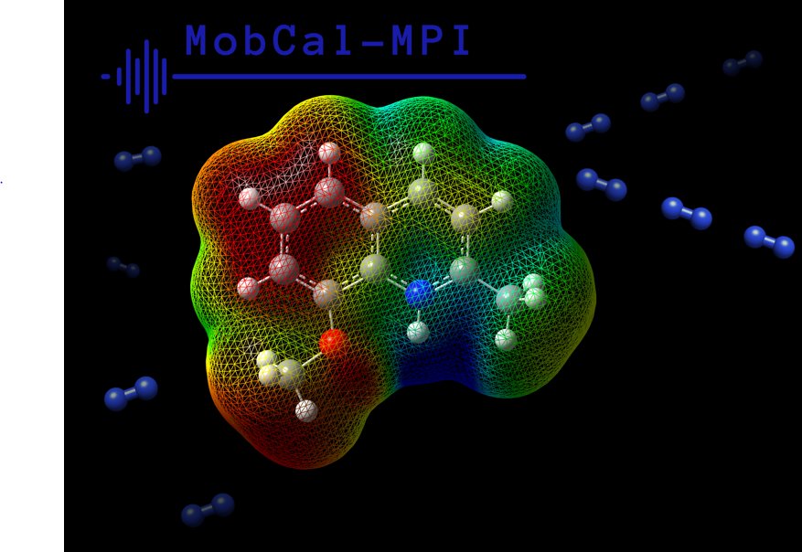
MobCal-MPI: A parallelized molecular collision cross section package with optimized accuracy and efficiency for trajectory method calculations
Hopkins Laboratory
Department of Chemistry
University of Waterloo

Slide 2
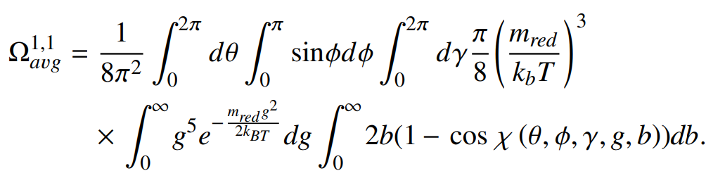
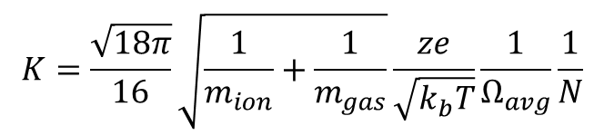
(Brief) introduction of CCS calculations
Collision cross section (CCS) is the effective area of interaction between buffer gas and ion, Yields insight into ion mobility (ie. Zero field Mason-Schamp equation)
$$K=\frac{\sqrt{18π}}{16}\sqrt{\frac{1}{m_{ion}}+\frac{1}{m_{gas}}}\frac{ze}{\sqrt{k_{b}T}}\frac{1}{Ω_{avg}}\frac{1}{N}$$
Where Ω_{avg} is the orientationally averaged collision cross section (assumes all orientations are equally probable)
A CCS value can be obtained analytically by looking at momentum transfer over all collision geometries, velocities, and impact parameters
θ,φ,γ : orientation angles
g : relative velocity
b : impact parameter
χ : deflection angle
Notes:
While the correlation of DMS-probed microsolvation to calculated solvent binding affinities is well established, it would be interesting to see if DMS measurements could directly assign binding energies to all systems. In other words, can DMS probe clustering propensities other than ion-solvent interactions (e.g., strength of Lewis acid-base adducts)? To this end, we propose the use of substituted benzylpyridinium (BP) “thermometer” ions to quantify the energy imparted to an analyte during its residence time in the DMS cell.

Slide 3
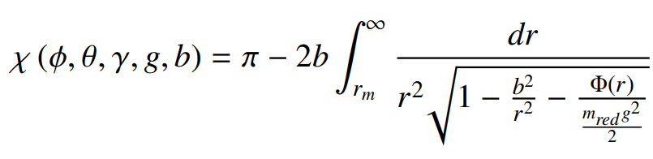
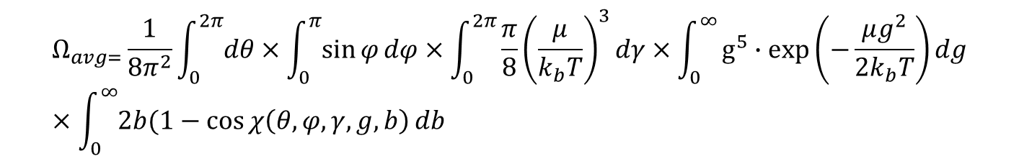
(Brief) introduction of CCS calculations
$$Ω_{avg=}\frac{1}{8π^{2}}\int_{0}^{2π}{dθ}×\int_{0}^{π}{\sin{φ}dφ}×\int_{0}^{2π}{\frac{π}{8}{\left(\frac{μ}{k_{b}T}\right)}^{3}dγ}×\int_{0}^{∞}{g^{5}∙exp\left(−\frac{μg^{2}}{2k_{b}T}\right)}dg×\int_{0}^{∞}{2b(1−\cos{χ\left(θ,φ,γ,g,b\right)}}db$$
θ,φ,γ : orientation angles
g : relative velocity
b : impact parameter
χ : deflection angle
The deflection angle depends ion orientation, impact parameter, relative velocity, and the ion-gas interaction potential (Φ(r)). Can be calculated through integration:
Cannot be determined analytically, and must be calculated numerically.
(Relatively) simple to do when a suitable potential is used to govern equation of motion.
Notes:
While the correlation of DMS-probed microsolvation to calculated solvent binding affinities is well established, it would be interesting to see if DMS measurements could directly assign binding energies to all systems. In other words, can DMS probe clustering propensities other than ion-solvent interactions (e.g., strength of Lewis acid-base adducts)? To this end, we propose the use of substituted benzylpyridinium (BP) “thermometer” ions to quantify the energy imparted to an analyte during its residence time in the DMS cell.

Slide 4
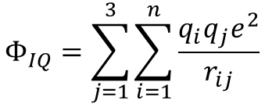
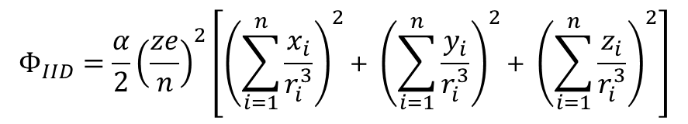

Potentials Used in MobCal-MPI Trajectory Method
Ion-gas interaction potential (Φ(r)) is derived from three components:
$Φ_{tot}\left(r\right)=Φ_{vdW}+Φ_{IID}$ ${+Φ}_{IQ}$
(Relatively) simple to do when a suitable potential is used to govern equation of motion.
We’ll get to vdW component in a second…
$$Φ_{IID}=\frac{α}{2}{\left(\frac{ze}{n}\right)}^{2}\left[{\left(\sum_{i=1}^{n}{\frac{x_{i}}{r_{i}^{3}}}\right)}^{2}\text{+} {\left(\sum_{i=1}^{n}{\frac{y_{i}}{r_{i}^{3}}}\right)}^{2}\text{+} {\left(\sum_{i=1}^{n}{\frac{z_{i}}{r_{i}^{3}}}\right)}^{2}\right]$$
α : polarizability buffer gas
r_{i} = (x_{i}, y_{i}, z_{i})
- 0.4825e
$$Φ_{IQ}=\sum_{j=1}^{3}{\sum_{i=1}^{n}{\frac{q_{i}q_{j}e^{2}}{r_{ij}}}}$$
+ 0.965e
- 0.4825e
Notes:
While the correlation of DMS-probed microsolvation to calculated solvent binding affinities is well established, it would be interesting to see if DMS measurements could directly assign binding energies to all systems. In other words, can DMS probe clustering propensities other than ion-solvent interactions (e.g., strength of Lewis acid-base adducts)? To this end, we propose the use of substituted benzylpyridinium (BP) “thermometer” ions to quantify the energy imparted to an analyte during its residence time in the DMS cell.

Slide 5
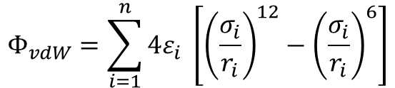
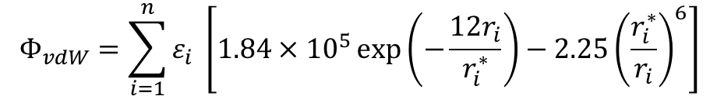
Potentials Used in MobCal-MPI Trajectory Methods
All CCS software before has used 12-6 LJ vdW potentials (MobCal, IMoS, HPCCS)
$$Φ_{vdW}=\sum_{i=1}^{n}{4ε_{i} \left[{\left(\frac{σ_{i}}{r_{i}}\right)}^{12}−{\left(\frac{σ_{i}}{r_{i}}\right)}^{6}\right]}$$
However, most molecular mechanics forcefields use different potentials to govern vdW interaction potentials.
One example is the Exp-6 type potential used in the MM3 forcefield
$$Φ_{vdW}=\sum_{i=1}^{n}{ε_{i} \left[1.84×{10}^{5}\exp\left(−\frac{12r_{i}}{r_{i}^{∗}}\right)−2.25{\left(\frac{r_{i}^{∗}}{r_{i}}\right)}^{6}\right]}$$
Where σ = (2^{1/6}) r_{i}*
Notes:
While the correlation of DMS-probed microsolvation to calculated solvent binding affinities is well established, it would be interesting to see if DMS measurements could directly assign binding energies to all systems. In other words, can DMS probe clustering propensities other than ion-solvent interactions (e.g., strength of Lewis acid-base adducts)? To this end, we propose the use of substituted benzylpyridinium (BP) “thermometer” ions to quantify the energy imparted to an analyte during its residence time in the DMS cell.

Slide 6
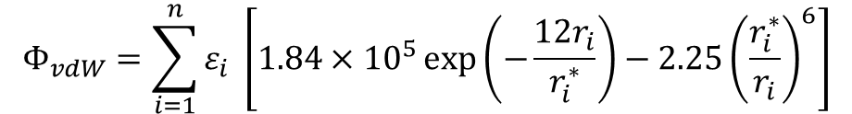
Choosing a vdW potential for forcefield parameters for MobCal-MPI
Based on a screening of CCS calculations in helium, the MM3 forcefield returned the lowest RMSE between calculation and experiment:
$$Φ_{vdW}=\sum_{i=1}^{n}{ε_{i} \left[1.84×{10}^{5}\exp\left(−\frac{12r_{i}}{r_{i}^{∗}}\right)−2.25{\left(\frac{r_{i}^{∗}}{r_{i}}\right)}^{6}\right]}$$
This approach made use of MMFF94 forcefield parameters (α_{i}, A_{i,} N_{i}, G_{i}) for each of the interacting atoms (one of which is N₂) to give ε_{i} and r_{i}*. Since one collision partner is always N₂, we denote ε_{ij} and r_{ij}* as ε_{i} and r_{i}*.
Notes:
While the correlation of DMS-probed microsolvation to calculated solvent binding affinities is well established, it would be interesting to see if DMS measurements could directly assign binding energies to all systems. In other words, can DMS probe clustering propensities other than ion-solvent interactions (e.g., strength of Lewis acid-base adducts)? To this end, we propose the use of substituted benzylpyridinium (BP) “thermometer” ions to quantify the energy imparted to an analyte during its residence time in the DMS cell.

Slide 7


Fitting ε_{i} and r_{i}*…
A uniform scaling factor is applied to each unique ε_{i} and r_{i}* such that:
$$r_{i,scaled}^{∗}=r_{i}^{∗}×ρ_{dist}$$
$$ε_{i,scaled}^{∗}=ε×ρ_{ener}$$
Prior fitting has been accomplished on a set of 18 compounds containing C, H, N, O, F, and S, with a limited variety in functional groups.
Here, we present fitting of scaling factors on 163 compounds, which additionally include P, Cl, Br, and I and a wide variety of functional groups such that (nearly) all chemical classes from MMFF94 parameters are represented.
Notes:
While the correlation of DMS-probed microsolvation to calculated solvent binding affinities is well established, it would be interesting to see if DMS measurements could directly assign binding energies to all systems. In other words, can DMS probe clustering propensities other than ion-solvent interactions (e.g., strength of Lewis acid-base adducts)? To this end, we propose the use of substituted benzylpyridinium (BP) “thermometer” ions to quantify the energy imparted to an analyte during its residence time in the DMS cell.

Slide 8
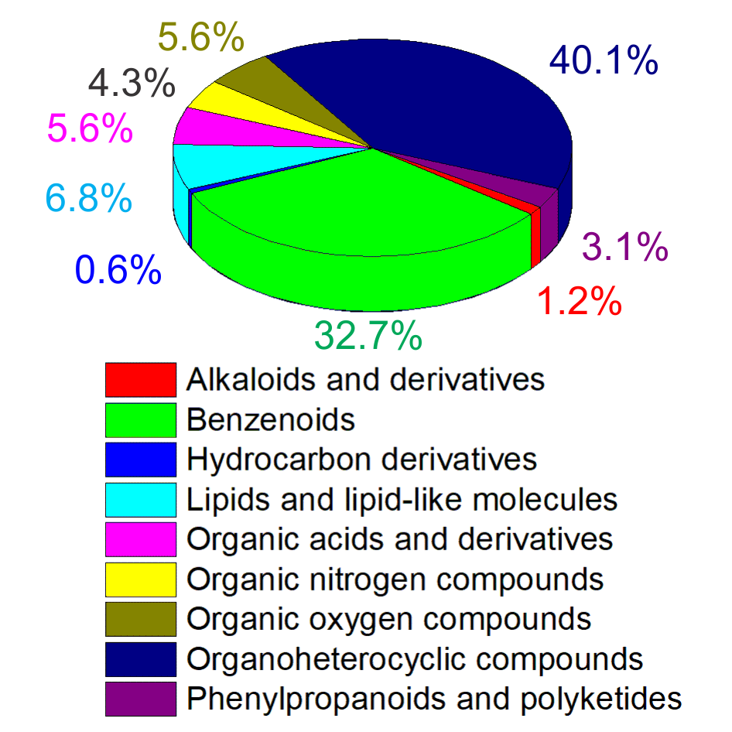
Getting compounds to fit vdW parameters
162 compounds containing a variety of functional groups
Identify low energy conformers / tautomers from B3LYP/6-31++g(d,p) energies/thermochemistry. Energies employ GD3 dispersion corrections
Notes:
While the correlation of DMS-probed microsolvation to calculated solvent binding affinities is well established, it would be interesting to see if DMS measurements could directly assign binding energies to all systems. In other words, can DMS probe clustering propensities other than ion-solvent interactions (e.g., strength of Lewis acid-base adducts)? To this end, we propose the use of substituted benzylpyridinium (BP) “thermometer” ions to quantify the energy imparted to an analyte during its residence time in the DMS cell.

Slide 9
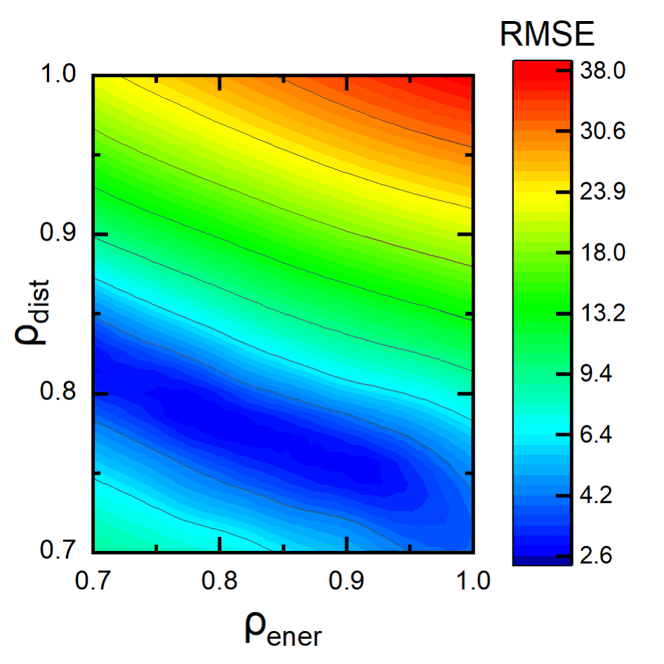
Fitting ε_{i} and r_{i}*…
We explored numerous combinations of δ_{dist} and δ_{ener} to arrive at those which produce the lowest RMSE:
Clearly, a lot of combinations are possible with low RMSE’s. However, the lowest was:
δ_{dist} = 0.78
δ_{ener} = 0.80
with RMSE = 2.60%
Notes:
While the correlation of DMS-probed microsolvation to calculated solvent binding affinities is well established, it would be interesting to see if DMS measurements could directly assign binding energies to all systems. In other words, can DMS probe clustering propensities other than ion-solvent interactions (e.g., strength of Lewis acid-base adducts)? To this end, we propose the use of substituted benzylpyridinium (BP) “thermometer” ions to quantify the energy imparted to an analyte during its residence time in the DMS cell.

Slide 10
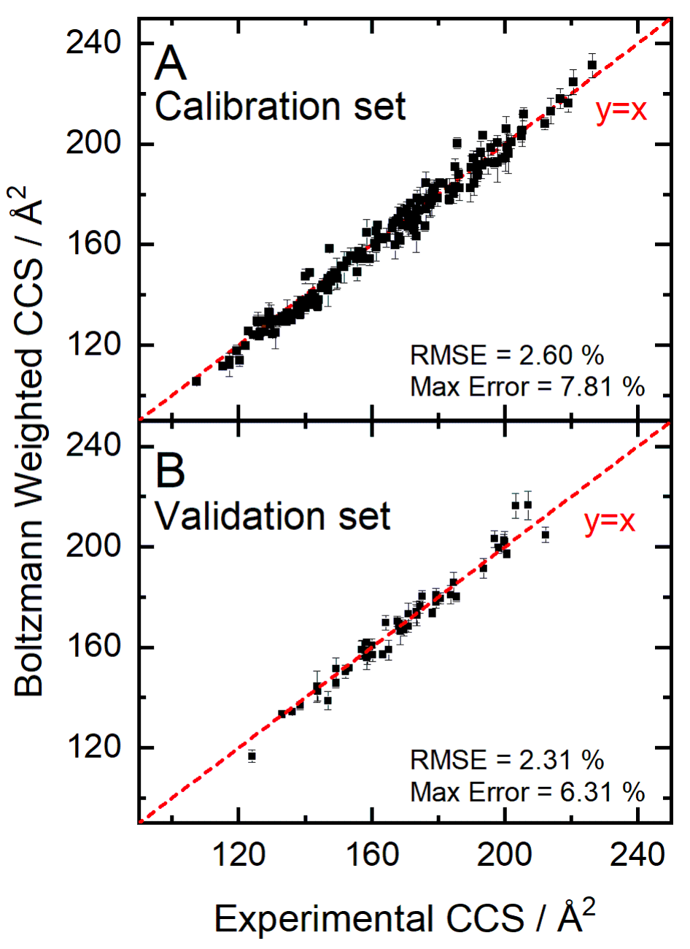
Evaluating the effectiveness of scaling parameters
External validation set of 50 compounds containing combinations of numerous functional groups were tested
Notes:
While the correlation of DMS-probed microsolvation to calculated solvent binding affinities is well established, it would be interesting to see if DMS measurements could directly assign binding energies to all systems. In other words, can DMS probe clustering propensities other than ion-solvent interactions (e.g., strength of Lewis acid-base adducts)? To this end, we propose the use of substituted benzylpyridinium (BP) “thermometer” ions to quantify the energy imparted to an analyte during its residence time in the DMS cell.

Slide 11
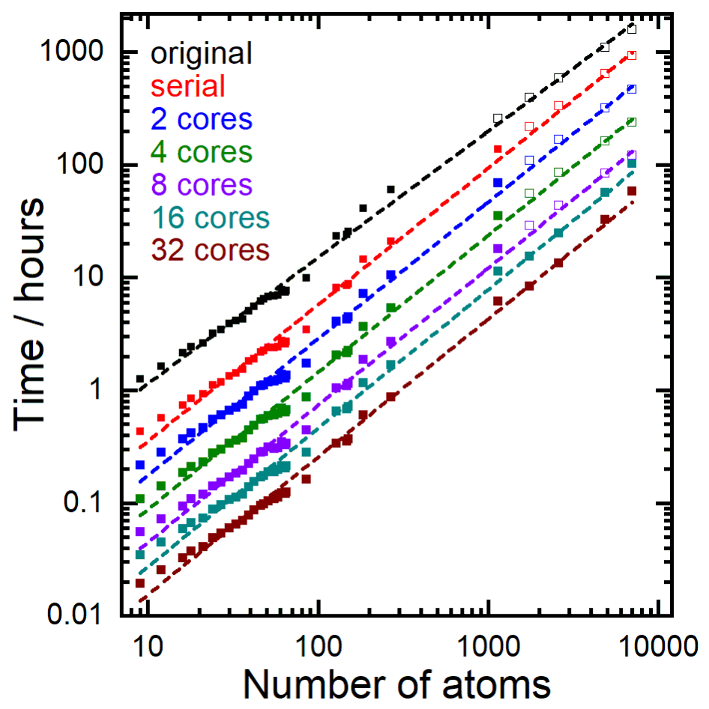
Deploying efficient code
Benchmarking the parallelization of MobCal-MPI:
Cores | Avg. Speedup | Efficiency
1 | 1.00 | 1.00
2 | 2.00 | 1.00
4 | 3.98 | 0.99
8 | 7.82 | 0.98
16 | 12.58 | 0.79
32 | 22.57 | 0.71
Notes:
While the correlation of DMS-probed microsolvation to calculated solvent binding affinities is well established, it would be interesting to see if DMS measurements could directly assign binding energies to all systems. In other words, can DMS probe clustering propensities other than ion-solvent interactions (e.g., strength of Lewis acid-base adducts)? To this end, we propose the use of substituted benzylpyridinium (BP) “thermometer” ions to quantify the energy imparted to an analyte during its residence time in the DMS cell.

Slide 12
Deploying efficient code
Not enough to just parallelize it. We want each core to be performing integer number of integrations.
Recommended to run with 40 points of velocity integration.
48 is divisible by 16. So use 48 points. (32 core calculation times have been scaled down accordingly based on number of steps)
Realistically not many options we can choose here
However, what about impact parameter integrations?
Recommended value is 500, so lots of options.
Let’s explore!
Notes:
While the correlation of DMS-probed microsolvation to calculated solvent binding affinities is well established, it would be interesting to see if DMS measurements could directly assign binding energies to all systems. In other words, can DMS probe clustering propensities other than ion-solvent interactions (e.g., strength of Lewis acid-base adducts)? To this end, we propose the use of substituted benzylpyridinium (BP) “thermometer” ions to quantify the energy imparted to an analyte during its residence time in the DMS cell.

Slide 13
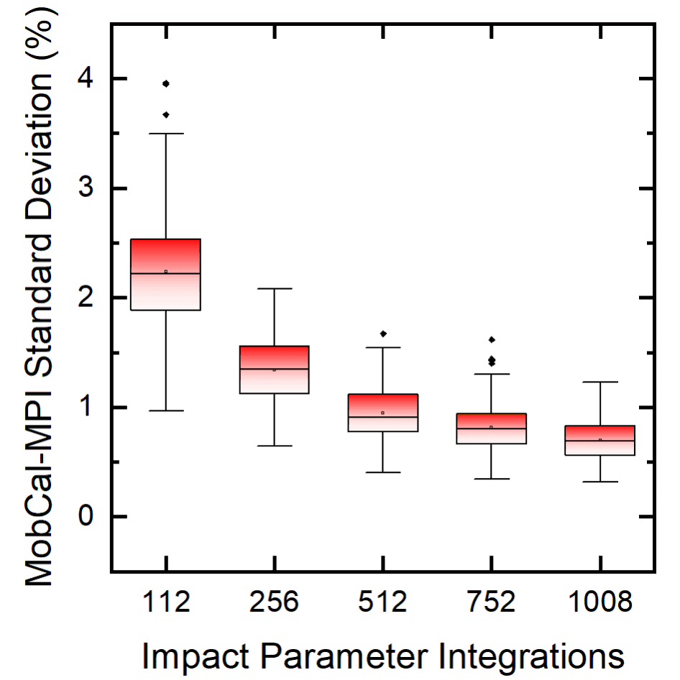
Deploying efficient code
But there’s a time cost to decreased variance. So what’s the best bang for your buck?
Seems like imp = 512
imp | Speedup relative to imp = 1008
112 | 10.42
256 | 4.94
512 | 2.57
752 | 1.78
1008 | 1.00
RMSE varies from 2.29% to 2.36% (negligible)
Notes:
While the correlation of DMS-probed microsolvation to calculated solvent binding affinities is well established, it would be interesting to see if DMS measurements could directly assign binding energies to all systems. In other words, can DMS probe clustering propensities other than ion-solvent interactions (e.g., strength of Lewis acid-base adducts)? To this end, we propose the use of substituted benzylpyridinium (BP) “thermometer” ions to quantify the energy imparted to an analyte during its residence time in the DMS cell.

Slide 14
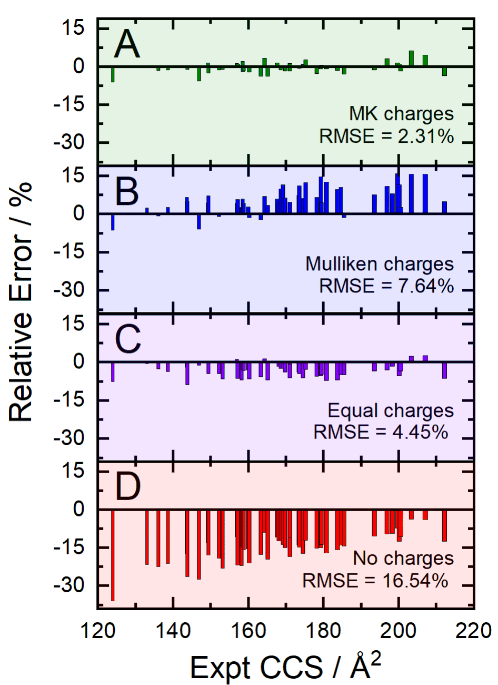
Use of Charge Schemes for V_{IID} and V_{IQ} interactions
Charges based on electrostatic potential mapping should be used for most accurate CCS calculations
We recommend the MK partition scheme, with partial charges constrained to reproduce the molecular dipole moment
Notes:
While the correlation of DMS-probed microsolvation to calculated solvent binding affinities is well established, it would be interesting to see if DMS measurements could directly assign binding energies to all systems. In other words, can DMS probe clustering propensities other than ion-solvent interactions (e.g., strength of Lewis acid-base adducts)? To this end, we propose the use of substituted benzylpyridinium (BP) “thermometer” ions to quantify the energy imparted to an analyte during its residence time in the DMS cell.

Slide 15
Converting Gaussian output files to MobCal input files automatically
Hopkins Laboratory
Department of Chemistry
University of Waterloo

Slide 16
Overview of the conversion routines
Open babel
Atomic coordinates and charges (Gaussian)
sdf2tinkerxyz
Generate .sdf file
Python module
Generate .xyz and .key files
Bash script and compile .f module
Generate .mfj (Mobcal) input file
Run MobCal-MPI
Graham cluster
Blue boxes: Software packages / python routines / bash scripts
Open boxes: Intermediate file types
Notes:
While the correlation of DMS-probed microsolvation to calculated solvent binding affinities is well established, it would be interesting to see if DMS measurements could directly assign binding energies to all systems. In other words, can DMS probe clustering propensities other than ion-solvent interactions (e.g., strength of Lewis acid-base adducts)? To this end, we propose the use of substituted benzylpyridinium (BP) “thermometer” ions to quantify the energy imparted to an analyte during its residence time in the DMS cell.

Slide 17
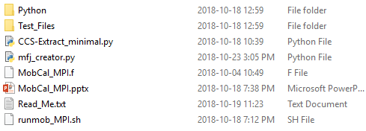
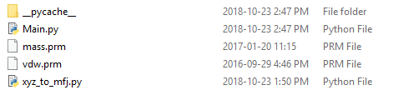
Summary of provided modules
Main folder
Inside python folder
Main folder
Python folder: Contains modules to convert between file formats to create .mfj (MobCal) inputs
Test_Files: Contains Gaussian outputs for testing purposes
CCS-Extract.py: Data mining script to extracting of CCS data upon file completion
Mfj_creator.py: generates .mfj file from atomtype and charge information given in Gaussian outputs. Uses OpenBabel, sdf2xyz2sdf, and external python scripts found in the Python folder. See ReadMe.txt for details on use.
MobCal_MPI.f: Fortran code
MobCal_MPI.pptx: This PowerPoint
Read_Me.txt: ReadMe file outlining the installation of software packages, use of the mfj_creator.py package, and submission of CCS calculations to HPC platforms
Runmob_MPI.sh: Sample bash script for bulk submission of CCS jobs (for SLURM schedulers)
mass.prm: summary of mass and atomtype information from Tinker
vdw.prm: summary of vdw parameters from the original publication for MMFF
Notes:
While the correlation of DMS-probed microsolvation to calculated solvent binding affinities is well established, it would be interesting to see if DMS measurements could directly assign binding energies to all systems. In other words, can DMS probe clustering propensities other than ion-solvent interactions (e.g., strength of Lewis acid-base adducts)? To this end, we propose the use of substituted benzylpyridinium (BP) “thermometer” ions to quantify the energy imparted to an analyte during its residence time in the DMS cell.

Slide 18
Summary of provided modules
Main folder
Inside python folder
Main folder
Main.py: The heart of the conversion software (do not edit this please)
mass.prm: summary of mass and atomtype information from Tinker
vdw.prm: summary of vdw parameters from the original publication for MMFF
xyz_to_mfj.py: A subroutine which converts tinkerXYZ files to mfj (MobCal) inputs (do not edit this)
Notes:
While the correlation of DMS-probed microsolvation to calculated solvent binding affinities is well established, it would be interesting to see if DMS measurements could directly assign binding energies to all systems. In other words, can DMS probe clustering propensities other than ion-solvent interactions (e.g., strength of Lewis acid-base adducts)? To this end, we propose the use of substituted benzylpyridinium (BP) “thermometer” ions to quantify the energy imparted to an analyte during its residence time in the DMS cell.

Slide 19
What the Python code does
1. Reads in connectivity and partial charge data from Gaussian .log output files
Conduct optimization and frequency calculations of multiple tautomers of a compound to find lowest energy conformer/protonation site.
Conduct calculations at the B3LYP/6-31++g(d,p) level of theory with the empiricaldispersion=GD3 and pop=(mk,dipole) keywords
Generate a .csv containing all of the .log files you wish to carry forward to MobCal
See the ReadMe.txt for more details
Notes:
While the correlation of DMS-probed microsolvation to calculated solvent binding affinities is well established, it would be interesting to see if DMS measurements could directly assign binding energies to all systems. In other words, can DMS probe clustering propensities other than ion-solvent interactions (e.g., strength of Lewis acid-base adducts)? To this end, we propose the use of substituted benzylpyridinium (BP) “thermometer” ions to quantify the energy imparted to an analyte during its residence time in the DMS cell.

Slide 20
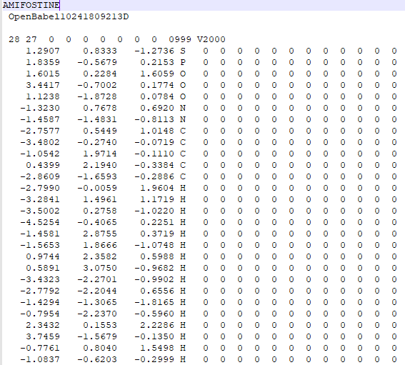
What the Python code does
2. Converts gaussian output to a .sdf file (a type of coordinate file) using OpenBabel
a .sdf file

Slide 21
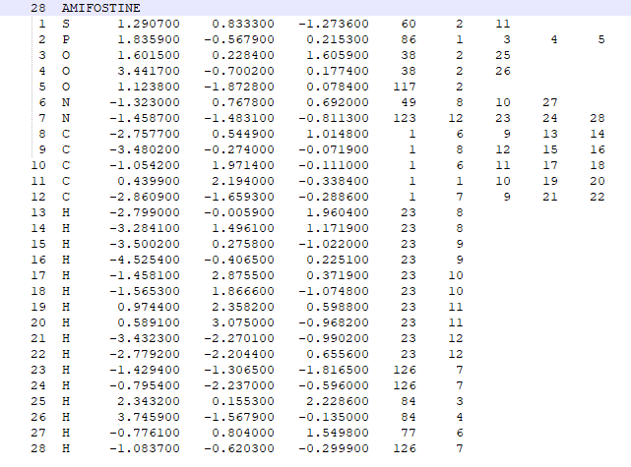
3. Generate .xyz and .key file from the .sdf file using the sdf2tinkerxyz software
a tinker .xyz file
The generated .xyz file has the information on atom types automatically assigned by the sdf2tinkerxyz software. It is recommended to check the assigned atom types.
MMFF94 atom types

Slide 22
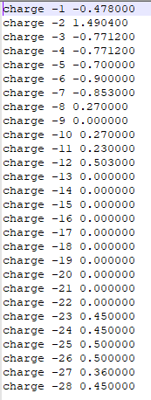
3. Generate .xyz and .key file from the .sdf file using the sdf2tinkerxyz software
a .key file
The generated .key file has the information on MMFF charges automatically assigned by the sdf2tinkerxyz software. Note that charges are sometimes improperly assigned, especially when multiple/uncommon protonation sites are present within a molecule. These charges aren’t the best, so it is not recommended to use these (note the charge assignments of zero for amifostine)
Instead, we replace the charges in the .key file with those generated by Gaussian by electrostatic potential mapping, and combine those in a final .mfj file

Slide 23
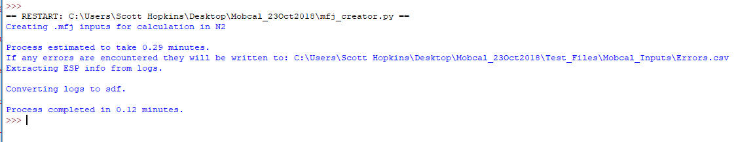
4. Generate the .mfj file for calculations using the mfj_creator.py python code. Do not move the mass.prm, vdw.prm, Main.py, or xyz_to_mfj.py from the python directory.
For information of deployment of the mfj_creator.py, see the REadMe.txt
Always perform manual verification of atom type assignment!
All errors will be written to a .csv file with the corresponding filename and specific error encountered

Slide 24
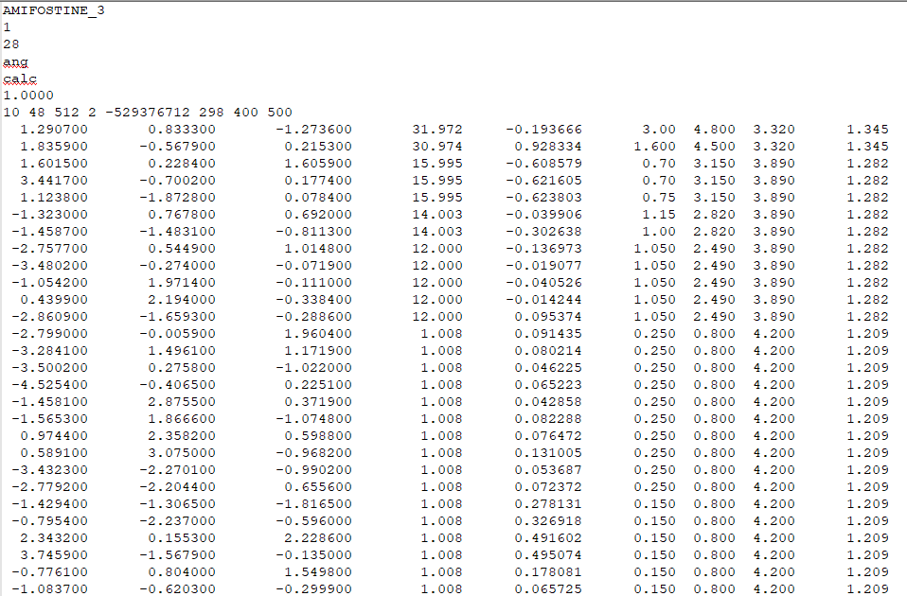
The .mfj file
xyz coordinates
Atomic mass
Partial charge
MMFF vdw parameters

Slide 25
The .mfj file
Title
Number of conformers (always 1)
Number of atoms
Specifies coordinates to be read in angstroms (ang)
Specifies if a calculated (calc), equal (equal), or no (none) partial charge scheme is used
Scaling factor for xyz coordinates. Set to 1.0000
(# cycles) (# of velocity int points) (# of impact parameter int points) (gas; 1=He, 2=N2) (random seed) (temp(s) list)
The original Mobcal code requires five information for an atom, which are: x coordinate, y coordinate, z coordinate, mass, and charge. In the modified code, four additional vdw parameters (α_{i}, N_{i}, A_{i}, and G_{i}) need to be provided for each atom. This is done by the xyztomfj code, but manual verification is always recommended.

Slide 26
5. Compile on HPC clusters. Most have legacy Fortran compilers with usage criteria listed on their websites. E.g., for Graham (compute Canada; Sharcnet consortium):
To compile:
Mpif90 -Ofast –o MobCal_MPI.exe MobCal_MPI.f
Note this is a capital O, not the number zero.
Some legacy fortran compilers do not properly implement optimization flags (ie the use of –Ofast) To verify functionality, please run MobCal-MPI on the test files provided and ensure that CCS values calculated at each cycle match the outputs (within reasonable error). If they do not, it is likely a compiler issue. This can be resolved by using less stringent (ie -O or -O2) or no optimization flags.
Change permission for bash script on SLURM scheduler and execute:
Chmod a+x runmob_fit.sh
./runmob_fit.sh

Slide 27
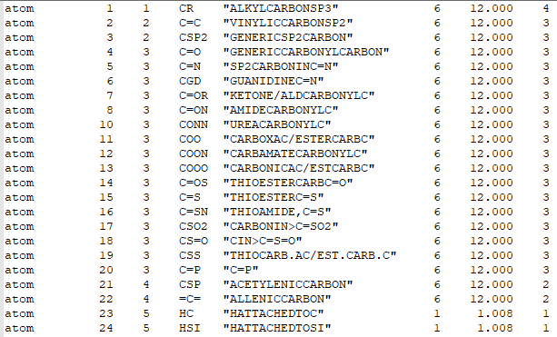
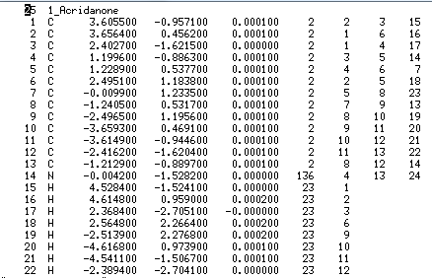
Aside: “Atom type” and “atom group”
mass.prm
.xyz file
atom type
atom group
“atom type”
A number of atoms with different atom types can belong to the same atom type group. For example, in the mass.prm file, it can be seen that C in a generic carbonyl and C in an amide are assigned atom types of 4 and 8, respectively, although they belong to the same atom group 3. Vdw parameters are assigned following atom group from the vdw.prm file.
Note that the .xyz file from the sdf2tinkerxyz software has the “atom type” information rather than “atom type group” information. Therefore, the xyztomfj.py code reads the mass.prm file to assign atom type groups, and assigns vdw parameters from the vdw.prm file based on the information.

