Slide 1
Quick Start Guide for:
Hopkins Laboratory
University of Waterloo
July 2023
Analyst 2023, 148 (14), 3257–3273. https://doi.org/10.1039/D3AN00545C.

Slide 2
Installation of Packages
Babel 2.4.1
The GUI is compatible with OpenBabel 2.4.1.
N. M. O'Boyle, M. Banck, C. A. James, C. Morley, T. Vandermeersch, and G. R. Hutchison. Open Babel: An open chemical toolbox. J. Cheminf. (2011), 3, 33.
There has been Syntax changes with later versions of OpenBabel, so we recommend that users download this specific version. OpenBabel 2.4.1 can be downloaded from:
https://sourceforge.net/projects/openbabel/files/openbabel/2.4.1/
Follow the on-screen instructions and install OpenBabel 2.4.1 in the default directory.
Adding Babel and SDF2XYZ2SDF directories to PATH
If you specified the default install directories for both packages, these need to be added to PATH.
To add the directories to the PATH:
Enter the phrase ‘Environment Variables’ in the Windows Search bar
Select ‘Edit the system environment variables’ option that appears
Select the ‘Environment Variables…’ radio button at the bottom of the screen.
Highlight the Path variable in the top box and select the ‘Edit…’ radio button.
Select the ‘New’ radio button and add the following two entries:
C:\Program Files\OpenBabel-2.4.1
C:\open3dtools\bin
Verify that obabel.exe and babel.exe can be found in C:\Program Files\OpenBabel-2.4.1
Verify that sdf2tinkerxyz.exe can be found in C:\open3dtools\bin
SDF2XYZ2SDF
The GUI accompanying MobCal-MPI 2.0 requires the SDF2XYZ2SDF program. For details on the functionality of this program, please see P. Tosco and T. Balle, Journal of Molecular Modeling, 2011, 17, 3021-3023.
SDF2XYZ2SDF can be downloaded from:
https://sourceforge.net/projects/sdf2xyz2sdf/files/binaries/windows/
Follow the on-screen instructions and install SDF2XYZ2SDF in the default directory.

Slide 3
Installation of Python
Python 3.7 or 3.8
The GUI is compatible with all Python 3.7+ releases. Download the version your desire from https://www.python.org/downloads/. When installing, ensure that the radio button to ‘Add Python 3.X to PATH’ is selected; it should be located at the bottom of the installer window.
It is also beneficial to install a custom installation of Python such that you can modify the install directory. A convenient location is C:/Python37 (for Python 3.7) or C:/Python38 (for Python 3.8)
Numpy and PyQt5
The MobCal-MPI Suite GUI requires the numpy and PyQt5 libraries. To install these:
Open up the command prompt (or equivalent for Mac/Linux). For Windows users, type cmd into the search bar.
Type the following commands:
pip install numpy pyqt5
Note that by running either of these commands, you may be prompted to update pip. This is normal behaviour.

Slide 4
Compiling MobCal-MPI 2.0
MobCal-MPI 2.0 is written in Fortran and is parallelized
To run the code in parallel, an MPI framework is needed
To compile the code, a Fortran compiler is needed
Both are usually combined in mpifort or mpiifort (Intel)
check $ mpifort --version
MPI \ compiler | gfortran | ifort
OpenMPI | $ mpifort –o MobCal-MPI_2.exe MobCal-MPI_2.f | $ mpifort –o MobCal-MPI_2.exe MobCal-MPI_2.f -Ofast
Intel MPI | - | $ mpiifort –o MobCal-MPI_2.exe MobCal-MPI_2.f -Ofast

Slide 5
Running MobCal-MPI 2.0
Once the MobCal-MPI_2.exe is created, for each <basename>.mfj file, a mobcal.run file needs to be created, having two lines:
<basename>.mfj
<basename>.mout
Then run
$ mpirun –np 4 ./MobCal-MPI_2.exe mobcal.run (OpenMPI)
$ mpirun –n 4 ./MobCal-MPI_2.exe mobcal.run (Intel MPI)
Here, “4” can be replaced by the number of cores to use

Slide 6
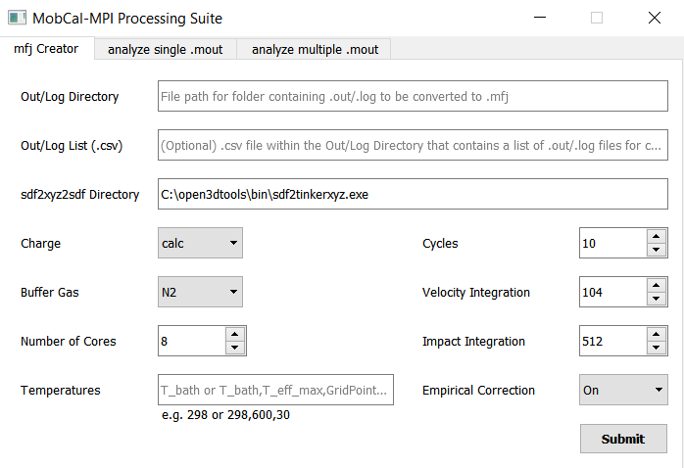
GUI: mfj-creater
Where the Gaussian / ORCA files are at
These need to be both, a
geometry optimization
ESP / CHELPG charge
calculation in order to get accurate results
|
|
Statistical Sampling parameters
|
|
Should match what you use with mpirun
Bath gas temperature,
Highest T_{eff},
Number of grid points (max 99),
→ no spaces!
Larger number of grid points does not increase the calculation time and a larger number is recommended

Slide 7
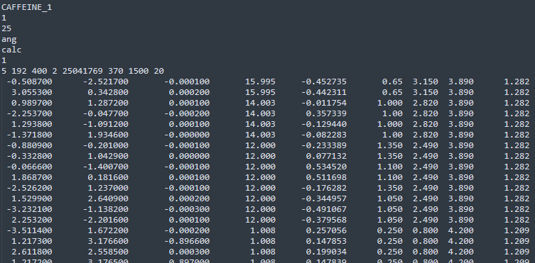
GUI: mfj-creater: Details on the *.mfj files
Label
Number of coordinate sets
Number of atoms
Unit of xyz (ang=Ångstom, a.u.=atomic units)
Charge distribution (unchanged)
Empirical correction to mobility (0=off, 1=on)
Itn, inp, imp, igas, seed, Tbath, Teff_max, # Tgrid
-----------------XYZ coordinates of molecule -----------------
atomic masses
atomic charges
------------MMFF94 parameters------------

Slide 8
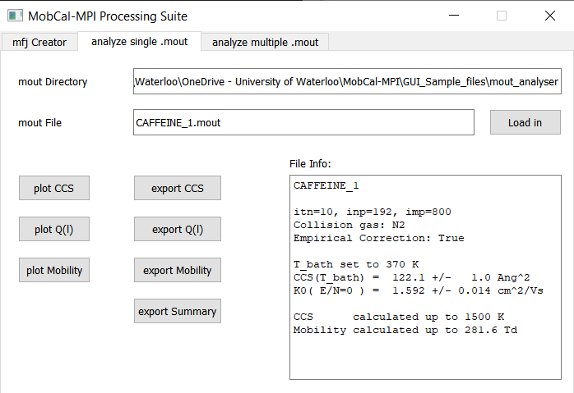
GUI: analyze single .mout
Plots CCS vs. Teff
Or CCS integrand (if only low field data is available)
Plots momentum transfer cross sections
General information
Low field data
Only printed if high field data is available
Plots K0 vs. E/N and fits alpha coefficients
Export data to csv/txt files

Slide 9
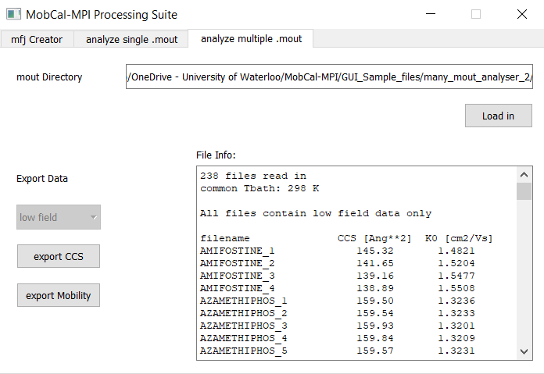
GUI: analyze multiple .mout
When all mout files only have low field data
Cannot be toggled
Printed if all Tbath are equal. Otherwise “Tbath ranges from XXX to XXX K”
Info, why „high field“ cannot be chosen in drop down menu
Both buttons will export low field data

Slide 10
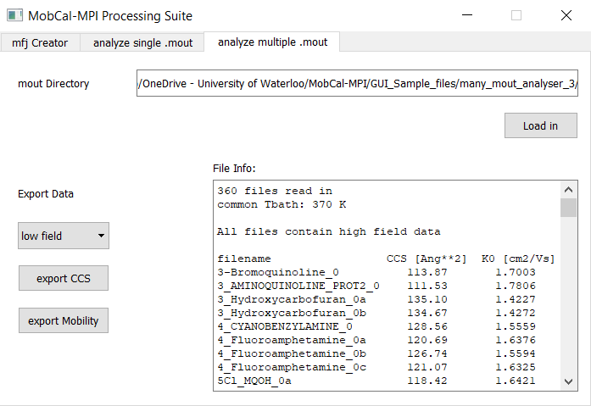
GUI: analyze multiple .mout
When all mout files only have high field data
Printed if all Tbath are equal. Otherwise “Tbath ranges from XXX to XXX K”
To be comparable, all Tbath should be equal
Can be toggled
Info
If the Teff grid is NOT the same between all files, there will be a warning in the output “# WARNING: Teff grids not matching. Interpolation on common range used!” and the CCSs are printed on a Teff grid ranging from the lowest common value to the highest common value
Buttons will export {low,high} field data, depending on the drop down choice

Slide 11
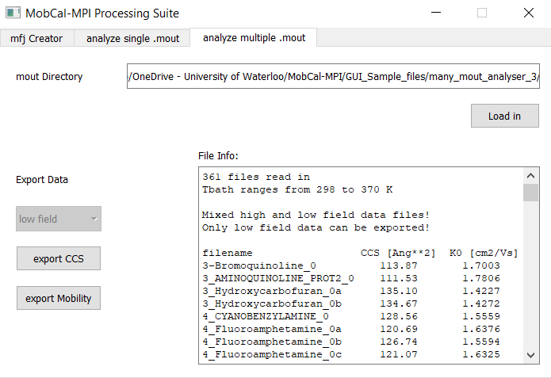
GUI: analyze multiple .mout
When all mout files only have mixed field data
Cannot be toggled
Printed if all Tbath are equal. Otherwise “Tbath ranges from XXX to XXX K”
Info that some files have high-field data, but not all of them.
Hence, the only possible Export is: „low field“
This then is the same as if we‘d had only low field data.
Buttons will export low field data

Slide 12
Where to get help:
Write an Email to
shopkins@uwaterloo.ca
a2haack@uwaterloo.ca
cieritan@uwaterloo.ca
A detailed manual will soon be available!
Term of Use
MobCal-MPI 2.0 is provided free of use to academic users to validate ion-mobility experiments with computational methods. MobCal-MPI 2.0 is freely available to the public for use in academic research. Any attempt to use MobCal-MPI 2.0 for profit without the written consent of the authors is considered a breach of the usage terms and may be subject to litigation.

Slide 13
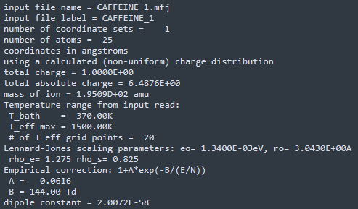
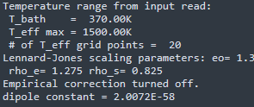
Details on the *.mout files
Label
Number of coordinate sets
Number of atoms
Unit of xyz (ang=Ångstom, a.u.=atomic units)
Charge distribution (unchanged)
Tbath, Teff_max, # Tgrid
van der Waals scaling (fixed)
Empirical correction to mobility (0=off, 1=on)
Empirical correction to mobility (0=off)

Slide 14
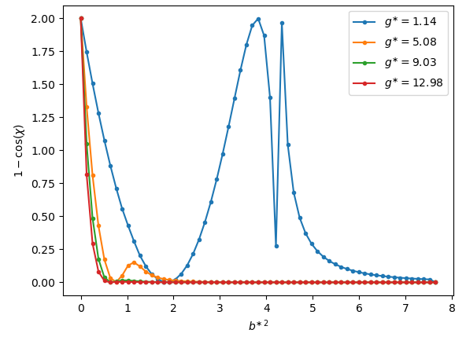
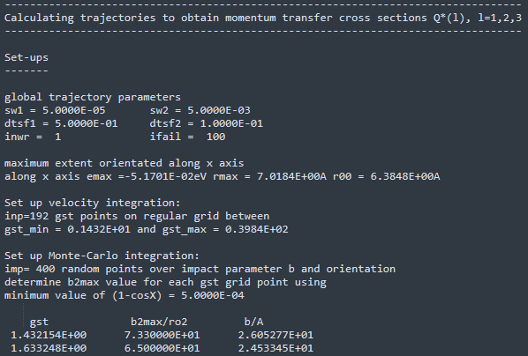
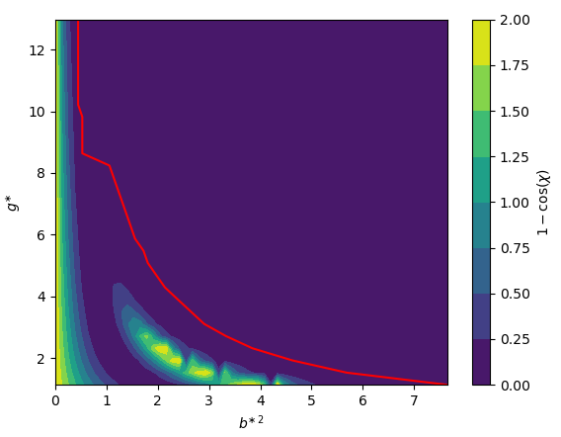
Details on the *.mout files
inp
Resulting velocity grid
b²max as a function of velocity
imp
Cutoff for b²max
Printing b²max for each velocity point

Slide 15
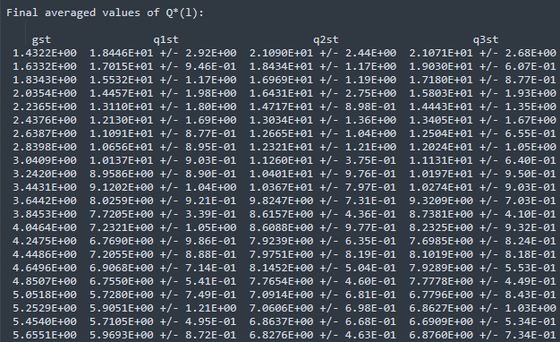
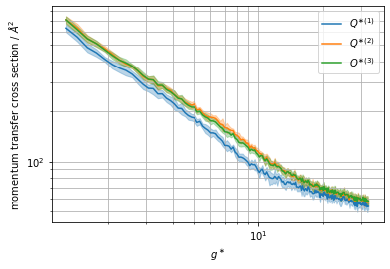




Details on the *.mout files
$$g^{∗}$$
$$Q^{∗(1)}±σ_{Q^{∗(1)}}$$
$$Q^{∗(2)}±σ_{Q^{∗(2)}}$$
$$Q^{∗(3)}±σ_{Q^{∗(3)}}$$

Slide 16
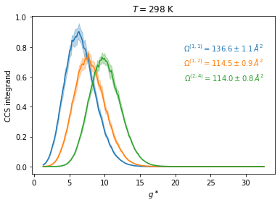
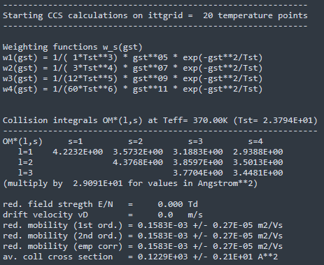
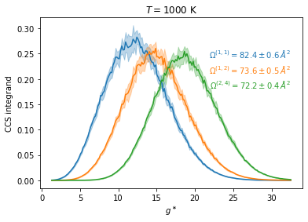

Details on the *.mout files
ω_{s}(gst)*Q^{(l)}(gst)
$$Ω^{∗(l,s)}$$
Loops over Tgrid
Detailed mobility data (1st, 2nd order and with empirical correction (only if turned on!))

Slide 17
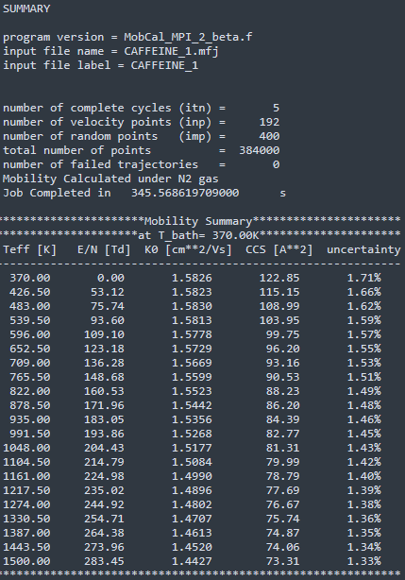
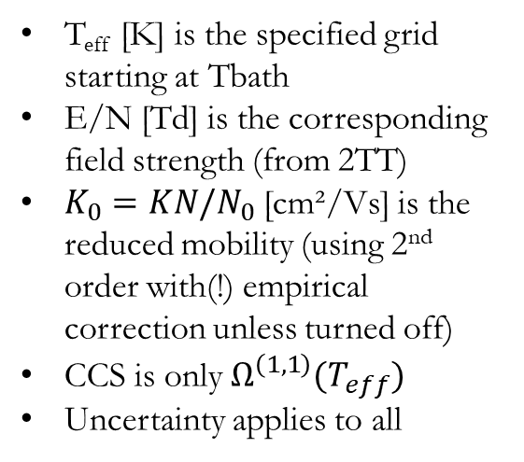
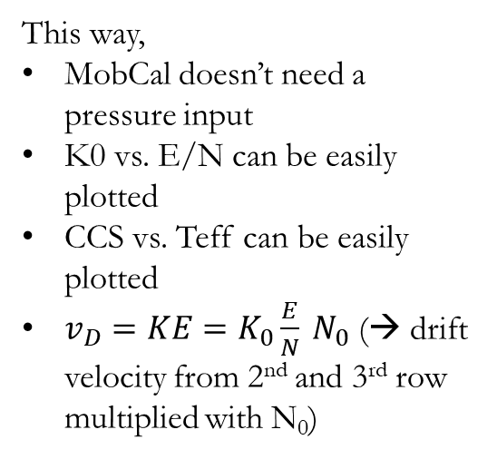
Details on the *.mout files
Integration parameters and timing
T_{eff} [K] is the specified grid starting at Tbath
E/N [Td] is the corresponding field strength (from 2TT)
$K_{0}=KN/N_{0}$ [cm²/Vs] is the reduced mobility (using 2nd order with(!) empirical correction unless turned off)
CCS is only $Ω^{\left(1,1\right)}(T_{eff})$
Uncertainty applies to all
This way,
MobCal doesn’t need a pressure input
K0 vs. E/N can be easily plotted
CCS vs. Teff can be easily plotted
$v_{D}=KE=K_{0}\frac{E}{N} N_{0}$ (→ drift velocity from 2nd and 3rd row multiplied with N₀)

