Slide 1
Gamerev
Rasmus Jarnborg Friis - cph-rf43@cphbusiness.dk
Andreas Guldborg Heick - cph-ah384@cphbusiness.dk
Mohammad Hariri - cph-mh682@cphbusiness.dk

Slide 2
Plan for præsentation
Introduktion
Arkitektur
Monolithic Application
BPMN - Camunda
Message Broker – RabbitMQ
Microservices

Slide 3
Introduktion
Hvad er gameRev?

Slide 4
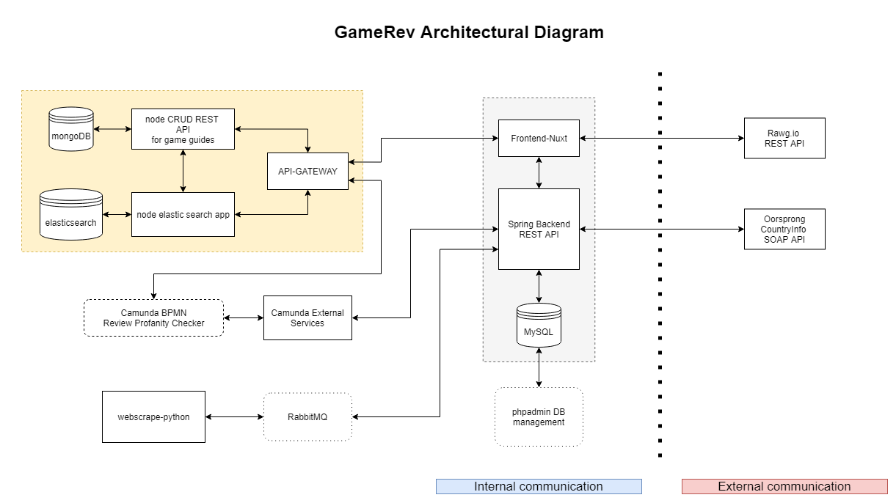
Docker
Sprog:
Java
Python
JavaScript
TypeScript
Frameworks:
Vue.js
NuxtJS
Spring Boot
NodeJS
ExpressJS

Slide 5
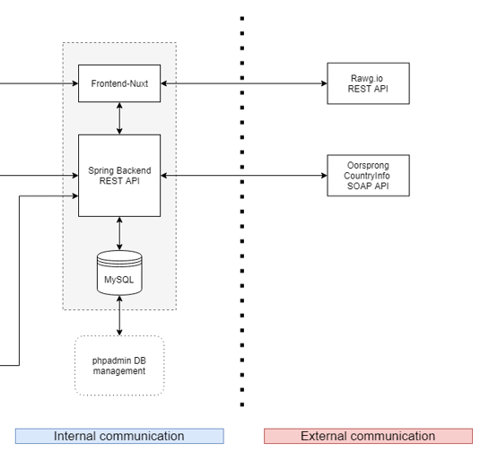
Monolithic application

Slide 6

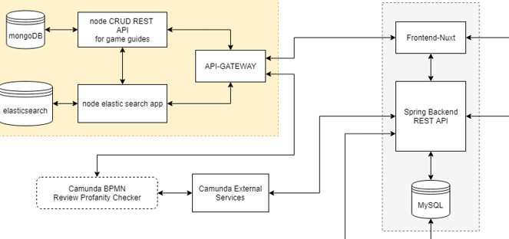
BPMN - Camunda

Slide 7
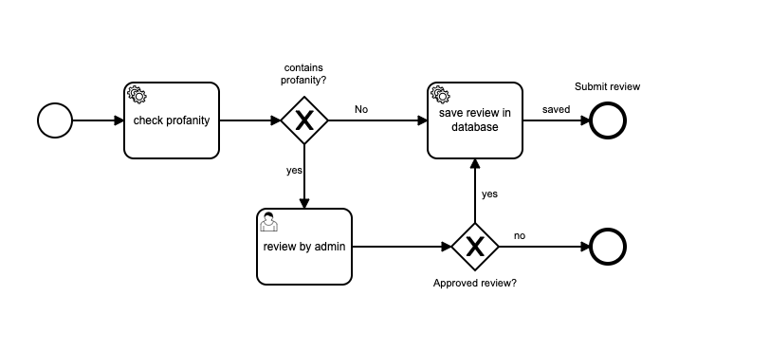
BPMN - Camunda

Slide 8
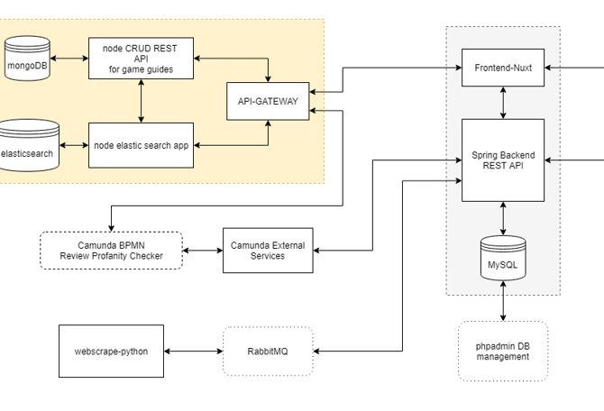

Message broker - rabbitmq

Slide 9
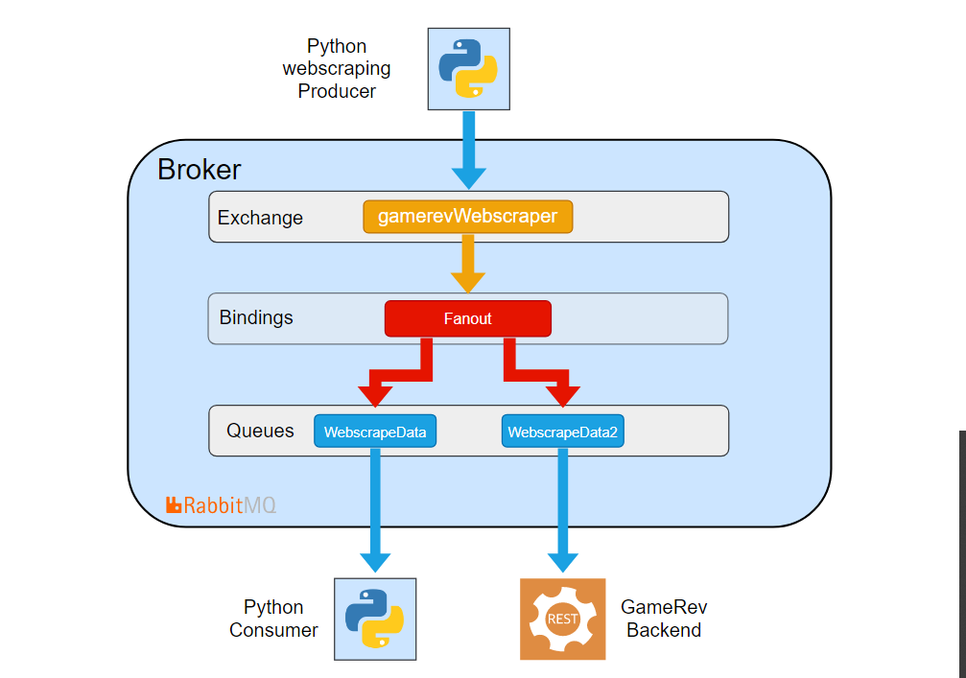
Message broker - rabbitmq

Slide 10
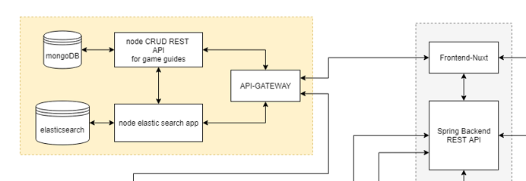

microservices

Slide 11
Slut
https://github.com/Hoppedyr/gameRev

