Slide 1




SMART INDIA HACKATHON 2026
TITLE PAGE
  Problem Statement ID – 26170
  Problem Statement Title- AI-Driven Anomaly Detection in Component Burn-In & Screening
  Theme-Smart Automation
  PS Category- Software
  Team ID-
  Team Name - Agamemnon

Slide 2
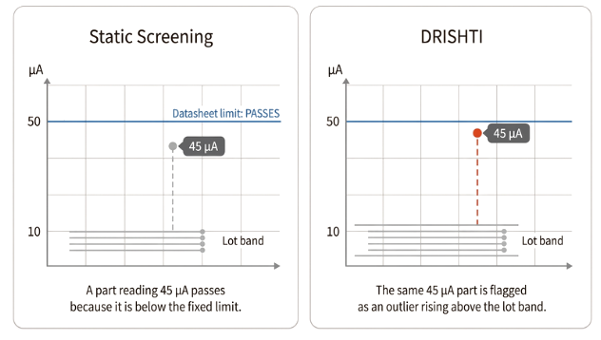
DRISHTI — AI-Driven Component Screening
Agamemnon
Proposed Solution
  DRISHTI judges every part against its own manufacturing lot and predicts where it will be at 168 hours, using only the first 24 hours of data
  Verdict for every part: PASS, FAIL, or ESCALATE, with a stated reason
How it addresses the problem
  45 µA leakage vs. 10 µA lot average — still passes the 50 µA limit
  Compares parts to a fixed datasheet limit, not their lot behavior
  It sees where a part is, not where it is heading
  It gives a pass/fail with no reason a QA inspector can review
Why now:
Innovation and uniqueness
Indian Space Policy 2023 opened satellite and launch-vehicle building to private industry. More suppliers mean more component lots, which must be screened consistently
  Lot-relative limits catch hidden outliers
  Forecast uncertainty prevents risky escapes
  Uncertain parts get extra burn-in
  Drift shape suggests the failure mechanism

Slide 3
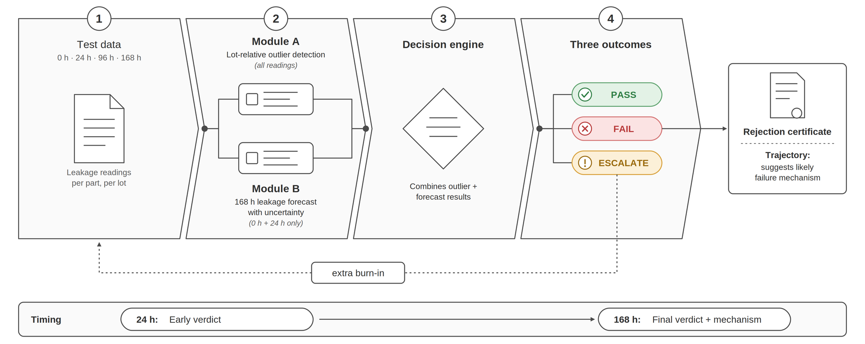







TECHNICAL APPROACH
Agamemnon
Technologies Used
Anomaly Detection — Module A
  Python, scikit-learn, PyOD
  Robust MAD statistics and dynamic lot limits
  Isolation Forest + ECOD ensemble
Drift Forecasting — Module B
  LightGBM with quantile and L1 objectives
  Trained to optimise MAE directly, matching the evaluation metric
Uncertainty Calibration
  Custom split-conformal module
  Conformalized Quantile Regression (CQR)
  Distribution-free intervals with a bounded error rate
Explainability
  InterpretML — Explainable Boosting Machine
  SHAP for feature attribution
  Interpretable-by-design, not post-hoc rationalisation
How a QA engineer's day changes
Before
After
  Waits for the full burn-in
  Checks each reading against one fixed limit
  Gets PASS or FAIL with no explanation
  At 24 h sees each part against its lot and its forecast 168 h range
  Gets PASS, FAIL, or ESCALATE
  Every rejection comes with a certificate stating the evidence

Slide 4


FEASIBILITY AND VIABILITY
Agamemnon
Feasibility
Viability
  No new hardware: Uses existing CSV/STDF test data
  Laptop-ready: CPU-only, open-source Python
  Air-gapped: Data stays inside the facility
  Modular: Module A works independently of Module B
  Proven methods: Peer-reviewed + industry practices
  Data roadmap: Simulation → NASA + UCI → Partner ATE data
  No defect labels: Conformal calibration
  Audit-ready: Versioned models, logs & rejection certificates
Risks & Mitigations
No public burn-in data → real analogue datasets; every result labelled real or synthetic
Small lots → minimum lot-size rule + historical baseline
Whole lot shifted → cross-lot baseline alongside dynamic limits
Unseen defect type → ESCALATE to extended burn-in, never auto-PASS
Risks & Mitigations
4
Notes:
4

Slide 5





IMPACT AND BENEFITS
Agamemnon
IMPACT
BENEFITS
WHO BENEFITS
ISRO & space integrators— Fewer latent-defect escapes into flight payloads, plus a full audit trail per rejected part.
01
Mission Assurance — catches drift-based defects before flight integration
Reliability — fewer escapes without more blanket over-rejection
01
02
Throughput — frees oven slots by rejecting at 24h instead of 168h
Economic — lower cost per screened part, shorter qualification cycle
02
Defence electronics— Same screening flow for mission-critical hardware where field repair is impossible.
03
Root-Cause Feedback — names the suspected mechanism for supplier action
Trust — glass-box verdicts a QA inspector can defend
03
04
Auditability — every rejection carries inspectable evidence
Strategic — indigenous, air-gapped-capable screening infrastructure
04
Automotive semiconductor QA— Directly reuses AEC-Q100 Part Average Testing practice; drops into existing test lines.
“Scrapping a good component costs a few thousand rupees.
Letting a bad one reach orbit costs the mission.
Our system is designed around that asymmetry.”
Medical device manufacturers— Traceable, inspectable rejection evidence for regulatory submission.
5
Notes:
5

Slide 6
RESEARCH AND REFERENCES
Agamemnon
Screening Standards & Failure Physics
Anomaly Detection Methods
1. MIL-STD-883, Method 1015 — Burn-In Test for Microelectronics
1. Liu, Ting & Zhou — "Isolation Forest", IEEE ICDM 2008
dla.mil/Land-and-Maritime/Business/Standardization
ieeexplore.ieee.org/document/4781136
2. AEC-Q001 — Guidelines for Part Average Testing
2. Li et al. — "ECOD: Unsupervised Outlier Detection Using Empirical CDFs", IEEE TKDE 2022
aecouncil.com/AECDocuments.html
3. NASA EEE-INST-002 — EEE Parts Selection, Screening, Qualification and Derating
ieeexplore.ieee.org/document/9737003
Related Work & Policy
nepp.nasa.gov
4. JEDEC JEP122 — Failure Mechanisms and Models for Semiconductor Devices
1. Ahmed, Hosseinpour, Baraldi, Zio & Lewitschnig — "AI-Based Framework for Burn-In Reduction in Semiconductor Manufacturing", Springer 2024
jedec.org/standards-documents
doi.org/10.1007/978-3-031-59361-1_5
2. Moreno-Lizaranzu & Cuesta — "Improving Electronic Sensor Reliability by Robust Outlier Screening", Sensors 2013
Uncertainty Quantification & Explainability
ncbi.nlm.nih.gov/pmc/articles/PMC3859076
1. Romano, Patterson & Candès — "Conformalized Quantile Regression", NeurIPS 2019
3. Indian Space Policy 2023, Department of Space
Datasets
arxiv.org/abs/1905.03222
2. Rudin — "Stop Explaining Black Box Models for High-Stakes Decisions", Nature Machine Intelligence 2019
arxiv.org/abs/1811.10154
6
Notes:
6

