Slide 1
Functional Testing
Hannes Pétursson
T303-HUGB | Hugbúnaðarfræði
Notes:
1

Slide 2
Brian Maric’s test quadrants
Automated
Business Facing
Manual
Functional Tests (Virkniprófanir) | Usability and Exploratory Testing (Nytsemis og könnunar prófanir)
Unit Tests (Einingaprófanir) | Property Testing (Eiginleikaprófanir)
Support Programming (Drive/test to spec)
Critique Product ( Test to failure)
Automated
Tool-Based
Technology Facing

Slide 3
Functional Tests
Customer tests
End to end tests
Manual tests
Automated UI tests
Automated API tests
Measurements

Slide 4
Customer Tests
Customers have specialized expertise, or domain knowledge, that programmers don't have.
Customer tests help customers communicate their expertise
Customer tests are really just examples, programmers can turn them into automated tests.
Follow the process
Describe, Demonstrate, Develop

Slide 5
End-to-end tests
Tests the system from end-to-end
From the UI to the database and back
Are brittle
Are expensive to write
Are slow

Slide 6
Manual Functional Tests - Example
Action | Expected | Pass/Fail
Open www.icelandair.is | Booking engine displayed
Enter From Reykjavík, To Amsterdam, click “Search” | Message “No departure date selected”
Enter Departure date, one adult, two infants, click “Search” | Message “Please note that you cannot travel with more than one infant per adult”
Enter one adult, zero infants, click “Search” | New page containing table with available departure dates

Slide 7
Manual Functional Tests - Instance
Action | Expected | Pass/Fail
Open www.icelandair.is | Booking engine displayed | Pass
Enter From Reykjavík, To Amsterdam, click “Search” | Message “No departure date selected” | Pass
Enter Departure date, one adult, two infants, click “Search” | Message “Please note that you cannot travel with more than one infant per adult” | Pass
Enter one adult, zero infants, click “Search” | New page containing table with available departure dates | FAIL! Got a message, “KEF-AMS not found in flight plan”

Slide 8
Automated UI tests
Disadvantages
UI bound (Háð viðmóti)
Functionality must generally be ready
Impediment against changes (Heftir breytingar)
Slow (Hægvirk)
Not convenient for TDD
Advantages
Lower learning curve
Less specialized skills required
Exercises the whole stack
Good for
Develop a minimal test suite fast

Slide 9
Automated API testing
Disadvantages
Does not test presentation layer
Requires programming knowledge
Advantages
Fast
Can be implemented before functionality (A-TDD)
Change resistant
Encourages decoupled design
Good for
Business rules
Data intensive functionality
Not good for
High interaction

Slide 10
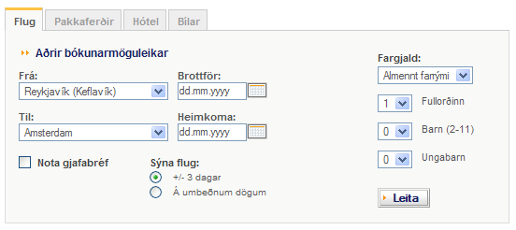
Customer tests - example
Combinations and price business rules

Slide 11
Specifications - Example
Simplified specifications
Saga business class costs twice the minimum fare
Children 2-11 pay half price
Infants pay no fare
Only one infant per adult

Slide 12
Test specification
Fare | Adults | Children | Infants | Verð
Economy | 2 | 1 | 0 | 25000
Economy | 1 | 2 | 1 | 20000
Saga | 2 | 2 | 1 | 60000
Saga | 0 | 1 | 1 | Not allowed
Economy | 1 | 1 | 2 | Not allowed
Saga | 1 | 1 | 1 | 30000
Minimum fare == 10.000

Slide 13
Executable specification (test automated)
com.icelandair.fargjald
Fare | Adults | Children | Infants | Price()
Economy | 2 | 1 | 0 | 25000
Economy | 1 | 2 | 1 | 20000
Saga | 2 | 2 | 1 | 60000
Saga | 0 | 1 | 1 | Not allowed
Economy | 1 | 1 | 2 | Not allowed
Saga | 1 | 1 | 1 | 30000

Slide 14
Executed test
com.icelandair.fare
Fare | Adults | Children | Infants | Price()
Economy | 2 | 1 | 0 | 25000
Economy | 1 | 2 | 1 | 20000
Saga | 2 | 2 | 1 | Expected 60000, got 61000
Saga | 0 | 1 | 1 | Not allowed
Economy | 1 | 1 | 2 | Not allowed
Saga | 1 | 1 | 1 | Expected 30000, got 31000

Slide 15
Example of UI testing tool - Selenium
Record-playback
Readable syntax
Two styles
Table driven – black box testing
Code driven – white box testing
Scripts the browser with JavaScript

Slide 16
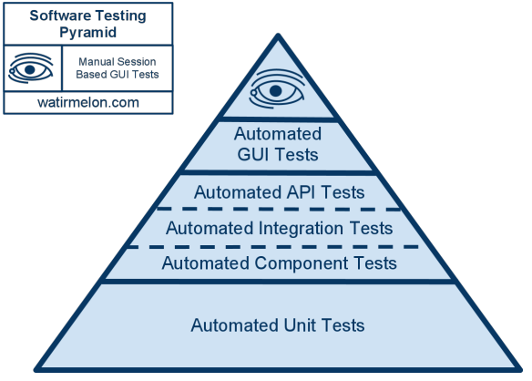
Software Testing Pyramid

Slide 17
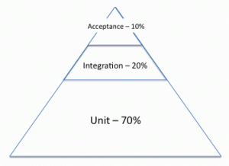

Slide 18
Measurement – Functional Tests
Code Coverage
RTF (Running Tested Feature)
The desired software is broken down into named features (requirements, stories) which are part of what it means to deliver the desired system.
For each named feature, there are one or more automated acceptance tests which, when they work, will show that the feature in question is implemented.
The RTF metric shows, at every moment in the project, how many features are passing all their acceptance tests.

Slide 19
RTF (Running Tested Feature)

Slide 20
Unit vs. Functional tests
Unit tests | Functional tests
Smallest unit of code (Class/method) | Higher level Business Logic
Programmer driven | Team driven (customer-tester-programmer)
Short cycle (minutes) | Longer cycle (hours-days)
Highly isolated scope stub, mock, dummy, fakes o.s.fr. -No filesystem or network | Team scope (don’t depend on systems outside the team’s control)
Program design | Functionality design
100s per second | 1/10-10s of seconds per test
Building the Code Right | Building the Right Code

Slide 21
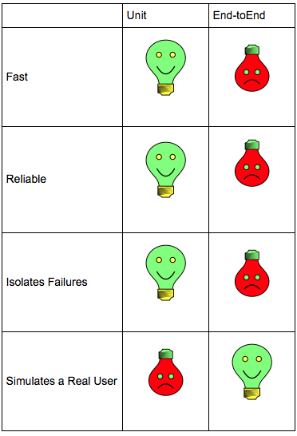

Slide 22
References
Test Pyramid
http://jamescrisp.org/2011/05/30/automated-testing-and-the-test-pyramid/
http://watirmelon.com/2011/06/10/yet-another-software-testing-pyramid/
http://martinfowler.com/bliki/TestPyramid.html
http://googletesting.blogspot.co.uk/2015/04/just-say-no-to-more-end-to-end-tests.html
https://www.symphonious.net/2015/04/30/making-end-to-end-tests-work/
http://www.jamesshore.com/Blog/Alternatives-to-Acceptance-Testing.html

Slide 23
Brian Maric’s test quadrants
Automated
Business Facing
Manual
Functional Tests (Virkniprófanir) | Usability and Exploratory Testing (Nytsemis og könnunar prófanir)
Unit Tests (Einingaprófanir) | Property Testing (Eiginleikaprófanir)
Support Programming (Drive/test to spec)
Critique Product ( Test to failure)
Automated
Tool-Based
Technology Facing

