Slide 1
Leaf Disease Detection Using Machine Learning
Mia Mahmudul Houque Shaon
ID: 2014314042
Asif Rahman
ID: 2012691042
Md Nazmul Islam Srabon
ID: 2021227042
CSE 299
Section 02
Group 05
Final Presentation

Slide 2
Introduction

Slide 3
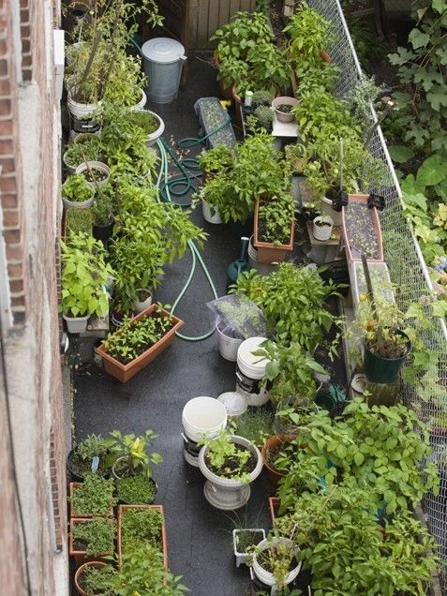
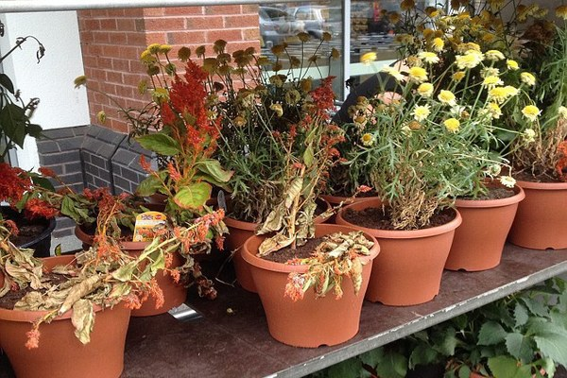
Gardening has become one of the top hobbies of urban people.
But the enthusiasm about it does not last for long among most of them.
Why?
Figure : Healthy Garden
Figure : Diseased Garden

Slide 4
Why?
Most of the urban people have no prior experience in farming.
Most features of agricultural technologies only focus on field agricultural crops rather than residential gardening.
Urban people are often unable to detect the plant diseases in time.

Slide 5
What is the solution?
Building an ML Model that
Can Recognise
the leaf
Detect healthy or diseased leaf

Slide 6
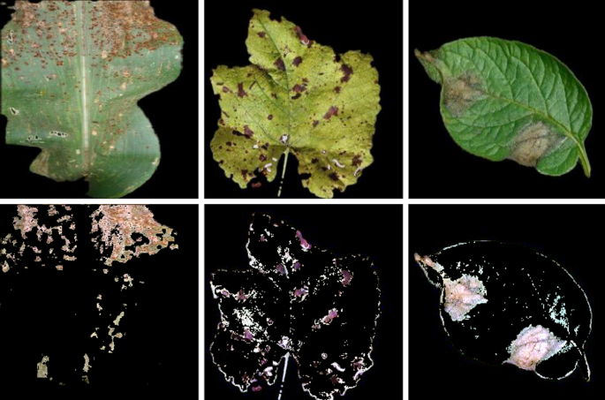
Continued…
Leaf disease detection is a field of study under the image recognition field of computer vision.
Machine learning(ML) is a part of artificial intelligence.
ML is used here to understand the training data and fit that training data into models to detect the disease.

Slide 7
System Diagram
Image Collection
Image Preprocessing
Prediction
Classification
Features Extraction

Slide 8
Aims and Objective
Aims
Developing a mobile application that can detect leaf disease and also suggest suitable remedies
Objective
Research ML and leaf diseases
Identify and collect proper datasets and design the ML model
Train the model and improve accuracy

Slide 9
Background Study

Slide 10
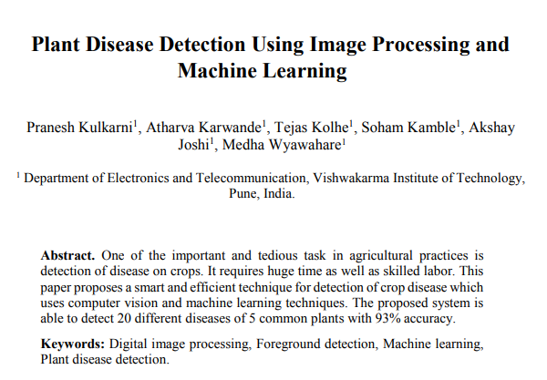
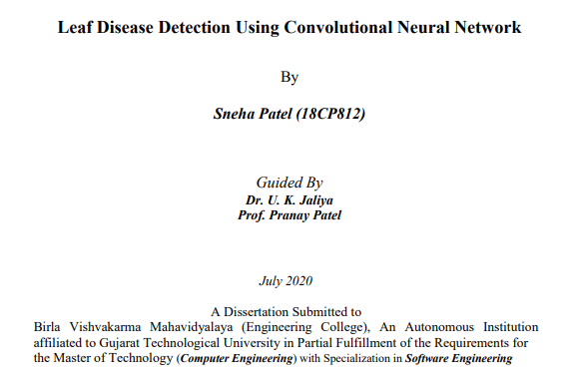

Background Study
Plant Disease Detection Using Image Processing and Machine Learning
A Research Paper
Leaf Disease Detection Using Convolutional Neural Network
A Research Paper
Detection of plant leaf diseases using image segmentation and soft computing techniques
Article in Press

Slide 11
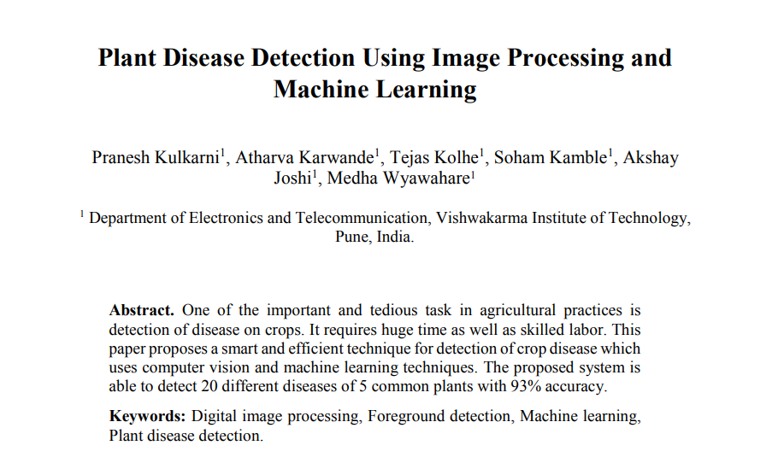
Background Study on Plant Disease Detection Using Image Processing and Machine Learning

Slide 12
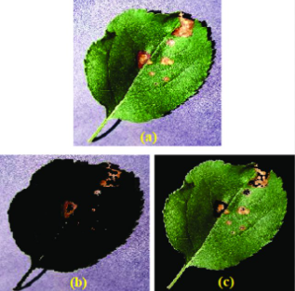
Continued…
Concept:
A technique for detection of crop disease which uses computer vision and machine learning techniques. This system is able to detect 20 different diseases of 5 common plants. The model is trained with 87000 RGB image samples.

Slide 13
Continued…
Methods Followed:
Image Preprocessing
Extracting textures using GLCM
Feature Selection
Correlation of variables with target variable
Image Classification
Random Forest Classifier
Results Achieved:
Average Accuracy of 93%
K-fold cross validation technique is implemented to find the accuracy score.
This method can find the accuracy on whole dataset without any bias

Slide 14
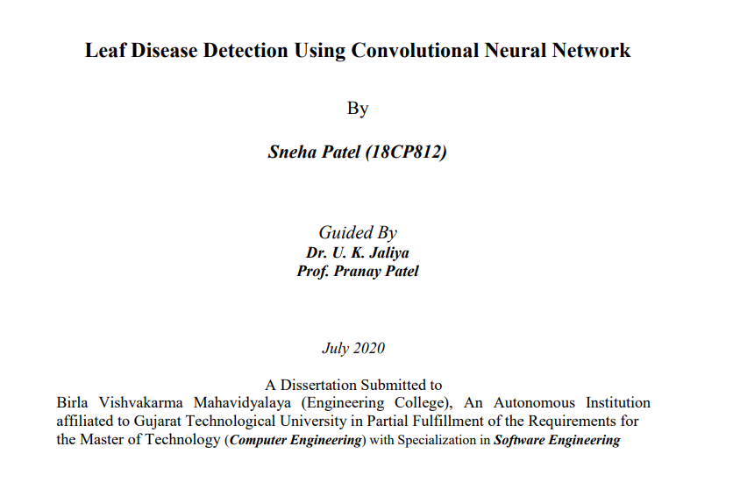
Background Study on Leaf Disease Detection Using Convolutional Neural Network

Slide 15
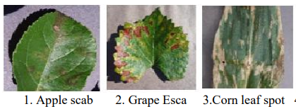
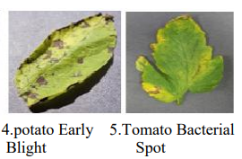
Continued…
Concept:
The aim is to detect apple, grape, corn, potato, and tomato plant leaves diseases. That contains twenty-four types of leaf diseases and twenty-four thousand leaves images are used.

Slide 16
Continued…
Methods Followed:
Image Preprocessing
Less preprocessing is required
compared to traditional approaches
Features Extraction
Automatic feature extraction is performed for better performance
Classification
CNN( Convolution Neural Network)
Results Achieved:
CNN
Accuracy of 90.23%
VGG16
Accuracy of 51.17%

Slide 17

Background Study on Detection of plant leaf diseases using image segmentation and soft computing techniques

Slide 18
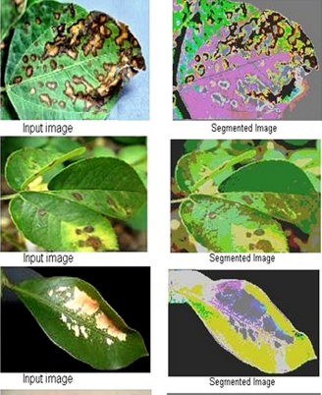
Continued…
Concept:
An article about detecting plant leaf disease using image segmentation where the author proposed some techniques which can be used to detect leaf disease.

Slide 19
Continued…
Methods Followed:
Image Preprocessing
Remove undesired distortion
Features Extraction
Color Co-occurrence method
Classification
K-Mean clustering
Support Vector Matrix (SVM)
Results Achieved:
K-Mean Clustering
Accuracy of 86.54%
SVM
Accuracy of 95.71%

Slide 20
Methodology

Slide 21
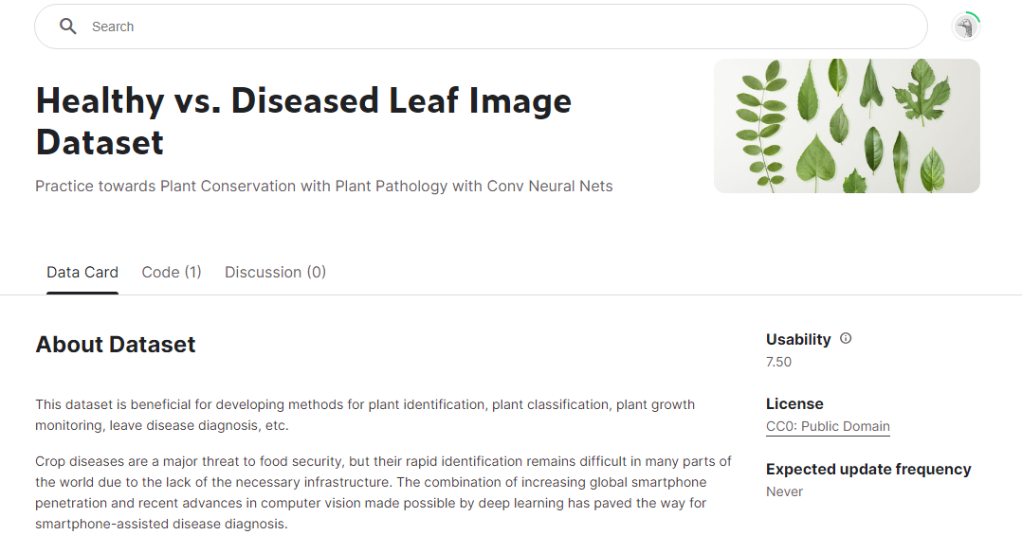
Dataset
https://www.kaggle.com/datasets/amandam1/healthy-vs-diseased-leaf-image-dataset

Slide 22
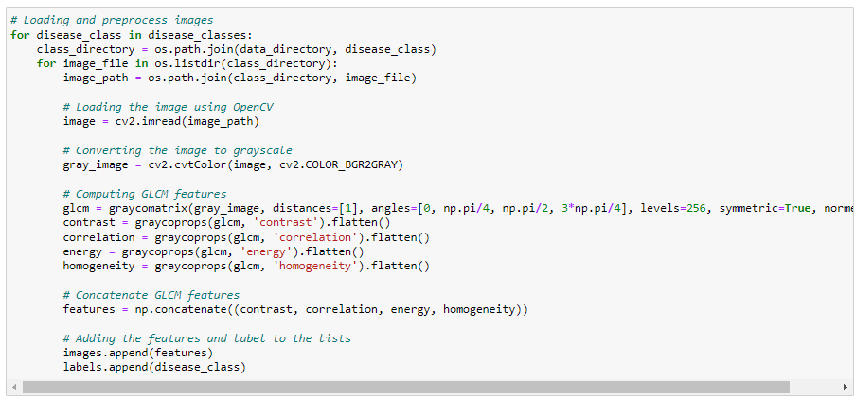
GLCM
Image Pre-processing
Converting RGB image to grayscale image
Computing GLCM features
Contrast
Co-relation
Energy
Homogeneity
Concatenating all GLCM features

Slide 23
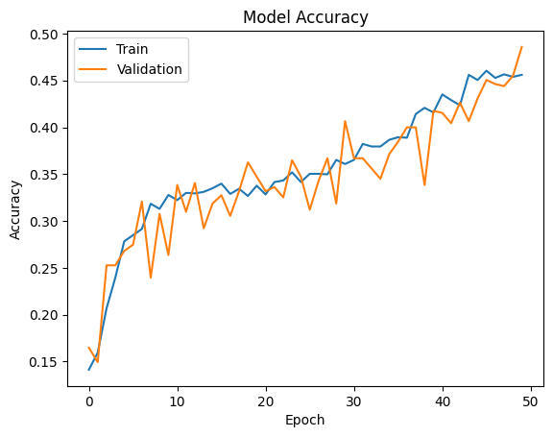
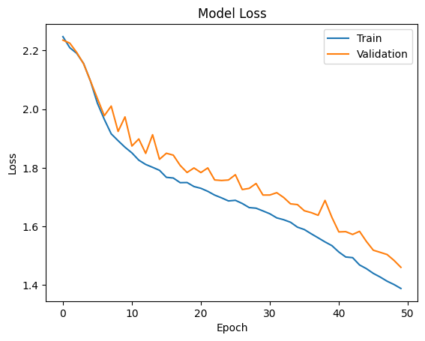
Accuracy & Loss Graph

Slide 24
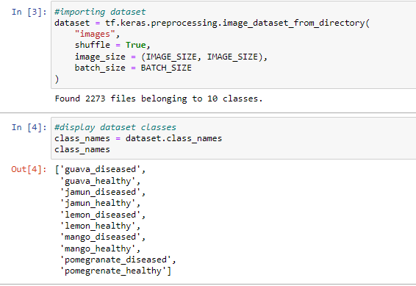
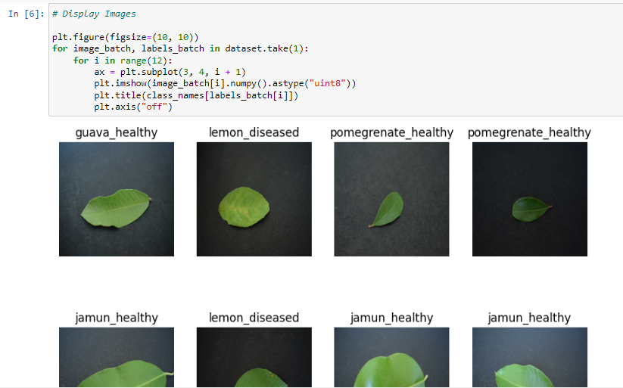
Import Dataset

Slide 25
Dataset Partition
To make the best use of our dataset we partitioned the dataset into 3 subsets. That are namely:
Training: Dataset to be used while training
Validation: Dataset to be tested against while training
Test: Dataset to be tested against after we trained a model
Prepare the dataset
80% training
20% testing
10% validation
10% test

Slide 26
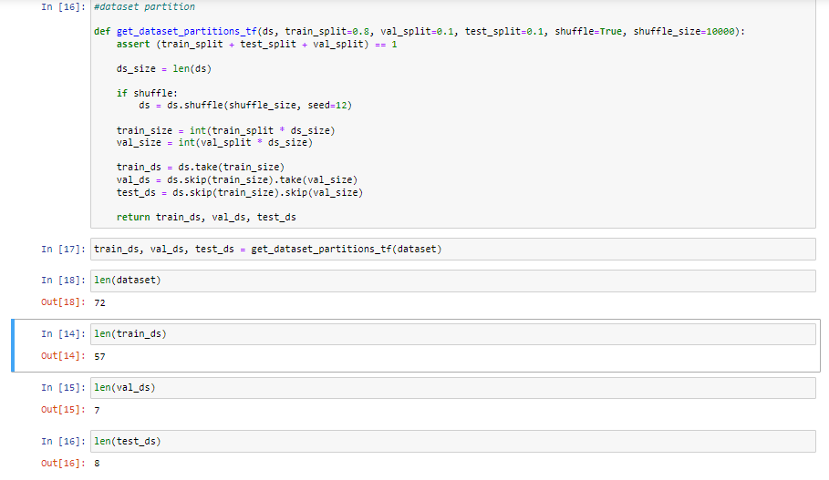
Dataset Partition

Slide 27
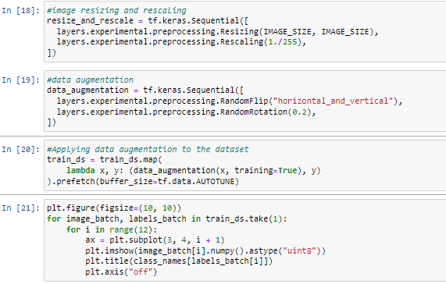
Image Pre-processing
Resizing and normalization
Data Augmentation
Apply data augmentation to train the dataset

Slide 28
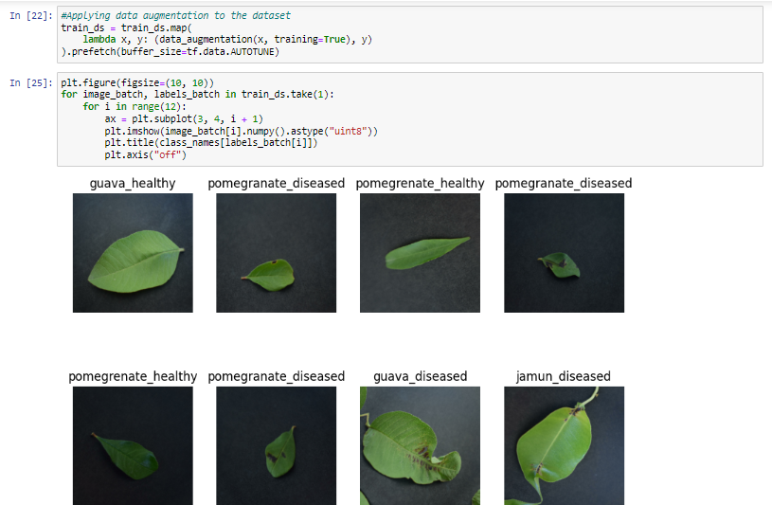
Image Pre-processing

Slide 29
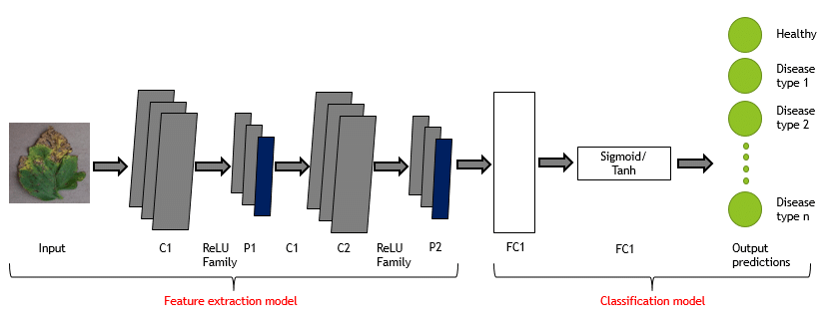
CNN Model Architecture

Slide 30
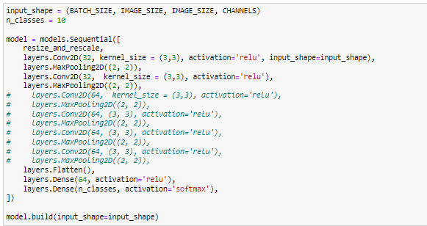
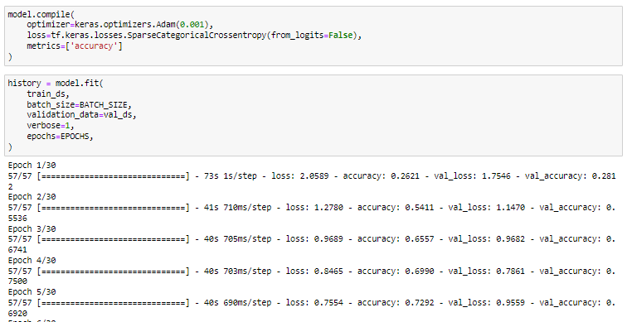
Model Architecture
Two Layers
Convolutional Layer
Pooling Layer
Model Architecture
Resize and Rescale
Data Augmentation
Convolutional Layer
Pooling Layer
Flatten Layer
Dense Layer

Slide 31
Result

Slide 32
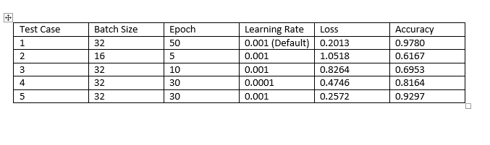
Result

Slide 33
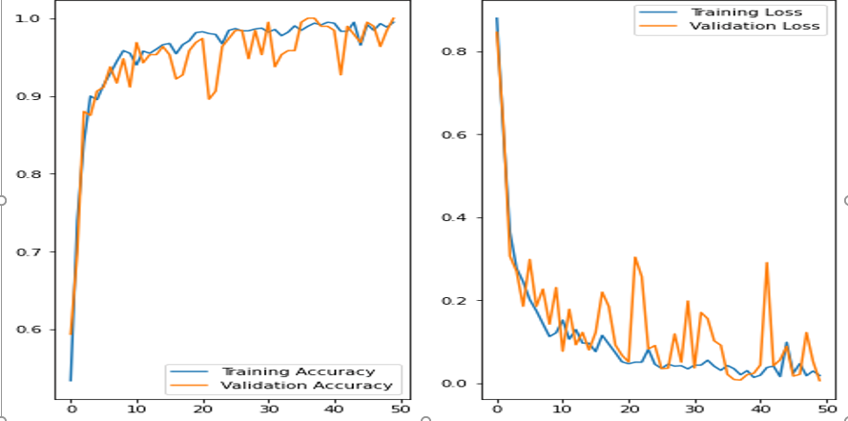
Test Case 1
Batch size : 32
Epoch : 50
Learning Rate : 0.001(Default)
Loss : 0.2013
Accuracy : 0.9780
Figure: Training and Validation Accuracy
Figure: Training and Validation Loss

Slide 34
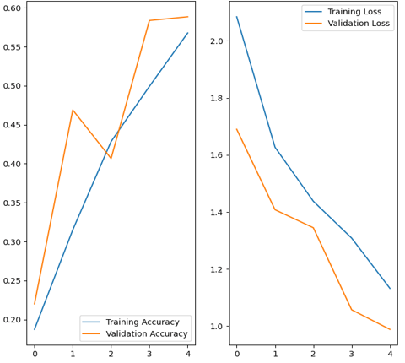
Test Case 2
Batch size : 16
Epoch : 5
Learning Rate : 0.001
Loss : 1.0518
Accuracy : 0.6167
Figure: Training and Validation Accuracy
Figure: Training and Validation Loss

Slide 35
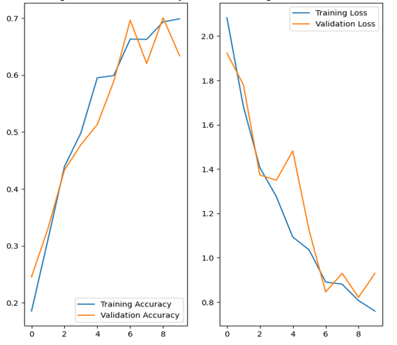
Test Case 3
Batch size : 32
Epoch : 10
Learning Rate : 0.001
Loss : 0.8264
Accuracy : 0.6953
Figure: Training and Validation Accuracy
Figure: Training and Validation Loss

Slide 36
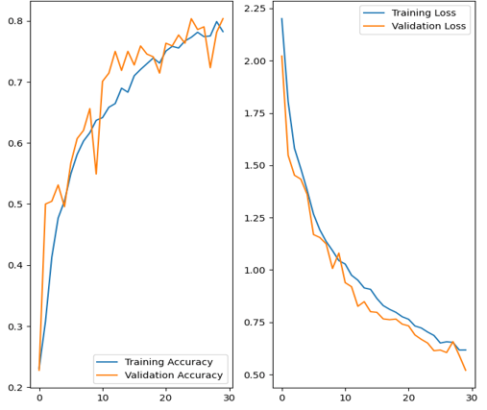
Test Case 4
Batch size : 32
Epoch : 30
Learning Rate : 0.0001
Loss : 0.4746
Accuracy : 0.8164
Figure: Training and Validation Accuracy
Figure: Training and Validation Loss

Slide 37
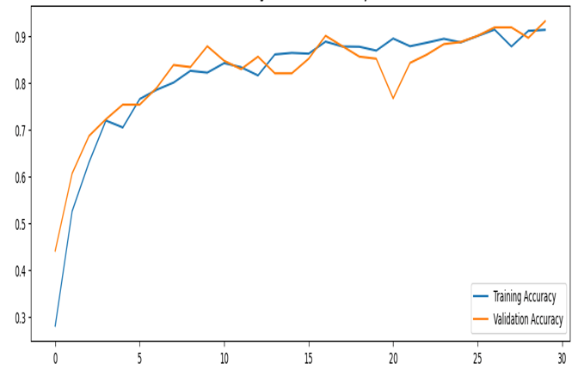
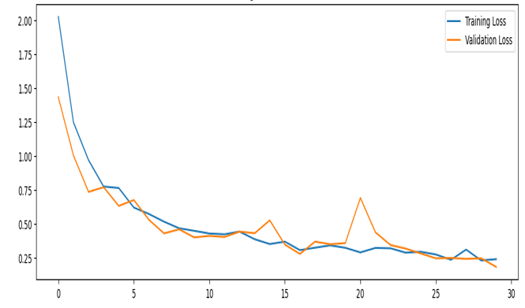
Test Case 5
Batch size : 32
Epoch : 30
Learning Rate : 0.001
Loss : 0.2572
Accuracy : 0.9297
Figure: Training and Validation Accuracy
Figure: Training and Validation Loss

Slide 38
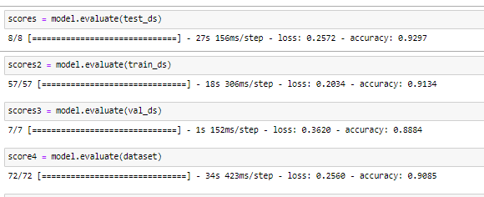
Test Case 5

Slide 39
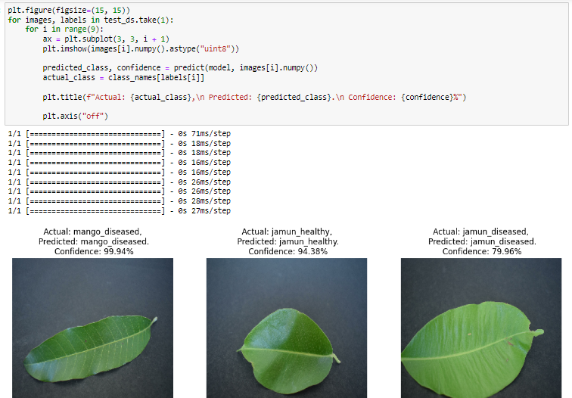
Prediction

Slide 40
Discussion

Slide 41
Discussion
To sum up,
We have successfully developed a CNN model that can analyse and classify leaf images and identify diseased leaf images
We have used CNN model both for feature extraction and classification purpose and got an accuracy of 92.97%.
We have also used a GLCM for feature extraction and CNN for classification to get an accuracy of only 45%. The reason for that could be the size of the dataset.

Slide 42
Thank You!

