Slide 1
FLOUR MILLS OF NIGERIA · SUPPLY CHAIN ANALYTICS
The Inventory Triage Engine
Forecasting demand and flagging risk per SKU — before it becomes a problem.
Project 1 — Demand Forecasting & Inventory Optimization

Slide 2
PROBLEM FRAMING
The Problem, In the Sponsor's Words
"
!
Stockouts delay production
SKUs run out with no advance warning — production stalls waiting on inventory.
We keep getting caught off guard — some SKUs run out and delay production, others sit overstocked and tie up working capital. I don't have anything today that tells me, ahead of time, which SKUs need attention and why.
$
Overstock ties up capital
Excess stock sits idle instead of freeing cash for other operations.
→
The ask
A self-serve tool — plain-language flags, before problems happen, not after.

Slide 3
APPROACH
A Two-Tier Architecture
TIER 1
TIER 2
DELIVERY
Demand Forecasting
Inventory Risk Triage
The Dashboard
Pooled LightGBM model across all SKUs
Leakage-safe lag & rolling features
Evaluated on MAE + WAPE (not RMSE)
→
Deterministic — not a second model
ROP_days & max_stock_days formulas
Walked forward to each SKU's lead time
→
Streamlit app, self-serve
Per-SKU forecast + plain-language flag
Full warehouse triage board
Why Tier 2 is a rule, not a model: inventory_status is fully determined by known thresholds (ROP, max stock). Training a classifier on it would only reproduce the same rule with less transparency — not add predictive value.

Slide 4
MODEL SELECTION
Model Selection — Four Approaches Compared
SELECTED
LightGBM (tuned)
Statistically tied with CatBoost; both clearly beat the classical baseline. Chosen as the lighter, more standard dependency.
~12% relative WAPE improvement over a naive 7-day rolling-average baseline
ETS measured as mean per-SKU WAPE (others pooled) — directionally comparable, not exact-basis.

Slide 5
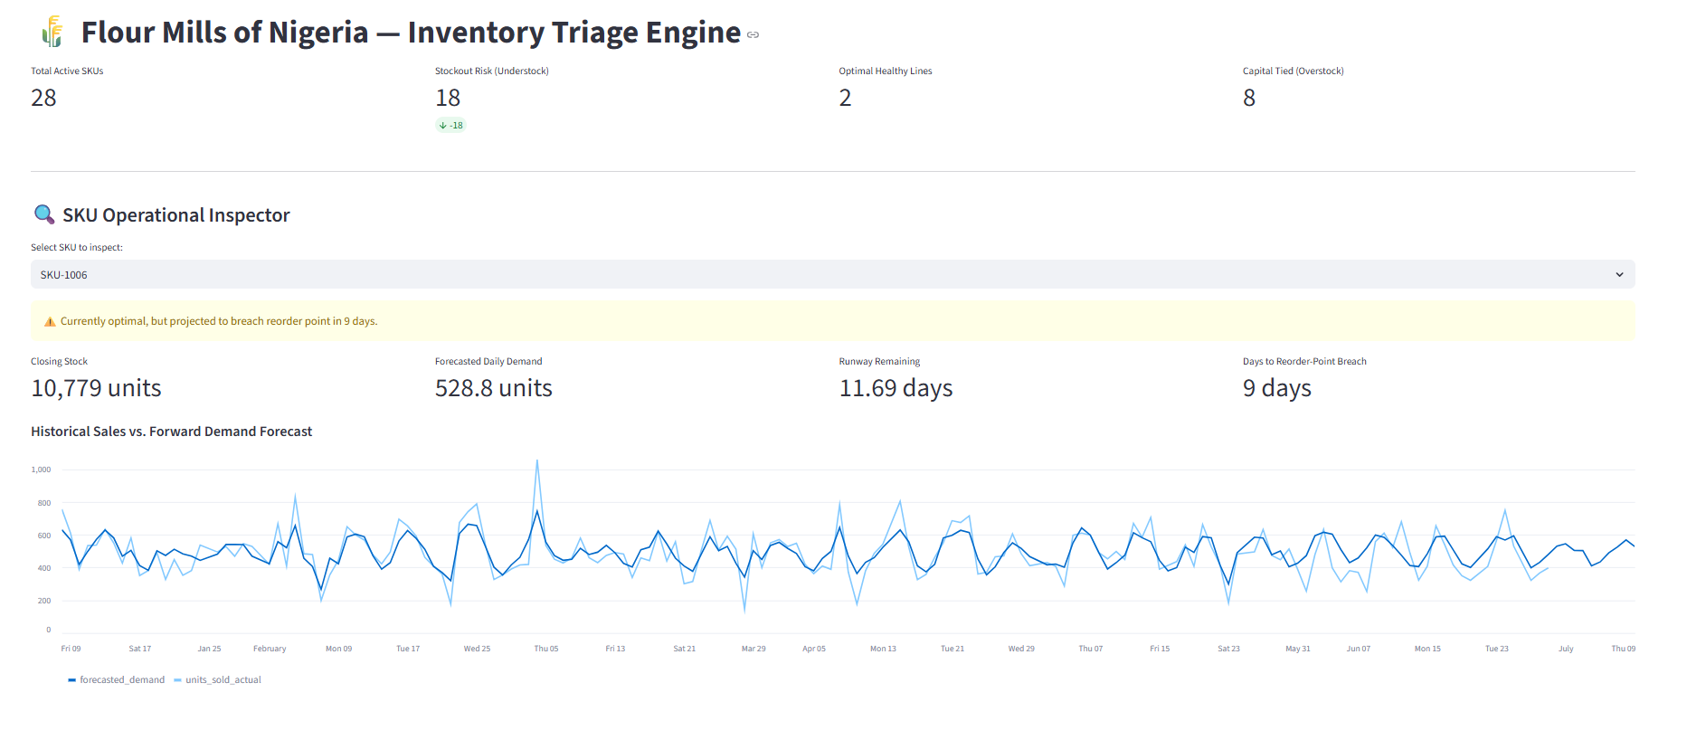
DEMO
The Tool, In Use
Live app — plant-wide overview, per-SKU inspector with plain-language flag, and forward demand forecast chart

Slide 6
FINDINGS
What We Found — And Where We're Cautious
17.9%
5 SKUs
Forecast WAPE
Consistently hard to forecast
Beats naive baseline by ~12% relative
Confirmed across 4 different models — a data issue, not a model-choice one
1
No incoming-receipts modeling — projection assumes zero restock during the forecast window (conservative, worst-case), so days-to-breach is a floor estimate, not a precise date.
2
Today's status is computed from real stock, not the forecast trajectory — avoids the trap of a depleting-to-zero simulation misreporting a healthy SKU as understock.
3
The five hard-to-forecast SKUs are flagged in-app as lower confidence, pending a proper root-cause investigation.

Slide 7
NEXT STEPS
What We'd Improve With More Time
1
AI-generated explanations + grounded Q&A
4
Action-confirmation loop
Designed and specified, not yet wired in — replaces templated flag text with LLM output grounded in each SKU's real numbers.
Let the team mark a flag as addressed, so it stops re-firing once someone has acted on it.
2
Rolling per-SKU confidence tracker
5
Live cache refresh
Replace the current static hard-SKU list with a live accuracy tracker that updates as new data arrives.
Move off manual cache-clearing to a scheduled refresh for daily unattended use.
3
Model incoming receipts
Account for POs already in transit, instead of assuming zero restock through the forecast window.
Flour Mills of Nigeria — Inventory Triage Engine

