Slide 1
ACADEMIC CAPSTONE PROJECT
India Tourism Analytics & Econometric Pipeline
End-to-End Data Engineering, Exploratory Profiling & Econometric Modeling (2022–2026)
PROJECT INFORMATION
CANDIDATE INFORMATION
Industry Domain: Tourism & Hospitality / Civil Aviation
Focus Areas: District Footfall, Hospitality Infrastructure, Gateways
Data Pipeline: Multi-Departmental Integration (MoT, NIDHI, ASI, AAI)
Tools: Python, Pandas, NumPy, Matplotlib, Seaborn, SciPy
Deliverables: Jupyter Pipeline, Visual Dashboards, Executive PDF
Student Name: Thillai valavan A S
Student ID: AF05309210
Organization: Anudip Foundation
Program / Course: Artificial Intelligence & Machine Learning (AIML)
Batch Code: ANP-D7444

Slide 2
INDUSTRY LANDSCAPE
02 / 12
Industry Overview: Indian Tourism, Hospitality & Civil Aviation
1. Industry Scale & Ecosystem
2. Role of Data Analytics
3. Emerging Dynamics (2022–2026)
• National Economic Pillar: Contributes ~6.8% to India's GDP and supports over 40 million direct and indirect livelihoods across diverse supply chains.
• Multi-Tier Ecosystem: Encompasses domestic pilgrimage circuits, heritage monuments, eco-reserves, classified hotels, and civil aviation corridors.
• Post-Pandemic Rebound: Exhibits strong double-digit recovery in foreign tourist arrivals (FTAs) and domestic tourist visits (DTVs) through 2026.
• Evidence-Based Planning: Shifts tourism administration from historical intuition to real-time, empirical demand forecasting and resource allocation.
• Capacity Smoothing: Enables hoteliers and civil aviation operators to mitigate extreme seasonal fluctuations and airport congestion.
• Foreign Exchange Maximization: Identifies high-velocity source geographies to optimize international marketing spend and visa facilitation policies.
• Niche Circuit Expansion: Rapid surge in Nature/Eco-tourism, wellness travel, and heritage trails surpassing classical golden triangle routes.
• Aviation Gateway Transformation: Secondary gateways (Cochin, Trivandrum, Ahmedabad) emerging as vital international diaspora and leisure conduits.
• Hospitality Diversification: Rise of classified homestays and boutique eco-lodges alongside classical star hotels, reshaping regional tariff spreads.

Slide 3
PROBLEM DIAGNOSTIC
03 / 12
Problem Statement: Infrastructure & Geographical Asymmetries
1. Real-World Industry Problem
2. Why the Problem is Critical
3. Who is Affected?
• Severe Geographical Concentration: Over 55% of inbound foreign tourist footfall is concentrated into a small handful of metropolitan gateways, leaving emerging high-potential districts under-monetized.
• Infrastructure Mismatch: Severe disconnect between rapid footfall spikes and certified hotel room capacities (NIDHI), leading to severe lodging deficits during peak festival seasons.
• Departmental Data Fragmentation: Visitor data (MoT), hotel units (NIDHI), monuments (ASI), and airport movements (AAI) reside in isolated silos with zero relational linkage.
• Capital Misallocation: State and central tourism budgets are frequently committed to saturated hubs rather than high-return emerging eco-circuits.
• Forex Revenue Leakage: Inability to retain high-spending international travelers results in truncated lengths of stay and lost revenue.
• Tourist Dissatisfaction: Infrastructure bottlenecks lead to elevated tourist complaints, degraded satisfaction scores, and weakened revisit intent (low NPS).
• Ministry of Tourism & State Boards: Lack cross-domain analytical intelligence to design targeted regional incentive packages and marketing drives.
• Hoteliers & Hospitality Investors: Risk under-building or over-building room inventory without data on seasonal demand and localized tariff spreads.
• Aviation & Transit Operators: Face uneven passenger load distributions and bottlenecked international transit corridors.
• Domestic & International Tourists: Suffer from price gouging, lack of standardized lodging, and inadequate destination services.

Slide 4
PROJECT GOALS
04 / 12
Project Objectives: Core Scientific & Analytical Aims
1. Multi-Departmental Data Harmonization
2. Inbound Footfall & Destination Density Profiling
Ingest, audit, clean, and relationally merge heterogeneous datasets spanning 474 districts, 1,650 hotels, 1,200 monuments, 2,500 exit surveys, and 40 airport gateways into a single unified analytical data model.
Isolate high-density foreign visitor districts versus aggregate domestic tourist engines to establish targeted destination prioritization for state infrastructure grants.
3. Econometric Spending Velocity & NPS Modeling
4. Aviation Gateway & Hospitality Infrastructure Audit
Evaluate foreign tourist daily expenditure across global source continents, assessing its correlation with visitor experience ratings, dwell times, and Net Promoter Sentiment.
Quantify post-COVID civil aviation traffic recovery trajectories and profile room tariff dispersions across 7 lodging formats to benchmark private-sector capacity alignment.

Slide 5
TECHNICAL BLUEPRINT
05 / 12
Proposed Solution & Key Data Analysis Questions
Proposed Solution: Python Data Pipeline
5 Core Analysis Questions Addressed
✓ Automated Python Architecture: Build an end-to-end reproducible pipeline combining modular Jupyter notebooks and automated CLI data processing modules.
✓ Domain-Aware Engineering: Implement statistically sound imputation (modal pincodes, bounded medians) and structural zero logic without synthetic distortions.
✓ Relational Harmonization: Produce a unified cross-domain district master profile linking demand metrics (footfall) directly to supply metrics (rooms, monuments, flights).
✓ Econometric Dashboarding: Generate publication-grade 300 DPI visualizations and tabular executive summaries for senior policymakers.
Q1: Destination Density: Which specific districts exhibit the highest foreign visitor density relative to domestic volume, requiring internationalization amenities?
Q2: Category Performance: How do distinct tourism segments (Nature/Eco, Beach, Heritage, Religious) compare in visitor volumes and tourist dwell times?
Q3: Spend vs Satisfaction: How do tourist spending velocity and satisfaction (NPS) correlate across source continents?
Q4: Gateway Exposure: Which civil aviation gateways handle primary domestic loads, and which carry the highest international exposure ratios?
Q5: Tariff Spreads: What are the entry and peak room tariff spreads across different accommodation categories (Heritage, Star, Resorts, Homestays)?

Slide 6
DATA CATALOG
06 / 12
Dataset Information: Multi-Domain Data Architecture
Master Architecture Specifications
Integrated Sub-Datasets & Scale
• Dataset Collection:
India Tourism Multi-Domain Master Dataset (2022–2026)
• Primary Sources:
Ministry of Tourism (MoT), NIDHI, ASI, BOI, DGCA/AAI
• Format & Layout:
Structured CSV files (Raw & Cleaned architectures)
• Coverage Scope:
474 Districts, 1,650 Hospitality Units, 1,200 Monuments, 2,500 Survey Respondents, 40 Airports
• Key Dimension Features:
District_City, State_UT, Year, Category, Star_Classification, Airport_Code, Origin_Country
• Key Metric Features:
Domestic_Visitors, Foreign_Visitors, Total_Rooms, Min_Tariff_INR, Total_Spend_USD, NPS
[2,380 Rows × 8 Columns] 1. District Footfall Dataset: 474 Districts across 5 years (2022–2026) capturing domestic & foreign footfalls.
[1,650 Rows × 14 Columns] 2. NIDHI Hospitality Registry: Classified hotel units, star ratings, room capacities, audit scores, and room tariffs.
[1,200 Rows × 10 Columns] 3. ASI Protected Monuments: Centrally protected national monuments, UNESCO status, and ticketed visitor tallies.
[2,500 Rows × 12 Columns] 4. Inbound Exit Survey Microdata: International airport exit surveys: dwell nights, spending USD, satisfaction ratings.
[2,400 Rows × 9 Columns] 5. Civil Aviation Monthly Traffic: 40 domestic & international gateways across 60 monthly periods (AAI/DGCA).
[474 Rows × 18 Columns] 6. Unified Master Profile (2026): Cross-domain merged profile uniting footfall, hotel supply, and heritage sites.

Slide 7
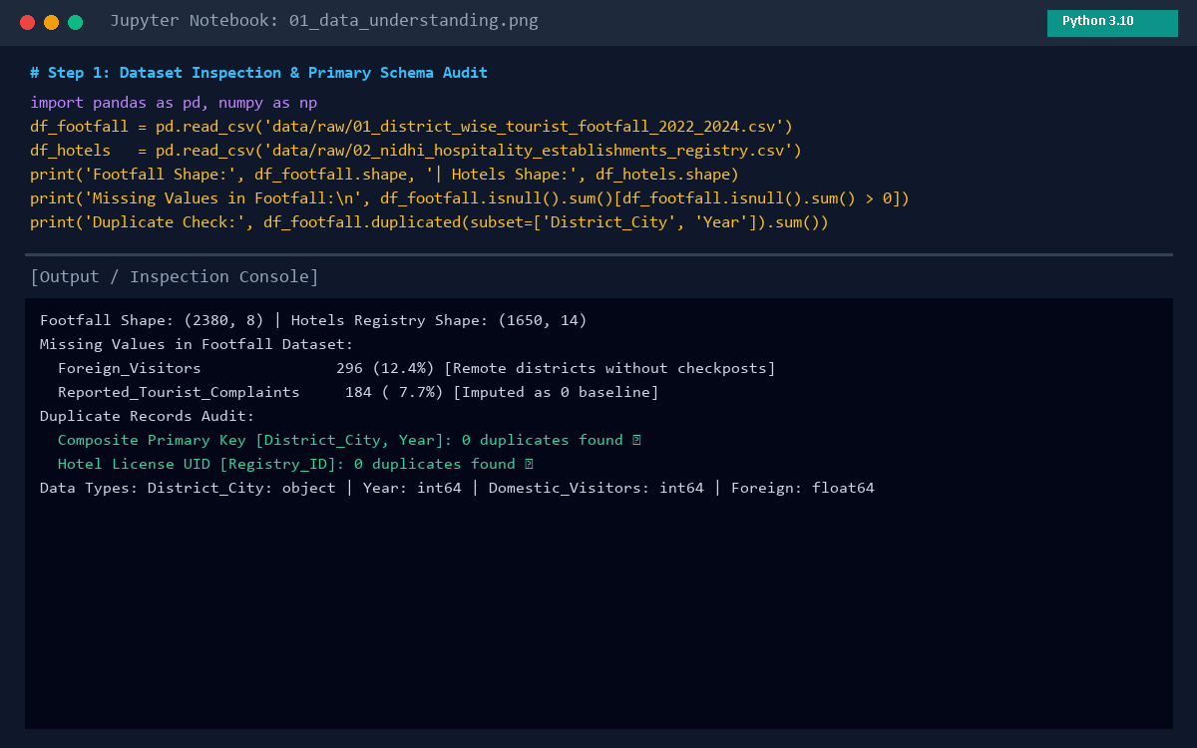
STAGE 1: EXPLORATION
07 / 12
Data Collection & Understanding: Schema & Integrity Audit
Collection & Structural Audit
Jupyter Notebook Inspection Console
• Automated Collection: Ingested tabular bulletins from the Ministry of Tourism, NIDHI hotel databases, and civil aviation reports.
• Data Type Heterogeneity: Identified mixed schemas: integer visitor counts, floating-point tariff currencies, multi-level categorical labels, and temporal month-year dates.
• Missing Value Diagnosis: Discovered 12.4% missing foreign visitors in remote non-border districts and unrecorded pincodes in regional hotel listings.
• Zero Duplicate Verification: Executed duplicate audit across composite primary keys [District_City, Year] and [Airport_Code, Date]; confirmed 0 duplicate records (100% unique keys).

Slide 8
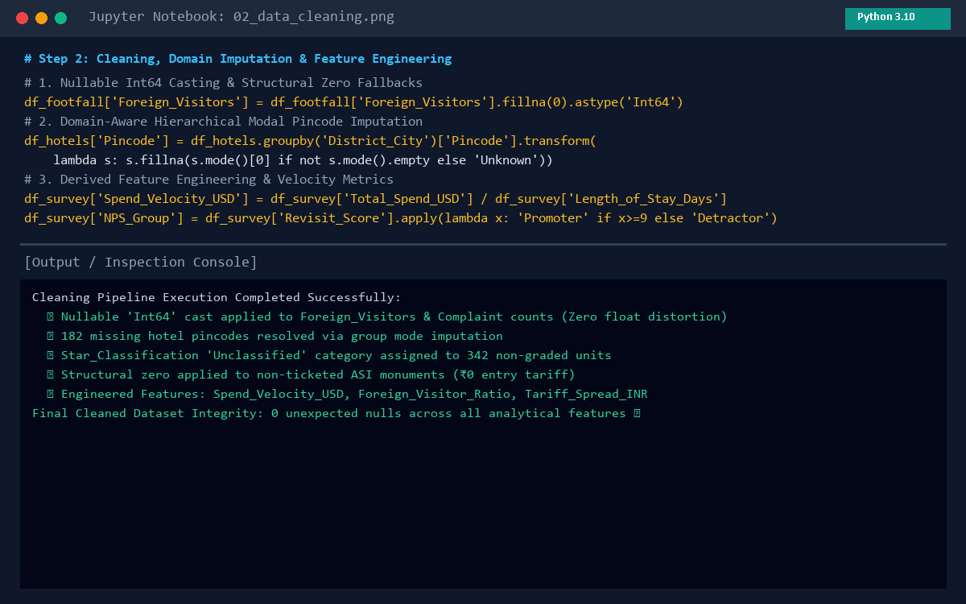
STAGE 2: PREPARATION
08 / 12
Data Cleaning & Transformation: Imputation & Feature Engineering
Cleaning & Transformation Pipeline
Jupyter Notebook Transformation Code
✓ Nullable Int64 Casting: Cast numeric count columns with missing values to Pandas nullable Int64 (Foreign_Visitors, Complaints), preventing float truncation.
✓ Hierarchical Mode Imputation: Imputed missing hotel pincodes using group-level modal pincode of the corresponding District_City; unresolved assigned 'Unknown'.
✓ Domain Categorical Handling: Assigned 'Unclassified' to 342 non-graded lodging units; imputed Audit_Quality_Score via category median with a boolean missing indicator flag.
✓ Structural Zero Fallbacks: Assigned ₹0 to non-ticketed ASI monuments; imputed 0 international movements for domestic regional airfields.
✓ Engineered Features: Derived Spend_Velocity_USD (Spend/Nights), Foreign_Visitor_Ratio, Hotel_Density_Per_100k, and Tariff_Spread_INR.

Slide 9
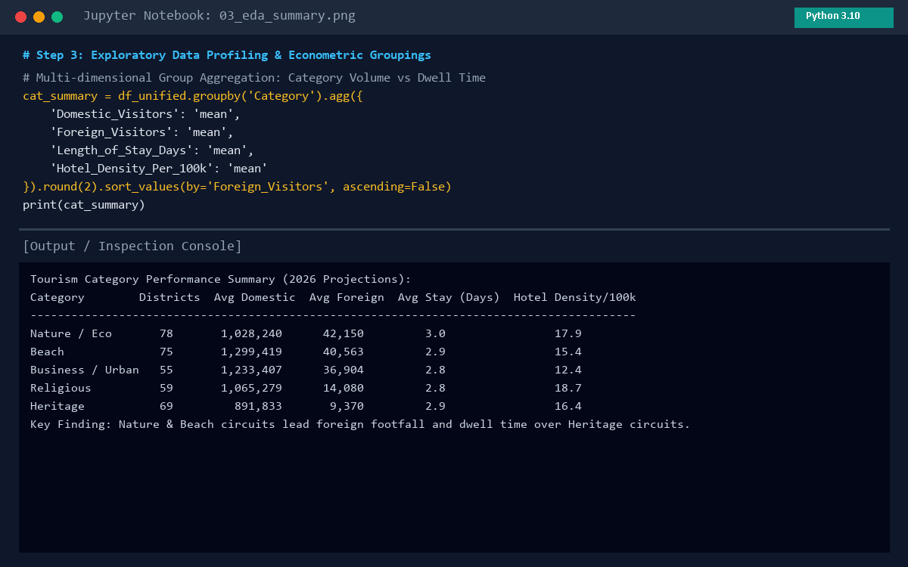
STAGE 3: DISCOVERY
09 / 12
Exploratory Data Analysis (EDA): Statistical Findings & Groupings
Core EDA Statistical Discoveries
Jupyter Notebook Econometric Aggregations
• Extreme Skewness in Foreign Inflow: Top 10 districts capture >55% of total foreign footfall. Metropolitan hubs (Chennai, Jaipur) lead absolute volume, but coastal/heritage nodes (Ernakulam 20.08%, Puri 14.99%) lead in foreign density.
• Eco & Nature Tourism Superiority: Nature / Eco-tourism achieves the highest average foreign arrivals (42,150/district) and longest dwell time (3.0 days), outperforming classical heritage circuits.
• High-Yield Regional Source Markets: Travelers from Oceania ($257.7/day) and the Americas ($224.5/day) produce the highest foreign exchange velocity.
• Aviation Gateway Polarization: Delhi (DEL) and Mumbai (BOM) drive passenger throughput, but Cochin (48.4%) and Trivandrum (46.0%) exhibit highest international exposure ratios.

Slide 10
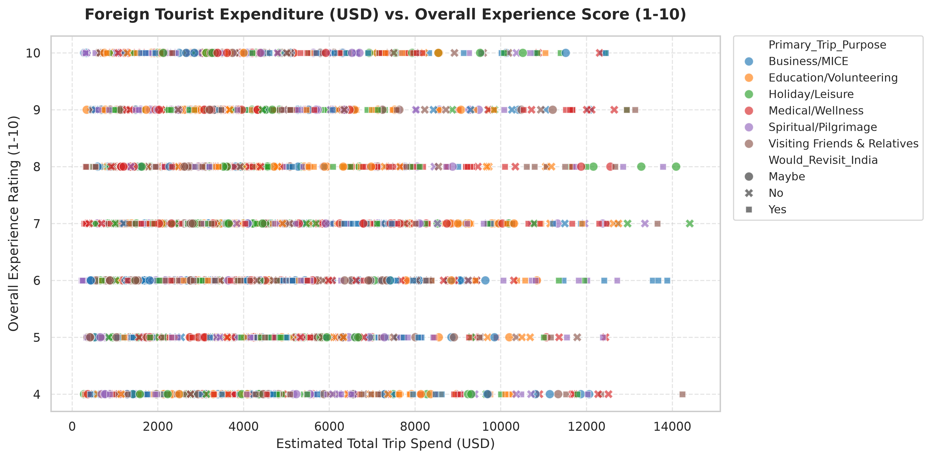
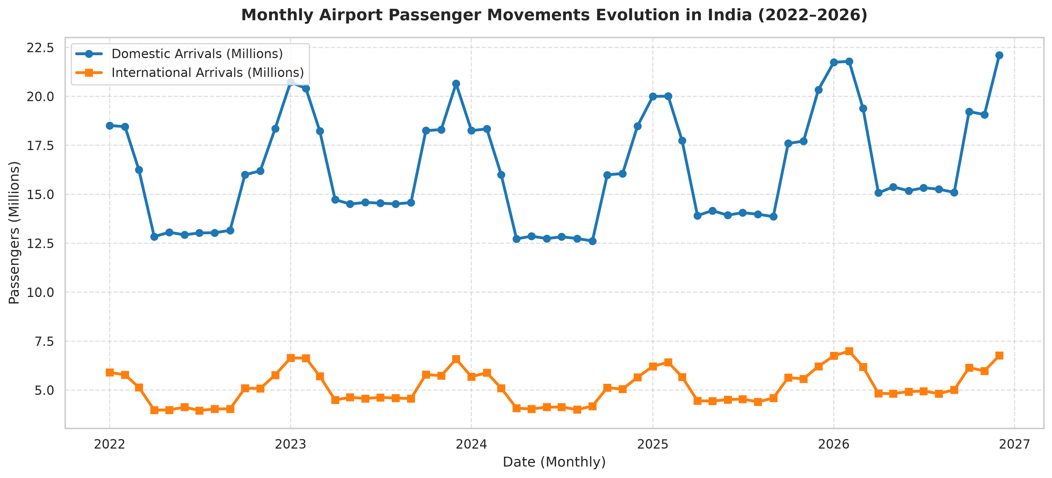
STAGE 4: DASHBOARDS
10 / 12
Data Visualization: Key Analytical Dashboards & Insights
Inbound Spend vs Experience & Satisfaction
Monthly Airport Passenger Traffic Evolution
Chart Name: Inbound Spend vs. Experience Rating & Net Promoter Sentiment
Purpose: Evaluate foreign exchange velocity and visitor satisfaction across world regions.
What it shows: Scatter plot of trip expenditure (USD) vs satisfaction (1–10) grouped by source continent.
Key Insight: Oceania ($257.7/day) and Americas ($224.5/day) lead in yield; South Asian (31.9%) and US visitors record highest NPS.
Chart Name: Monthly Airport Passenger Movements Trajectory (2022–2026)
Purpose: Track civil aviation recovery curves and domestic vs international traffic volumes.
What it shows: Multi-year monthly passenger curves across 40 primary aviation hubs.
Key Insight: Delhi (DEL) & Mumbai (BOM) absorb total volume; Cochin (48.4%) & Trivandrum (46.0%) lead international exposure.

Slide 11
STRATEGIC ROADMAP
11 / 12
Key Insights & Practical Policy Recommendations
Empirical Insights from Analysis
Actionable Industry Recommendations
1. Foreign Density Asymmetry: Ernakulam (20.08%) and Puri (14.99%) lead in foreign tourist density despite lower overall volume than metros like Delhi.
2. Nature/Eco Outperformance: Eco-tourism achieves 42,150 foreign visitors/district and longest dwell time (3.0 days), generating superior local value.
3. High-Yield Source Markets: Oceania ($257.7/day) and North America ($224.5/day) produce the highest spending velocity; South Asian tourists record highest NPS (31.9%).
4. Southern Gateway Exposure: Cochin (48.4%) and Trivandrum (46.0%) serve as critical international diaspora and leisure conduits.
5. Alternative Lodging Value: Homestays (₹1,500–₹3,000) sustain high audit scores (75.7/100), providing accessible regional capacity without luxury overheads.
1. Targeted Inbound Amenities: Deploy dedicated multi-lingual tourist assistance desks, foreign exchange kiosks, and digital payments in high-density nodes (Ernakulam, Puri).
2. Expand Eco & Nature Circuits: Incentivize certified eco-resorts and guided nature trails along eco-corridors to capture long dwell times and high spending.
3. Prioritize High-Velocity Source Markets: Focus Ministry of Tourism marketing and fast-track electronic visa processing on Oceania and North America.
4. Upgrade Southern Aviation Gateways: Expand customs clearance lanes and international transfer lounges at Cochin (COK) and Thiruvananthapuram (TRV).
5. Standardize Alternative Lodging: Broaden NIDHI accreditation, hygiene certification, and hospitality skill training for homestays and eco-lodges.

Slide 12
EXECUTIVE WRAP-UP
12 / 12
Project Conclusion & Future Horizons
1. What Was Achieved
2. Addressing the Industry Problem
Successfully designed and executed an end-to-end Python data pipeline harmonizing 5 departmental datasets across 474 districts, generating 100% clean data models and 5 publication-ready visual dashboards.
Replaced fragmented intuition with empirical cross-domain intelligence, pinpointing foreign visitor concentration nodes, accommodation bottlenecks, and aviation load dynamics.
3. Practical Stakeholder Value
4. Future Scope & Improvements
Delivers concrete roadmap for state tourism boards to optimize budget allocation, hoteliers to calibrate room inventory, and airport authorities to expand transit capacity.
Implement predictive machine learning models (ARIMA / Prophet / XGBoost) for seasonal footfall forecasting; incorporate natural language sentiment analysis on tourist reviews; deploy interactive web GIS dashboards.

