Slide 1

MLSA Internship:
Full Stack Development

Slide 2

Introduction to My Journey
Hello everyone! Today, I'm excited to share my project: a calculator and quiz application created using HTML, CSS, and JavaScript. This project allowed me to combine structure, style, and interactivity, providing a user-friendly experience. I hope you enjoy exploring the functionalities!

Slide 3

HTML
HTML (Hyper Text Markup Language) is the standard markup language used to create web pages. It structures content using a variety of elements, such as headings, paragraphs, links, images, and lists, all defined by tags. HTML serves as the backbone of a webpage, providing the necessary framework for displaying information. It's essential for building any website, as it allows browsers to interpret and render content. With HTML, developers can create accessible and semantic web applications that are user-friendly and easy to navigate.

Slide 4

CSS
CSS (Cascading Style Sheets) is a stylesheet language used to control the presentation and layout of HTML elements on a webpage. It enables developers to apply styles such as colors, fonts, spacing, and positioning, enhancing the visual appeal of web content. CSS allows for responsive design, making it possible to create layouts that adapt to different screen sizes and devices. By separating content (HTML) from design (CSS), developers can maintain a cleaner codebase and improve site performance. Overall, CSS plays a crucial role in creating engaging and user-friendly web experiences.

Slide 5
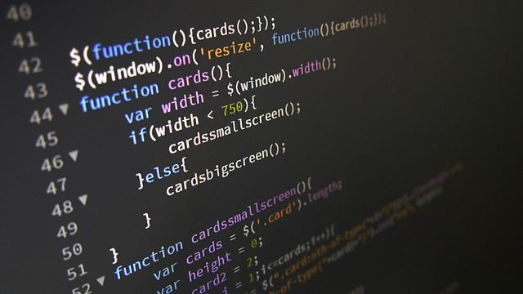
JS
JavaScript (JS) is a dynamic programming language that enables interactive and dynamic content on web pages. It allows developers to manipulate HTML and CSS in real time, enhancing user experience with features like animations, form validation, and interactive elements. JavaScript runs in the browser, making it essential for creating responsive applications that react to user inputs. With the advent of frameworks like React, Angular, and Vue, JavaScript has also become a powerful tool for building complex web applications. Overall, JS is vital for modern web development, enabling a rich and interactive web experience.

Slide 6
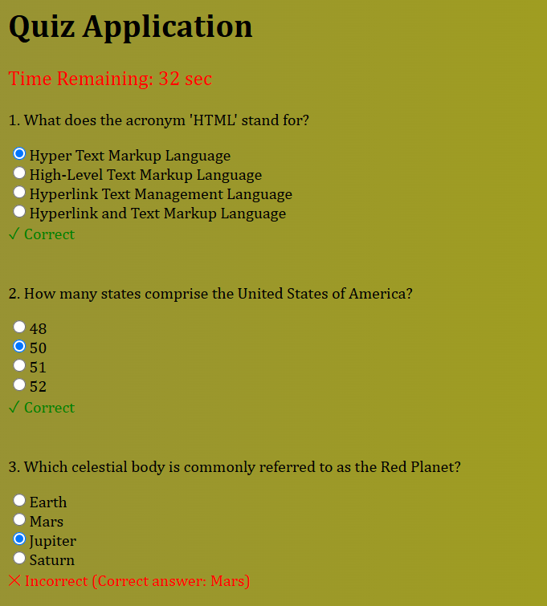
Project 1: Quiz Application
Objective: Develop a simple quiz application.
Component: Questions ,answers ,timer, submit
button, score.
Implementation: HTML,CSS,JS

Slide 7
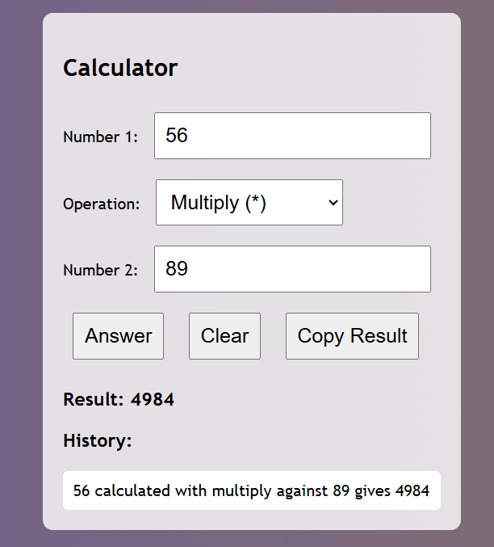
Project 2: Calculator
Objective: Develop a calculator application that performs basic arithmetic operations.
Functions: Addition, subtraction ,multiplication ,
division ,power ,square root, logarithm
and factorial.
Implementation: HTML,CSS,JS

Slide 8

Overall Internship Experience
1
Skills
Strengthened HTML, CSS, and JavaScript foundations
2
Confidence
Enhanced ability to create interactive web applications
3
Insights
Gained valuable full-stack development workflow experience

Slide 9

Name: Harsh Anand
Branch: CSE
Roll No:2300290100116

