Slide 1
Genome Assembly
de Bruijn Graph Genome Assembly

Slide 2
Genome (Sequence) Assembly
In bioinformatics, sequence assembly refers to aligning and merging fragments from a longer DNA sequence in order to reconstruct the original sequence. This is needed as DNA sequencing technology cannot read whole genomes in one go, but rather reads small pieces of between 20 and 30,000 bases, depending on the technology used.

Slide 3
Problem of Genome Assembly
The problem of sequence assembly can be compared to taking many copies of a book, passing each of them through a shredder with a different cutter, and piecing the text of the book back together just by looking at the shredded pieces.

Slide 4
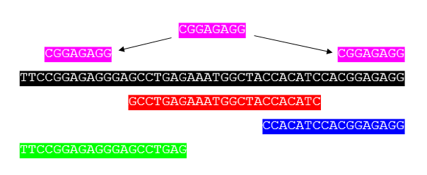
Genome assemblers
The first sequence assemblers began to appear in the late 1980s and early 1990s as variants of simpler sequence alignment programs to piece together vast quantities of fragments generated by automated sequencing instruments called DNA sequencers.

Slide 5
De-novo Assembly
Assembling short reads to create full-length (sometimes novel) sequences, without using a template.
The shotgun assembly problem
Overlap-Layout-Consensus (OLC) assembly
de Bruijn graph (DBG) assembly

Slide 6
The Shotgun Assembly
Shotgun sequencing is a method used for sequencing random DNA strands. It is named by analogy with the rapidly expanding, quasi-random shot grouping of a shotgun.
In shotgun assembly, DNA is broken up randomly into numerous small segments, which are sequenced using the chain termination method to obtain reads. Multiple overlapping reads for the target DNA are obtained by performing several rounds of this fragmentation and sequencing. Computer programs then use the overlapping ends of different reads to assemble them into a continuous sequence.

Slide 7
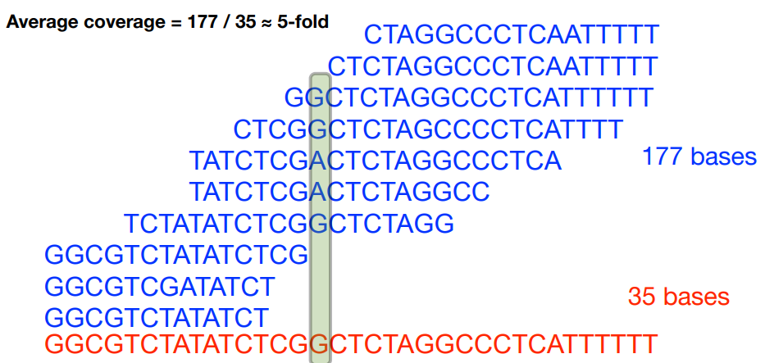
The Shotgun Assembly
Assume sequencing produces such a large number of fragments(reads) that almost all genome positions are covered by many fragments but we don’t know what came from where.
Coverage (read depth or depth) is the average number of reads representing a given nucleotide in the reconstructed sequence.

Slide 8
The Shotgun Assembly
Proponents of this approach argue that it is possible to sequence the whole genome at once using large arrays of sequencers, which makes the whole process much more efficient than more traditional approaches. Detractors argue that although the technique quickly sequences large regions of DNA, its ability to correctly link these regions is suspect, particularly for genomes with repeating regions. As sequence assembly programs become more sophisticated and computing power becomes cheaper, it may be possible to overcome this limitation.

Slide 9
Overlap-Layout-Consensus (OLC) assembly
Reads are provided to the algorithm. Overlapping regions are identified. Each read is graphed as a node and the overlaps are represented as edges joining the two nodes involved. The algorithm determines the best path through the graph (Hamiltonian path). Redundant information (i.e., unused nodes and edges) is discarded. This process is carried out multiple times and resulting sequences are combined to give the final consensus sequence that represents the genome.

Slide 10
de Bruijn graph (DBG) assembly
In the 1940s, a Dutch mathematician called Nicolaas de Bruijn became interested in finding the shortest circular string of characters that contains all possible substrings, each of same length, in a given alphabet. The solution he came up with involved constructing a graph with all possible (k − 1)-mers as nodes. Each k-mer was an edge directed from node A to node B if the (k − 1)-mer in node A is a prefix, and that in node B, a suffix of the k-mer.

Slide 11
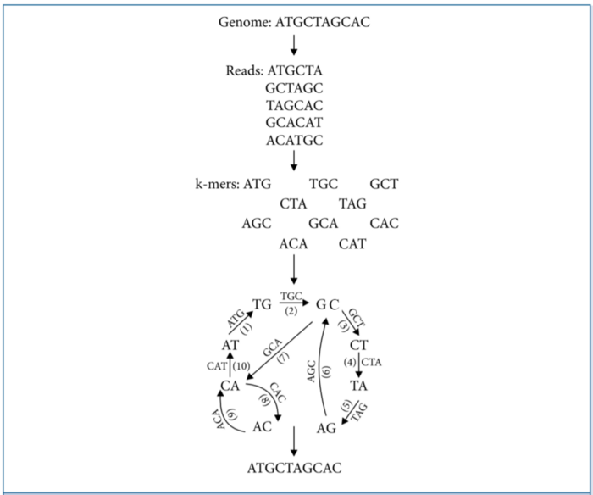
de Bruijn graph (DBG) assembly
The answer to the stated problem now was to find a path through the graph that traverses each edge exactly once, or in other words Eulerian trail. An example in which the sequence “ATGCTAGCAC” of the length 10, is assembled from five reads, each of length 6.

Slide 12
de Bruijn graph (DBG) assembly
Reads are broken into smaller fragments of a specified size k. In the above example, k corresponds to 3. k-mers are identified and a de Bruijn graph with (k–1)-mers as nodes and k-mers as edges drawn as described in the text. An Eulerian path is traced through this network resulting in the reconstruction of the original genome sequence.

Slide 13
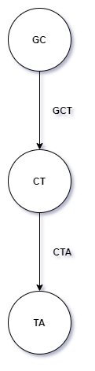
de Bruijn graph (DBG) assembly
The following steps can be specified in the process of reconstructing the original sequence from the given short reads.
Steps
Take all (k-1)-mers from the set of k-mers, e.g. ATG, TGC-> AT, TG, GC. We should have gone past the size of k-mer reads.
Construct a multi-graph with nodes being k-1-mers; draw an edge between two k-1 mers only if the two k-1 mers are taken from the same read. Ex: GCT & CTA
Graph constructed this way is guaranteed to have a Eulerian trail, follow the trail and connect the nodes to form our original sequence. The graph similar to this will appear.

Slide 14
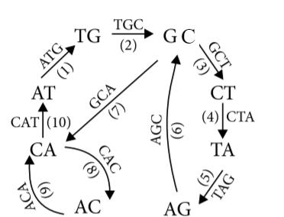
de Bruijn graph (DBG) assembly
This algorithm can be used to assemble k-mer reads. We can loosen the condition to accept reads above a given length, and to break each k-mer to (k-n)-mers to account for reads that have k-n overlap, instead of k-1 overlap. Further, it is convenient to reconstruct the parts that are easier to assemble (contigs) and leave out parts that are ambiguous.

Slide 15
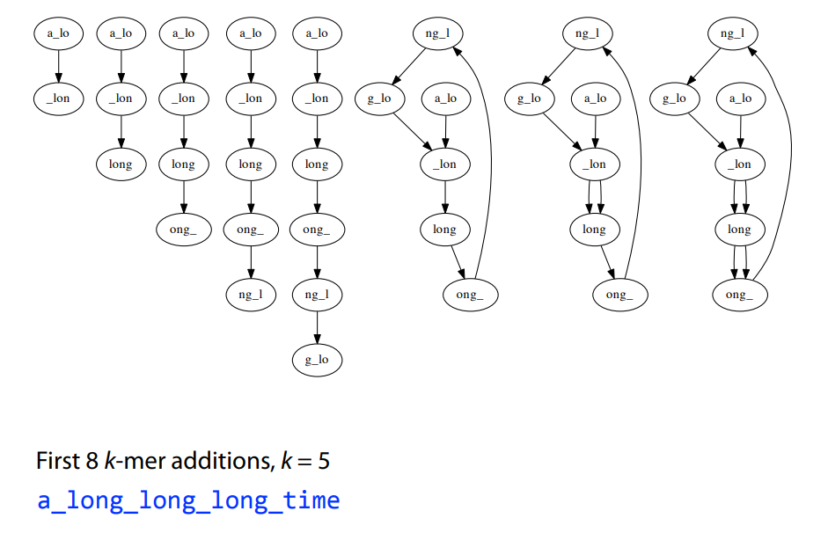
For an input string a_long_long_long_time:
For k = 5
Take each k mer and split into left and right k-1 mers
Add k-1 mers as nodes to De Bruijn graph (if not already there), add edge from left k-1 mer to right k-1 mer

Slide 16
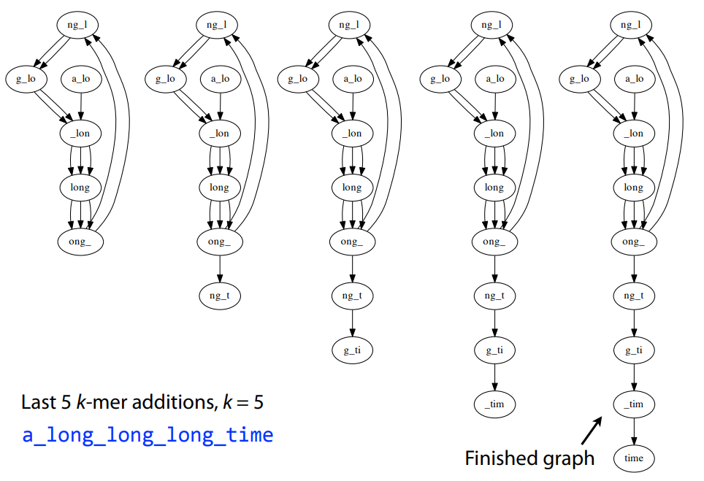

Slide 17
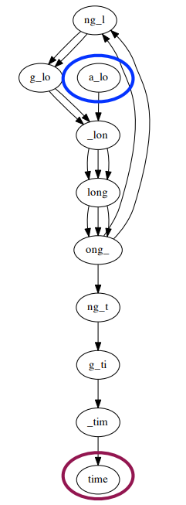
Node for k-1-mer from left end is semi-balanced with one more outgoing edge than incoming.
Node for k-1-mer at right end is semi-balanced with one more incoming than outgoing.
Other nodes are balanced since number of times k-1-mer occurs as a left k-1-mer is equal to number of times it occurs as a right k-1-mer.
Errors and differences between chromosomes also lead to non-Eulerian graphs
Graph is not connected; largest component is not Eulerian
The genome path is an Eulerian path in the de Bruijn graph (or a path that uses every edge exactly once)
To make the graph balanced and strongly connected to find an eulerian path, simply we can draw an edge connecting the two unbalanced nodes.

