Slide 1

Abusive Language Detection in Games
Spataru Horia-Stefan

Slide 2
Agenda
Recap: The Mission
The Dataset
The Code
The Results
Conclusions & plans for the future

Slide 3
Recap: The Mission
A short introduction summarizing the previous milestones:
This project aims to harness the capabilities of machine learning to identify and terminate harmful content.
It is not just about lines of code or algorithms; it’s a mission to create a safer and more respectful online environment
Challenge: Effective detection systems require high-quality training datasets; Principle: “Garbage in, garbage out” – classifier accuracy depends on training data.
Existing models struggle with diverse contexts. Swift adaptation to new comments is essential.

Slide 4
The Dataset
For this project I chose to use the CONDA dataset that I found documented inside an article.
CONDA stands for CONtextual Dual-Annotated dataset.
It is specifically designed for in-game toxic language detection.
The dataset enables joint intent classification and slot filling analysis, which are essential tasks in Natural Language Understanding (NLU).
Size: CONDA consists of approximately 45,000 utterances.
These utterances are extracted from 12,000 conversations within the chat logs of 1,900 completed Dota 2 matches.
Unlike traditional toxicity detection models that focus solely on single utterances, CONDA emphasizes deeper context understanding.
The dataset includes a thorough analysis of in-game toxicity.
Intent classification identifies the purpose or intent behind an utterance (e.g., asking for help, expressing frustration).
Slot filling identifies specific slots or entities within an utterance (e.g., player names, game-related terms).
CONDA evaluates strong NLU models using fine-grained results for different intent classes and slot classes.
Baseline models used in the paper include:
Joint BERT : A BERT-based model for joint intent classification and slot filling.
Capsule NN : A neural network architecture.
RNN-NLU : Recurrent Neural Network for NLU tasks.
Slot-gated : A model with slot-specific gates.
Inter-BiLSTM : An intent and slot model based on bidirectional LSTMs.

Slide 5
The Code
The python code does this essentially:
It preprocesses text data;
It creates TF-IDF natural language processing technique used to evaluate the importance of different words in a sentence, features;
It trains a logistic regression model, evaluates its performance, and saves predictions for the test set.
Generates the final output in a CSV file containing predicted intent class labels for the test data, as well as accuracy analysis in the IDE Terminal.

Slide 6
The results
Validation Accuracy:
The overall accuracy of the model on the validation set is approximately 90.54%.
This means that the model correctly predicts the intent class for about 90.54% of the validation examples.
Precision:
Precision measures the proportion of true positive predictions (correctly predicted instances) out of all positive predictions (both true positives and false positives).
For each class (A, E, I, O), precision is calculated as:Precision=True Positives + False PositivesTrue Positives​
Recall (Sensitivity):
Recall measures the proportion of true positive predictions out of all actual positive instances (true positives and false negatives).
For each class, recall is calculated as:Recall=True Positives + False NegativesTrue Positives​

Slide 7
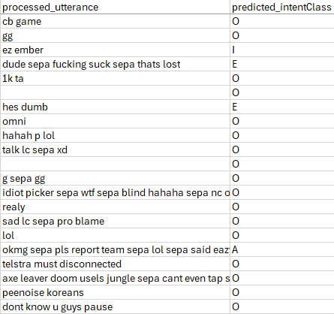
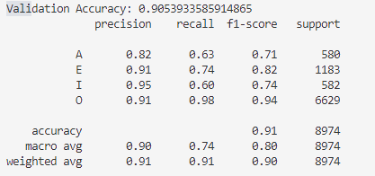

Slide 8
Conclusion & Future plans
Why We Did This:
Gaming Environment: Gaming communities thrive on communication, but toxic language can harm player experiences.
Positive Interaction: Our goal was to foster respectful interactions by identifying and addressing abusive language.
What we used:
CONDA Dataset:
Contextual: CONDA provides context-rich chat logs from Dota 2 matches.
Dual Annotated: It combines intent classification and slot filling.
TF-IDF Features:
Captured word importance within utterances.
Enabled effective model training.
Logistic Regression Model:
Simple, interpretable, and performed well.
Future exploration: Neural networks, ensemble methods.
Next Steps:
Interface: Create user-friendly GUI.
Real-Time Integration: Deploy in-game chat systems.
Ethical Considerations: Balance accuracy and false positives.

Slide 9

Thank You!
Q&A

