Slide 1


TEMPERATURE, HUMIDITY & MOTION MONITORING SYSTEM
PAGE 01
PRESENTED BY-
KSHITIJ MANDAL 22BAI10236
HARSHIT BIHANI 22BAI10249
DHARMBIR SINGH 22BAI10233
SANYA SHOURYA 22BAI10240
SURYANSH PRASHAR 22BAI10241
GROUP -12

Slide 2
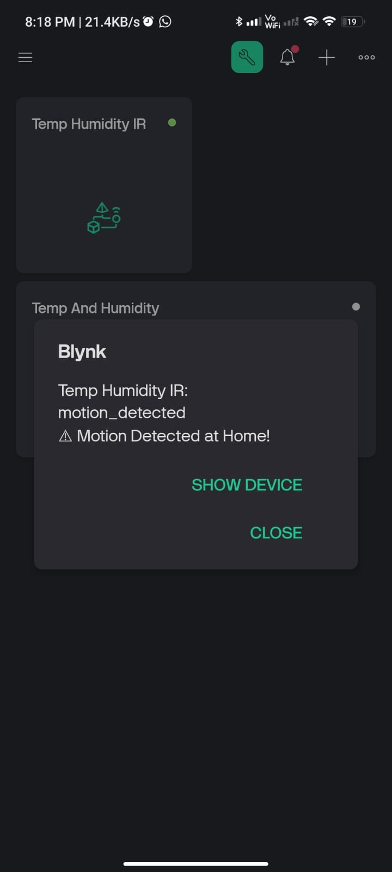
INTRODUCTION
PAGE 02
This project is a Temperature, Humidity, and Motion Monitoring System using NodeMCU ESP8266. It collects real-time data from a DHT11 sensor for temperature and humidity, an IR motion sensor for movement detection, and compares indoor readings with outdoor weather data fetched from the OpenWeather API.
The system is integrated with the Blynk app, allowing remote monitoring and alerts based on predefined conditions. Three LEDs are used for visual alerts:
Orange LED (D3) → Humidity alert
Yellow LED (D1) → Temperature alert
Blue LED (D2) → Motion detection
This project is powered via USB, ensuring a stable and reliable power source. It can be applied in smart homes, industrial monitoring, and medical facilities where real-time environmental tracking is crucial.

Slide 3
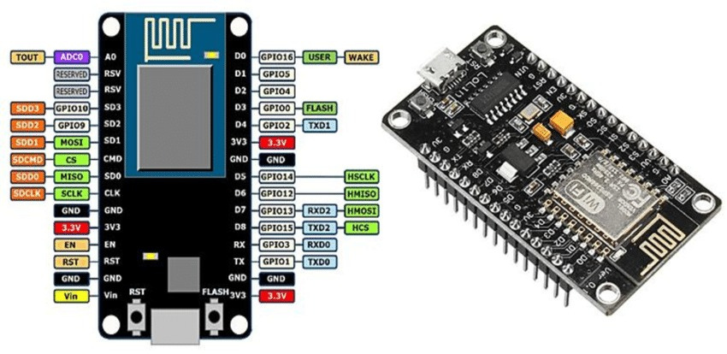
PAGE 03
COMPONENTS USED -
1. MICROCONTROLLER:
NODEMCU ESP8266 → THE MAIN CONTROLLER, HANDLES SENSOR DATA, WIFI CONNECTIVITY, AND COMMUNICATION WITH THE BLYNK APP.
📡 Function:
Wi-Fi-enabled microcontroller for data processing and communication.
🔥 Working:
Collects data from DHT11 and IR sensors.
Fetches outdoor weather data using the OpenWeatherMap API.
Sends real-time data to the LCD display.
💡 Use in Our Project:
Data Processing: Reads and processes sensor data.
Weather API Integration: Fetches live outdoor weather data.
Alert Activation: Triggers LED alerts based on temperature, humidity, and motion conditions.

Slide 4
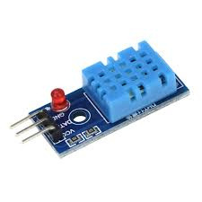
PAGE 04
COMPONENTS USED -
2. SENSORS:
DHT11 TEMPERATURE & HUMIDITY SENSOR → MEASURES INDOOR TEMPERATURE & HUMIDITY.
📡 Function:
Measures temperature and humidity levels.
🔥 Working:
Uses a thermistor to detect temperature.
Uses a capacitive humidity sensor to measure moisture in the air.
💡 Use in Our Project:
Temperature Monitoring: Tracks indoor temperature.
Humidity Monitoring: Measures indoor humidity levels.
LED Alerts:
Orange LED (D3): Activates when indoor vs. outdoor Humidity difference > 3°C.
Yellow LED (D1): Activates when indoor vs. outdoor Temperature difference > 10%.

Slide 5
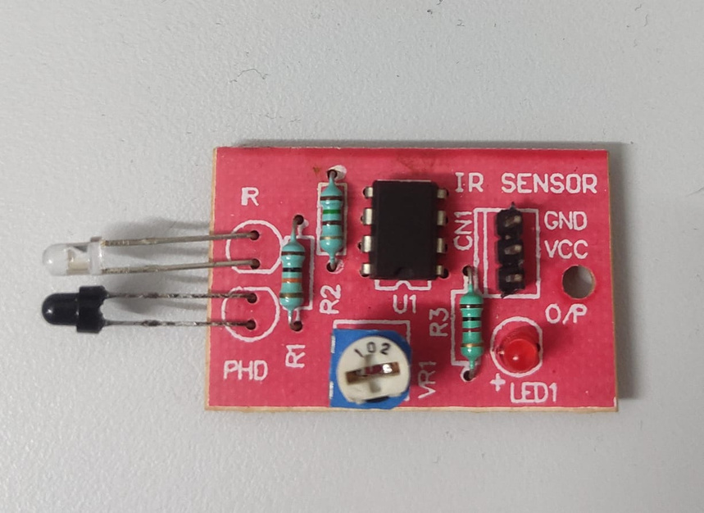
PAGE 05
COMPONENTS USED -
2. SENSORS:
IR MOTION SENSOR → DETECTS MOTION AND TRIGGERS ALERTS OR ACTIONS.
📡 Function:
Detects motion by emitting and receiving infrared rays.
🔥 Working:
Emits infrared rays and detects reflections from objects.
Triggers an alert when motion is detected.
💡 Use in Our Project:
Motion Detection: Identifies movement in the area.
LED Alert: Activates the blue LED (D2) when motion is detected.
Enhanced Security: Helps in home security and smart monitoring by detecting unauthorized motion.

Slide 6
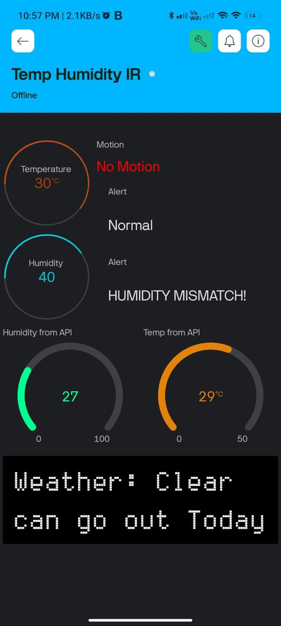
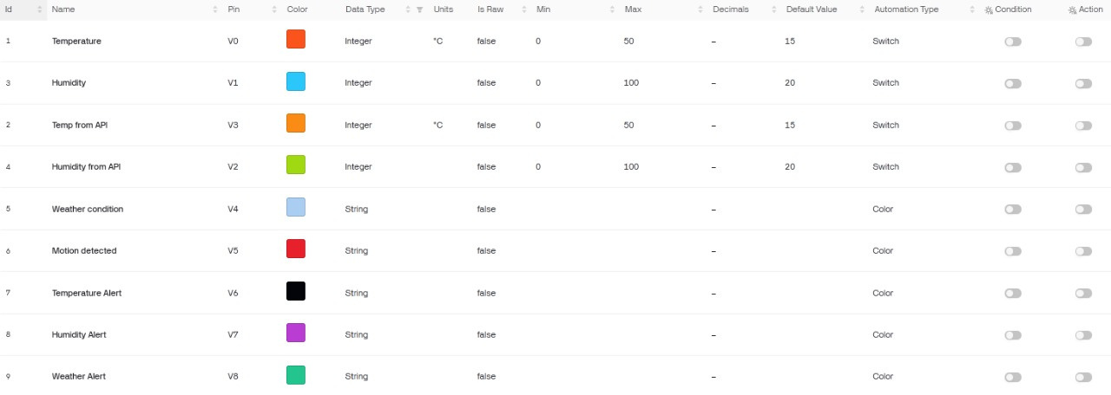
PAGE 06
COMPONENTS USED -
3. OUTPUT COMPONENTS:
3 LEDS → VISUAL INDICATORS FOR DIFFERENT CONDITIONS:
ORANGE LED (D3) → HUMIDITY ALERT.
YELLOW LED (D1) → TEMPERATURE ALERT.
BLUE LED (D2) → MOTION DETECTION.
BLYNK APP → DISPLAYS REAL-TIME DATA, ALERTS VIA SMARTPHONE.

Slide 7
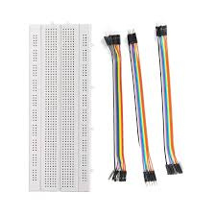
PAGE 07
COMPONENTS USED -
4. Power Supply:
USB Power Source (5V via NodeMCU) → Powers all components reliably.
5. Connectivity & Data Handling:
WiFi (ESP8266 Built-in WiFi) → Connects to the internet to send/receive data.
OpenWeather API → Fetches real-time weather data for comparison with indoor sensor readings.
6. SUPPORTING COMPONENTS & WIRING:
JUMPER WIRES → CONNECT ALL COMPONENTS.
BREADBOARD (OPTIONAL) → HELPS IN PROTOTYPING THE CIRCUIT.

Slide 8
PROBLEM STATEMENT
PAGE 08
The Smart Temperature, Humidity & Motion Monitoring System is designed to enhance environmental monitoring and security by providing real-time insights into indoor conditions. It is particularly beneficial in regions experiencing extreme weather conditions, homes, offices, laboratories, server rooms, and agricultural storage facilities, where maintaining an optimal environment is essential.
The system aims to achieve the following objectives:
Monitor indoor temperature and humidity in real-time:
In places with extreme weather conditions—such as deserts with high temperatures or cold
regions prone to freezing—it is crucial to maintain a stable indoor climate. This system
continuously tracks temperature and humidity to ensure comfortable living or working
conditions, preventing issues like overheating, excessive dryness, or dampness.
Compare indoor sensor data with outdoor weather conditions:
By integrating data from the OpenWeather API, the system enables users to compare their indoor
environment with outdoor conditions. This is particularly useful for smart homes and climate-
controlled environments, where heating, cooling, or ventilation adjustments can be made based
on real-time weather data, improving energy efficiency.

Slide 9
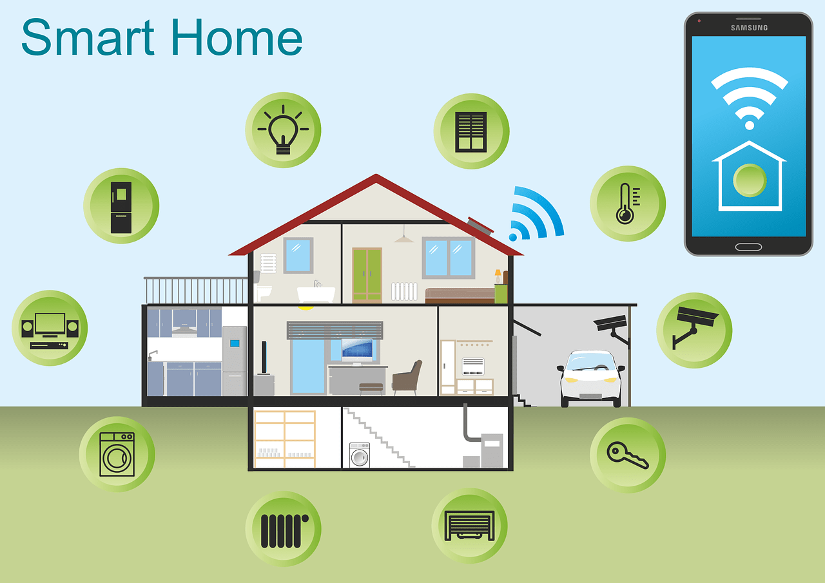
PAGE 09
Detect motion and send alerts:
Security is a major concern in both residential and commercial
spaces. The system detects motion within the monitored area and
triggers alerts, making it suitable for homes, offices, and
warehouses where unauthorized access needs to be monitored.
This feature adds an extra layer of security by promptly notifying
users of any movement.
Notify users through the Blynk app and LEDs:
Users receive real-time alerts via LED indicators and the Blynk
mobile app, ensuring they are instantly informed of any significant
environmental changes or motion detection. This feature is
beneficial for remote monitoring of homes and industrial sites,
allowing users to respond quickly to critical changes.
Provide a user-friendly and remotely accessible monitoring system:
The system is designed for ease of use, with remote accessibility via a
smartphone app. This makes it ideal for smart home automation,
elderly care, server rooms, and greenhouse monitoring, where real-
time data access and control are necessary to maintain the right
conditions without physical presence.

Slide 10
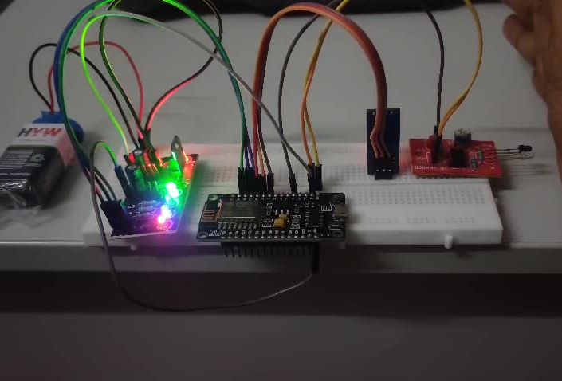
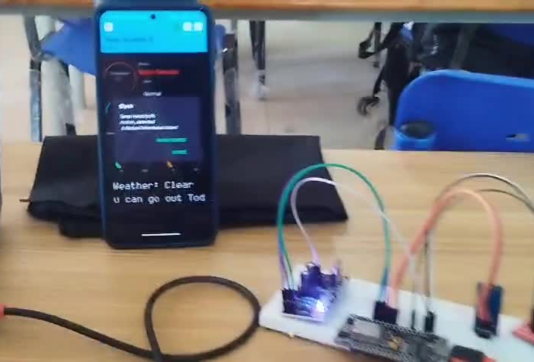
HARDWARE DEMO
PAGE 10
WITH BATTERY
WITHOUT BATTERY

Slide 11
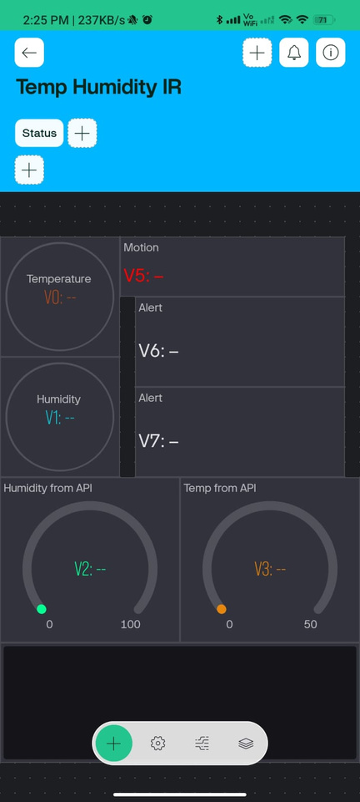
PAGE 11
TECHNICAL SPECIFICATIONS
Real-time Data Collection: Continuously monitors temperature, humidity, and motion using DHT11 and IR sensor.
Wi-Fi-Enabled Remote Monitoring: Connects to the Blynk app for real-time data updates and remote access.
Weather API Integration: Fetches outdoor temperature, humidity, and weather conditions to compare with indoor data.
LED Indicators for Alerts:
Yellow LED (D1): Alerts for temperature variations exceeding the threshold.
Blue LED (D2): Lights up on motion detection by the IR sensor.
Orange LED (D3): Alerts when indoor vs. outdoor humidity differs significantly.
USB-Powered Operation: Eliminates battery issues, ensuring stable power supply and uninterrupted performance.
Scalable & Customizable: Can be expanded with additional sensors (CO2, smoke, sound) for smart home automation, industrial safety, and medical monitoring.

Slide 12
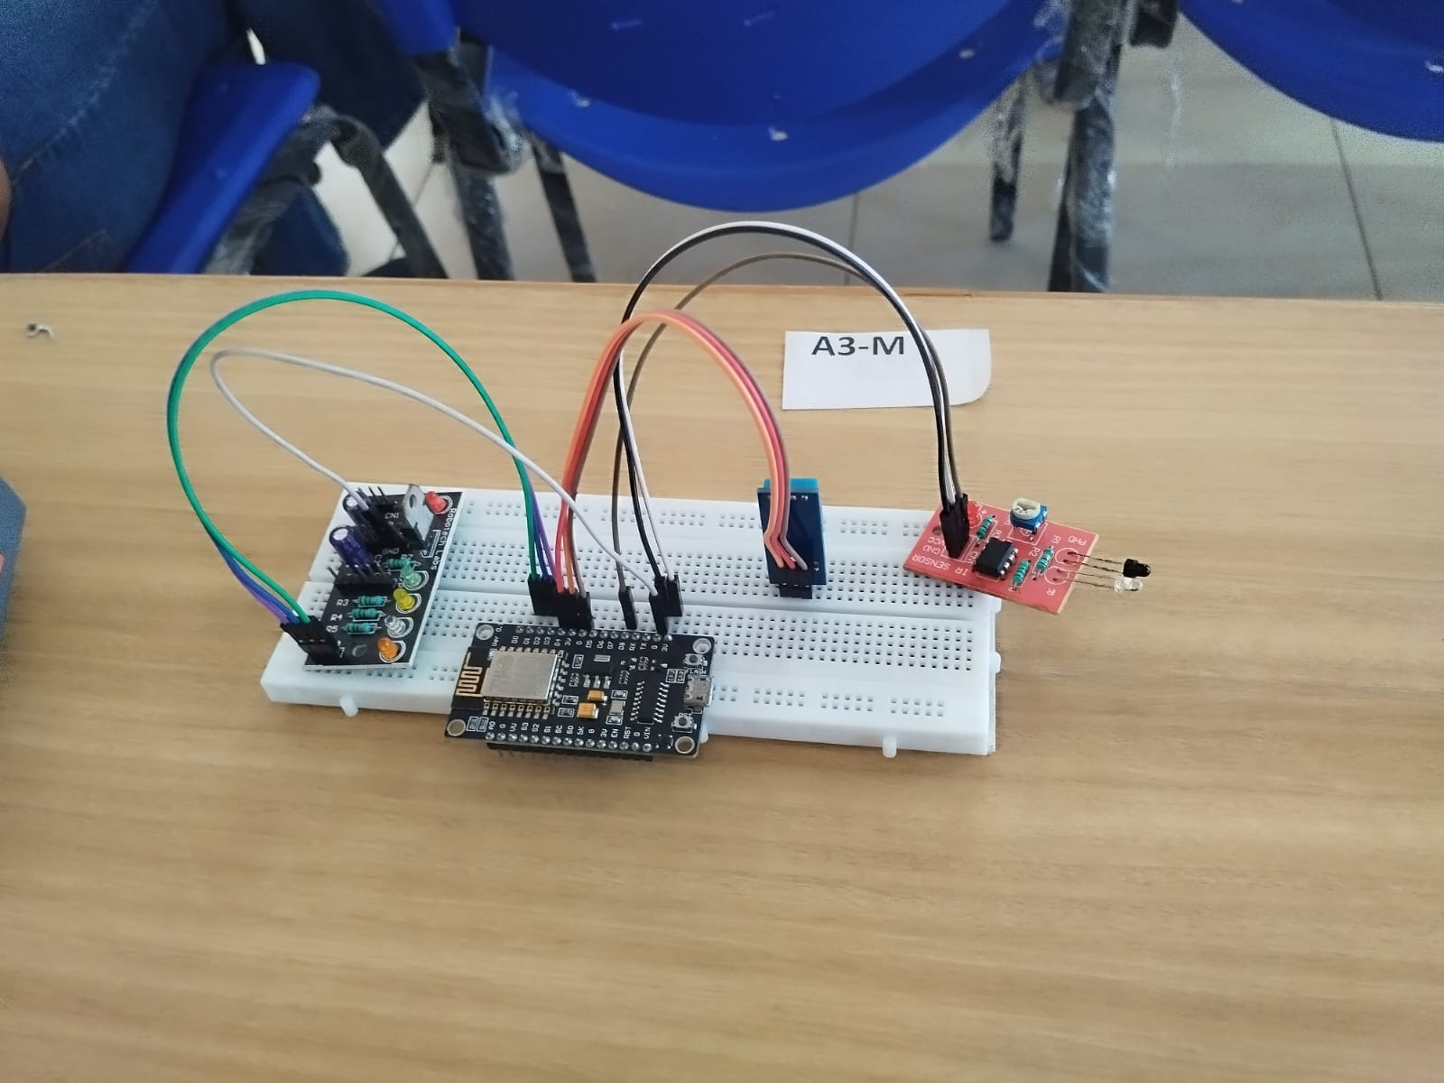
HARDWARE MODEL
PAGE 12

Slide 13
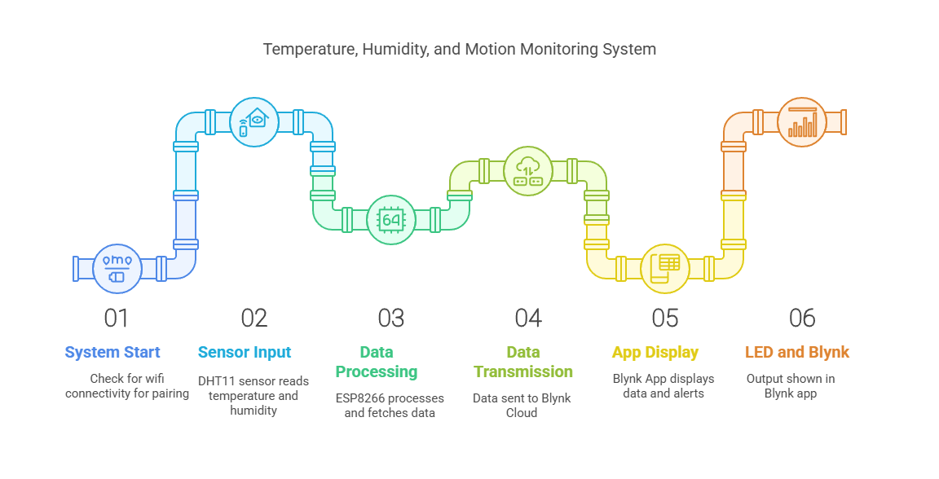
HARDWARE MODEL
PAGE 13

Slide 14
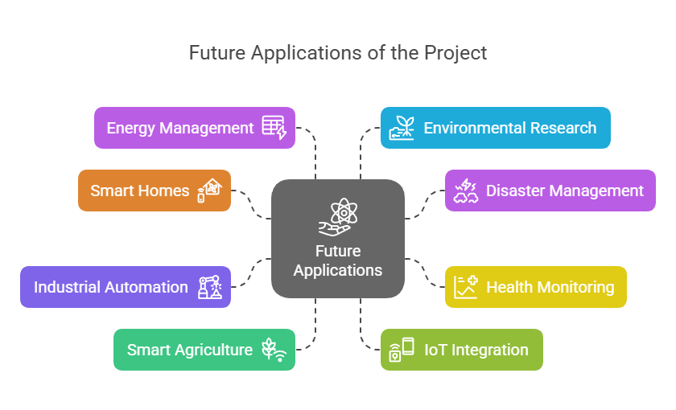
FUTURE APPLICATIONS
PAGE 14

Slide 15

PAGE 15
CONCLUSION
This project successfully monitors indoor environmental conditions and compares them with live weather data. The Blynk app integration enables remote access, and LED alerts provide real-time notifications. This system can be further enhanced with more sensors, smart automation, and battery-powered operation for wider applications in homes, industries, and healthcare.

