Slide 1
CSCI230 – Java GUI Final Project Report
SWINGy Box

Slide 2
Topics
Project Overview
Main Window Screen Capture
Project Software Architecture
Software Stack
Project Development Experiences
Additional Screen Captures

Slide 3
Project Overview
Project Name:
SWINGy Box
Group Members and Responsibilities
Jacob Larson: Physics, Entity and Texture Classes
Cameron Grigoriadis: Game Modeling, Overlay UI, Game State
Project Functionality Description:
This project is a game similar to the viral iOS game Flappy Bird. It features a character controlled by the player that must avoid obstacles to score points and not lose the game.

Slide 4
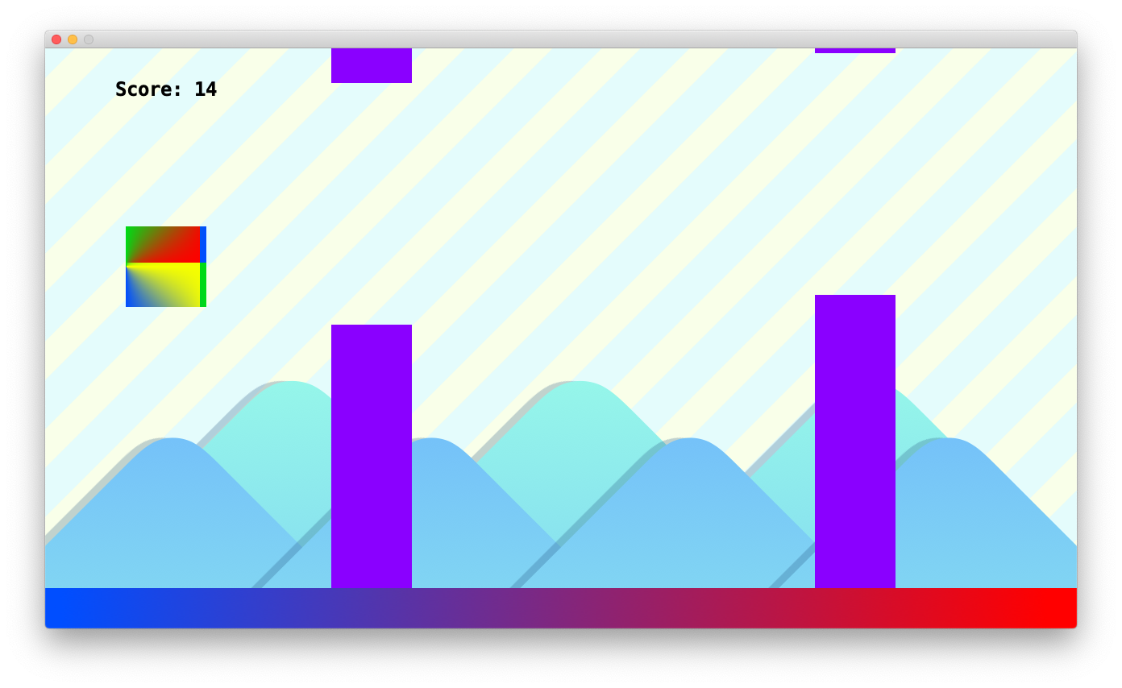
Main Window Screen Capture

Slide 5
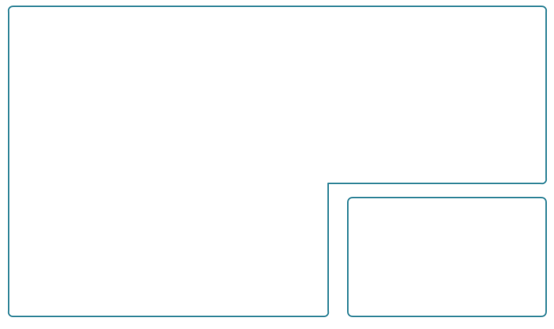
Software Architecture
CSCI230FinalProject
Character
creates, shows
has
has
extends
MainWindow
Entity
has
has
Sprite
has
UI
OverlayPanel
Game
uses
GameUIFonts
Game Model

Slide 6
Software Stack
Developed with Java using mostly AWT with some Swing components
Developed primarily on Windows 7 and some on macOS
Most testing done using Windows 7

Slide 7
Project Development Experiences
The size of the source code
We’re sitting at just under 800 lines of code right now.
I’d say once we’re completely done it’ll be around 900
Time you’ve spent
Jacob
Estimate: ~20 hours by the end
Cameron
I tried to work along with Jacob when possible. I’d say we spent at least 4 work days on this project
The things, knowledge… you learning
Jacob
Using null layouts
Git and project collaboration
Cameron
Game logic and state management
Source control with multiple people
Detecting key presses and responding to them
Using HTML and SWING
What went well and what went wrong
Jacob
Had trouble getting things to align correctly before I realized that I was aligning things within a nested JPanel instead of aligning the JPanel itself
Physics went well, as I had done a similar project a few years ago
Texture class was a modified version of something I developed earlier in this class so that was a breeze
Cameron
Easier:
Presenting and styling text using HTML and JLabel
We worked together very well and figured out how to use git together quickly
Difficult:
Getting views to layer the way we wanted them to
Making views updatable and causing them to appear appropriately
Making the UI more user-friendly and fun
What will you do differently if you have a chance to this project agagin…
Jacob
Not use Java for a game? It makes it fast and easy but always feels limiting
Cameron
I would try to figure out how to draw characters using Graphics2D

Slide 8
Additional Screen Captures
Please see following slides:

Slide 9
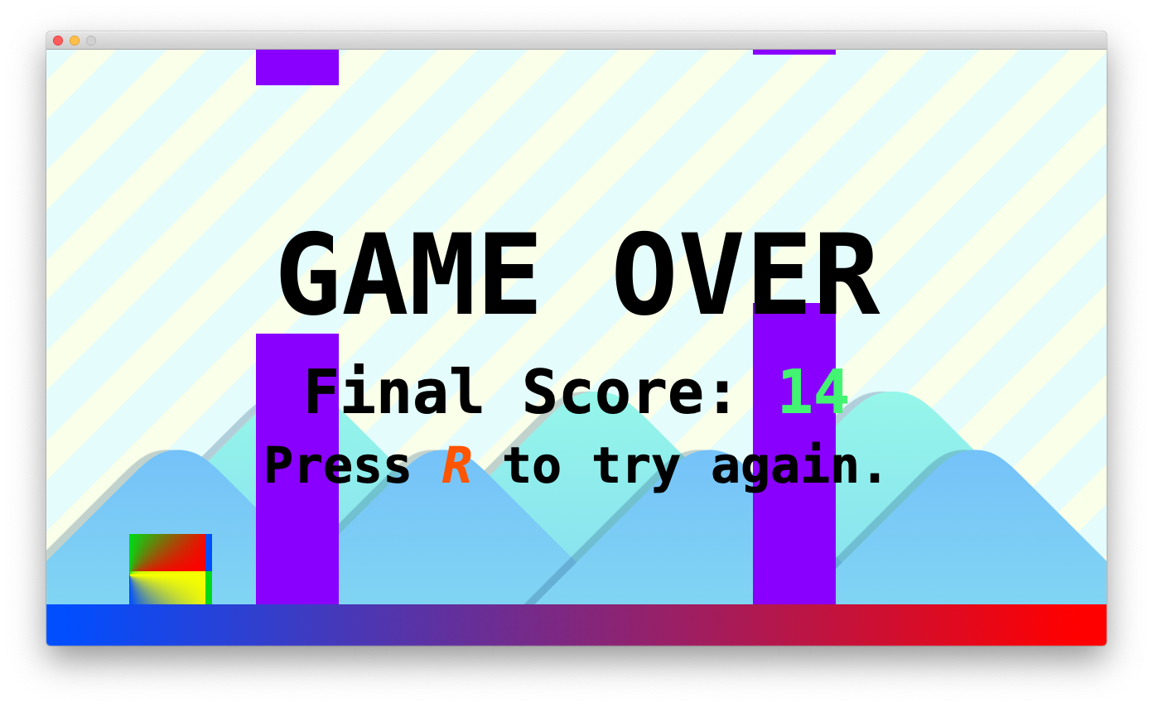
Game Over Screen

Slide 10
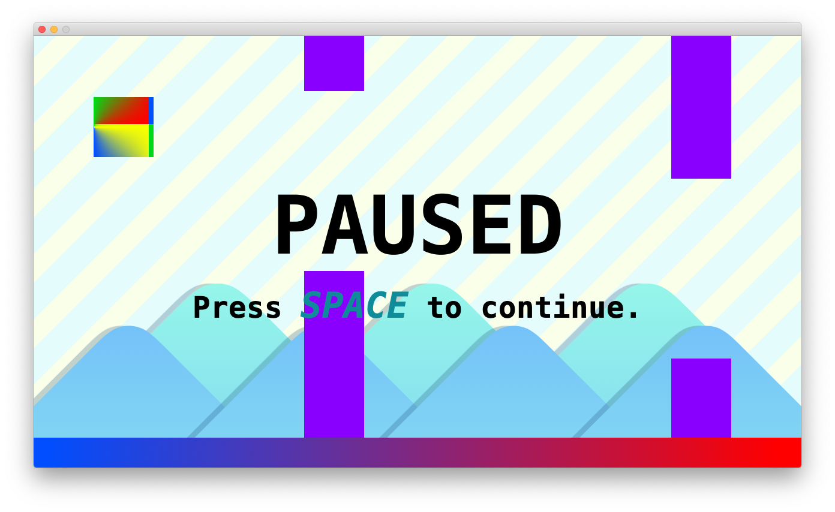
Pause Screen

