Slide 1
CSCI230 – Java GUI Final Project Report
Very Cool Project #1

Slide 2
Topics
Project Overview
Main Window Screen Capture
Project Software Architecture
Software Stack
Project Development Experiences
Additional Screen Captures

Slide 3
Project Overview
Project Name:
Very Cool Project #1
Group Members and Responsibilities
Jacob Larson: Physics, Entity and Texture Classes
Cameron Grigoriadis: Responsible for ….
Project Functionality Description:
This project is a game similar to the viral iOS game Flappy Bird. It features a character controlled by the player that must avoid obstacles to score points and not lose the game.

Slide 4
Main Window Screen Capture

Slide 5
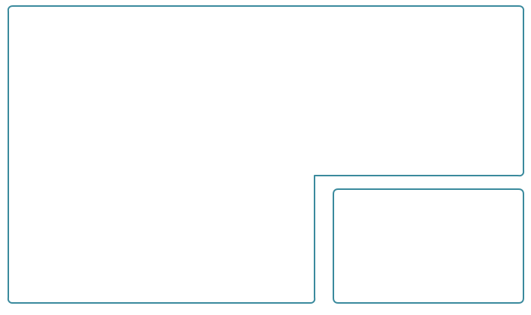
Software Architecture
CSCI230FinalProject
Character
creates, shows
has
MainWindow
has
extends
Entity
has
has
has
Texture
ScrollingBackdrop
has
UI
OverlayPanel
Game
uses
GameUIFonts
Game Model

Slide 6
Software Stack
Developed with Java using mostly AWT with some Swing components
Developed primarily on Windows 7 and some on macOS
Most testing done using Windows 7

Slide 7
Project Development Experiences
The size of the source code
We’re sitting at just under 800 lines of code right now.
I’d say once we’re completely done it’ll be around 900
Time you’ve spent
Jacob
Estimate: ~20 hours by the end
The things, knowledge… you learning
Jacob
Using null layouts
Git and project collaboration
What went well and what went wrong
Jacob
Had trouble getting things to align correctly before I realized that I was aligning things within a nested JPanel instead of aligning the JPanel itself
Physics went well, as I had done a similar project a few years ago
Texture class was a modified version of something I developed earlier in this class so that was a breeze
What will you do differently if you have a chance to this project agagin…
Jacob
Not use Java for a game? It makes it fast and easy but always feels limiting

Slide 8
Additional Screen Captures
Include at least one additional screen capture. If you have more than one, please use additional pages.

