Slide 1
CSCI230 – Java GUI Final Project Report
SWINGy Box

Slide 2
Topics
Project Overview
Main Window Screen Capture
Project Software Architecture
Software Stack
Project Development Experiences
Additional Screen Captures

Slide 3
Project Overview
Project Name:
SWINGy Box
Group Members and Responsibilities
Jacob Larson: Physics, Entity and Texture Classes
Cameron Grigoriadis: Game Modeling, Overlay UI, Game State
Project Functionality Description:
This project is a game similar to the viral iOS game Flappy Bird. It features a character controlled by the player that must avoid obstacles to score points and not lose the game.

Slide 4
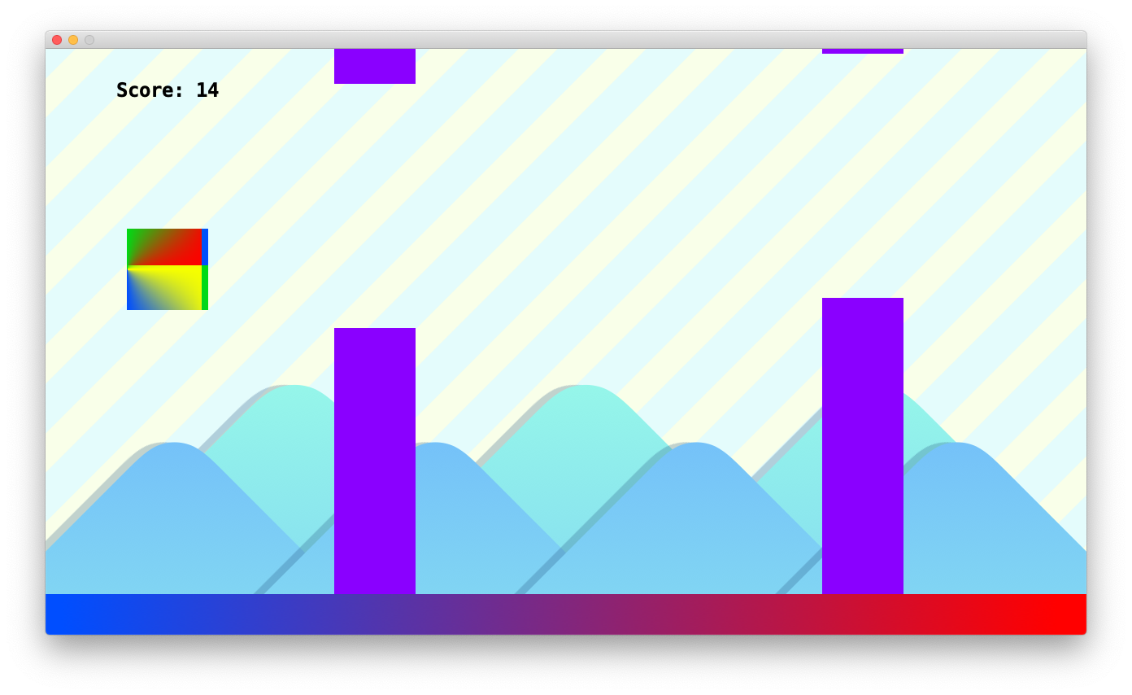
Main Window Screen Capture

Slide 5
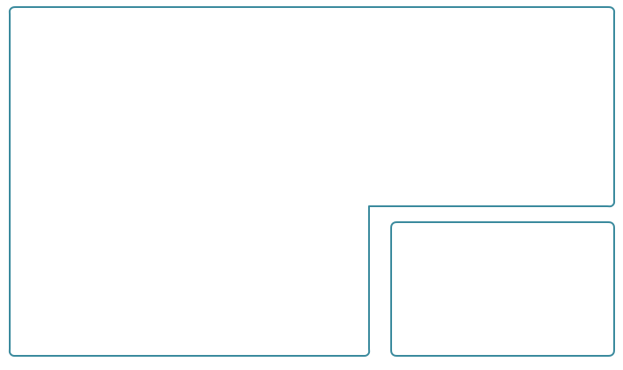
Software Architecture
CSCI230FinalProject
Character
creates, shows
has
has
extends
MainWindow
Entity
has
has
Sprite
has
UI
OverlayPanel
Game
uses
GameUIFonts
Game Model

Slide 6
Software Stack
Developed with:
Java
AWT
Swing
Developed on:
Windows 7 using NetBeans 8.0.2
Windows 10 using NetBeans 10.0
Mac OS X using NetBeans 11.0

Slide 7
Project Development Experiences
Project Size:
Around 800 lines of code

Slide 8
Project Development Experiences Jacob:
Time you’ve spent:
Estimate: A little over 20 hours by the end
Things learned:
Using null layouts
Git and project collaboration
What went well and what went wrong
Easier:
Had trouble getting things to align correctly before I realized that I was aligning things within a nested JPanel instead of aligning the JPanel itself
Z-ordering was always a pain to work with
Difficult:
Physics went well, as I had done a similar project a few years ago
Texture class was a modified version of something I developed earlier in this class so that was a breeze
What will you do differently if you have a chance to this project again?
Probably not use Java for a game; it makes it fast and easy but always feels limiting (and then I remember Minecraft)

Slide 9
Project Development Experiences Cameron:
Time you’ve spent:
I tried to work along with Jacob when possible.
I’d say we spent at least 4 work days on this project
Things learned:
Game logic and state management
Source control with multiple people
Detecting key presses and responding to them
Using HTML and SWING
What went well and what went wrong:
Easier:
Presenting and styling text using HTML and Jlabel
We worked together very well and figured out how to use Git together quickly
Difficult:
Getting views to layer the way we wanted them to
Making views updatable and causing them to appear appropriately
Making the UI more user-friendly and fun
What will you do differently if you have a chance to this project again?
I would try to figure out how to draw characters using Graphics2D

Slide 10
Additional Screen Captures
Please see following slides:

Slide 11
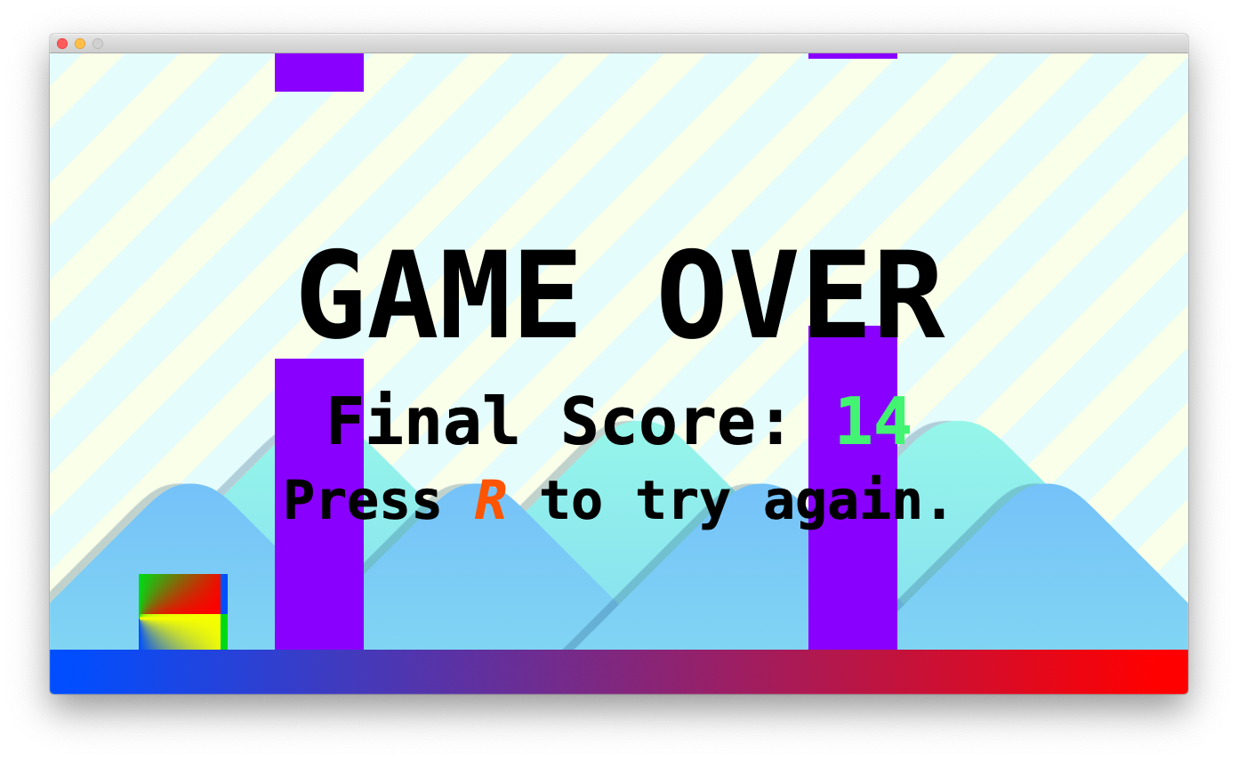
Game Over Screen

Slide 12
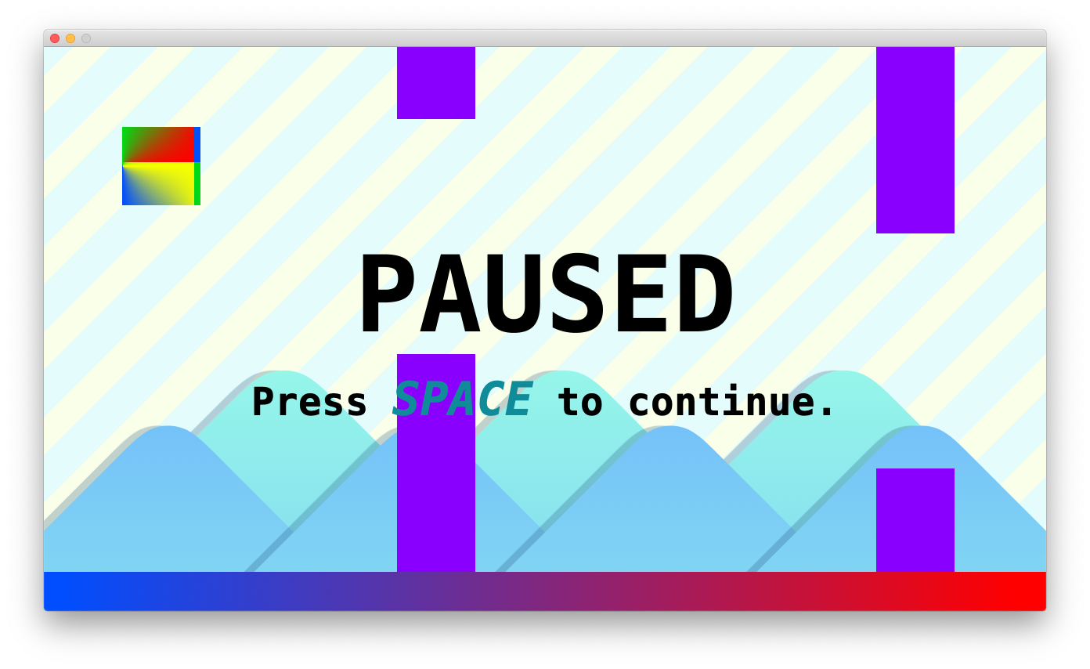
Pause Screen

