Slide 1
Analyzing Covid 19 data using SQL
By Wasiu Fausat

Slide 2
Project Overview
In this project, I analyze COVID-19 data using SQL to gain insights into the pandemic's impact.
The dataset includes records of confirmed cases, deaths, and recoveries across various countries over time.
The project aim to understand trends, identify key statistics, and draw meaningful conclusions about the spread and severity of the virus.

Slide 3
Dataset Description
Province: Geographic subdivision within a country/region.
Country/Region: Geographic entity where data is recorded.
Latitude: North-south position on Earth's surface.
Longitude: East-west position on Earth's surface.
Date: Recorded date of CORONA VIRUS data.
Confirmed: Number of diagnosed CORONA VIRUS cases.
Deaths: Number of CORONA VIRUS related deaths.
Recovered: Number of recovered CORONA VIRUS cases.

Slide 4
Data Preprocessing
Cleaning Steps:
  Handling null Values
  Date formatting

Slide 5
Basic Statistics
78,386
2020-01-22
Start date
2021-06-13
End date
TOTAL NO OF ROWS
154
18
PROVINCES
MONTHS OF SPREAD
US
Bhutan
HIGHEST CONFIRMED CASE
LOWEST DEATH CASE

Slide 6
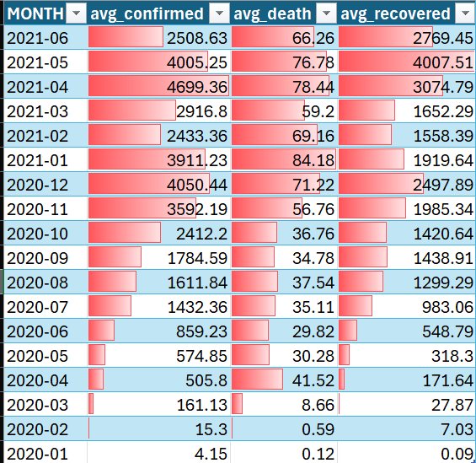
Data Analysis
Monthly average for confirmed, deaths, recovered cases

Slide 7
Data Analysis
Most frequent value for confirmed, deaths, recovered each month

Slide 8
Data Analysis
Minimum values for confirmed, deaths, recovered per year

Slide 9
Data Analysis
Maximum values of confirmed, deaths, recovered per year

Slide 10
Data Analysis
Total number of confirmed, deaths, recovered cases each month

Slide 11
Data Analysis
169,065,144
Total Confirmed Cases
2156.828
Average Confirmed Cases
157,288,925.078
Variance Confirmed Cases
12,541.488
STDEV Confirmed Cases
The spread out of Corona virus with respect to Confirmed case

Slide 12
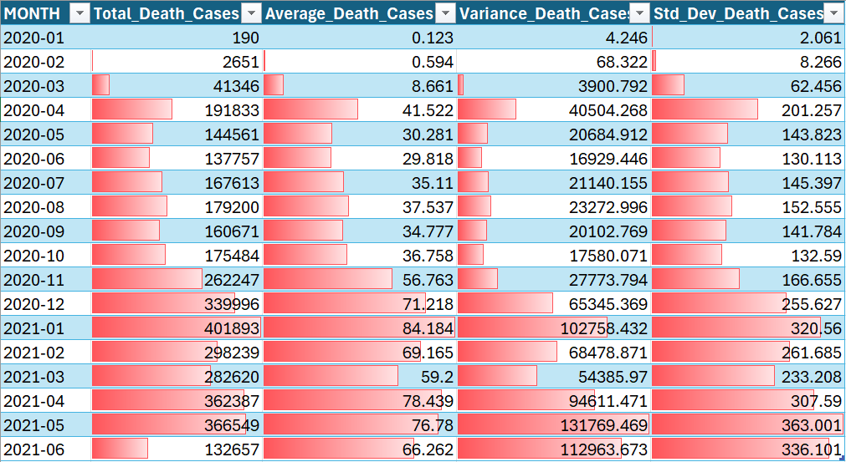
Data Analysis
Coronavirus spread out with respect to death case per month

Slide 13
Data Analysis
113,089,548
Total Recovered Cases
1,442.726
Average Recovered Cases
The spread out of Corona virus with respect to Recovered case
107,029,523.262
Variance Recovered Cases
10,345.507
STDEV Recovered Cases

Slide 14
Data Analysis
Top 5 countries having highest recovered case

Slide 15
Thank You

