Slide 1

Movie Analysis using Heuristic Evaluation by Sentiment Harvesting
MAHESH

Slide 2
Introduction
By the numbers prediction of movies is more of a numerical exercise and doesn’t contain intrinsic context.
Critical reaction relates to the aesthetic value and not the entertainment value.
There is a need to account for public reaction.

Slide 3


Sir MVIT : CSE Dept
We present a new algorithm that accounts for revenue and public opinion to help judge how much the movie is making in the theatres.
We call it MAHESH.
A presentation by :
K. Hussain Fayaz (1MV12CS033)
Santosh Kumar Desai (1MV12CS091)
Vinod Kalkundrikar (1MV13CS422)

Slide 4

NECESSITY

Slide 5
DATA INPUT
We need the updated statistics on the movie, importantly
Language
Number of theatres in each week.
Revenue collected per week.
Trailer release date.
Movie release date.

Slide 6
PROCESSING INPUT
The correction in the estimates is progressively related to public opinion. Hence we need public reaction as feedback during entire process of estimation.
Think of it as course correction module.

Slide 7
Training the platform
We need an archive of movies that serve as training scenarios.
The data may contain different values of input parameters.
Let’s call the duration of movie analysis as a session.
We divide it into seven intervals.
These intervals are:
Trailer release to movie release.
Movie release to first week end date.
1st week end to 2nd week end.
2nd week end to 3rd week end.
3rd week end to 4th week end.
4th week end to 5th week end.
5th week end to 6th week end.

Slide 8
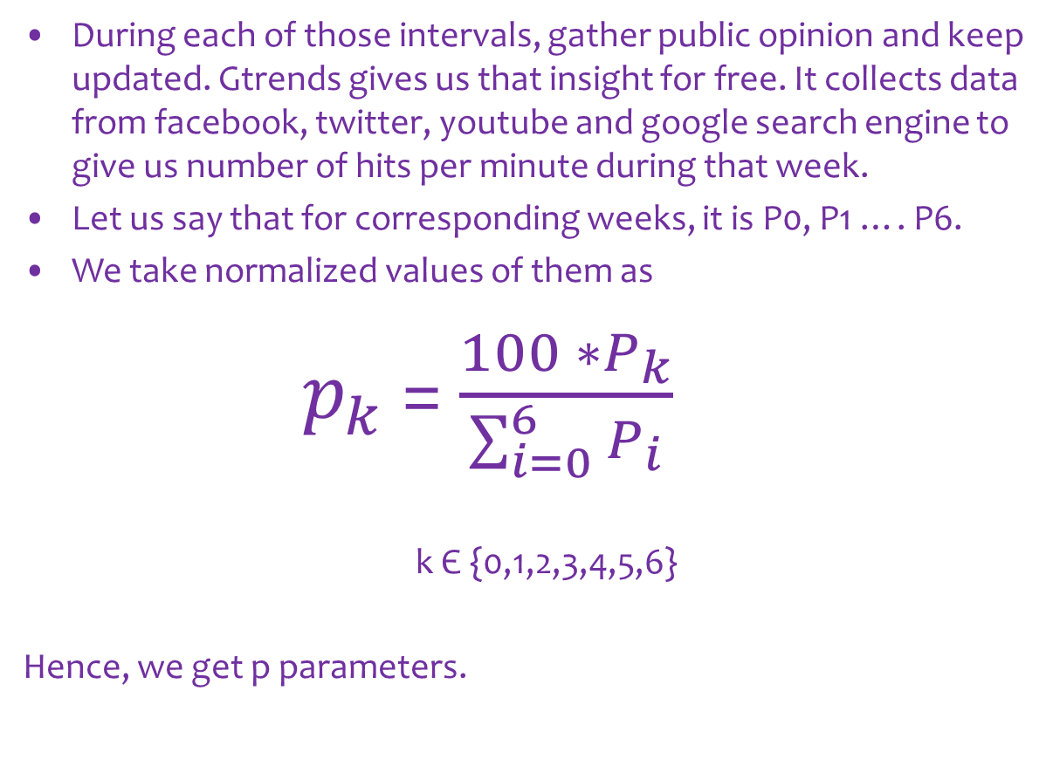
Training the platform – the sequel
During each of those intervals, gather public opinion and keep updated. Gtrends gives us that insight for free. It collects data from facebook, twitter, youtube and google search engine to give us number of hits per minute during that week.
Let us say that for corresponding weeks, it is P0, P1 …. P6.
We take normalized values of them as
$p_{k}$ = $\frac{100 ∗P_{k}}{\sum_{i=0}^{6}{P_{i}}}$
k Є {0,1,2,3,4,5,6}
Hence, we get p parameters.

Slide 9
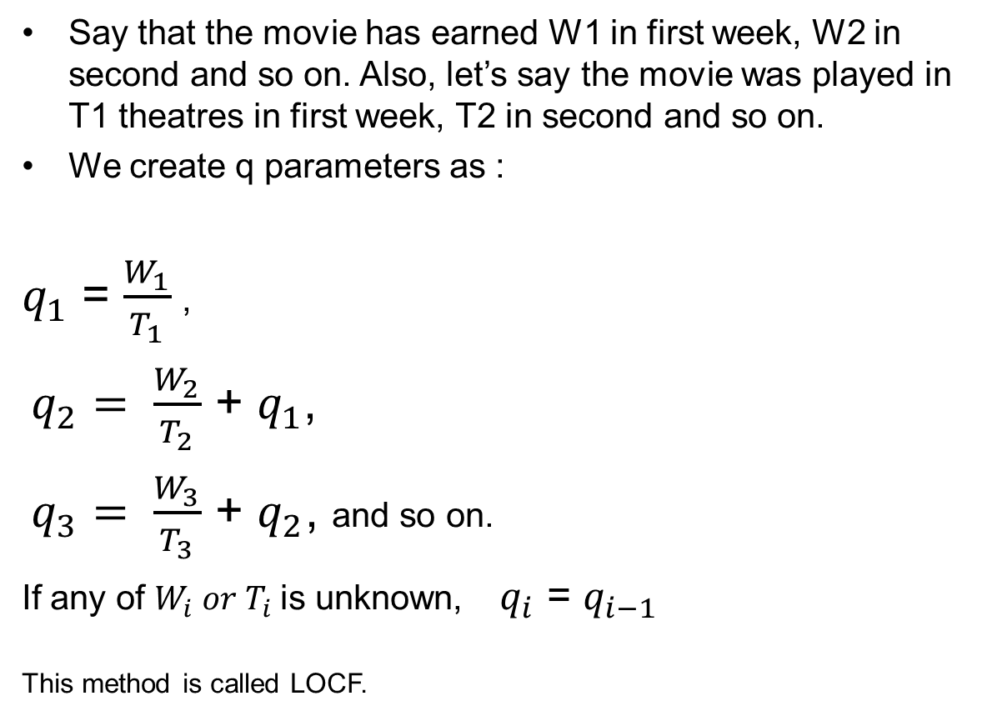
Training the platform – the spinoff
Say that the movie has earned W1 in first week, W2 in second and so on. Also, let’s say the movie was played in T1 theatres in first week, T2 in second and so on.
We create q parameters as :
$q_{1}$ = $\frac{W_{1}}{T_{1}}$ ,
$q_{2}= \frac{W_{2}}{T_{2}}$ + $q_{1}$,
$q_{3}= \frac{W_{3}}{T_{3}}$ + $q_{2}$, and so on.
If any of $W_{i} or T_{i}$ is unknown,$q_{i}$ = $q_{i−1}$
This method is called LOCF.

Slide 10
Training the platform – the remake
Find the linear relation of gross to parameters as
Gross ~ C0*W1 + C1*L + C2*p0 + ∑ ak*pi + bk*qi +ck*pi*qi
where
k takes values 1 to 6.
i takes values 1 to 6.

Slide 11
Testing the platform
Gain similar data to the tested movies.
Substitute coefficients in the equation.
Estimaten = C0*W1 + C1*L + C2*p0 + ∑ ak*pi + bk*qi +ck*pi*qi
Where k and i take values from 1 to n.
Take max, min and mean of these predictions.
If the value is less than W1 value, substitute its value.

Slide 12
Practical Results
The correlation between actual gross amount and max_predict value is :0.99008429046208
The correlation between actual gross amount and min_predict value is :0.988494245036351
The correlation between actual gross amount and mean_predict value is :0.992688146694479

Slide 13

Conclusion
It might seem confusing but look at the benefits.
Audience can know, contribute and demand better movies and entertainment value.
Producers can plan recent trends and plan advertising and merchandising accordingly.
Actors can interact with the fans to encourage new projects.
Revenue models of movies can be changed accordingly to at least return their investment or make a target profit by the numbers.
Theatre managers will know where it is best to invest their money to make maximum profit.

